Slide 1
27-5
This work is licensed under a Creative Commons Attribution-Sharealike 4.0 International License.
Please add this statement to all the videos you create.
English Bible quotes are from the World English Bible US, which is in the public domain.
Notes:
Ch
27 Rebuilding of the Temple
1. Cyrus tells Jews to rebuild the temple - Ezra 1:1-11 (Left Top)
2. The altar is built - Ezra 3:1-6 (Right Top)
3. The foundation of the Temple is laid - Ezra 3:7-13 (Right 2nd)
4. Construction of the Temple stops - Ezra 4:1-5, 24 (Right 3rd)
5. Haggai and Zechariah give prophecy and rebuilding resumes - Ezra 5:1-17 (Left
Center)
6. King Darius pays for all the construction - Ezra 6:1-14 (Left Center)

Slide 2
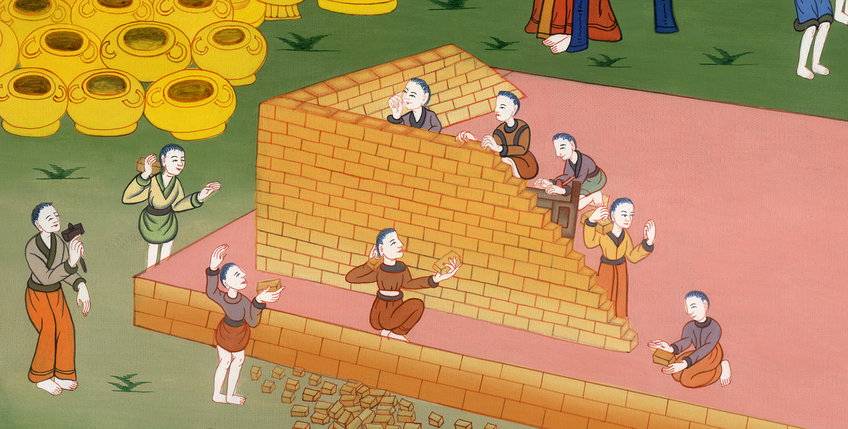
Haggai and Zechariah give prophecy and rebuilding resumes - Ezra 5:1-17

Slide 3
5. Haggai and Zechariah give prophecy and rebuilding resumes - Ezra 5:1-17 (Left
Center)
John

Slide 4
Haggai and Zechariah give prophecy and rebuilding resumes - Ezra 5:1-17

Slide 5
Ezra5:1Now the prophets, Haggai the prophet and Zechariah the son of Iddo, prophesied to the Jews who were in Judah and Jerusalem. They prophesied to them in the name of the God of Israel.
John

Slide 6
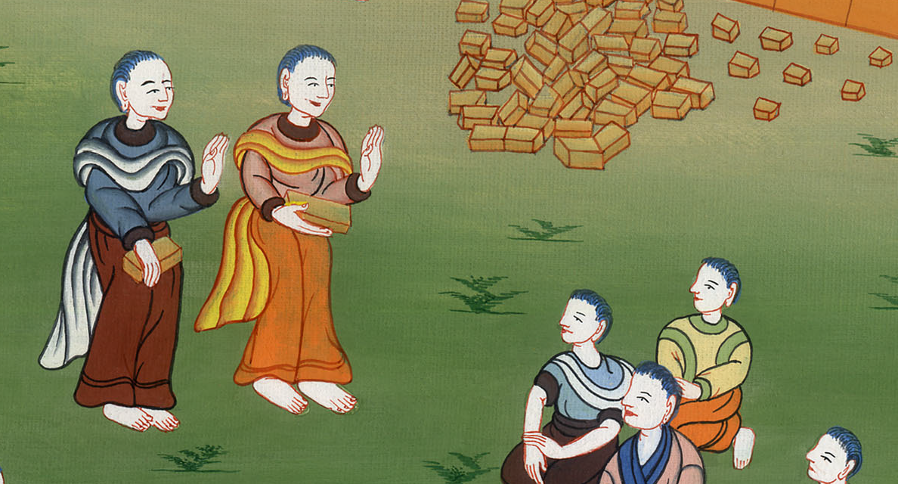
Ezra 5:1

Slide 7
2Then Zerubbabel the son of Shealtiel, and Jeshua the son of Jozadak rose up and began to build God’s house which is at Jerusalem; and with them were the prophets of God, helping them.
John

Slide 8
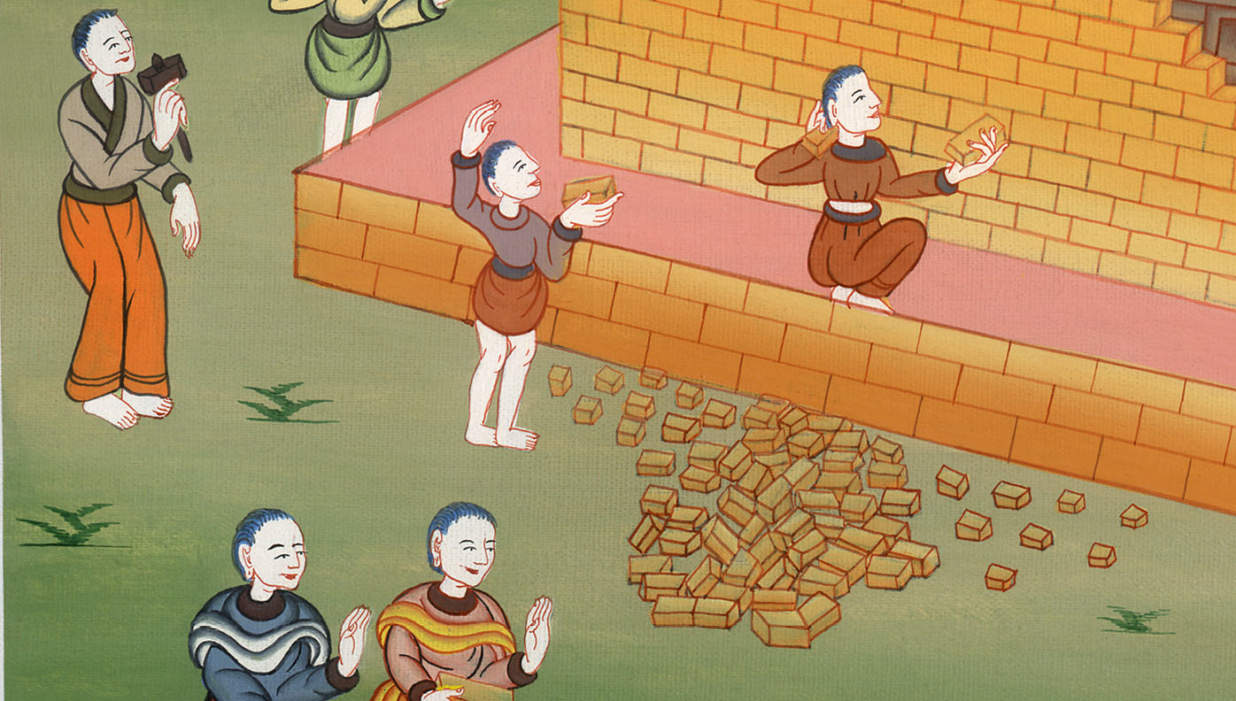
Ezra 5:2

Slide 9
3At the same time Tattenai, the governor beyond the River, came to them, with Shetharbozenai and their companions, and asked them, “Who gave you a decree to build this house and to finish this wall?” 4They also asked for the names of the men were who were making this building.
John

Slide 10
Ezra 5:3,4

Slide 11
5But the eye of their God was on the elders of the Jews, and they didn’t make them cease until the matter should come to Darius, and an answer should be returned by letter concerning it..
John

Slide 12
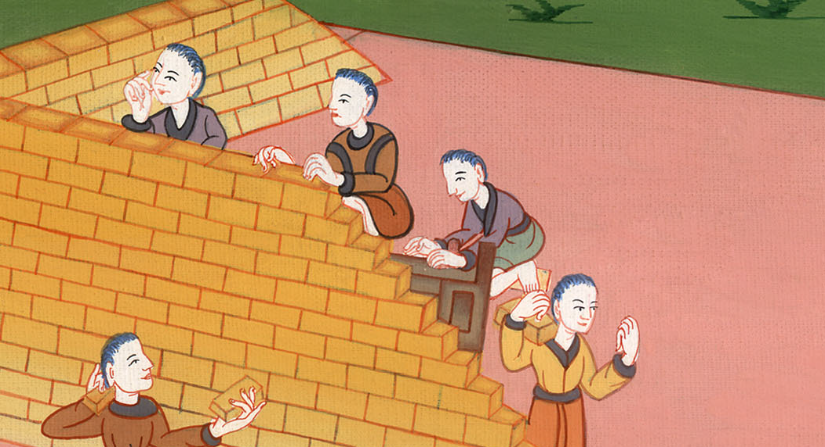
Ezra 5:5

Slide 13
6The copy of the letter that (they) sent to Darius the king follows. 7They sent a letter to him, in which was written:
To Darius the king, all peace.
John

Slide 14
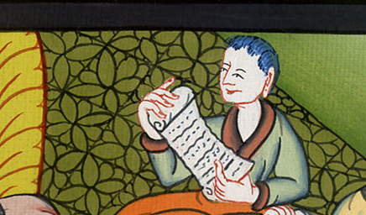
Ezra 5:6,7

Slide 15
8Be it known to the king that we went into the province of Judah, to the house of the great God, which is being built with great stones and timber is laid in the walls. This work goes on with diligence and prospers in their hands.
John

Slide 16
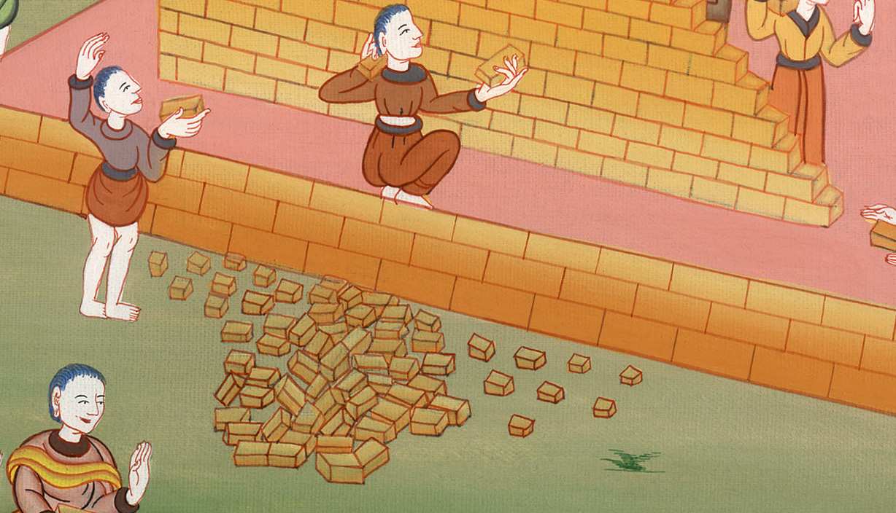
Ezra 5:8

Slide 17
9Then we asked those elders, and said to them thus, “Who gave you a decree to build this house, and to finish this wall?” 10We asked them their names also, to inform you that we might write the names of the men who were at their head.
John

Slide 18
Ezra 5:9,10

Slide 19
11Thus they returned us answer, saying, “We are the servants of the God of heaven and earth and are building the house that was built these many years ago, which a great king of Israel built and finished.
John

Slide 20
Ezra 5:11

Slide 21
12But after our fathers had provoked the God of heaven to wrath, he gave them into the hand of Nebuchadnezzar king of Babylon, the Chaldean, who destroyed this house and carried the people away into Babylon.
John

Slide 22
Ezra 5:12

Slide 23
13But in the first year of Cyrus king of Babylon, Cyrus the king made a decree to build this house of God.
John

Slide 24
Ezra 5:13

Slide 25
14The gold and silver vessels of God’s house, which Nebuchadnezzar took out of the temple that was in Jerusalem and brought into the temple of Babylon, those Cyrus the king also took out of the temple of Babylon, and they were delivered to one whose name was Sheshbazzar, whom he had made governor.
John

Slide 26
Ezra 5:14

Slide 27
15He said to him, ‘Take these vessels, go, put them in the temple that is in Jerusalem, and let God’s house be built in its place.’
John

Slide 28
Ezra 5:15

Slide 29
16Then the same Sheshbazzar came and laid the foundations of God’s house which is in Jerusalem. Since that time even until now it has been being built, and yet it is not completed.
John

Slide 30
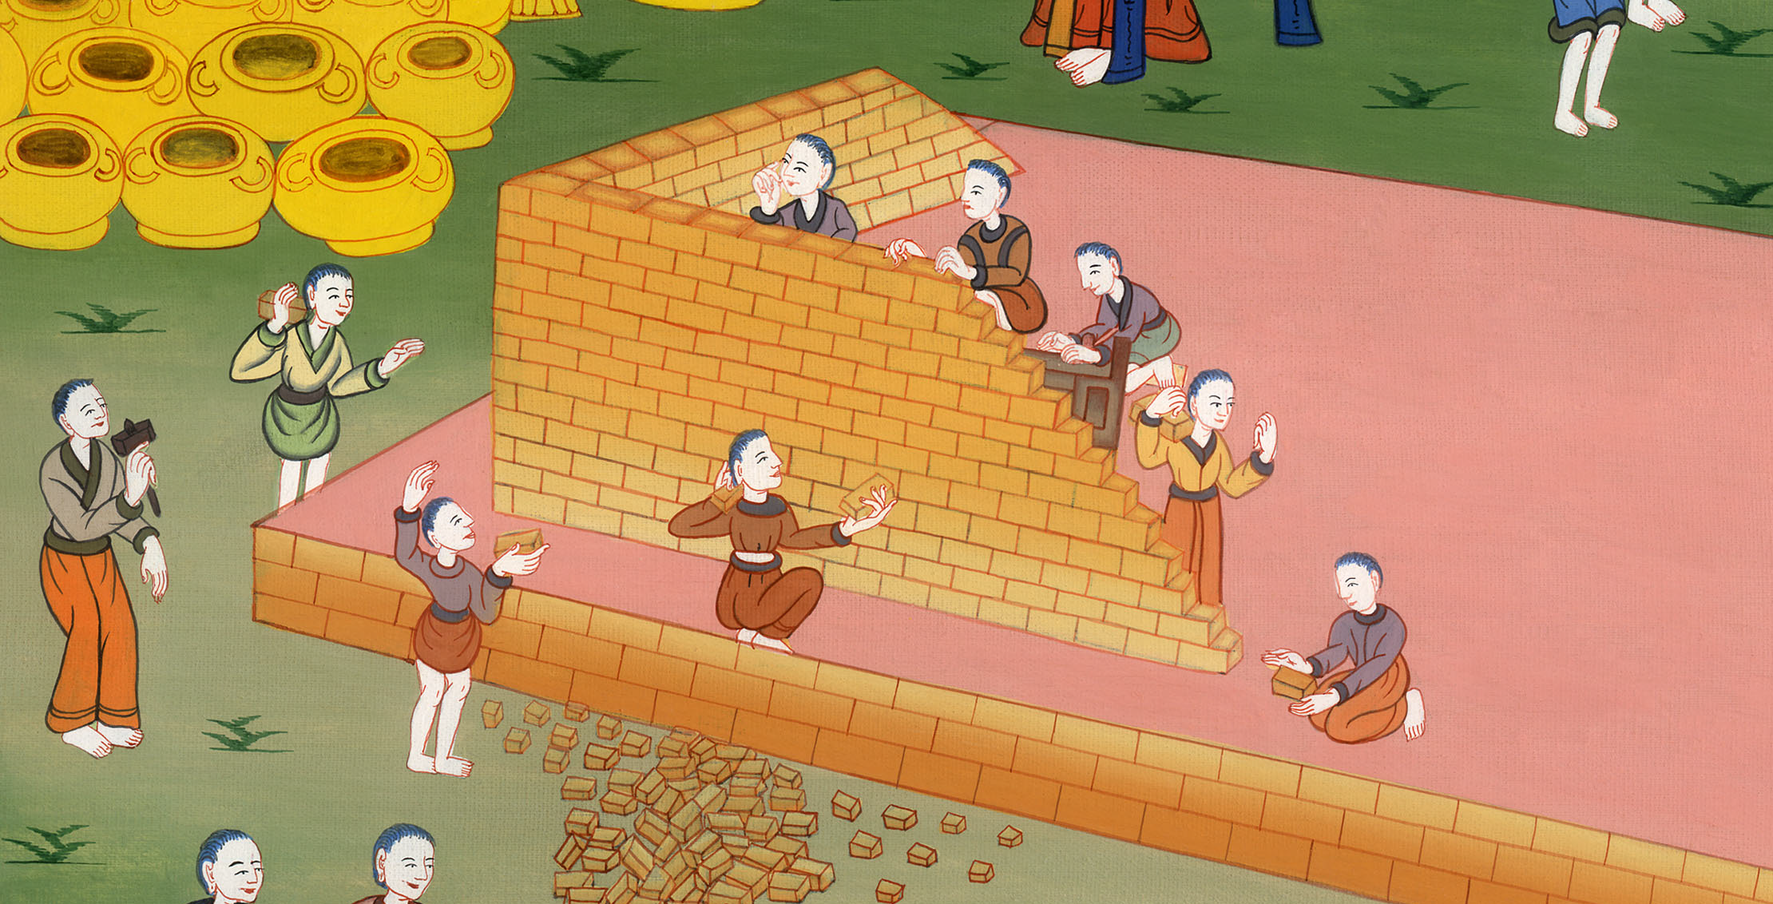
Ezra 5:16

Slide 31
17Now therefore, if it seems good to the king, let a search be made in the king’s treasure house, which is there at Babylon, whether it is so that a decree was made by Cyrus the king to build this house of God at Jerusalem; and let the king send his pleasure to us concerning this matter.”
John

Slide 32
Ezra 5:17

