Slide 1
28-1
This work is licensed under a Creative Commons Attribution-Sharealike 4.0 International License.
Please add this statement to all the videos you create.
English Bible quotes are from the World English Bible US, which is in the public domain.
Notes:
Ch
28 Esther
1. Queen Vashti’s refuses King - 1:1-22 (Left Bottom Room in Palace)
2. Esther’s coronation banquet - 2:1-20 (Right Bottom Room in Palace)
3. Guards Plot against King - 2:21-23 (At Palace Gate)
4. Mordecai won’t bow to Haman - 3:1-6 (Right side of Palace Gate)
5. Haman Plots to kill the Jews - 3:7 – 4:17 (On Palace Roof and Top Left)
6. Esther enters the Throne Room - 5:1-8 (Palace Center)
7. Haman builds gallows - 5:9-14 (Right Top)
8. The King asks Haman what should be done- 6:1-9 (Left Top Room in Palace)
9. Haman leads Mordecai on King’s Horse - 6:10-14 (Right Bottom)
10. Esther exposes Haman - 7:1-10 (Right Top Room in Palace)
11. Mordecai raised up - 8:1 – 10:3 (Left Bottom)

Slide 2
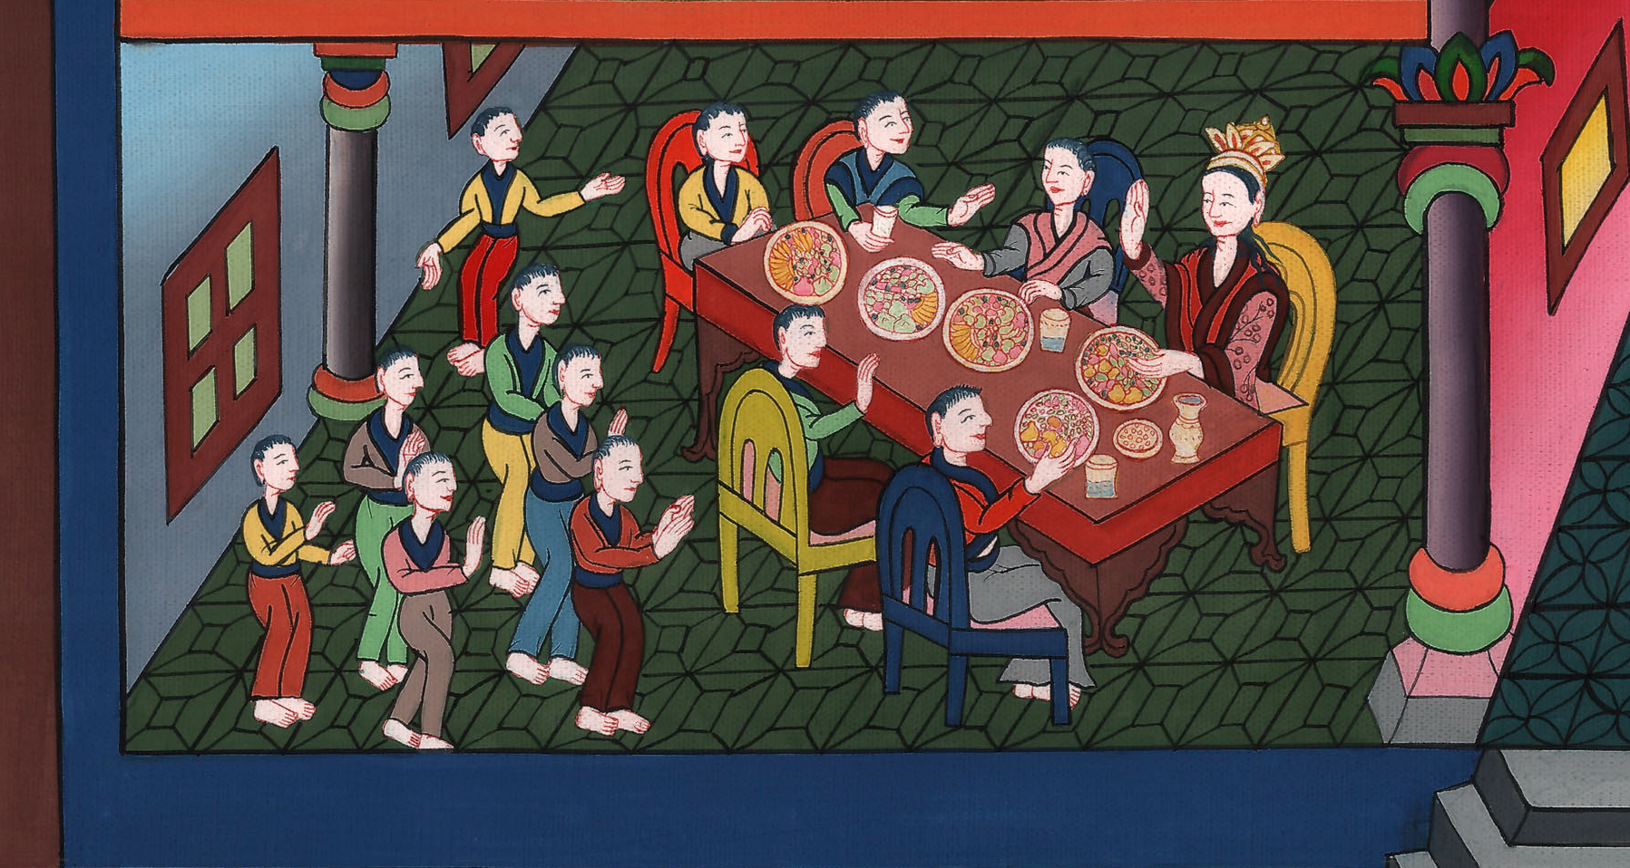
Queen Vashti refuses the King –
Esther 1:1-22

Slide 3
28 Esther
1. Queen Vashti refuses the King – Esther 1:1-22 (Left Bottom Room in Palace)
John

Slide 4
Queen Vashti refuses the King –
Esther 1:1-22

Slide 5
Esther 1:1Now in the days of Ahasuerus (this is Ahasuerus who reigned from India even to Ethiopia, over one hundred twenty-seven provinces), 2in those days, when the King Ahasuerus sat on the throne of his kingdom, which was in Susa the palace,
John

Slide 6
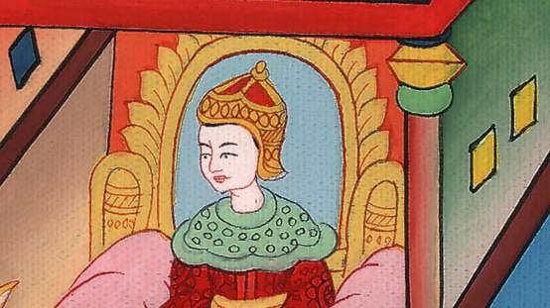
Esther 1:1,2

Slide 7
3in the third year of his reign, he made a feast for all his princes and his servants; the army of Persia and Media, the nobles and princes of the provinces being before him.
John

Slide 8
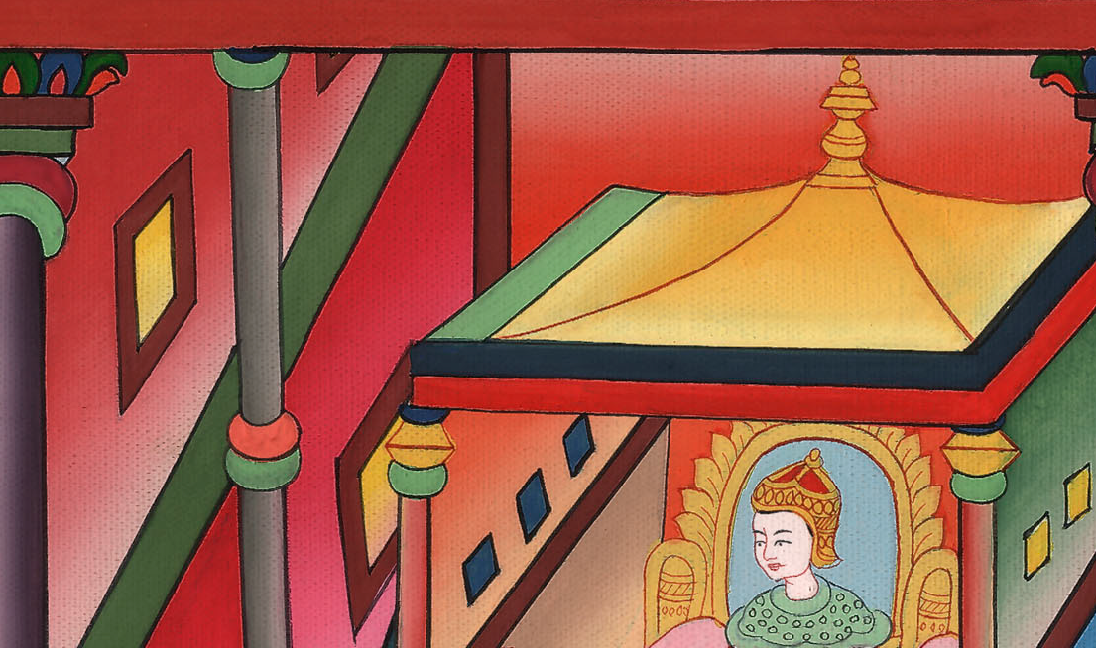
Esther 1:3

Slide 9
5When these days were fulfilled, the king made a seven day feast for all the people who were present in Susa the palace, both great and small, in the court of the garden of the king’s palace.
John

Slide 10
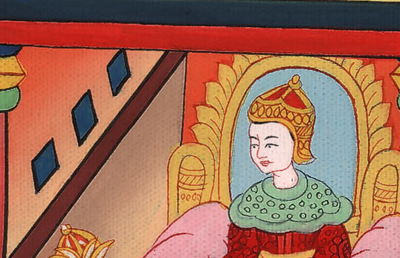
Esther 1:5

Slide 11
9Also Vashti the queen made a feast for the women in the royal house which belonged to King Ahasuerus.
John

Slide 12
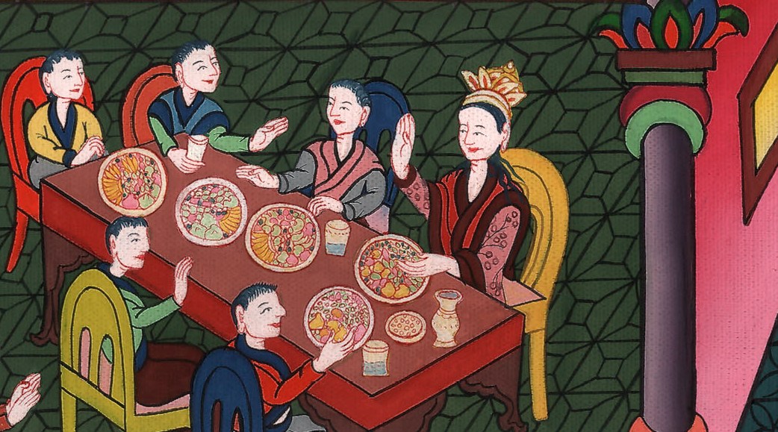
Esther 1:9

Slide 13
10On the seventh day, when the heart of the king was merry with wine, he commanded … the seven eunuchs who served in the presence of Ahasuerus the king,
John

Slide 14
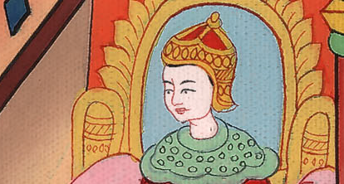
Esther 1:10

Slide 15
11to bring Vashti the queen before the king wearing the royal crown, to show the people and the princes her beauty; for she was beautiful.
John

Slide 16
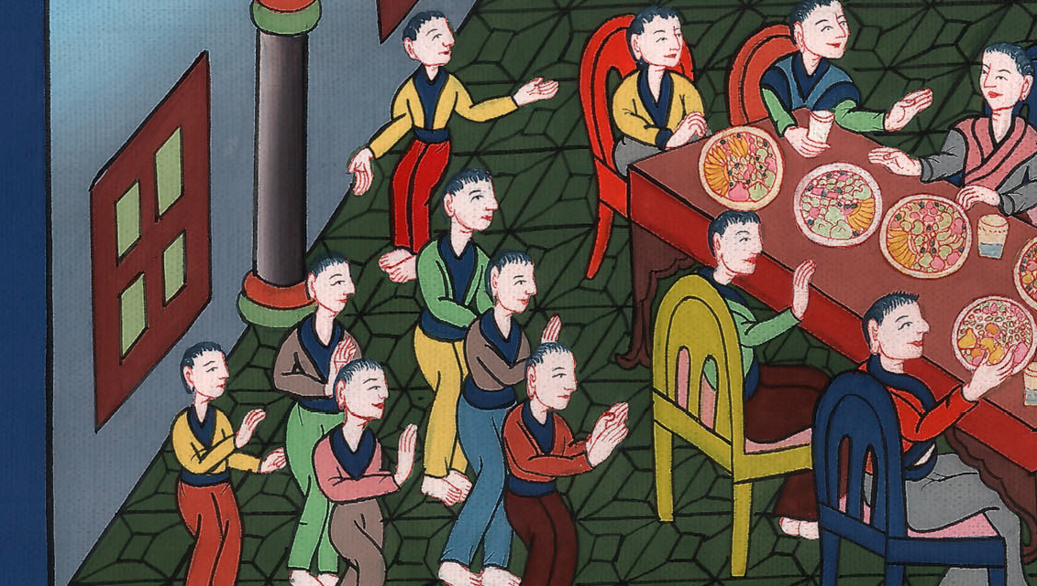
Esther 1:11

Slide 17
12But the queen Vashti refused to come at the king’s commandment by the eunuchs. Therefore the king was very angry, and his anger burned in him.
John

Slide 18
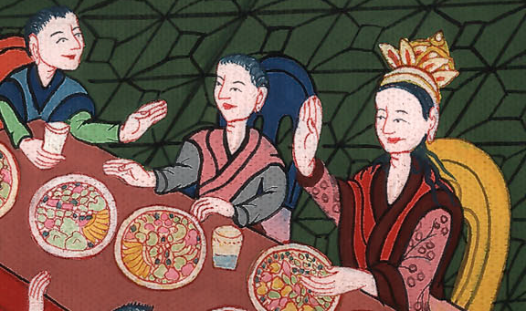
Esther 1:12

Slide 19
13Then the king said to the wise men, who knew the times (for it was the king’s custom to consult those who knew law and judgment;
John

Slide 20
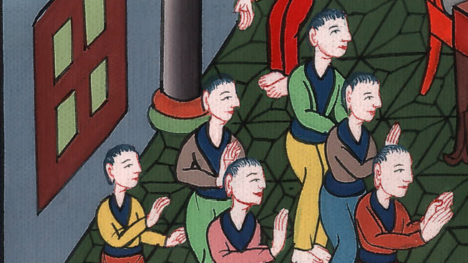
Esther 1:13

Slide 21
15“What shall we do to Queen Vashti according to law, because she has not done the bidding of the King Ahasuerus by the eunuchs?”
John

Slide 22
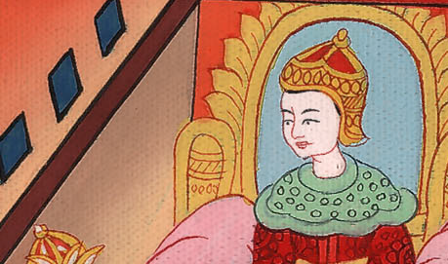
Esther 1:15

Slide 23
16Memucan answered before the king and the princes, “Vashti the queen has not done wrong to just the king, but also to all the princes, and to all the people who are in all the provinces of the King Ahasuerus.
John

Slide 24
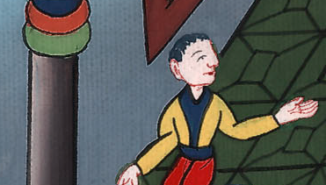
Esther 1:16

Slide 25
17For this deed of the queen will become known to all women, causing them to show contempt for their husbands when it is reported, ‘King Ahasuerus commanded Vashti the queen to be brought in before him, but she didn’t come.’
John

Slide 26
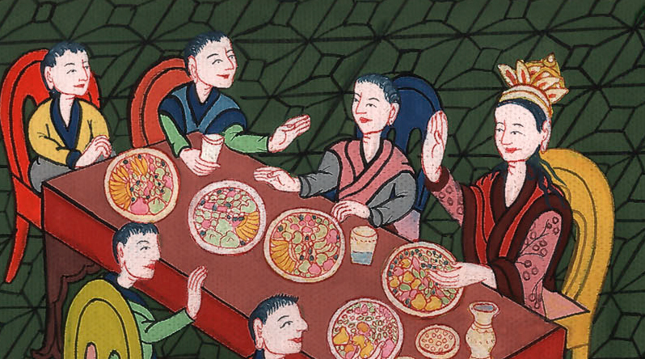
Esther 1:17

Slide 27
18Today, the princesses of Persia and Media who have heard of the queen’s deed will tell all the king’s princes. This will cause much contempt and wrath.
John

Slide 28
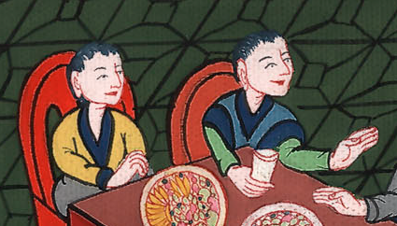
Esther 1:18

Slide 29
19“If it pleases the king, let a royal commandment go from him, and let it be written among the laws of the Persians and the Medes, so that it cannot be altered, that Vashti may never again come before King Ahasuerus; and let the king give her royal estate to another who is better than she.
John

Slide 30
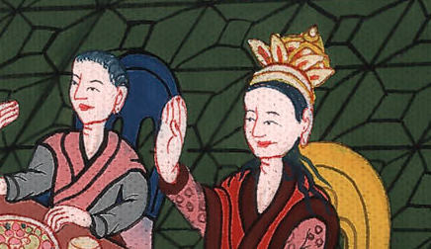
Esther 1:19

Slide 31
20When the king’s decree which he shall make is published throughout all his kingdom (for it is great), all the wives will give their husbands honor, both great and small.”
John

Slide 32
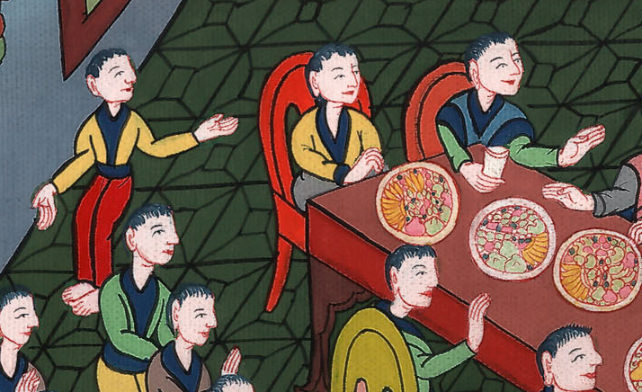
Esther 1:20

Slide 33
21This advice pleased the king and the princes, and the king did according to the word of Memucan:
John

Slide 34
Esther 1:21

Slide 35
22for he sent letters into all the king’s provinces, into every province according to its writing, and to every people in their language, that every man should rule his own house, speaking in the language of his own people.
John

Slide 36
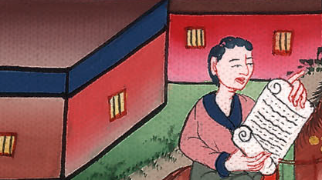
Esther 1:22

