Slide 1
28-2
This work is licensed under a Creative Commons Attribution-Sharealike 4.0 International License.
Please add this statement to all the videos you create.
English Bible quotes are from the World English Bible US, which is in the public domain.
Notes:
Ch
28 Esther
1. Queen Vashti’s refuses King - 1:1-22 (Left Bottom Room in Palace)
2. Esther’s coronation banquet - 2:1-20 (Right Bottom Room in Palace)
3. Guards Plot against King - 2:21-23 (At Palace Gate)
4. Mordecai won’t bow to Haman - 3:1-6 (Right side of Palace Gate)
5. Haman Plots to kill the Jews - 3:7 – 4:17 (On Palace Roof and Top Left)
6. Esther enters the Throne Room - 5:1-8 (Palace Center)
7. Haman builds gallows - 5:9-14 (Right Top)
8. The King asks Haman what should be done- 6:1-9 (Left Top Room in Palace)
9. Haman leads Mordecai on King’s Horse - 6:10-14 (Right Bottom)
10. Esther exposes Haman - 7:1-10 (Right Top Room in Palace)
11. Mordecai raised up - 8:1 – 10:3 (Left Bottom)

Slide 2
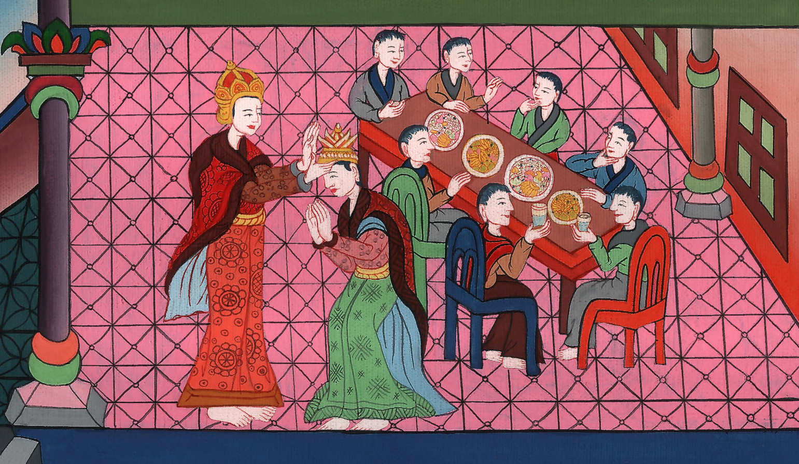
Esther Becomes Queen of Persia- Esther 2:1-20

Slide 3
2. Esther Becomes Queen of Persia- Esther 2:1-20 (Right Bottom Room in Palace)
John

Slide 4
Esther Becomes Queen of Persia- Esther 2:1-20

Slide 5
Esther 2:1After these things, when the wrath of King Ahasuerus was pacified, he remembered Vashti, and what she had done, and what was decreed against her.
John

Slide 6
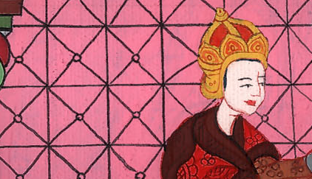
Esther 2:1

Slide 7
2Then the king’s servants who served him said, “Let beautiful young virgins be sought for the king.
John

Slide 8
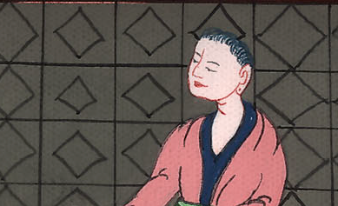
Esther 2:2

Slide 9
3Let the king appoint officers in all the provinces of his kingdom, that they may gather together all the beautiful young virgins to the citadel of Susa, to the women’s house, to the custody of Hegai the king’s eunuch, keeper of the women. Let cosmetics be given them;
John

Slide 10
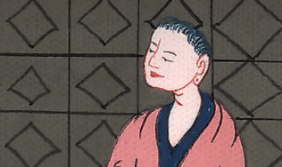
Esther 2:3

Slide 11
4and let the maiden who pleases the king be queen instead of Vashti.” The thing pleased the king, and he did so.
John

Slide 12
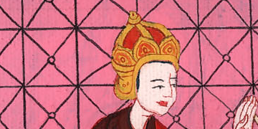
Esther 2:4

Slide 13
5There was a certain Jew in the citadel of Susa whose name was Mordecai, the son of Jair, the son of Shimei, the son of Kish, a Benjamite,
John

Slide 14
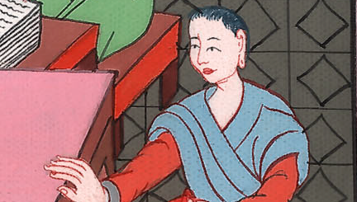
Esther 2:5

Slide 15
6who had been carried away from Jerusalem with the captives who had been carried away with Jeconiah king of Judah, whom Nebuchadnezzar the king of Babylon had carried away.
John

Slide 16
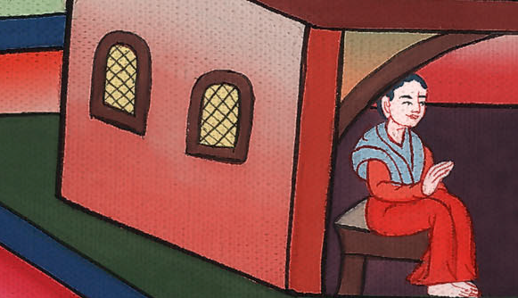
Esther 2:6

Slide 17
7He brought up Hadassah, that is, Esther, his uncle’s daughter; for she had neither father nor mother. The maiden was fair and beautiful; and when her father and mother were dead, Mordecai took her for his own daughter.
John

Slide 18
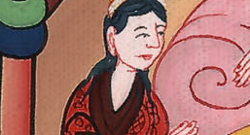
Esther 2:7

Slide 19
8So, when the king’s commandment and his decree was heard, and when many maidens were gathered together to the citadel of Susa, to the custody of Hegai, Esther was taken into the king’s house, to the custody of Hegai, keeper of the women.
John

Slide 20
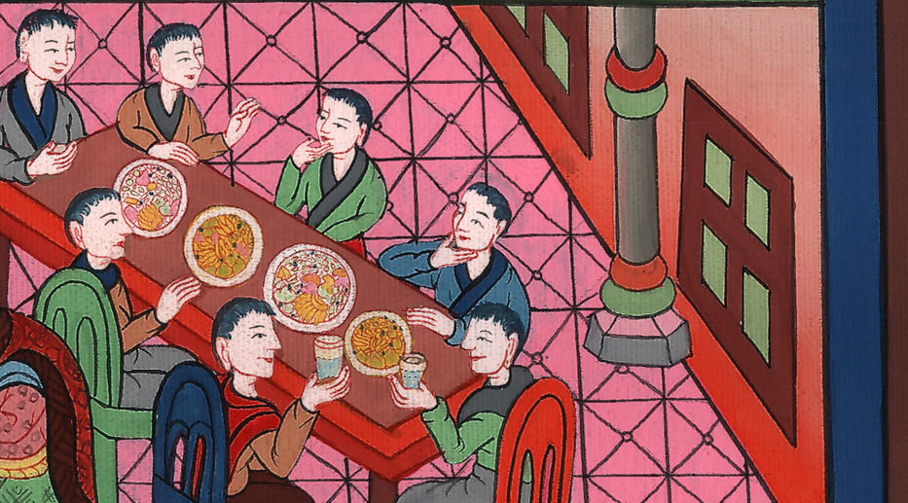
Esther 2:8

Slide 21
9The maiden pleased him, and she obtained kindness from him. He quickly gave her cosmetics and her portions of food, and the seven choice maidens who were to be given her out of the king’s house. He moved her and her maidens to the best place in the women’s house.
John

Slide 22
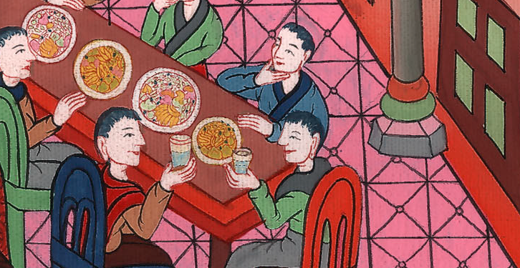
Esther 2:9

Slide 23
10Esther had not made known her people nor her relatives, because Mordecai had instructed her that she should not make it known.
John

Slide 24
Esther 2:10

Slide 25
11Mordecai walked every day in front of the court of the women’s house, to find out how Esther was doing, and what would become of her.
John

Slide 26
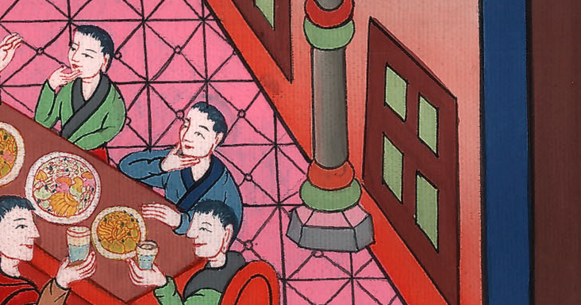
Esther 2:11

Slide 27
12Each young woman’s turn came to go in to King Ahasuerus after her purification for twelve months (for so were the days of their purification accomplished, six months with oil of myrrh, and six months with sweet fragrances and with preparations for beautifying women).
John

Slide 28
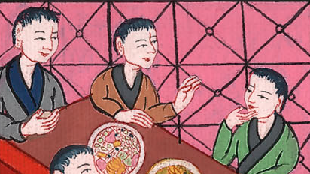
Esther 2:12

Slide 29
13The young woman then came to the king like this: whatever she desired was given her to go with her out of the women’s house to the king’s house.
John

Slide 30
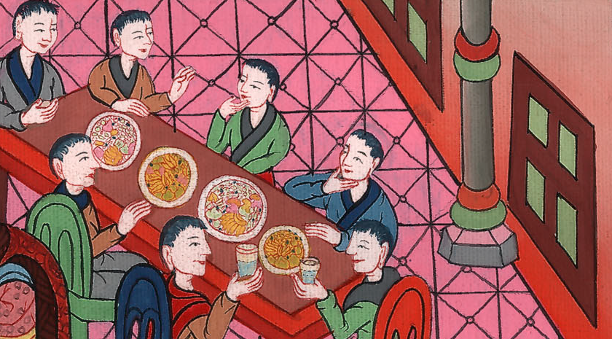
Esther 2:13

Slide 31
14In the evening she went, and on the next day she returned into the second women’s house, to the custody of Shaashgaz, the king’s eunuch, who kept the concubines. She came in to the king no more, unless the king delighted in her, and she was called by name.
John

Slide 32
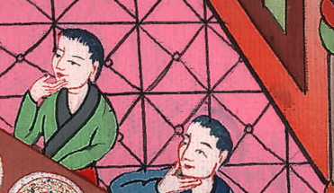
Esther 2:14

Slide 33
15Now when the turn of Esther, the daughter of Abihail the uncle of Mordecai, who had taken her for his daughter, came to go in to the king, she required nothing but what Hegai the king’s eunuch, the keeper of the women, advised. Esther obtained favor in the sight of all those who looked at her.
John

Slide 34
Esther 2:15

Slide 35
16So Esther was taken to King Ahasuerus into his royal house… 17The king loved Esther more than all the women, and she obtained favor and kindness in his sight more than all the virgins; so that he set the royal crown on her head, and made her queen instead of Vashti.
John

Slide 36
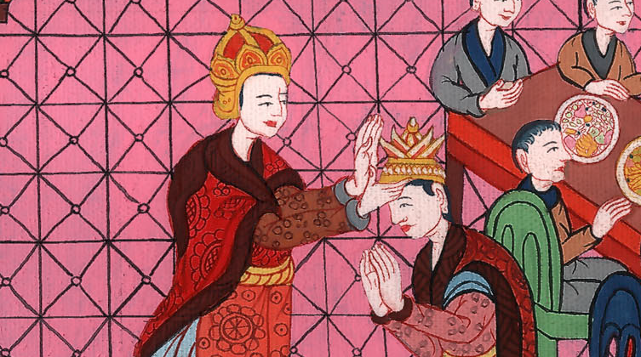
Esther 2:17

Slide 37
18Then the king made a great feast for all his princes and his servants, even Esther’s feast; and he proclaimed a holiday in the provinces, and gave gifts according to the king’s bounty.
John

Slide 38
Esther 2:18

