Slide 1
28-3
This work is licensed under a Creative Commons Attribution-Sharealike 4.0 International License.
Please add this statement to all the videos you create.
English Bible quotes are from the World English Bible US, which is in the public domain.
Notes:
Ch
28 Esther
1. Queen Vashti’s refuses King - 1:1-22 (Left Bottom Room in Palace)
2. Esther’s coronation banquet - 2:1-20 (Right Bottom Room in Palace)
3. Mordecai won’t bow to Haman - 2:21-23, 3:1-6 (Right side of Palace Gate)
4. Haman Plots to kill the Jews - 3:7 – 4:17 (On Palace Roof and Top Left)
5. Esther enters the Throne Room - 5:1-8 (Palace Center)
6. Haman builds gallows - 5:9-14 (Right Top)
7. The King asks Haman what should be done- 6:1-9 (Left Top Room in Palace)
8. Haman leads Mordecai on King’s Horse - 6:10-14 (Right Bottom)
9. Esther exposes Haman - 7:1-10 (Right Top Room in Palace)
10. Mordecai raised up - 8:1 – 10:3 (Left Bottom)

Slide 2
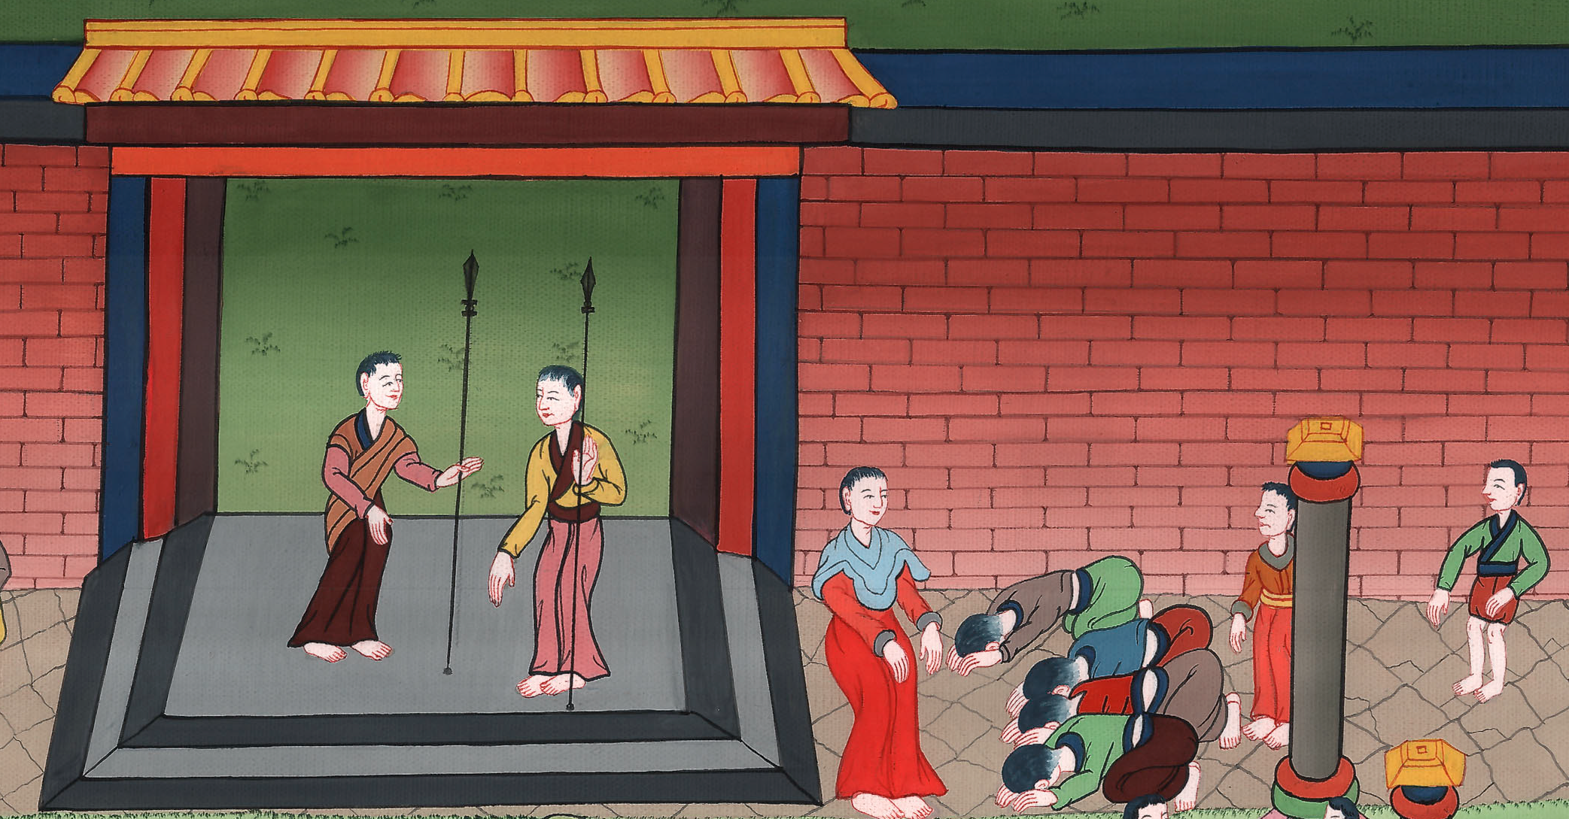
Mordecai won’t bow to Haman –
Esther 2:20-23, 3:1-6

Slide 3
3. Mordecai won’t bow to Haman – Esther 2:20-23, 3:1-6 (At Palace Gate)
John

Slide 4
Mordecai won’t bow to Haman –
Esther 2:20-23, 3:1-6

Slide 5
20Esther had not yet made known her relatives nor her people, as Mordecai had commanded her; for Esther obeyed Mordecai, like she did when she was brought up by him.
John

Slide 6
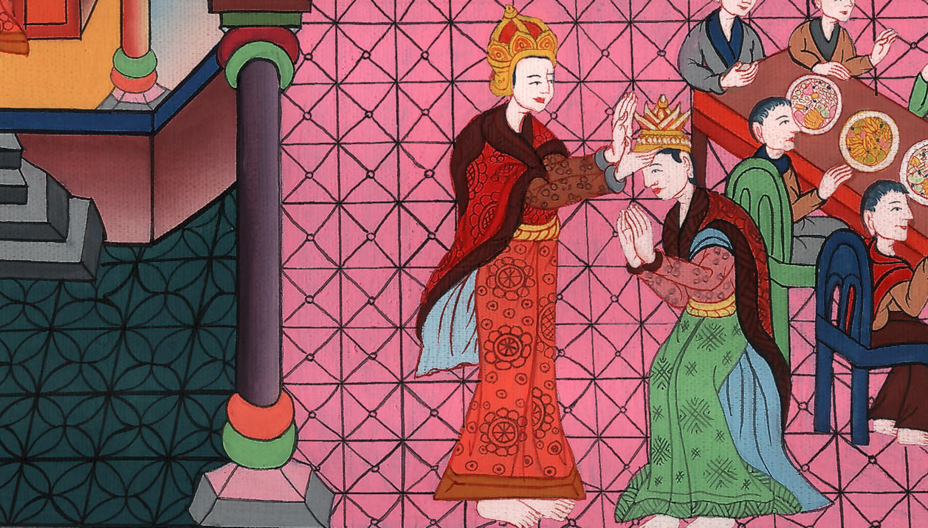
Esther 2:20

Slide 7
21In those days, while Mordecai was sitting in the king’s gate, two of the king’s eunuchs, Bigthan and Teresh, who were doorkeepers, were angry, and sought to lay hands on the King Ahasuerus.
John

Slide 8
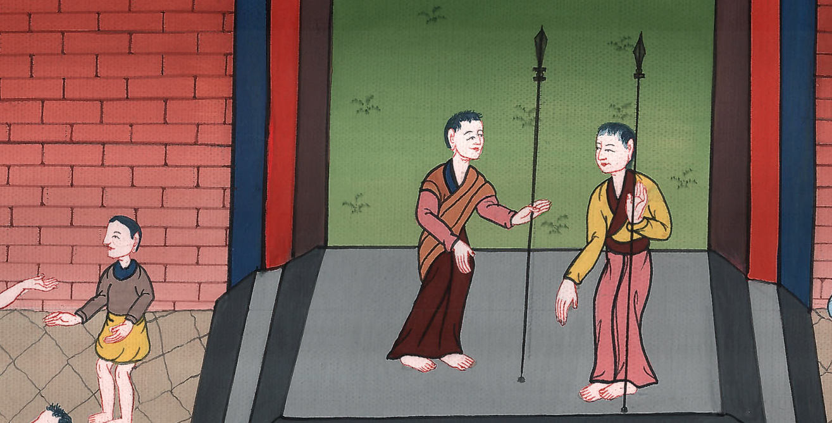
Esther 2:21

Slide 9
22This thing became known to Mordecai, who informed Esther the queen; and Esther informed the king in Mordecai’s name.
John

Slide 10
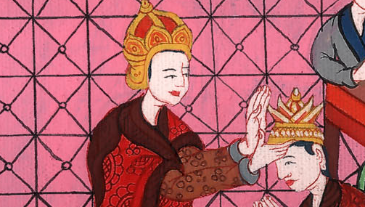
Esther 2:22

Slide 11
23When this matter was investigated, and it was found to be so, they were both hanged on a gallows; and it was written in the book of the chronicles in the king’s presence.
John

Slide 12
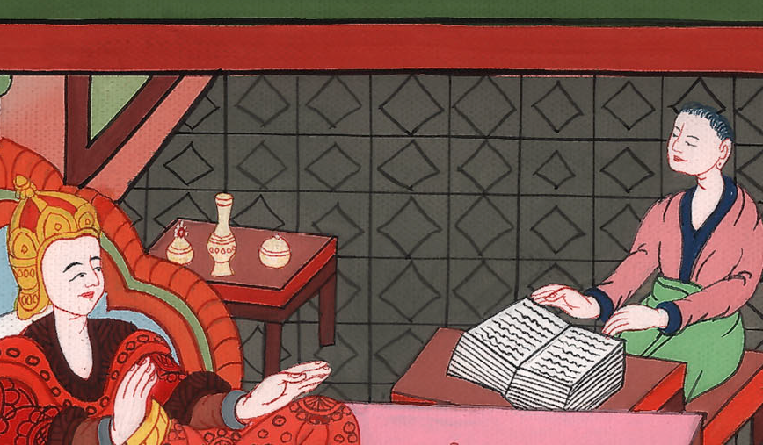
Esther 2:23

Slide 13
3:1After these things King Ahasuerus promoted Haman the son of Hammedatha the Agagite, and advanced him, and set his seat above all the princes who were with him.
John

Slide 14
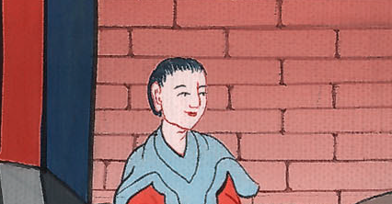
Esther 3:1

Slide 15
2All the king’s servants who were in the king’s gate bowed down and paid homage to Haman, for the king had so commanded concerning him. But Mordecai didn’t bow down or pay him homage.
John

Slide 16
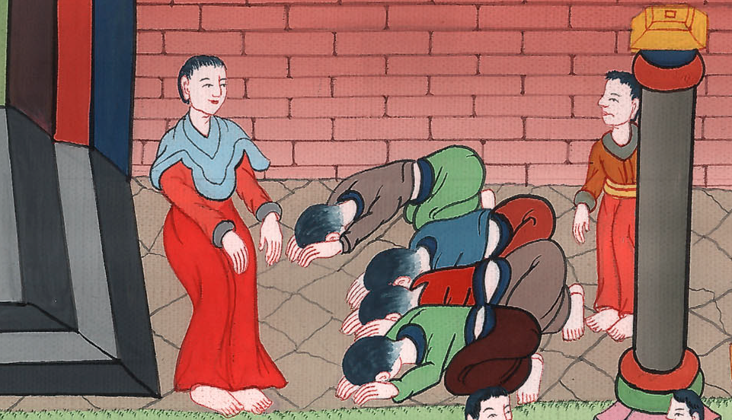
Esther 3:2

Slide 17
3Then the king’s servants who were in the king’s gate said to Mordecai, “Why do you disobey the king’s commandment?”
John

Slide 18
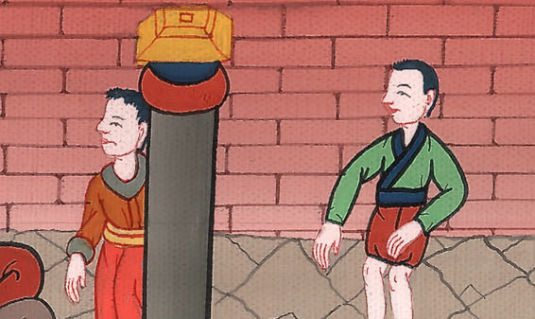
Esther 3:3

Slide 19
4Now it came to pass, when they spoke daily to him, and he didn’t listen to them, that they told Haman, to see whether Mordecai’s reason would stand; for he had told them that he was a Jew.
John

Slide 20
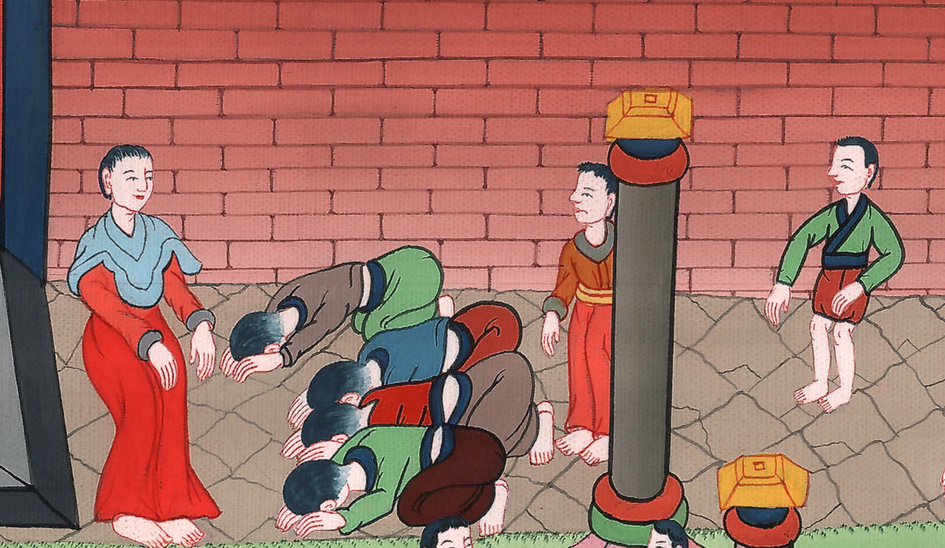
Esther 3:4

Slide 21
5When Haman saw that Mordecai didn’t bow down nor pay him homage, Haman was full of wrath.
John

Slide 22
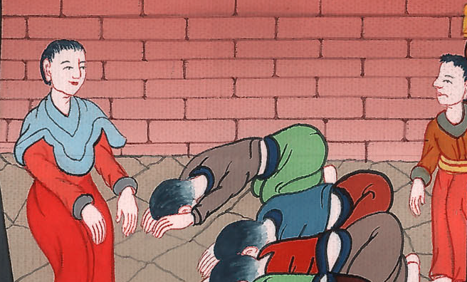
Esther 3:5

Slide 23
6But he scorned the thought of laying hands on Mordecai alone, for they had made known to him Mordecai’s people. Therefore Haman sought to destroy all the Jews who were throughout the whole kingdom of Ahasuerus, even Mordecai’s people.
John

Slide 24
Esther 3:6

