Slide 1
28-4
This work is licensed under a Creative Commons Attribution-Sharealike 4.0 International License.
Please add this statement to all the videos you create.
English Bible quotes are from the World English Bible US, which is in the public domain.
Notes:
Ch
28 Esther
1. Queen Vashti’s refuses King - 1:1-22 (Left Bottom Room in Palace)
2. Esther’s coronation banquet - 2:1-20 (Right Bottom Room in Palace)
3. Mordecai won’t bow to Haman - 2:21-23, 3:1-6 (Right side of Palace Gate)
4. Haman Plots to kill the Jews - 3:7 – 4:17 (On Palace Roof and Top Left)
5. Esther enters the Throne Room - 5:1-8 (Palace Center)
6. Haman builds gallows - 5:9-14 (Right Top)
7. The King asks Haman what should be done- 6:1-9 (Left Top Room in Palace)
8. Haman leads Mordecai on King’s Horse - 6:10-14 (Right Bottom)
9. Esther exposes Haman - 7:1-10 (Right Top Room in Palace)
10. Mordecai raised up - 8:1 – 10:3 (Left Bottom)

Slide 2
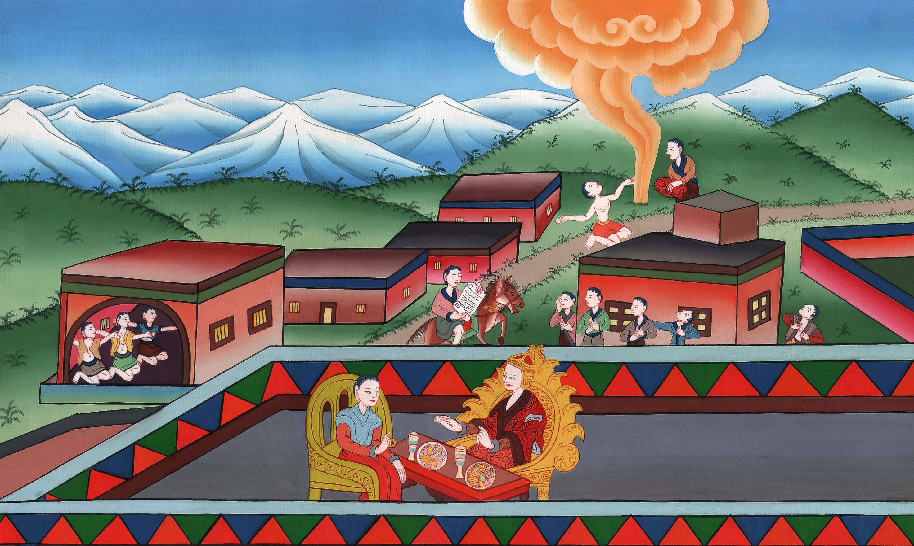
Haman Plots to kill the Jews – Esther 3:6 – 4:17

Slide 3
4. Haman Plots to kill the Jews – Esther 3:6 – 4:17 (On Palace Roof and Top Left)
John

Slide 4
Haman Plots to kill the Jews – Esther 3:6 – 4:17

Slide 5
Esther 3:6But he scorned the thought of laying hands on Mordecai alone, for they had made known to him Mordecai’s people. Therefore Haman sought to destroy all the Jews who were throughout the whole kingdom of Ahasuerus, even Mordecai’s people.
John

Slide 6
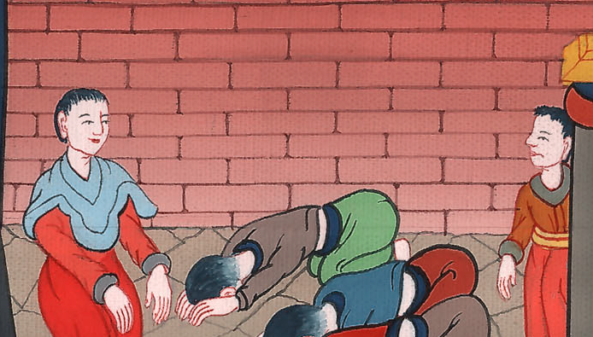
Esther 3:6

Slide 7
8Haman said to King Ahasuerus, “There is a certain people scattered abroad and dispersed among the peoples in all the provinces of your kingdom, and their laws are different from other people’s. They don’t keep the king’s laws. Therefore it is not for the king’s profit to allow them to remain.
John

Slide 8
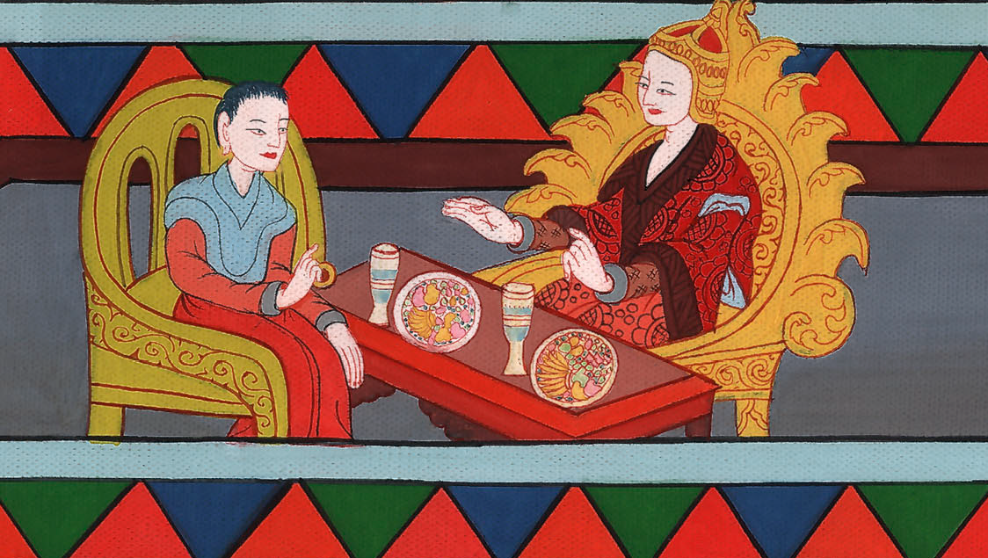
Esther 3:8

Slide 9
9If it pleases the king, let it be written that they be destroyed; and I will pay ten thousand talents of silver into the hands of those who are in charge of the king’s business, to bring it into the king’s treasuries.”
John

Slide 10
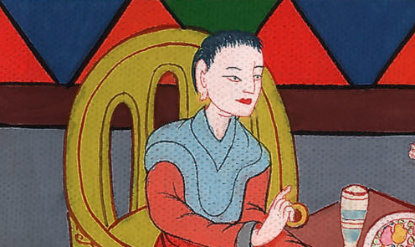
Esther 3:9

Slide 11
10The king took his ring from his hand, and gave it to Haman the son of Hammedatha the Agagite, the Jews’ enemy.
John

Slide 12
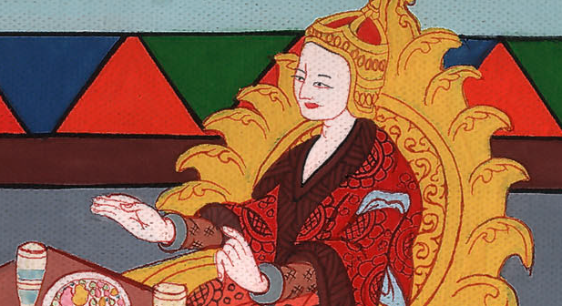
Esther 3:10

Slide 13
11The king said to Haman, “The silver is given to you, the people also, to do with them as it seems good to you.”
John

Slide 14
Esther 3:11

Slide 15
12Then the king’s scribes were called in on the first month, on the thirteenth day of the month; and all that Haman commanded was written to the king’s local governors, and to the governors who were over every province, and to the princes of every people, to every province according to its writing, and to every people in their language. It was written in the name of King Ahasuerus, and it was sealed with the king’s ring.
John

Slide 16
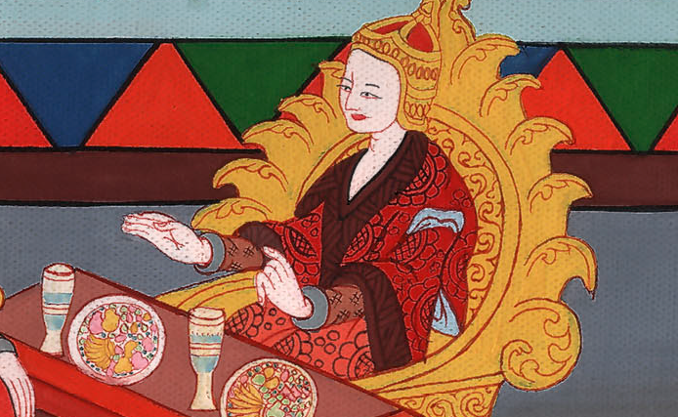
Esther 3:12

Slide 17
13Letters were sent by couriers into all the king’s provinces, to destroy, to kill, and to cause to perish, all Jews, both young and old, little children and women, in one day, even on the thirteenth day of the twelfth month, which is the month Adar, and to plunder their possessions.
John

Slide 18
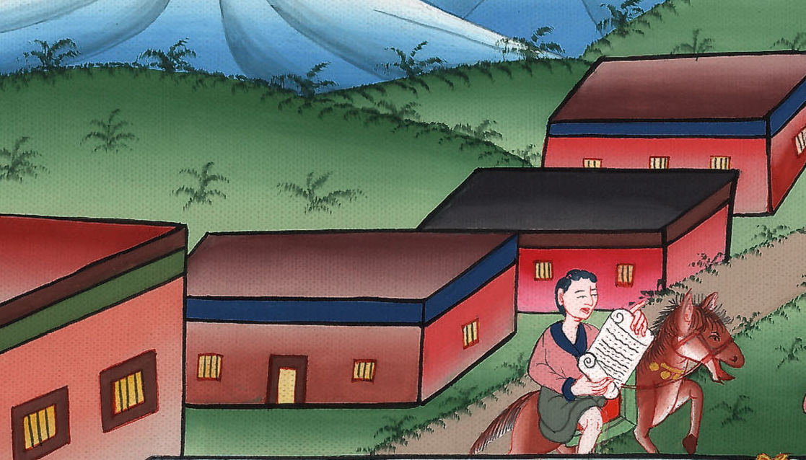
Esther 3:13

Slide 19
14A copy of the letter, that the decree should be given out in every province, was published to all the peoples, that they should be ready against that day.
John

Slide 20
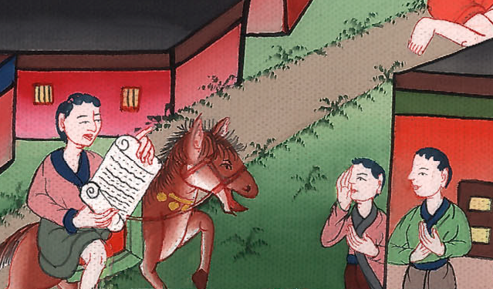
Esther 3:14

Slide 21
15The couriers went out in haste by the king’s commandment, and the decree was given out in the citadel of Susa. The king and Haman sat down to drink; but the city of Susa was perplexed.
John

Slide 22
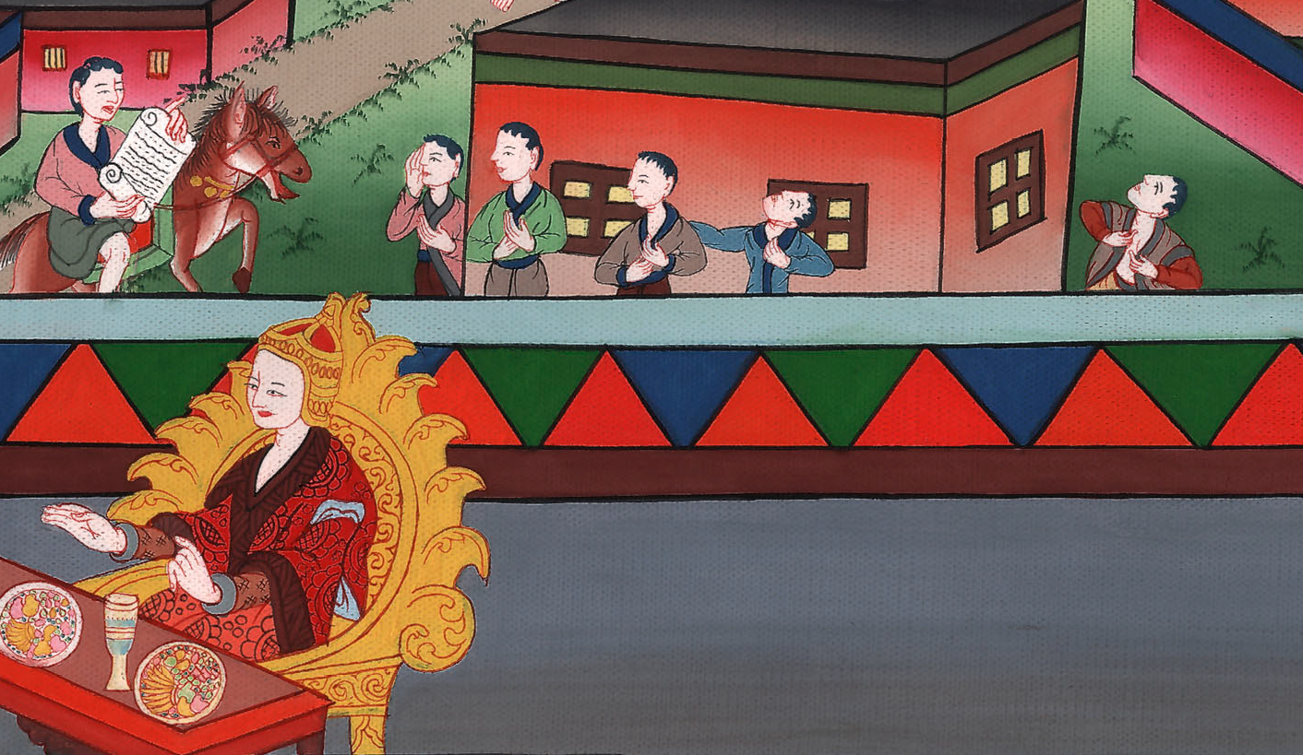
Esther 3:15

Slide 23
1Now when Mordecai found out all that was done, Mordecai tore his clothes and put on sackcloth with ashes, and went out into the middle of the city, and wailed loudly and bitterly.
John

Slide 24
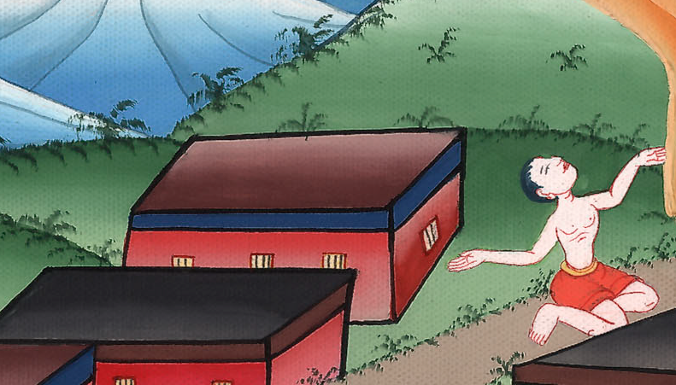
Esther 4:1

Slide 25
3In every province, wherever the king’s commandment and his decree came, there was great mourning among the Jews, and fasting, and weeping, and wailing; and many lay in sackcloth and ashes.
John

Slide 26
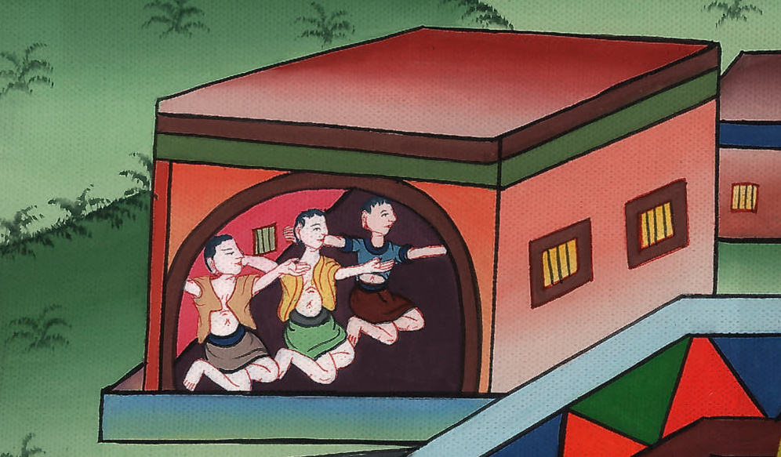
Esther 4:3

Slide 27
4Esther’s maidens and her eunuchs came and told her this, and the queen was exceedingly grieved. She sent clothing to Mordecai, to replace his sackcloth, but he didn’t receive it.
John

Slide 28
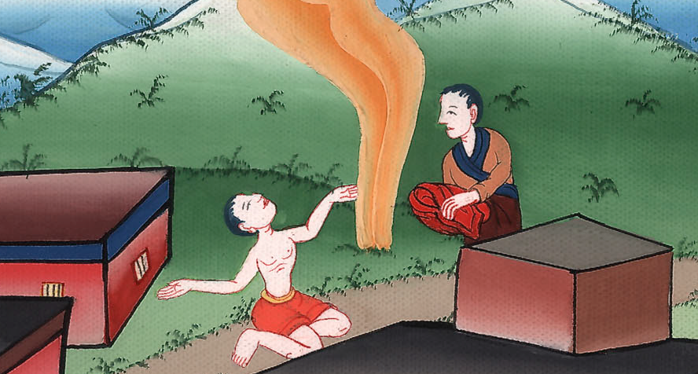
Esther 4:4

Slide 29
5Then Esther called for Hathach, one of the king’s eunuchs, whom he had appointed to attend her, and commanded him to go to Mordecai, to find out what this was, and why it was. 6So Hathach went out to Mordecai, to the city square which was before the king’s gate.
John

Slide 30
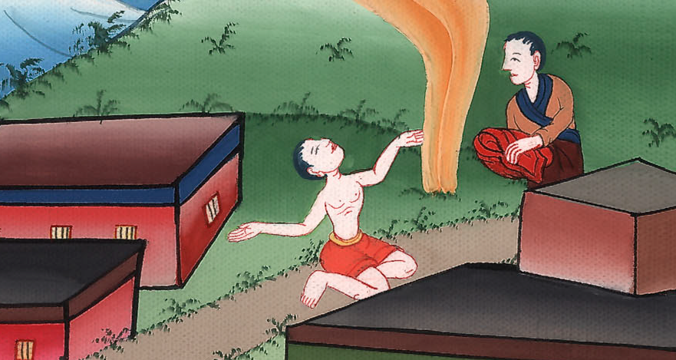
Esther 4:5,6

Slide 31
7Mordecai told him of all that had happened to him, and the exact sum of the money that Haman had promised to pay to the king’s treasuries for the destruction of the Jews.
John

Slide 32
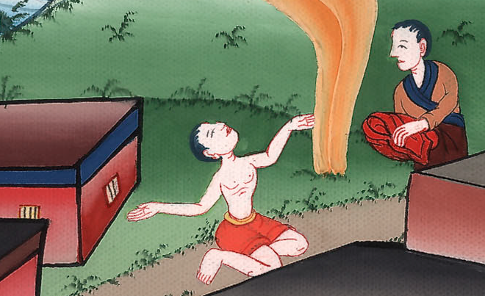
Esther 4:7

Slide 33
8He also gave him the copy of the writing of the decree that was given out in Susa to destroy them, to show it to Esther, and to declare it to her, and to urge her to go in to the king to make supplication to him, and to make request before him for her people.
John

Slide 34
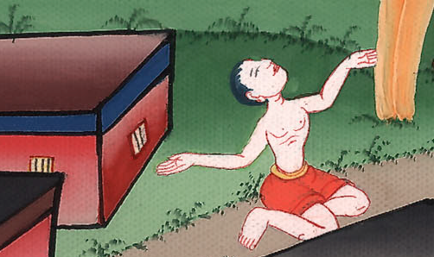
Esther 4:8

Slide 35
9Hathach came and told Esther the words of Mordecai. 10Then Esther spoke to Hathach, and gave him a message to Mordecai:
John

Slide 36
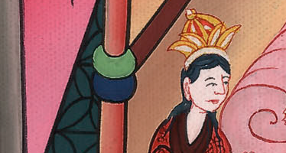
Esther 4:9,10

Slide 37
11“All the king’s servants and the people of the king’s provinces know that whoever, whether man or woman, comes to the king into the inner court without being called, there is one law for him, that he be put to death, except those to whom the king might hold out the golden scepter, that he may live. I have not been called to come in to the king these thirty days.”
John

Slide 38
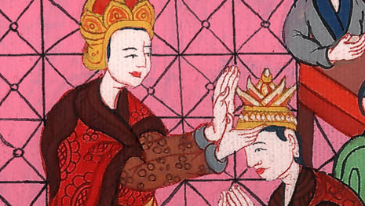
Esther 4:11

Slide 39
12They told Esther’s words to Mordecai. 13Then Mordecai asked them to return this answer to Esther: “Don’t think to yourself that you will escape in the king’s house any more than all the Jews.
John

Slide 40
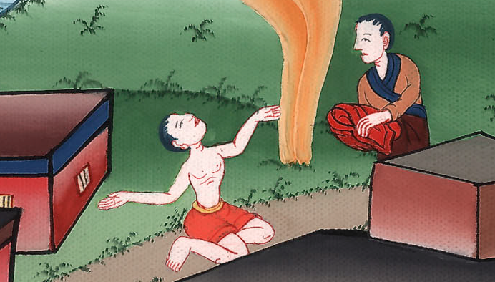
Esther 4:12,13

Slide 41
14For if you remain silent now, then relief and deliverance will come to the Jews from another place, but you and your father’s house will perish. Who knows if you haven’t come to the kingdom for such a time as this?”
John

Slide 42
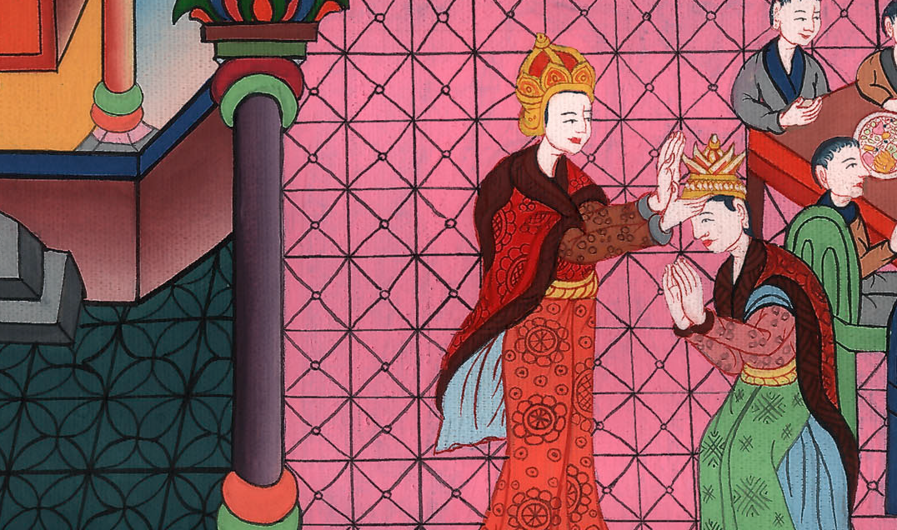
Esther 4:14

Slide 43
15Then Esther asked them to answer Mordecai, 16“Go, gather together all the Jews who are present in Susa, and fast for me, and neither eat nor drink three days, night or day. I and my maidens will also fast the same way. Then I will go in to the king, which is against the law; and if I perish, I perish.”
John

Slide 44
Esther 4:15,16

Slide 45
17So Mordecai went his way, and did according to all that Esther had commanded him.
John

Slide 46
Esther 4:17

