Slide 1
28-5
This work is licensed under a Creative Commons Attribution-Sharealike 4.0 International License.
Please add this statement to all the videos you create.
English Bible quotes are from the World English Bible US, which is in the public domain.
Notes:
Ch
28 Esther
1. Queen Vashti’s refuses King - 1:1-22 (Left Bottom Room in Palace)
2. Esther’s coronation banquet - 2:1-20 (Right Bottom Room in Palace)
3. Mordecai won’t bow to Haman - 2:21-23, 3:1-6 (Right side of Palace Gate)
4. Haman Plots to kill the Jews - 3:7 – 4:17 (On Palace Roof and Top Left)
5. Esther enters the Throne Room - 5:1-8 (Palace Center)
. Haman builds gallows - 5:9-14 (Right Top)
6The King asks Haman what should be done- 6:1-9 (Left Top Room in Palace)
. 7. Haman leads Mordecai on King’s Horse - 6:10-14 (Right Bottom)
8Esther exposes Haman - 7:1-10 (Right Top Room in Palace)
. 9. Mordecai raised up - 8:1 – 10:3 (Left Bottom)

Slide 2
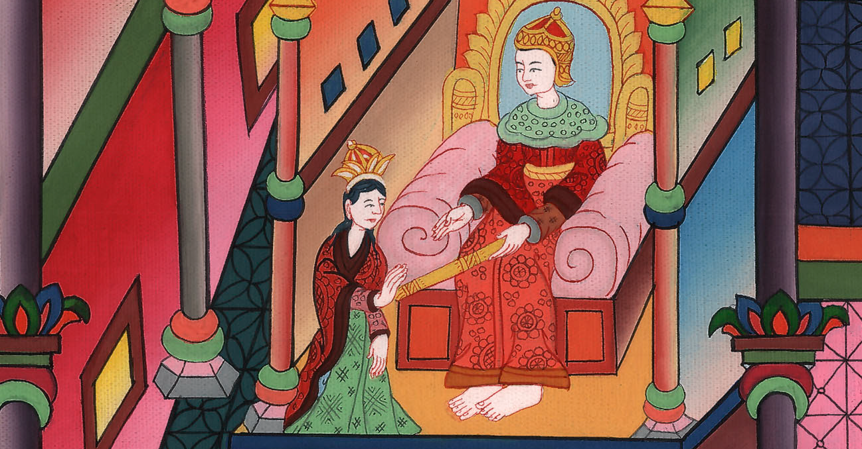
Esther enters the Throne Room – Esther 5:1-14

Slide 3
5. Esther enters the Throne Room – Esther 5:1-14 (Palace Center)
John

Slide 4
Esther enters the Throne Room – Esther 5:1-14

Slide 5
Esther 5:1Now on the third day, Esther put on her royal clothing and stood in the inner court of the king’s house, next to the king’s house. The king sat on his royal throne in the royal house, next to the entrance of the house.
John

Slide 6
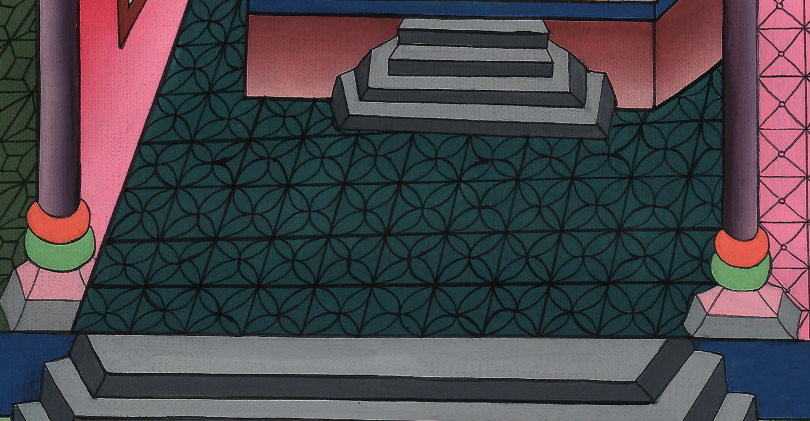
Esther 5:1

Slide 7
2When the king saw Esther the queen standing in the court, she obtained favor in his sight; and the king held out to Esther the golden scepter that was in his hand. So Esther came near and touched the top of the scepter.
John

Slide 8
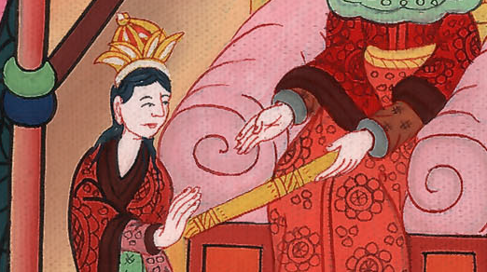
Esther 5:2

Slide 9
3Then the king asked her, “What would you like, queen Esther? What is your request? It shall be given you even to the half of the kingdom.”
John

Slide 10
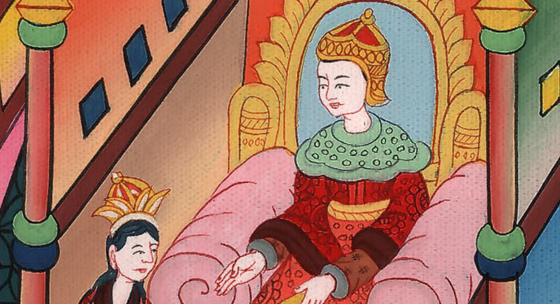
Esther 5:3

Slide 11
4Esther said, “If it seems good to the king, let the king and Haman come today to the banquet that I have prepared for him.”
John

Slide 12
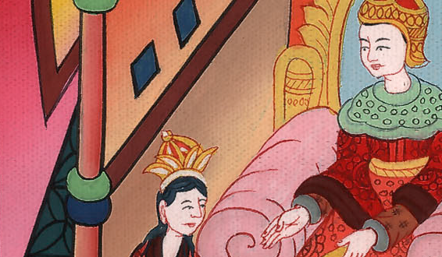
Esther 5:4

Slide 13
5Then the king said, “Bring Haman quickly, so that it may be done as Esther has said.” So the king and Haman came to the banquet that Esther had prepared.
John

Slide 14
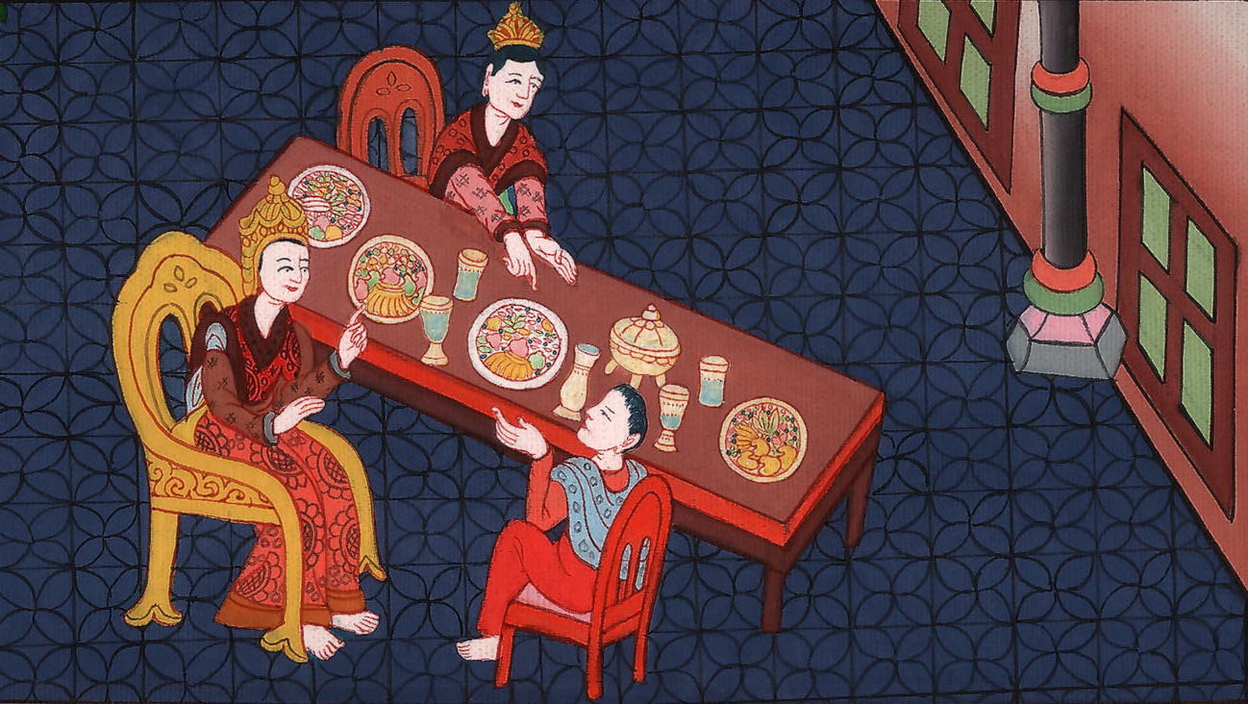
Esther 5:5

Slide 15
6The king said to Esther at the banquet of wine, “What is your petition? It shall be granted you. What is your request? Even to the half of the kingdom it shall be performed.”
John

Slide 16
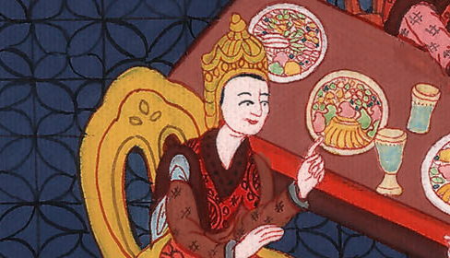
Esther 5:6

Slide 17
7Then Esther answered and said, “My petition and my request is this. 8If I have found favor in the sight of the king, and if it pleases the king to grant my petition and to perform my request, let the king and Haman come to the banquet that I will prepare for them, and I will do tomorrow as the king has said.”
John

Slide 18
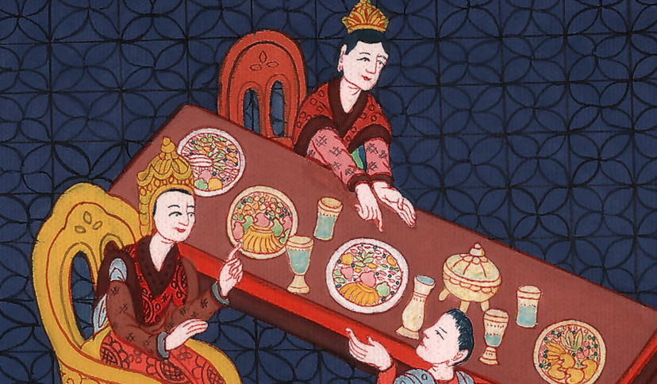
Esther 5:7

Slide 19
9Then Haman went out that day joyful and glad of heart, but when Haman saw Mordecai in the king’s gate, that he didn’t stand up nor move for him, he was filled with wrath against Mordecai.
John

Slide 20
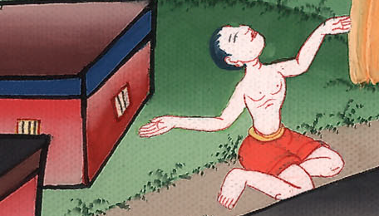
Esther 5:9

Slide 21
10Nevertheless Haman restrained himself, and went home. There, he sent and called for his friends and Zeresh his wife.
John

Slide 22
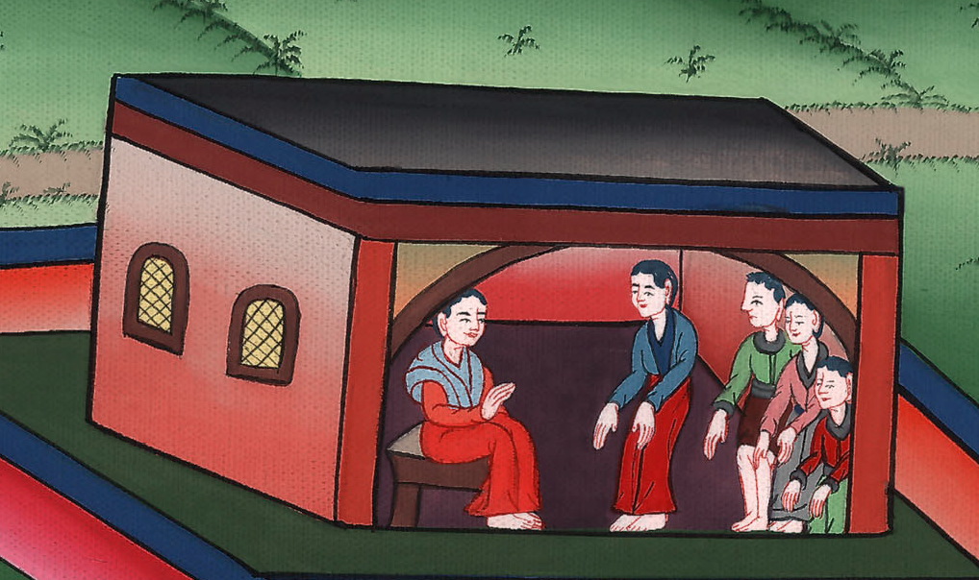
Esther 5:10

Slide 23
11Haman recounted to them the glory of his riches, the multitude of his children, all the things in which the king had promoted him, and how he had advanced him above the princes and servants of the king.
John

Slide 24
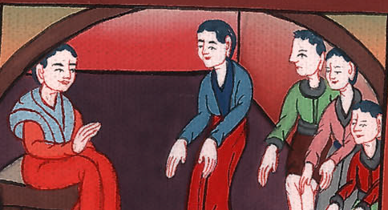
Esther 5:11

Slide 25
12Haman also said, “Yes, Esther the queen let no man come in with the king to the banquet that she had prepared but myself; and tomorrow I am also invited by her together with the king.
John

Slide 26
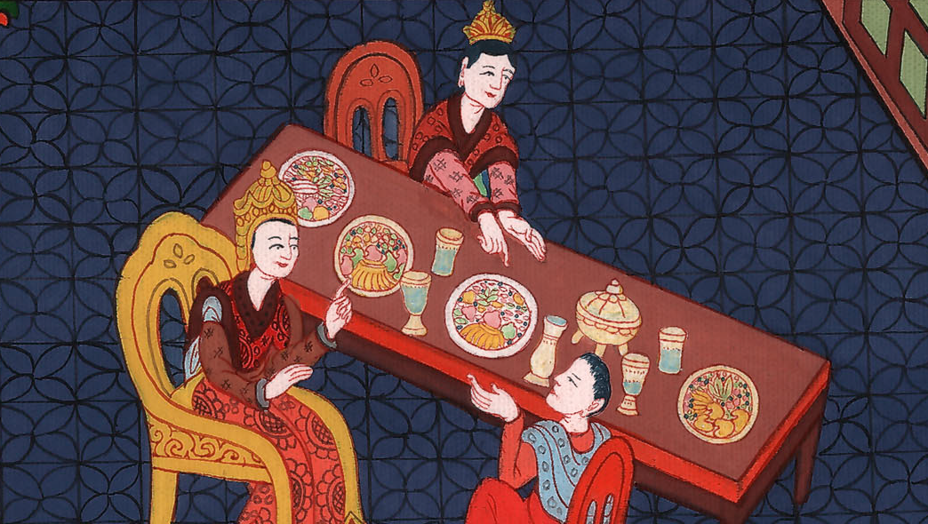
Esther 5:12

Slide 27
13Yet all this avails me nothing, so long as I see Mordecai the Jew sitting at the king’s gate.”
John

Slide 28
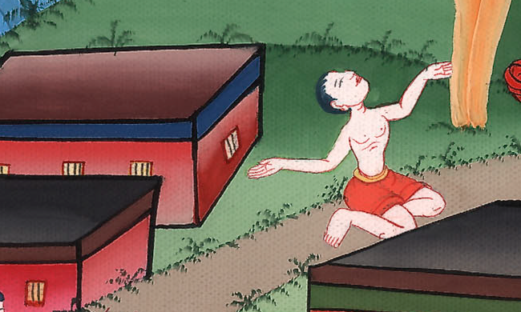
Esther 5:13

Slide 29
14Then Zeresh his wife and all his friends said to him, “Let a gallows be made fifty cubits high, and in the morning speak to the king about hanging Mordecai on it. Then go in merrily with the king to the banquet.” This pleased Haman, so he had the gallows made.
John

Slide 30
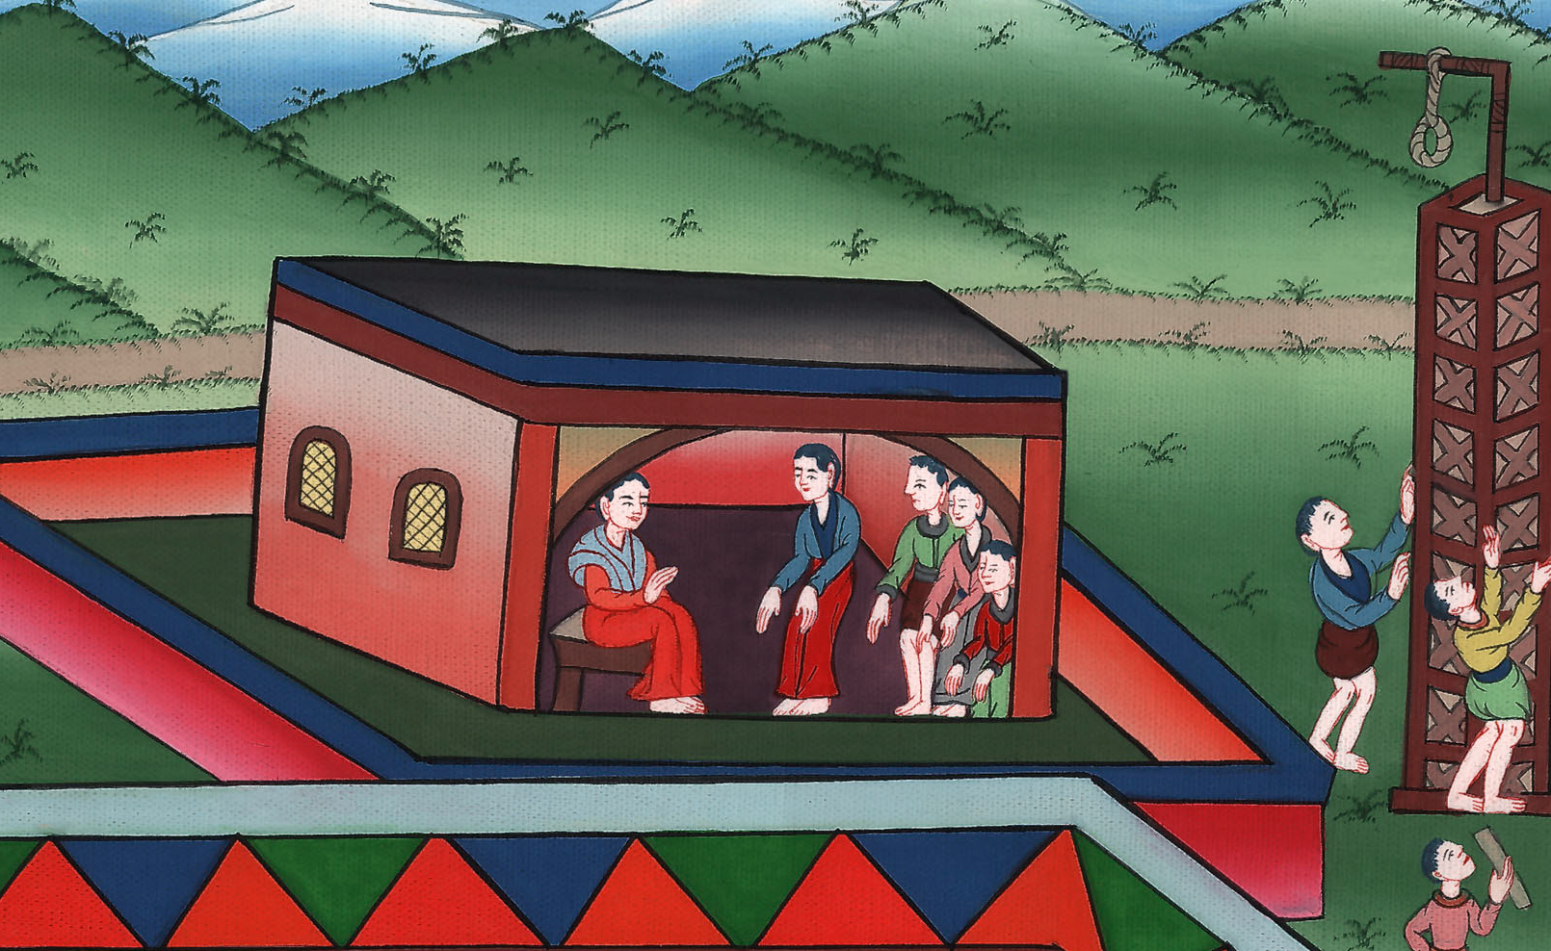
Esther 5:14

