Slide 1
28-6
This work is licensed under a Creative Commons Attribution-Sharealike 4.0 International License.
Please add this statement to all the videos you create.
English Bible quotes are from the World English Bible US, which is in the public domain.
Notes:
Ch
28 Esther
1. Queen Vashti’s refuses King - 1:1-22 (Left Bottom Room in Palace)
2. Esther’s coronation banquet - 2:1-20 (Right Bottom Room in Palace)
3. Mordecai won’t bow to Haman - 2:21-23, 3:1-6 (Right side of Palace Gate)
4. Haman Plots to kill the Jews - 3:7 – 4:17 (On Palace Roof and Top Left)
5. Esther enters the Throne Room - 5:1-8 (Palace Center)
. Haman builds gallows - 5:9-14 (Right Top)
6The King asks Haman what should be done- 6:1-9 (Left Top Room in Palace)
. Haman leads Mordecai on King’s Horse - 6:10-14 (Right Bottom)
7.Esther exposes Haman - 7:1-10 (Right Top Room in Palace)
8 Mordecai raised up - 8:1 – 10:3 (Left Bottom)

Slide 2
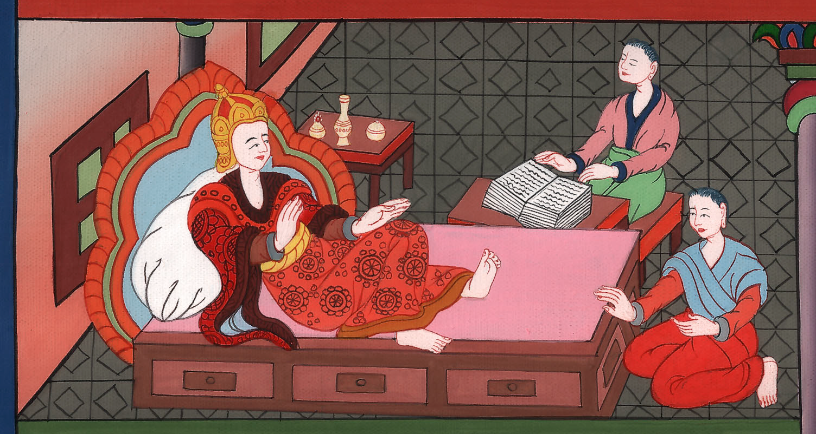
The King asks Haman what should be done - Esther 6:1-14

Slide 3
6 The King asks Haman what should be done - Esther 6:1-14 (Left Top Room in Palace)
John

Slide 4
The King asks Haman what should be done - Esther 6:1-14

Slide 5
Esther 6:1On that night, the king couldn’t sleep. He commanded the book of records of the chronicles to be brought, and they were read to the king.
John

Slide 6
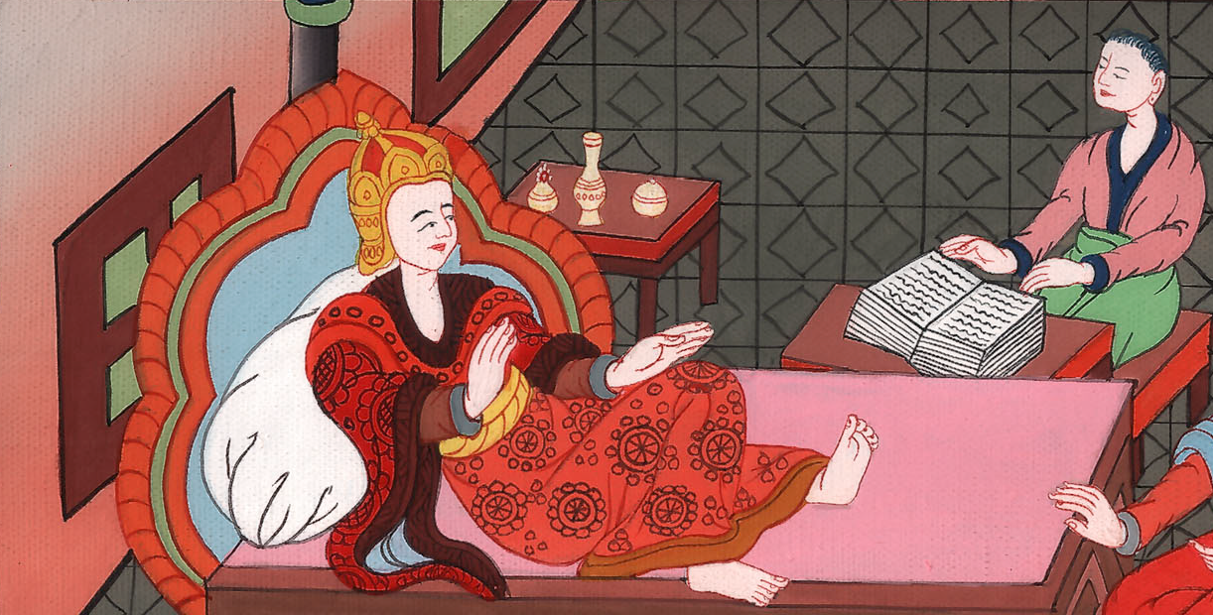
Esther 6:1

Slide 7
2It was found written that Mordecai had told of Bigthana and Teresh, two of the king’s eunuchs, who were doorkeepers, who had tried to lay hands on the King Ahasuerus
John

Slide 8
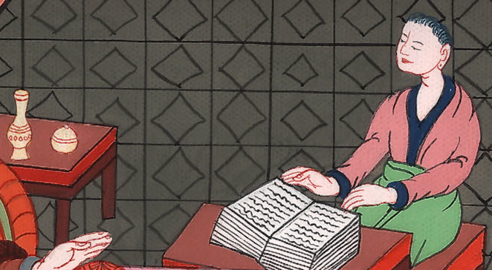
Esther 6:2

Slide 9
3The king said, “What honor and dignity has been given to Mordecai for this?”
Then the king’s servants who attended him said, “Nothing has been done for him.”
John

Slide 10
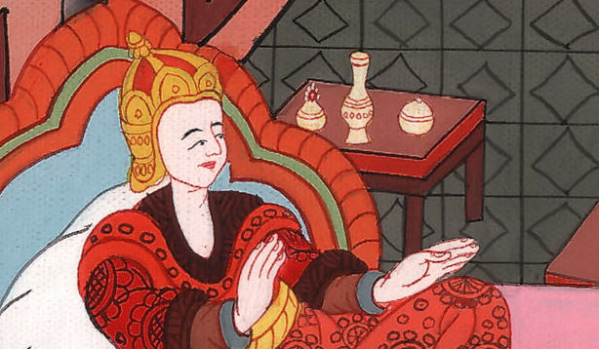
Esther 6:3

Slide 11
The king said, “Who is in the court?” Now Haman had come into the outer court of the king’s house, to speak to the king about hanging Mordecai on the gallows that he had prepared for him.
John

Slide 12
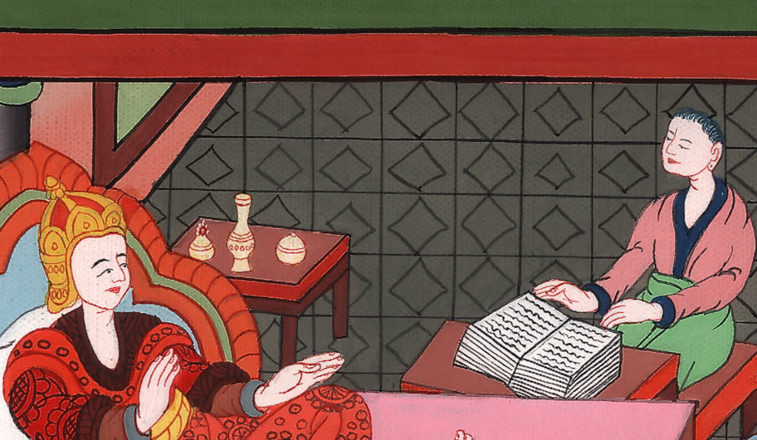
Esther 6:4

Slide 13
5The king’s servants said to him, “Behold, Haman stands in the court.”
The king said, “Let him come in.”
John

Slide 14
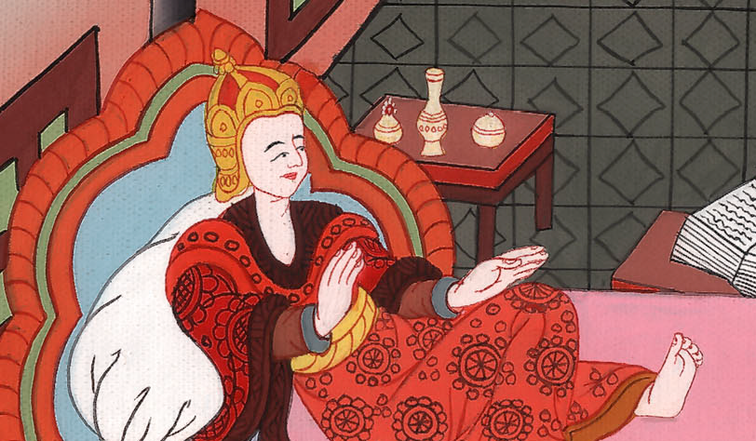
Esther 6:5

Slide 15
6So Haman came in. The king said to him, “What shall be done to the man whom the king delights to honor?”
Now Haman said in his heart, “Who would the king delight to honor more than myself?”
John

Slide 16
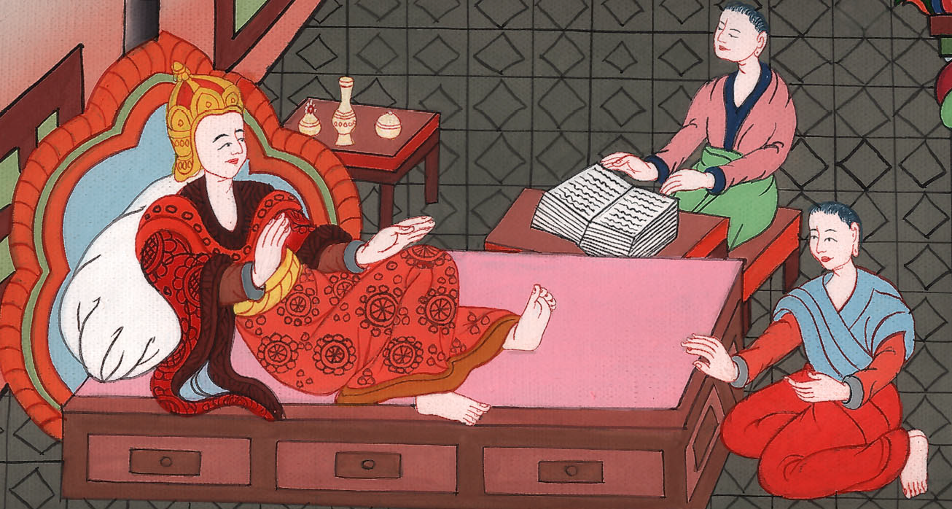
Esther 6:6

Slide 17
7Haman said to the king, “For the man whom the king delights to honor, 8let royal clothing be brought which the king uses to wear, and the horse that the king rides on, and on the head of which a royal crown is set.
John

Slide 18
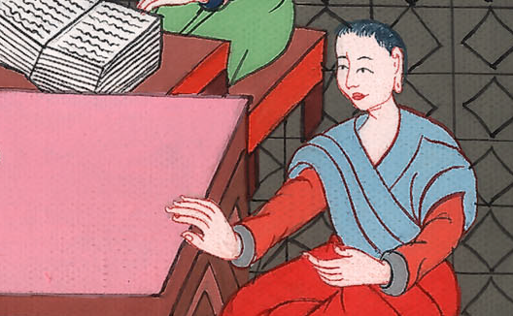
Esther 6:7,8

Slide 19
9Let the clothing and the horse be delivered to the hand of one of the king’s most noble princes, that they may array the man whom the king delights to honor with them, and have him ride on horseback through the city square, and proclaim before him, ‘Thus it shall be done to the man whom the king delights to honor!’”
John

Slide 20
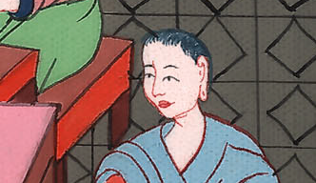
Esther 6:9

Slide 21
10Then the king said to Haman, “Hurry and take the clothing and the horse, as you have said, and do this for Mordecai the Jew, who sits at the king’s gate. Let nothing fail of all that you have spoken.”
John

Slide 22
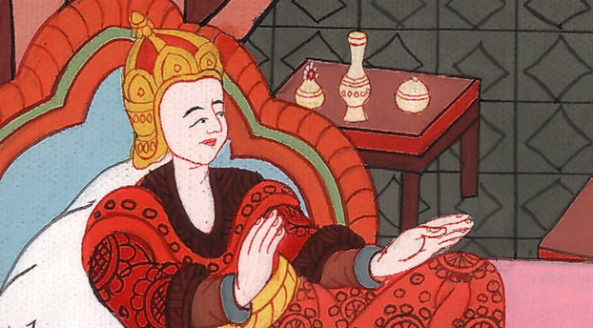
Esther 6:10

Slide 23
11Then Haman took the clothing and the horse, and arrayed Mordecai, and had him ride through the city square, and proclaimed before him, “Thus it shall be done to the man whom the king delights to honor!”
John

Slide 24
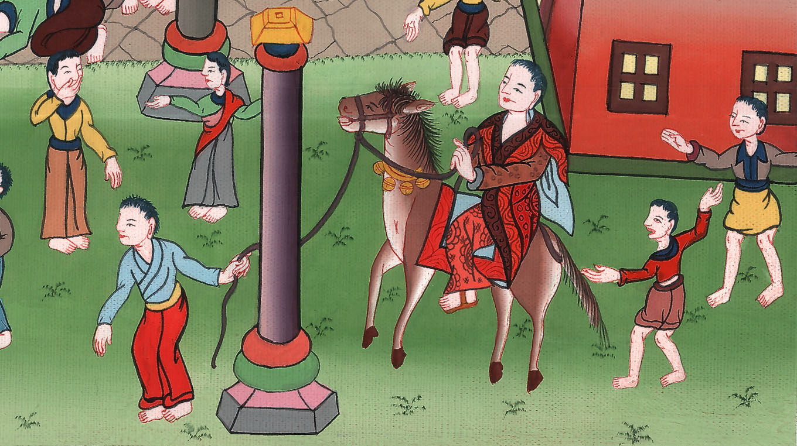
Esther 6:11

Slide 25
12Mordecai came back to the king’s gate, but Haman hurried to his house, mourning and having his head covered.
John

Slide 26
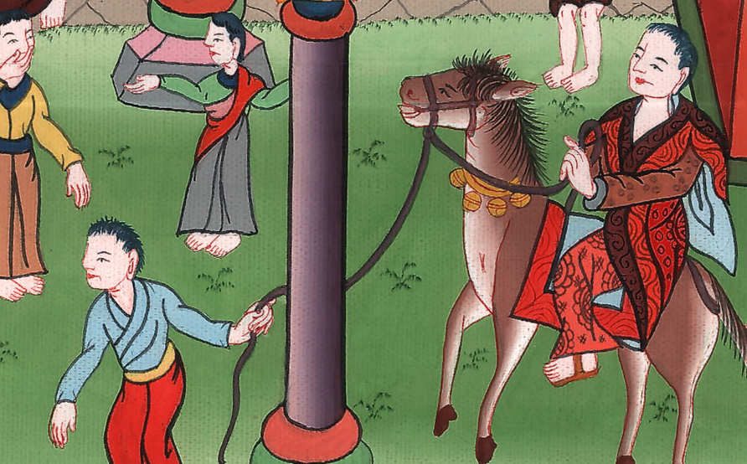
Esther 6:12

Slide 27
13Haman recounted to Zeresh his wife and all his friends everything that had happened to him. Then his wise men and Zeresh his wife said to him, “If Mordecai, before whom you have begun to fall, is of Jewish descent, you will not prevail against him, but you will surely fall before him.”
John

Slide 28
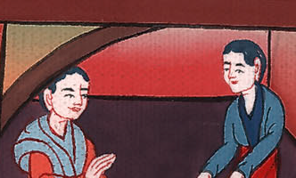
Esther 6:13

Slide 29
14While they were yet talking with him, the king’s eunuchs came, and hurried to bring Haman to the banquet that Esther had prepared.
John

Slide 30
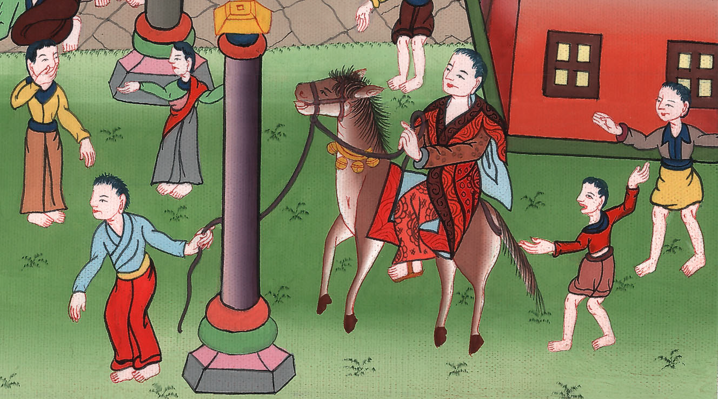
Esther 6:14

