Slide 1
28-7
This work is licensed under a Creative Commons Attribution-Sharealike 4.0 International License.
Please add this statement to all the videos you create.
English Bible quotes are from the World English Bible US, which is in the public domain.
Notes:
Ch
28 Esther
1. Queen Vashti’s refuses King - 1:1-22 (Left Bottom Room in Palace)
2. Esther’s coronation banquet - 2:1-20 (Right Bottom Room in Palace)
3. Mordecai won’t bow to Haman - 2:21-23, 3:1-6 (Right side of Palace Gate)
4. Haman Plots to kill the Jews - 3:7 – 4:17 (On Palace Roof and Top Left)
5. Esther enters the Throne Room - 5:1-8 (Palace Center)
. Haman builds gallows - 5:9-14 (Right Top)
6The King asks Haman what should be done- 6:1-9 (Left Top Room in Palace)
. Haman leads Mordecai on King’s Horse - 6:10-14 (Right Bottom)
7.Esther exposes Haman - 7:1-10 (Right Top Room in Palace)
8 Mordecai raised up - 8:1 – 10:3 (Left Bottom)

Slide 2
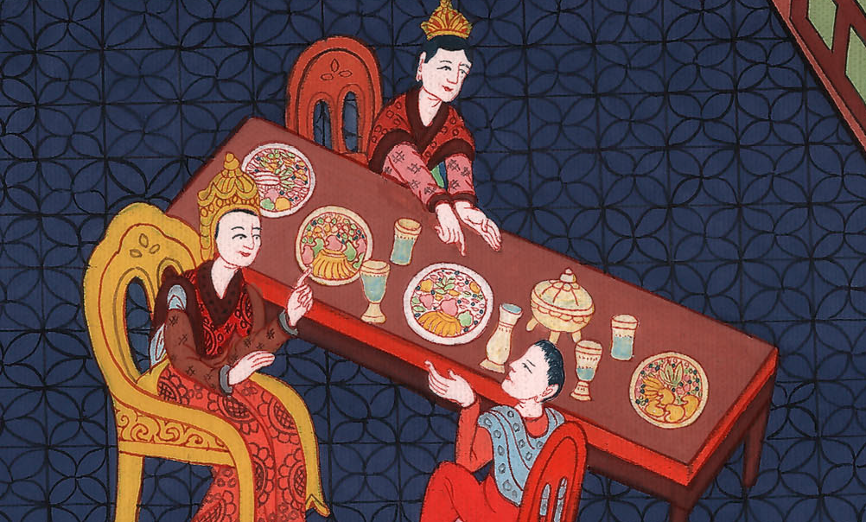
Haman Is Put to Death - Esther 7:1-10

Slide 3
7. Haman Is Put to Death - Esther 7:1-10 (Right Top Room in Palace)
John

Slide 4
Haman Is Put to Death - Esther 7:1-10

Slide 5
Esther 7:1So the king and Haman came to banquet with Esther the queen.
John

Slide 6
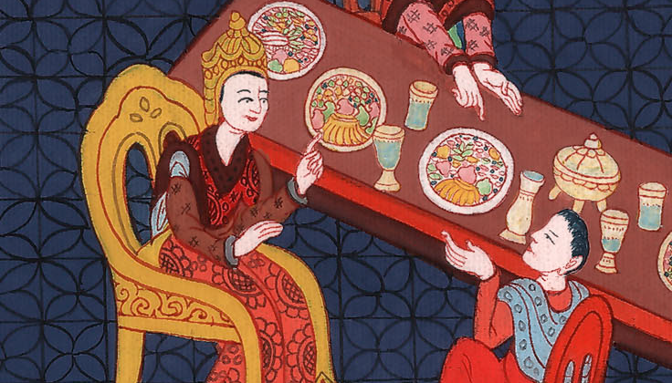
Esther 7:1

Slide 7
2The king said again to Esther on the second day at the banquet of wine, “What is your petition, queen Esther? It shall be granted you. What is your request? Even to the half of the kingdom it shall be performed.”
John

Slide 8
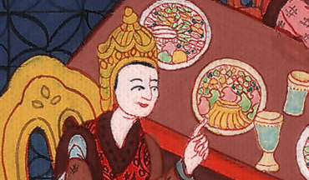
Esther 7:2

Slide 9
3Then Esther the queen answered, “If I have found favor in your sight, O king, and if it pleases the king, let my life be given me at my petition, and my people at my request.
John

Slide 10
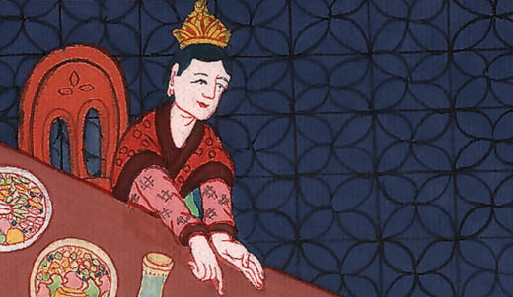
Esther 7:3

Slide 11
4For we are sold, I and my people, to be destroyed, to be slain, and to perish. But if we had been sold for male and female slaves, I would have held my peace, although the adversary could not have compensated for the king’s loss.”
John

Slide 12
Esther 7:4

Slide 13
5Then King Ahasuerus said to Esther the queen, “Who is he, and where is he who dared presume in his heart to do so?”
John

Slide 14
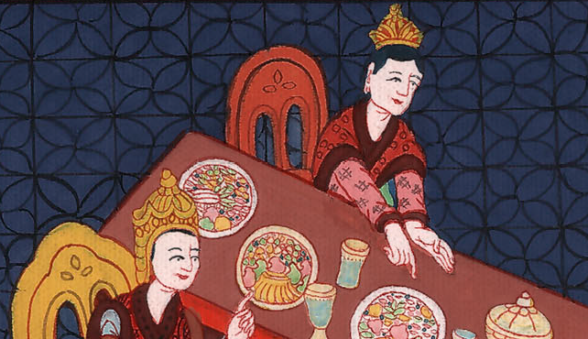
Esther 7:5

Slide 15
6Esther said, “An adversary and an enemy, even this wicked Haman!”
Then Haman was afraid before the king and the queen.
John

Slide 16
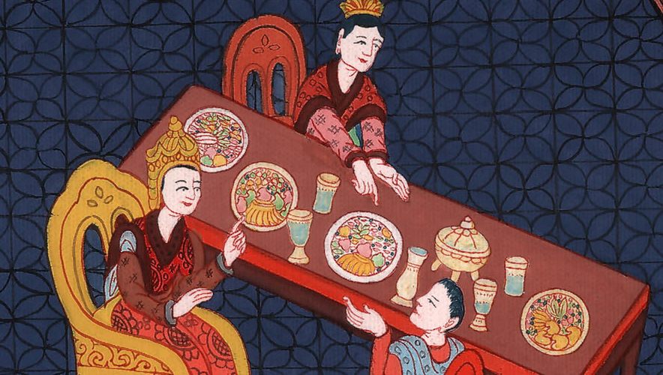
Esther 7:6

Slide 17
7The king arose in his wrath from the banquet of wine and went into the palace garden. Haman stood up to make request for his life to Esther the queen, for he saw that there was evil determined against him by the king. .
John

Slide 18
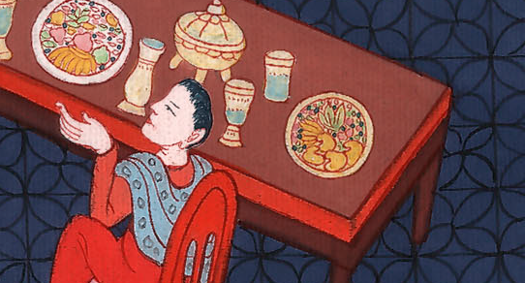
Esther 7:7

Slide 19
8Then the king returned out of the palace garden into the place of the banquet of wine; and Haman had fallen on the couch where Esther was. Then the king said, “Will he even assault the queen in front of me in the house?” As the word went out of the king’s mouth, they covered Haman’s face.
John

Slide 20
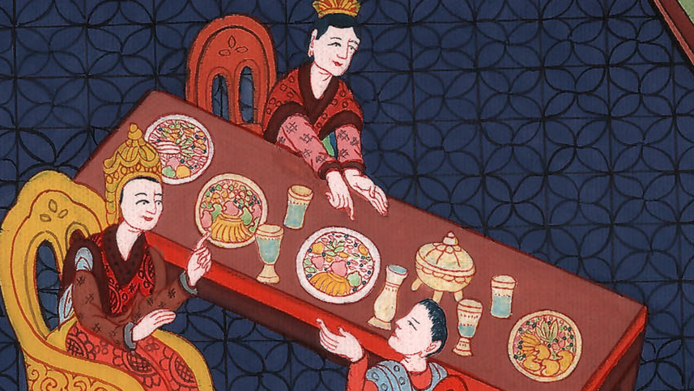
Esther 7:8

Slide 21
9Then Harbonah, one of the eunuchs who were with the king, said, “Behold, the gallows fifty cubits high, which Haman has made for Mordecai, who spoke good for the king, is standing at Haman’s house.”
The king said, “Hang him on it!”
John

Slide 22
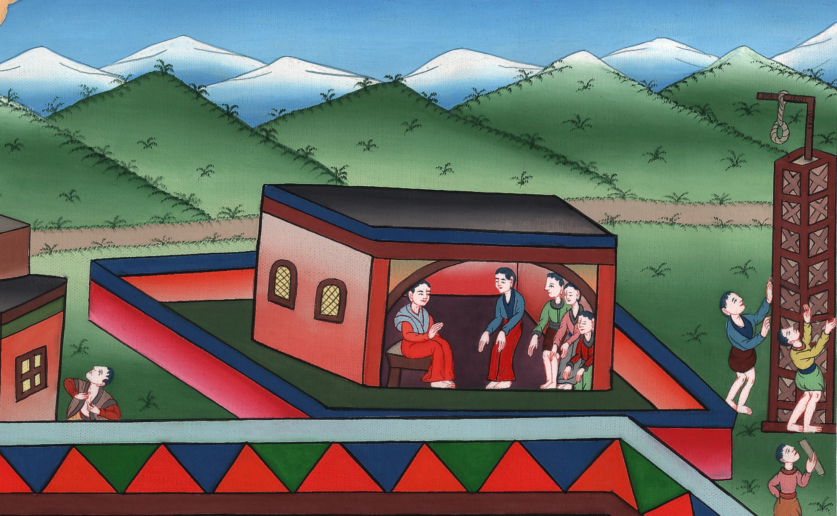
Esther 7:9

Slide 23
10So they hanged Haman on the gallows that he had prepared for Mordecai. Then the king’s wrath was pacified
John

Slide 24
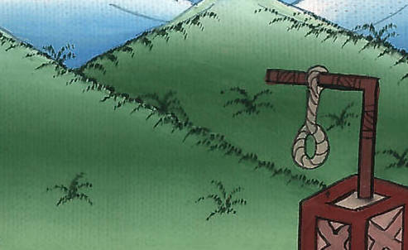
Esther 7:10

