Slide 1
29-1
This work is licensed under a Creative Commons Attribution-ShareAlike 4.0 International License.
Please add this statement to all the videos you create.
English Bible quotes are from the World English Bible US, which is in the public domain.
Notes:
Ch
29 Job
1. Satan’s appearance before God – Job 1:1-12 (Top)
2. Satan’s first attack on Job – Job 1:13-22 (Below Top)
3. Satan’s second attack on Job – Job 2:1-10 (Right Center)
4. Friends come to council Job – Job 2:11 – 37:24 (Right Bottom)
5. God speaks to Job – Job 38:1 – 42:6 (Center)
6. Job prays for his three friends – Job 42:7-9 (Left Bottom)
7. Job is restored – Job 42:10-17 (Left Center)

Slide 2
Satan’s appearance before God –
Job 1:1-12

Slide 3
29 Job
1. Satan’s appearance before God – Job 1:1-12 (Top)
John

Slide 4
Satan’s appearance before God –
Job 1:1-12

Slide 5
Job1:1There was a man in the land of Uz, whose name was Job. That man was blameless and upright, and one who feared God, and turned away from evil.
John

Slide 6
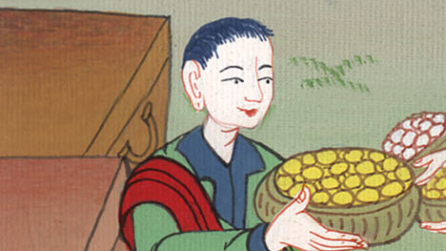
Job 1:1

Slide 7
3His possessions also were seven thousand sheep, three thousand camels, five hundred yoke of oxen, five hundred female donkeys, and a very great household; so that this man was the greatest of all the children of the east.
John

Slide 8
Job 1:3

Slide 9
2There were born to him seven sons and three daughters. 4His sons went and held a feast in the house of each one on his birthday; and they sent and called for their three sisters to eat and to drink with them.
John

Slide 10
Job 1:2,4

Slide 11
5It was so, when the days of their feasting had run their course, that Job sent and sanctified them, and rose up early in the morning, and offered burnt offerings according to the number of them all. For Job said, “It may be that my sons have sinned, and renounced God in their hearts.” Job did so continually.
John

Slide 12
Job 1:5

Slide 13
6Now on the day when God’s sons came to present themselves before Yahweh, Satan also came among them. 7Yahweh said to Satan, “Where have you come from?”
Then Satan answered Yahweh, and said, “From going back and forth in the earth, and from walking up and down in it.”
John

Slide 14
Job 1:6,7

Slide 15
John
Who is Satan

Slide 16
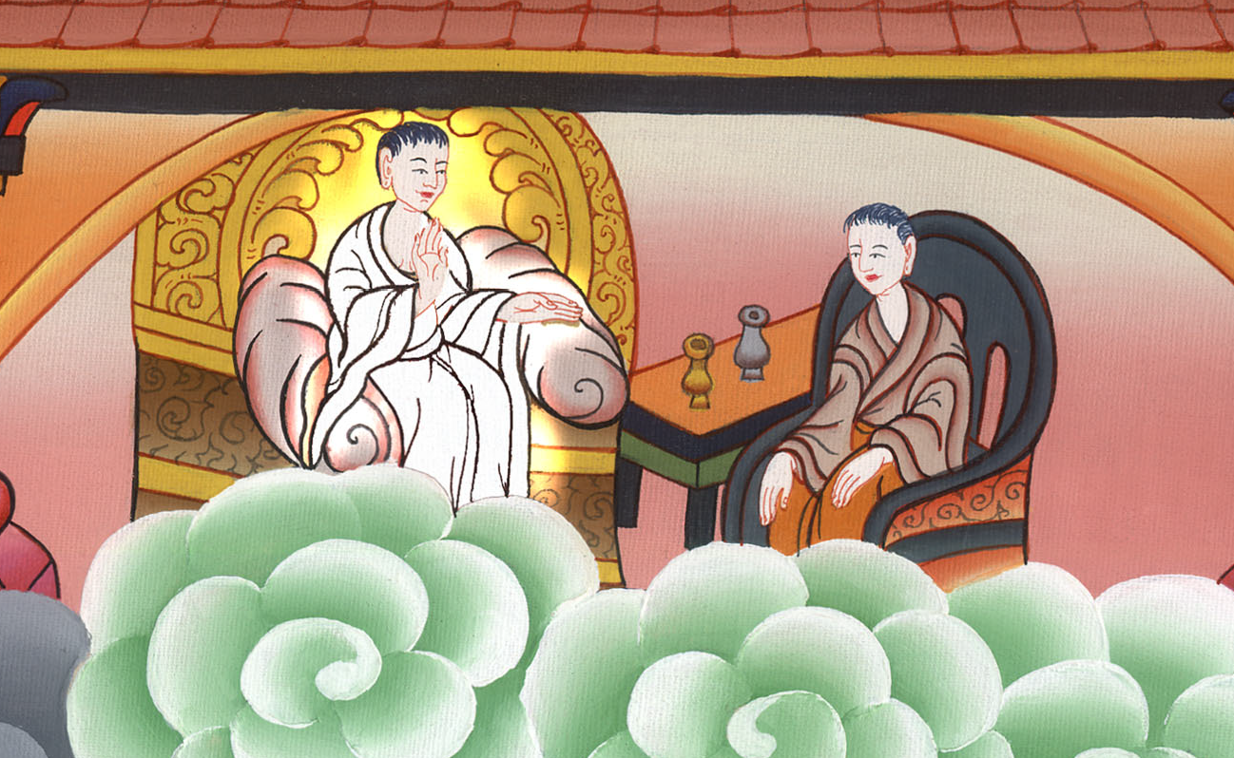

Slide 17
8Yahweh said to Satan, “Have you considered my servant, Job? For there is no one like him in the earth, a blameless and an upright man, one who fears God, and turns away from evil.”
John

Slide 18
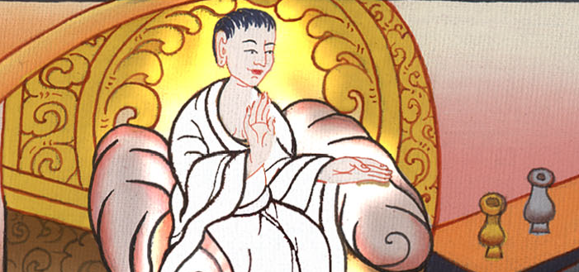
Job 1:8

Slide 19
9Then Satan answered Yahweh, and said, “Does Job fear God for nothing? 10Haven’t you made a hedge around him, and around his house, and around all that he has, on every side? You have blessed the work of his hands, and his substance is increased in the land.
John

Slide 20
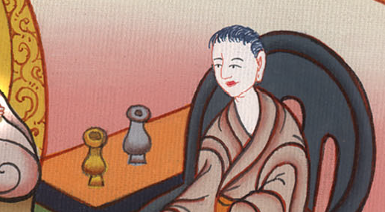
Job 1:9,10

Slide 21
11But stretch out your hand now, and touch all that he has, and he will renounce you to your face.”
John

Slide 22
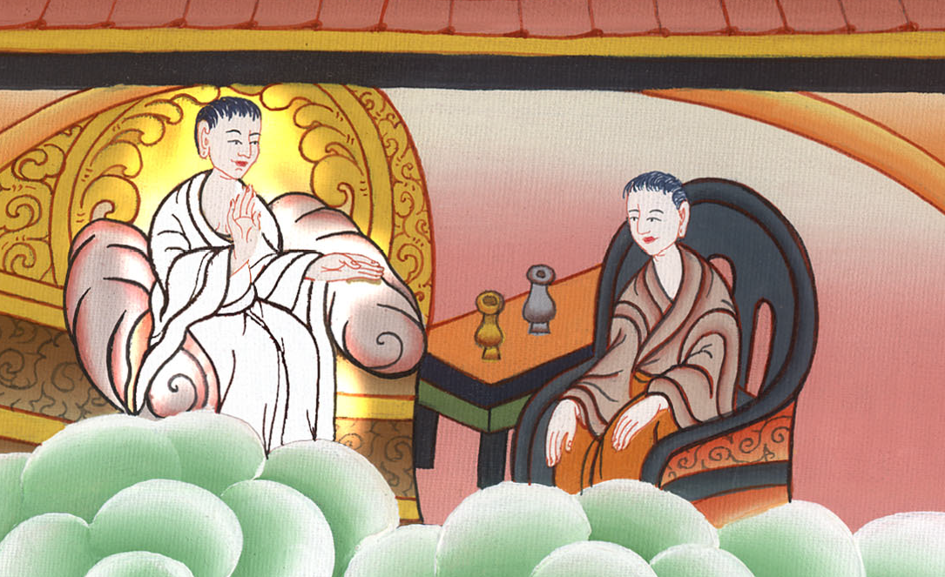
Job 1:11

Slide 23
12Yahweh said to Satan, “Behold, all that he has is in your power. Only on himself don’t stretch out your hand.”
So Satan went out from the presence of Yahweh.
John

Slide 24
Job 1:12

