Slide 1
29-2
This work is licensed under a Creative Commons Attribution-Sharealike 4.0 International License.
Please add this statement to all the videos you create.
English Bible quotes are from the World English Bible US, which is in the public domain.
Notes:
Ch
29 Job
1. Satan’s appearance before God – Job 1:1-12 (Top)
2. Satan’s first attack on Job – Job 1:13-22 (Below Top)
3. Satan’s second attack on Job – Job 2:1-10 (Right Center)
4. Friends come to council Job – Job 2:11 – 37:24 (Right Bottom)
5. God speaks to Job – Job 38:1 – 42:6 (Center)
6. Job prays for his three friends – Job 42:7-9 (Left Bottom)
7. Job is restored – Job 42:10-17 (Left Center)
j

Slide 2
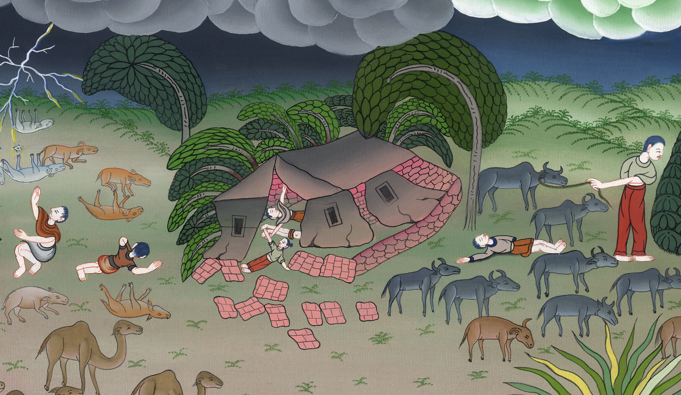
Satan’s first attack on Job –
Job 1:13-22

Slide 3
2. Satan’s first attack on Job – Job 1:13-22 (Below Top)
John

Slide 4
Satan’s first attack on Job –
Job 1:13-22

Slide 5
Job1:13It fell on a day when his sons and his daughters were eating and drinking wine in their oldest brother’s house, 14that a messenger came to Job, and said, “The oxen were plowing, and the donkeys feeding beside them,
John

Slide 6
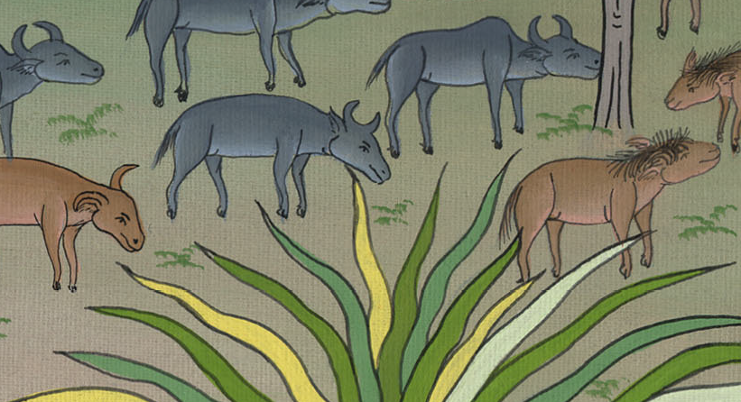
Job 1:14

Slide 7
15and the Sabeans attacked, and took them away. Yes, they have killed the servants with the edge of the sword, and I alone have escaped to tell you.”
John

Slide 8
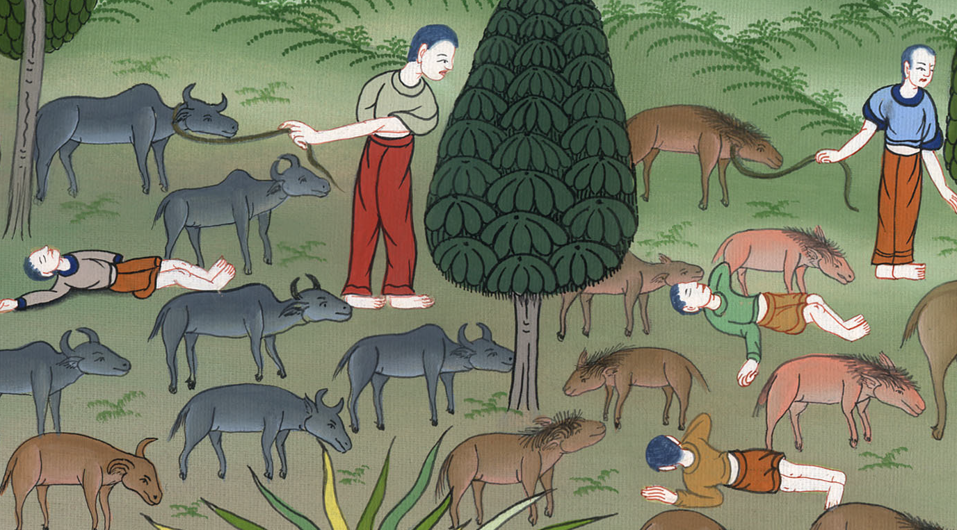
Job 1:15

Slide 9
16While he was still speaking, another also came and said, “The fire of God has fallen from the sky, and has burned up the sheep and the servants, and consumed them, and I alone have escaped to tell you.”
John

Slide 10
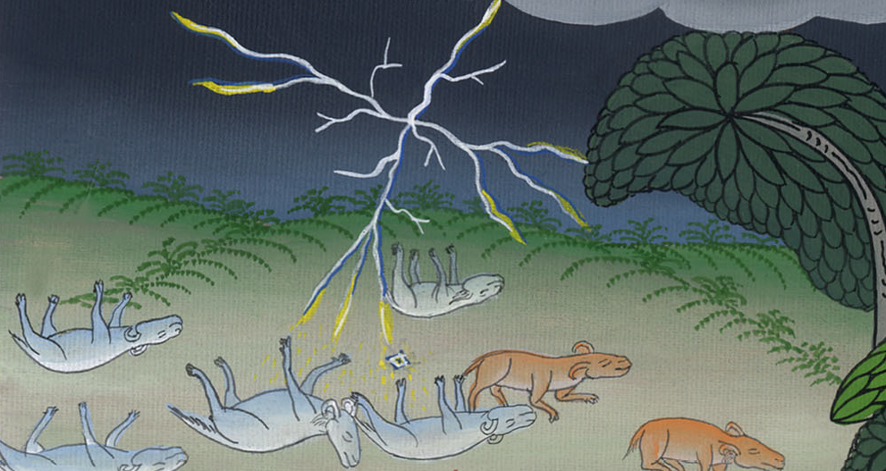
Job 1:16

Slide 11
17While he was still speaking, another also came and said, “The Chaldeans made three bands, and swept down on the camels, and have taken them away, yes, and killed the servants with the edge of the sword; and I alone have escaped to tell you.”
John

Slide 12
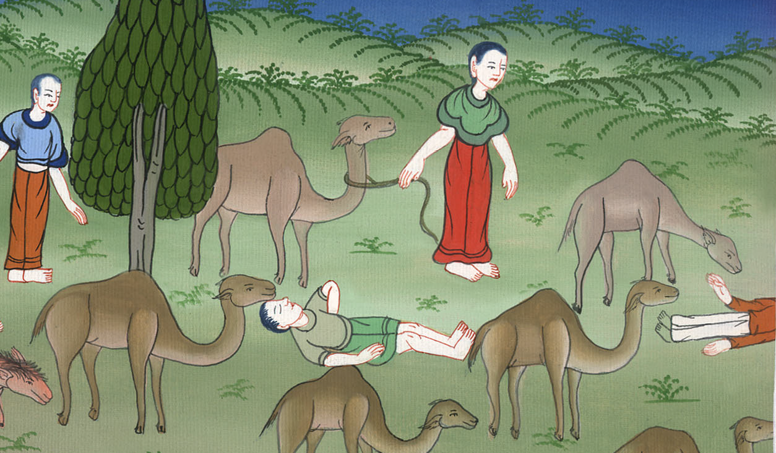
Job 1:17

Slide 13
18While he was still speaking, there came also another, and said, “Your sons and your daughters were eating and drinking wine in their oldest brother’s house, 19and behold, there came a great wind from the wilderness, and struck the four corners of the house, and it fell on the young men, and they are dead. I alone have escaped to tell you.”
John

Slide 14
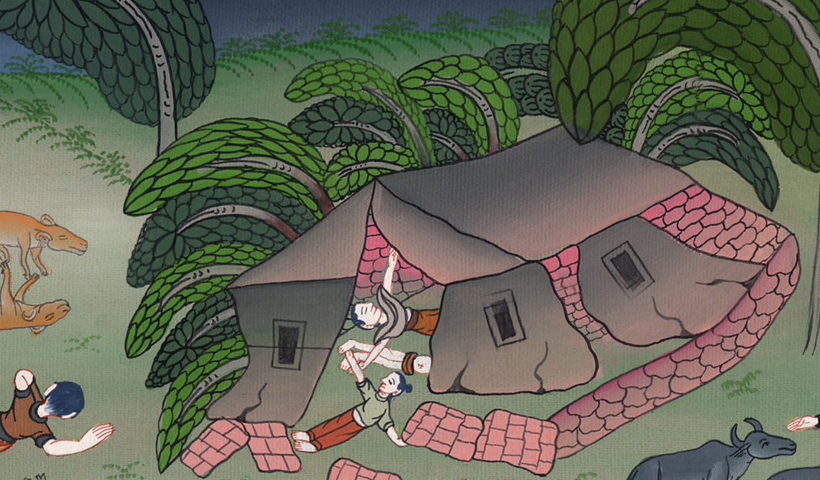
Job 1:18,19

Slide 15
20Then Job arose, and tore his robe, and shaved his head, and fell down on the ground, and worshiped.
John

Slide 16
Job 1:20

Slide 17
21He said, “Naked I came out of my mother’s womb, and naked will I return there. Yahweh gave, and Yahweh has taken away. Blessed be Yahweh’s name.”
John

Slide 18
Job 1:21

Slide 19
22In all this, Job didn’t sin, nor charge God with wrongdoing.
John

Slide 20
Job 1:22

