Slide 1
29-3
This work is licensed under a Creative Commons Attribution-ShareAlike 4.0 International License.
Please add this statement to all the videos you create.
English Bible quotes are from the World English Bible US, which is in the public domain.
Notes:
Ch
29 Job
1. Satan’s appearance before God – Job 1:1-12 (Top)
2. Satan’s first attack on Job – Job 1:13-22 (Below Top)
3. Satan’s second attack on Job – Job 2:1-10 (Right Center)
4. Friends come to council Job – Job 2:11 – 37:24 (Right Bottom)
5. God speaks to Job – Job 38:1 – 42:6 (Center)
6. Job prays for his three friends – Job 42:7-9 (Left Bottom)
7. Job is restored – Job 42:10-17 (Left Center)

Slide 2
Satan’s second attack on Job – Job 2:1-10

Slide 3
3. Satan’s second attack on Job – Job 2:1-10 (Right Center)

Slide 4
Satan’s second attack on Job – Job 2:1-10

Slide 5
Job2:1Again, on the day when God’s sons came to present themselves before Yahweh, Satan came also among them to present himself before Yahweh. 2Yahweh said to Satan, “Where have you come from?”
Satan answered Yahweh, and said, “From going back and forth in the earth, and from walking up and down in it.”

Slide 6
Job 2:1,2

Slide 7
3Yahweh said to Satan, “Have you considered my servant Job? For there is no one like him in the earth, a blameless and an upright man, one who fears God, and turns away from evil.

Slide 8
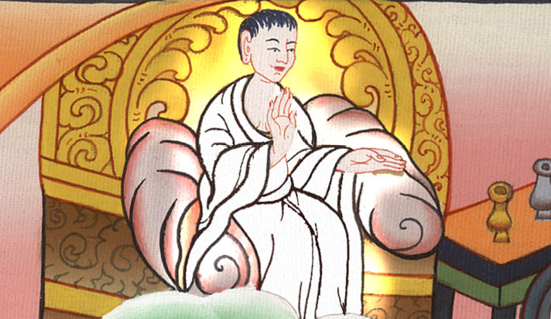
Job 2:3

Slide 9
He still maintains his integrity, although you incited me against him, to ruin him without cause.”

Slide 10
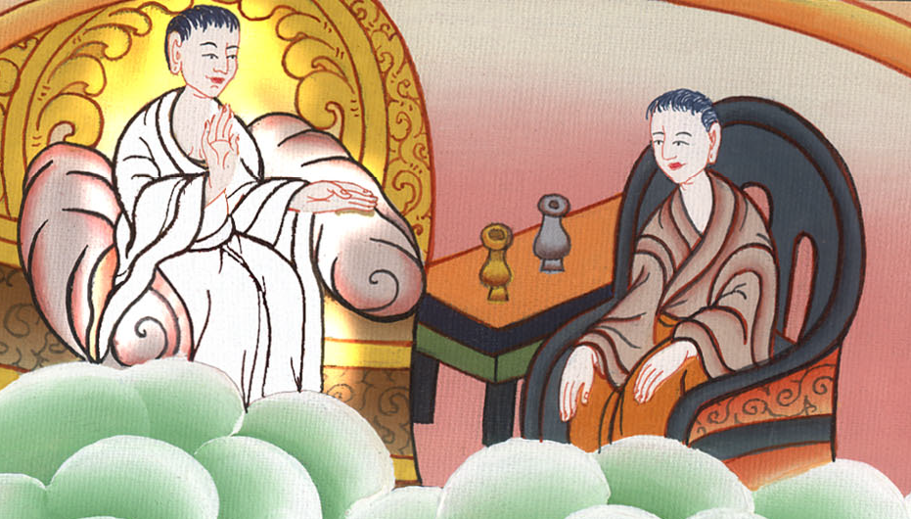
Job 2:3

Slide 11
4Satan answered Yahweh, and said, “Skin for skin. Yes, all that a man has he will give for his life.

Slide 12
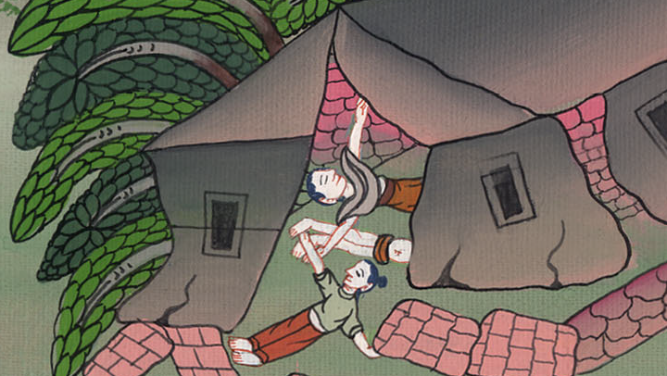
Job 2:4

Slide 13
5But stretch out your hand now, and touch his bone and his flesh, and he will renounce you to your face.”

Slide 14
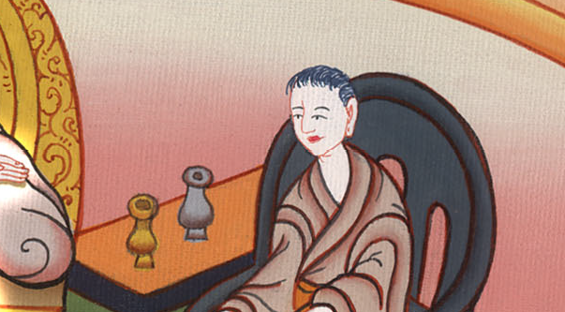
Job 2:5

Slide 15
6Yahweh said to Satan, “Behold, he is in your hand. Only spare his life.”

Slide 16
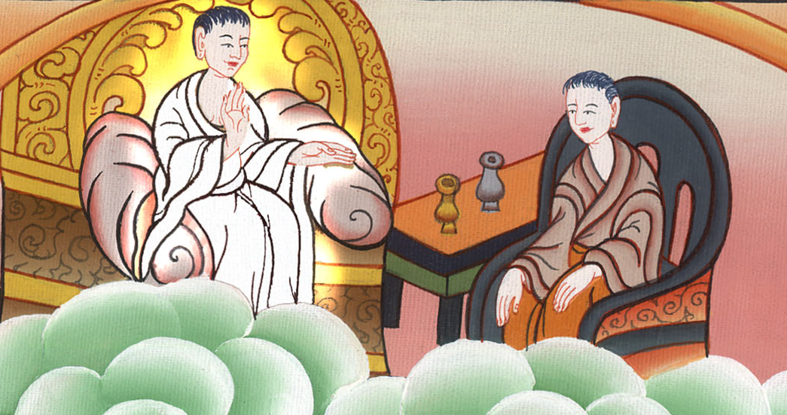
Job 2:6

Slide 17
7So Satan went out from the presence of Yahweh, and struck Job with painful sores from the sole of his foot to his head. 8He took for himself a potsherd to scrape himself with, and he sat among the ashes.

Slide 18
Job 2:7,8

Slide 19
9Then his wife said to him, “Do you still maintain your integrity? Renounce God, and die.

Slide 20
Job 2:9

Slide 21
10But he said to her, “You speak as one of the foolish women would speak. What? Shall we receive good at the hand of God, and shall we not receive evil?”

Slide 22
Job 2:10

Slide 23
In all this Job didn’t sin with his lips.

Slide 24
Job 2:10

