Slide 1
29-4
This work is licensed under a Creative Commons Attribution-ShareAlike 4.0 International License.
Please add this statement to all the videos you create.
English Bible quotes are from the World English Bible US, which is in the public domain.
Notes:
Ch
29 Job
1. Satan’s appearance before God – Job 1:1-12 (Top)
2. Satan’s first attack on Job – Job 1:13-22 (Below Top)
3. Satan’s second attack on Job – Job 2:1-10 (Right Center)
4. Friends come to council Job – Job 2:11 – 37:24 (Right Bottom)
5. God speaks to Job – Job 38:1 – 42:6 (Center)
6. Job prays for his three friends – Job 42:7-9 (Left Bottom)
7. Job is restored – Job 42:10-17 (Left Center)

Slide 2
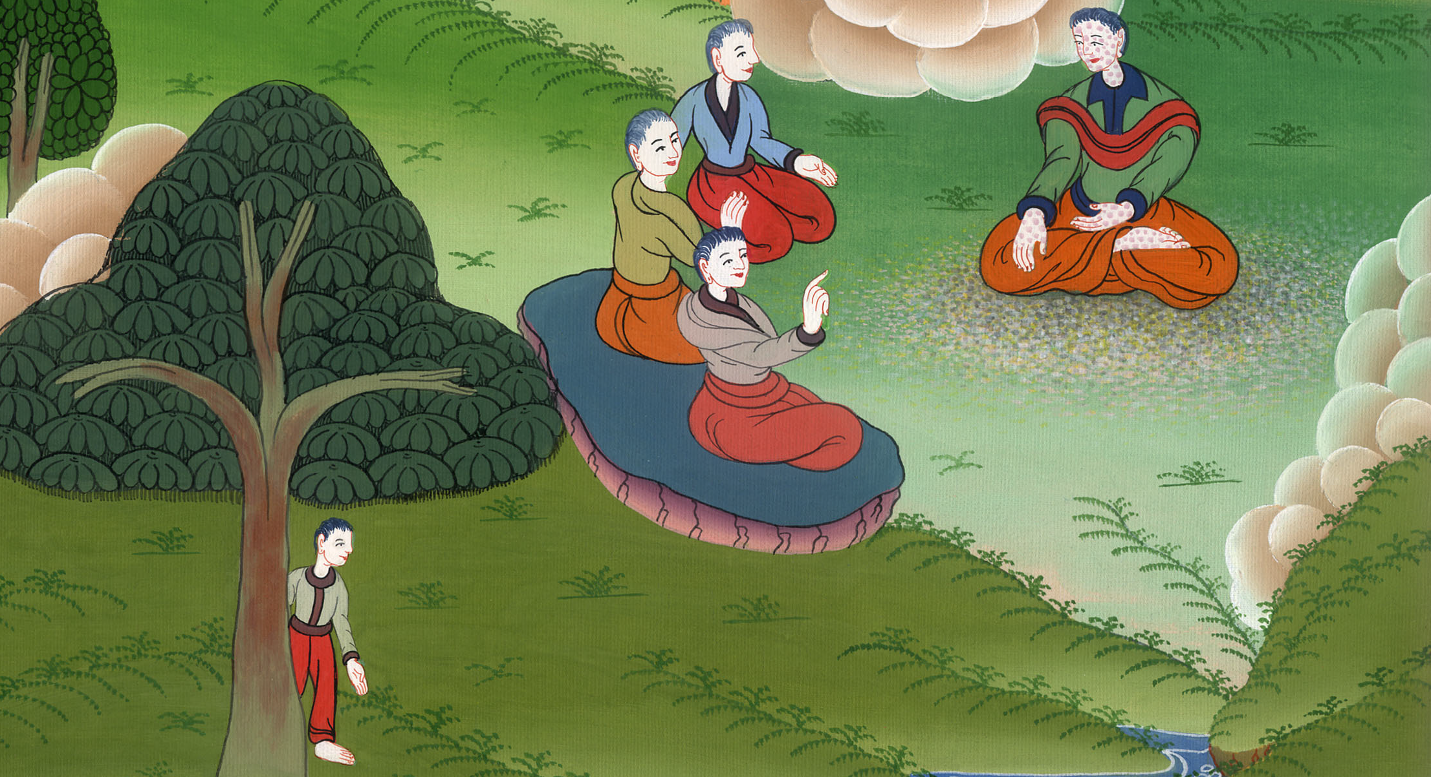
Friends come to counsel Job –
Job 2:11 – 37:24

Slide 3
4. Friends come to counsel Job – Job 2:11 – 37:24 (Right Bottom)
John

Slide 4
Friends come to counsel Job –
Job 2:11 – 37:24

Slide 5
Job2:11Now when Job’s three friends heard of all this evil that had come on him, they each came from his own place: Eliphaz the Temanite, Bildad the Shuhite, and Zophar the Naamathite; and they made an appointment together to come to sympathize with him and to comfort him.
John

Slide 6
Job 2:11

Slide 7
12When they lifted up their eyes from a distance, and didn’t recognize him, they raised their voices, and wept; and they each tore his robe, and sprinkled dust on their heads toward the sky. .
John

Slide 8
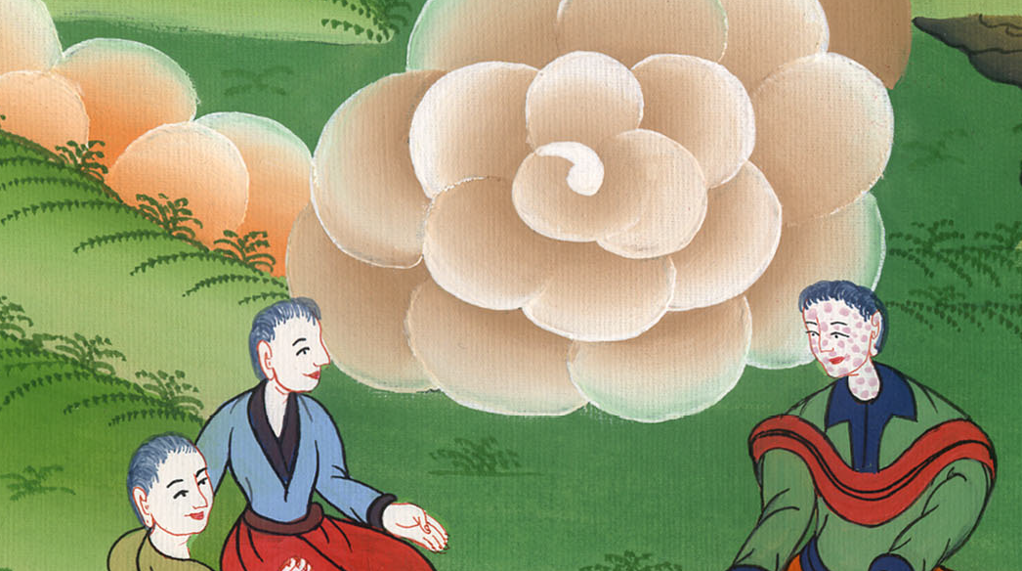
Job 2:12

Slide 9
13So they sat down with him on the ground seven days and seven nights, and no one spoke a word to him, for they saw that his grief was very great.
John

Slide 10
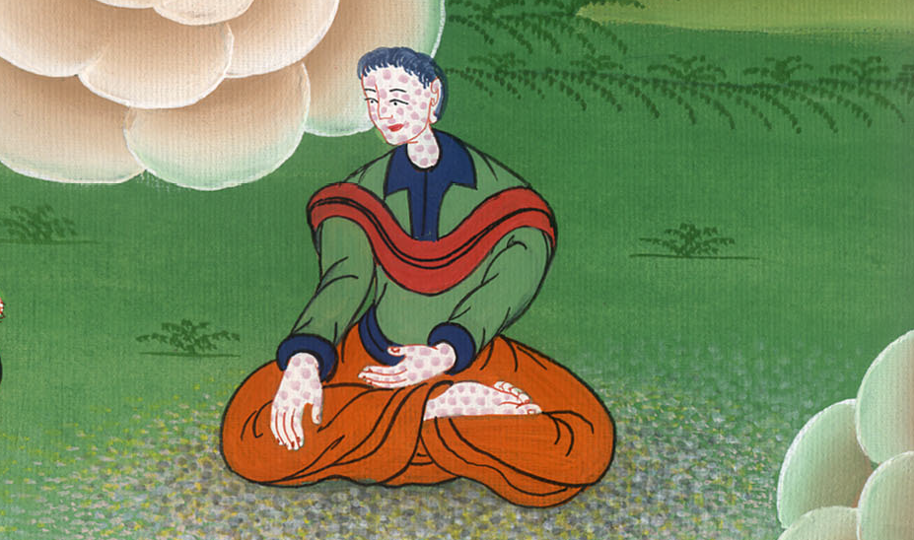
Job 2:13

Slide 11
3:1After this Job opened his mouth, and cursed the day of his birth. 2Job answered:
3“Let the day perish in which I was born,
the night which said, ‘There is a boy conceived.’
John

Slide 12
Job 3:1-3

Slide 13
23Why is light given to a man whose way is hidden,
whom God has hedged in?
24For my sighing comes before I eat.
My groanings are poured out like water.
John

Slide 14
Job 3:23,24

Slide 15
25For the thing which I fear comes on me,
that which I am afraid of comes to me.
26I am not at ease, neither am I quiet, neither do I have rest;
but trouble comes.”
John

Slide 16
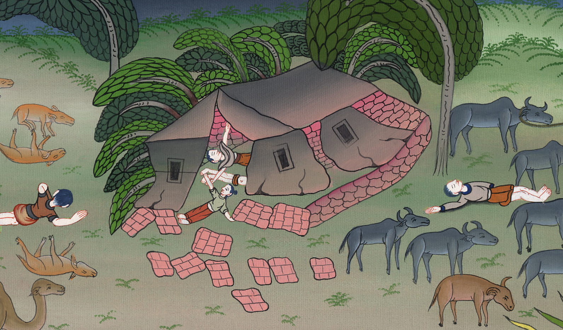
Job 3:25,26

Slide 17
1Then Eliphaz the Temanite answered,
2“If someone ventures to talk with you, will you be grieved?
But who can withhold himself from speaking?
John

Slide 18
Job 4:1,2

Slide 19
8According to what I have seen, those who plow iniquity
and sow trouble, reap the same.
9By the breath of God they perish.
By the blast of his anger are they consumed.
(God doesn’t punish innocent people, you must have done something wrong
For many days his friends tried to accuse him)
John

Slide 20
Job 4:8,9

Slide 21
(Job continues to insist that he has not done anything wrong)
5“If I have walked with falsehood,
and my foot has hurried to deceit
6(let me be weighed in an even balance,
that God may know my integrity);
John

Slide 22
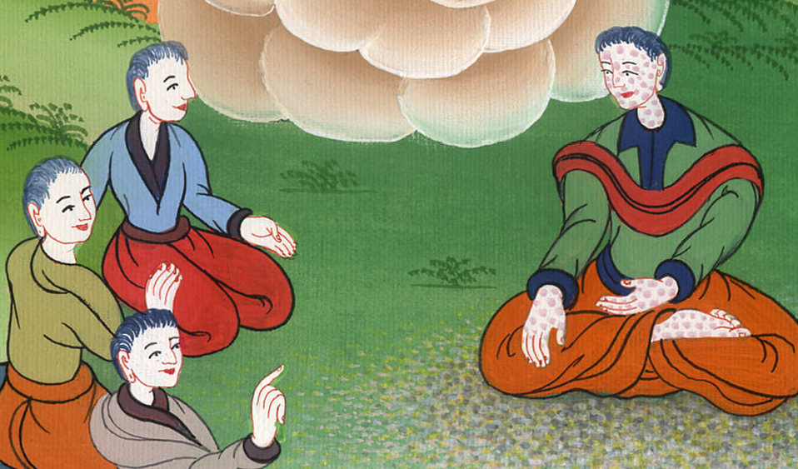
Job 31:5,6

Slide 23
34:31“For has any said to God,
‘I am guilty, but I will not offend any more.
32Teach me that which I don’t see.
If I have done iniquity, I will do it no more’?
John

Slide 24
Job 34:31,32

Slide 25
(His friends kept saying) 33Shall his recompense be as you desire, that you refuse it?
For you must choose, and not I.
Therefore speak what you know.
John

Slide 26
Job 34:33

