Slide 1
29-6
This work is licensed under a Creative Commons Attribution-ShareAlike 4.0 International License.
Please add this statement to all the videos you create.
English Bible quotes are from the World English Bible US, which is in the public domain.
Notes:
Ch
29 Job
1. Satan’s appearance before God – Job 1:1-12 (Top)
2. Satan’s first attack on Job – Job 1:13-22 (Below Top)
3. Satan’s second attack on Job – Job 2:1-10 (Right Center)
4. Friends come to council Job – Job 2:11 – 37:24 (Right Bottom)
5. God speaks to Job – Job 38:1 – 42:6 (Center)
6. Job prays for his three friends – Job 42:7-9 (Left Bottom)
7. Job is restored – Job 42:10-17 (Left Center)

Slide 2
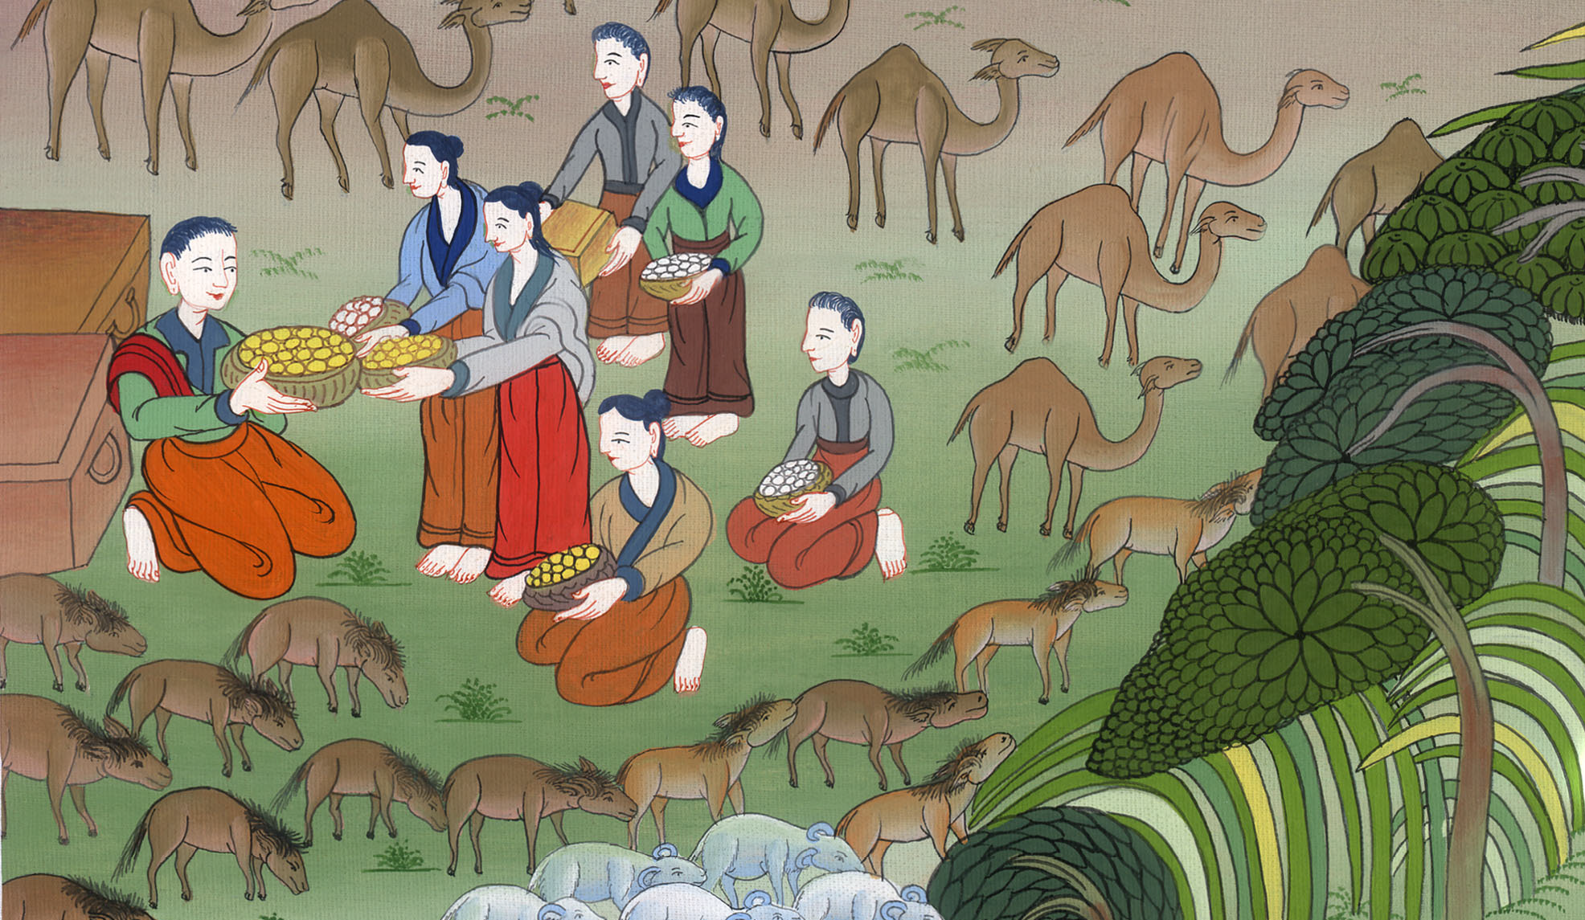
Job is restored – Job 42:7-17

Slide 3
6. Job is restored – Job 42:7-17 (Left Bottom)
John

Slide 4
Job is restored – Job 42:7-17

Slide 5
Job 42:7It was so, that after Yahweh had spoken these words to Job, Yahweh said to Eliphaz the Temanite, “My wrath is kindled against you, and against your two friends; for you have not spoken of me the thing that is right, as my servant Job has.
John

Slide 6
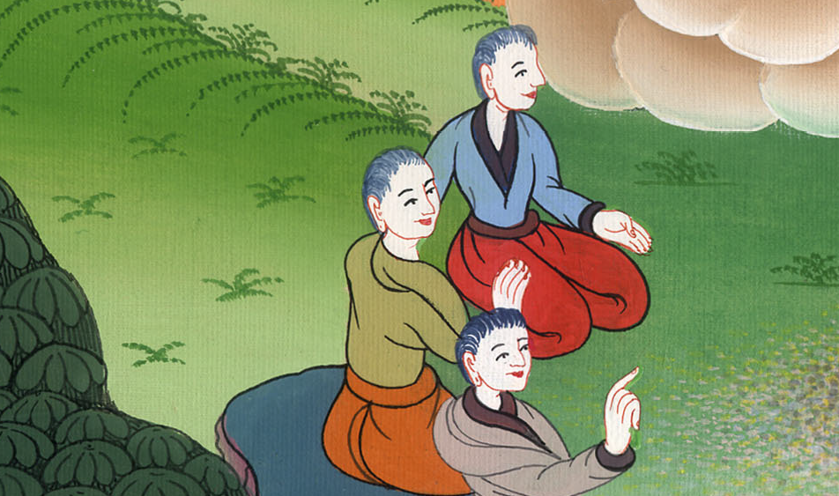
Job 42:7

Slide 7
8Now therefore, take to yourselves seven bulls and seven rams, and go to my servant Job, and offer up for yourselves a burnt offering; and my servant Job shall pray for you, for I will accept him, that I not deal with you according to your folly. For you have not spoken of me the thing that is right, as my servant Job has.”
John

Slide 8
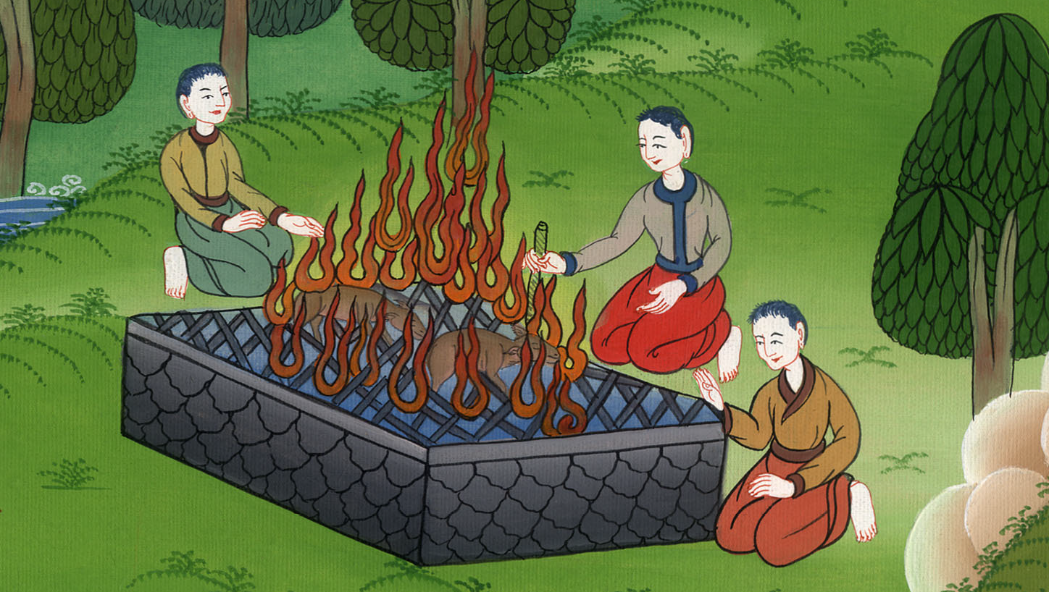
Job 42:8

Slide 9
9So Eliphaz the Temanite and Bildad the Shuhite and Zophar the Naamathite went and did what Yahweh commanded them, and Yahweh accepted Job.
John

Slide 10
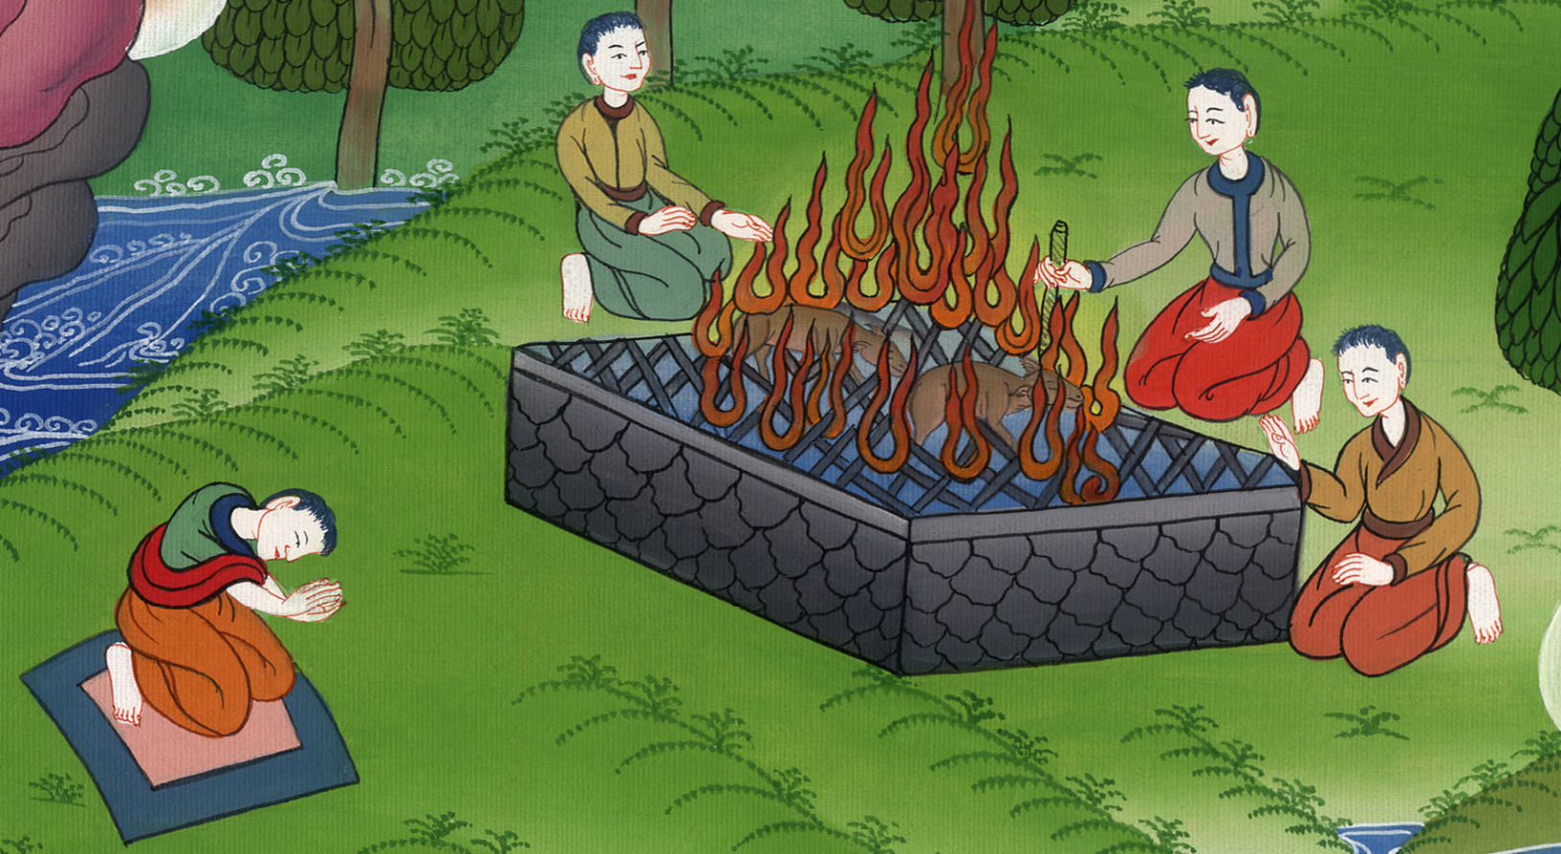
Job 42:9

Slide 11
10Yahweh restored Job’s prosperity when he prayed for his friends. Yahweh gave Job twice as much as he had before.
John

Slide 12
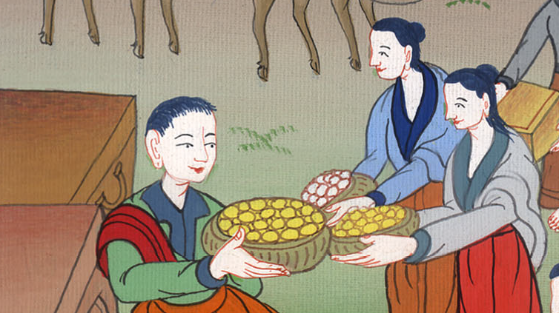
Job 42:10

Slide 13
11Then all his brothers, all his sisters, and all those who had been of his acquaintance before, came to him and ate bread with him in his house. They comforted him, and consoled him concerning all the evil that Yahweh had brought on him. Everyone also gave him a piece of money, and everyone a ring of gold.
John

Slide 14
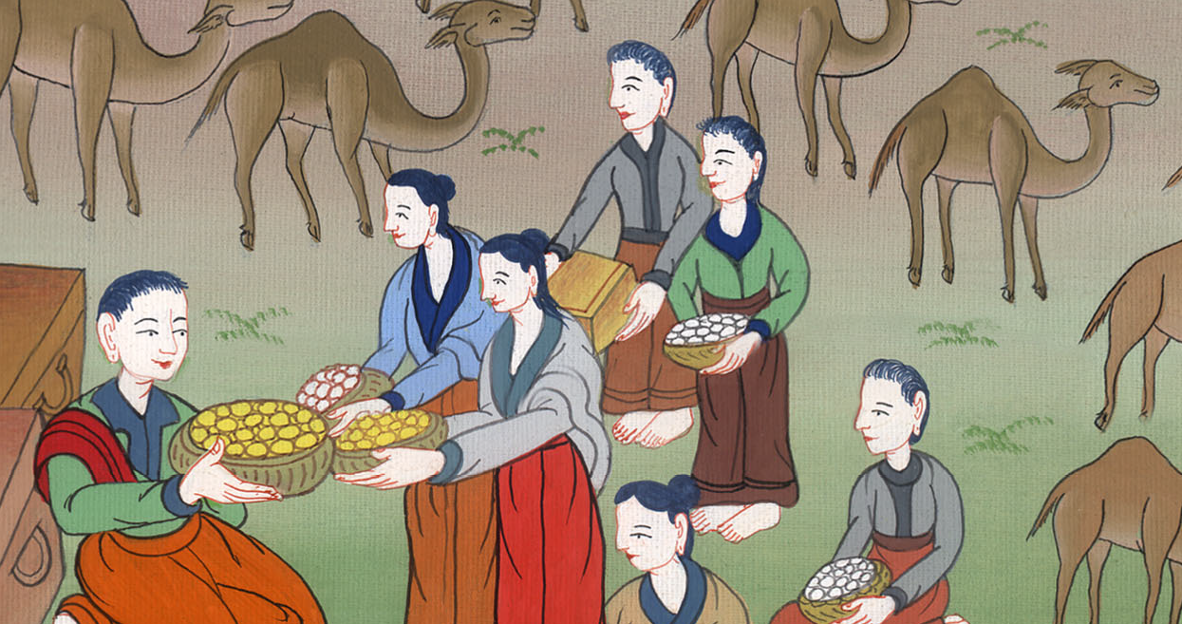
Job 42:11

Slide 15
12So Yahweh blessed the latter end of Job more than his beginning. He had fourteen thousand sheep, six thousand camels, one thousand yoke of oxen, and a thousand female donkeys. 13He had also seven sons and three daughters.
John

Slide 16
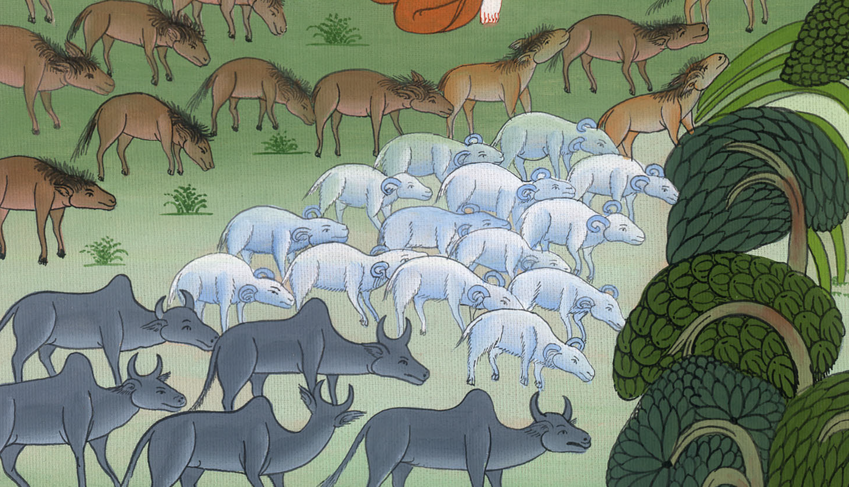
Job 42:12,13

Slide 17
15In all the land were no women found so beautiful as the daughters of Job. Their father gave them an inheritance among their brothers.
John

Slide 18
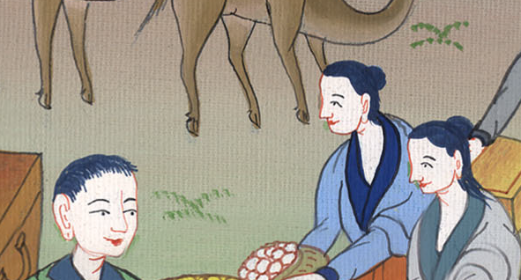
Job 42:15

Slide 19
16After this Job lived one hundred forty years, and saw his sons, and his sons’ sons, to four generations. 17So Job died, being old and full of days.
John

Slide 20
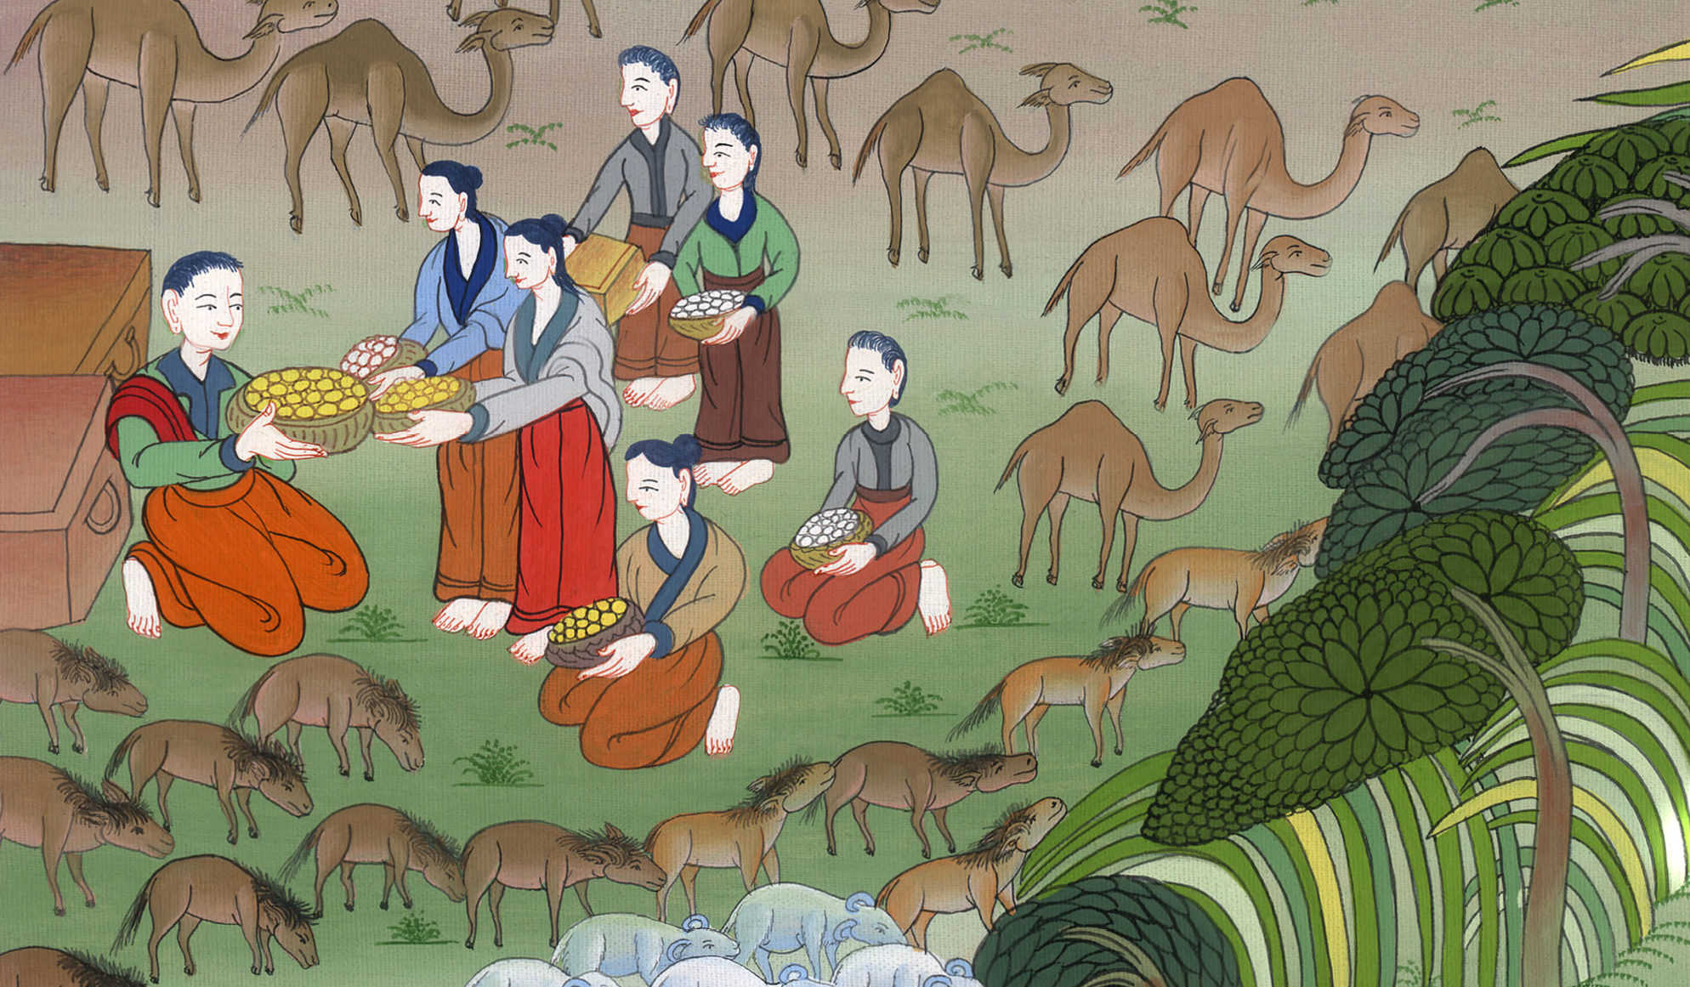
Job 42:16,17

