Slide 1
30-1
This work is licensed under a Creative Commons Attribution-ShareAlike 4.0 International License.
Please add this statement to all the videos you create.
English Bible quotes are from the World English Bible US, which is in the public domain.
Notes:
30 Jesus’ Birth
1. John the Baptist’s birth foretold - Luke 1:5-25 (Left Top)
2. The Birth of Jesus Foretold - Luke 1:26 – 38 (Right Top)
3. Mary visits Elizabeth - Luke 1:39-56 (Center Top)
4. Birth of John - Luke 1:57-80 (Right Bottom)
5. Joseph’s Dream - Matthew 1:18-25 (Center Bottom)
6. Birth of Jesus - Luke 2:1–7 (Center)
7. The Shepherds and the Angels - Luke 2:8–20 (Right Center)

Slide 2
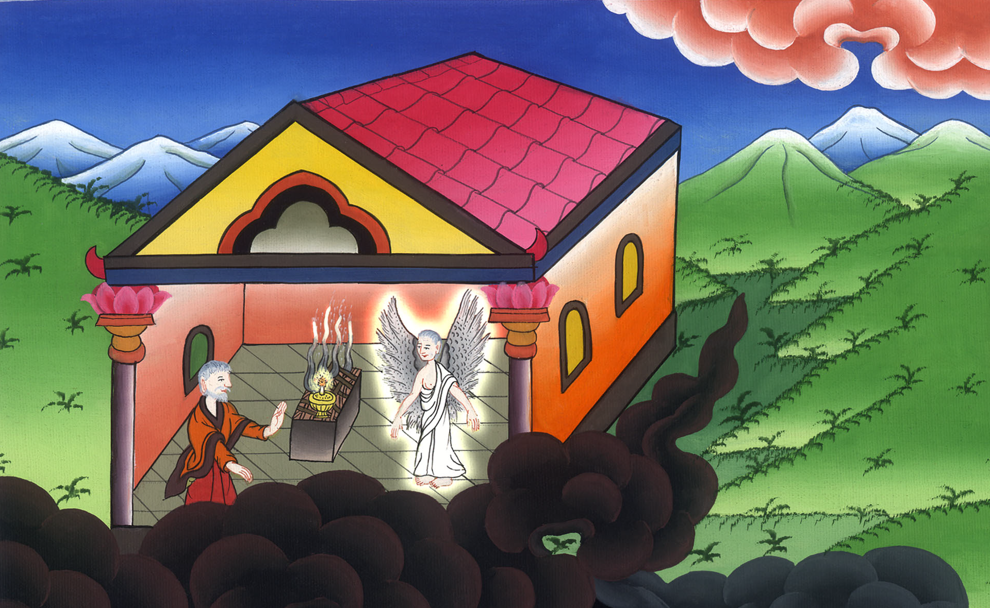
John the Baptist’s birth foretold –
Luke 1:5-25

Slide 3
30 Jesus’ Birth
1. John the Baptist’s birth foretold - Luke 1:5-25

Slide 4
John the Baptist’s birth foretold –
Luke 1:5-25

Slide 5
5There was in the days of Herod, the king of Judea, a certain priest named Zacharias, of the priestly division of Abijah. He had a wife of the daughters of Aaron, and her name was Elizabeth.

Slide 6
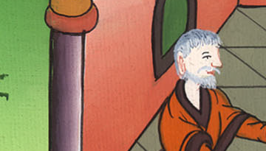
Luke 1:5

Slide 7
6They were both righteous before God, walking blamelessly in all the commandments and ordinances of the Lord. 7But they had no child, because Elizabeth was barren, and they both were well advanced in years.

Slide 8
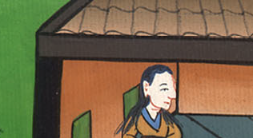
Luke 1:6,7

Slide 9
8Now while he executed the priest’s office before God in the order of his division 9according to the custom of the priest’s office, his lot was to enter into the temple of the Lord and burn incense.

Slide 10
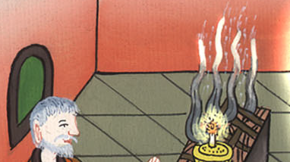
Luke 1:8,9

Slide 11
10The whole multitude of the people were praying outside at the hour of incense.

Slide 12
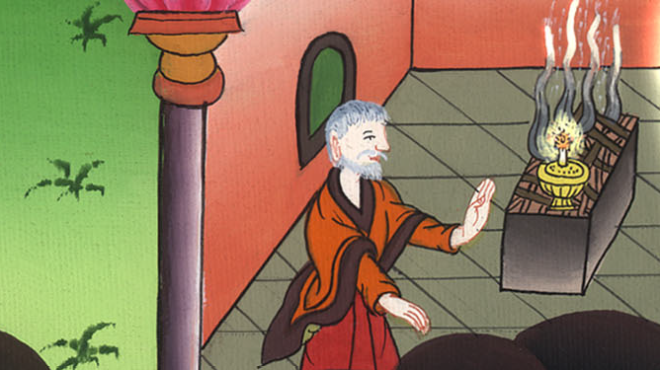
Luke 1:10

Slide 13
11An angel of the Lord appeared to him, standing on the right side of the altar of incense. 12Zacharias was troubled when he saw him, and fear fell upon him.
x

Slide 14
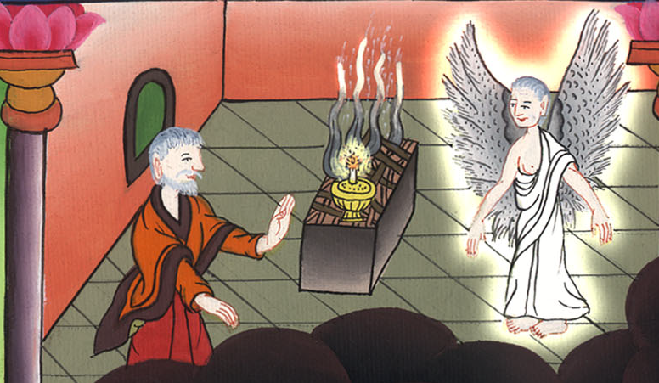
Luke 1:11,12

Slide 15
13But the angel said to him, “Don’t be afraid, Zacharias, because your request has been heard. Your wife, Elizabeth, will bear you a son, and you shall call his name John.

Slide 16
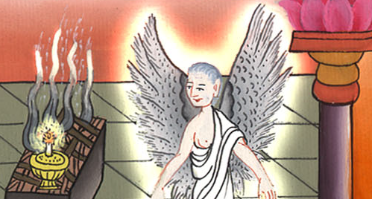
Luke 1:13

Slide 17
14You will have joy and gladness, and many will rejoice at his birth.

Slide 18
Luke 1:14

Slide 19
15For he will be great in the sight of the Lord, and he will drink no wine nor strong drink. He will be filled with the Holy Spirit, even from his mother’s womb. 16He will turn many of the children of Israel to the Lord their God.

Slide 20
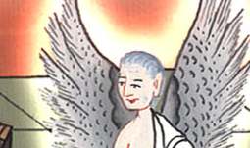
Luke 1:15,16

Slide 21
17He will go before him in the spirit and power of Elijah, ‘to turn the hearts of the fathers to the children,’ and the disobedient to the wisdom of the just; to prepare a people prepared for the Lord.”

Slide 22
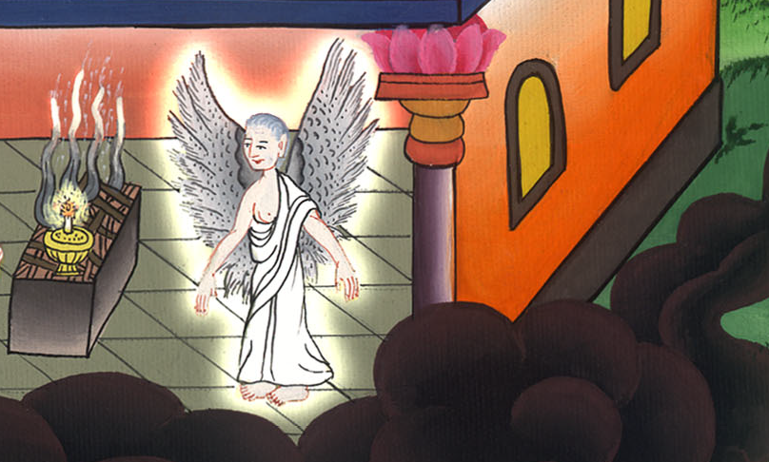
Luke 1:17

Slide 23
18Zacharias said to the angel, “How can I be sure of this? For I am an old man, and my wife is well advanced in years.”

Slide 24
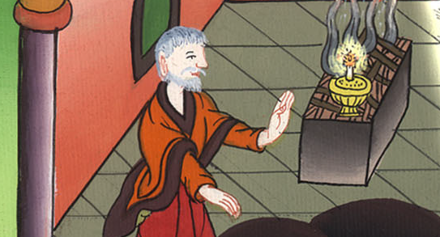
Luke 1:18

Slide 25
19The angel answered him, “I am Gabriel, who stands in the presence of God. I was sent to speak to you and to bring you this good news.

Slide 26
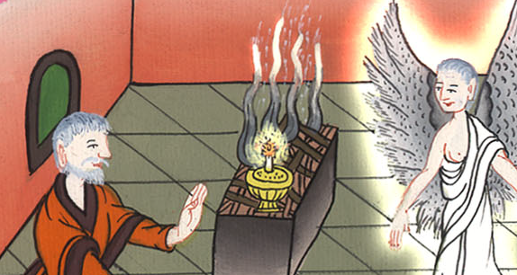
Luke 1:19

Slide 27
20Behold, you will be silent and not able to speak until the day that these things will happen, because you didn’t believe my words, which will be fulfilled in their proper time.”

Slide 28
Luke 1:20

Slide 29
21The people were waiting for Zacharias, and they marveled that he delayed in the temple.

Slide 30
Luke 1:21

Slide 31
22When he came out, he could not speak to them. They perceived that he had seen a vision in the temple. He continued making signs to them, and remained mute.

Slide 32
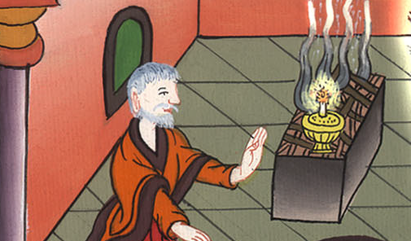
Luke 1:22

Slide 33
23When the days of his service were fulfilled, he departed to his house.

Slide 34
Luke 1:23

Slide 35
24After these days Elizabeth his wife conceived, and she hid herself five months, saying, 25“Thus has the Lord done to me in the days in which he looked at me, to take away my reproach among men.”

Slide 36
Luke 1:24,25

