Slide 1
30-2
This work is licensed under a Creative Commons Attribution-ShareAlike 4.0 International License.
Please add this statement to all the videos you create.
English Bible quotes are from the World English Bible US, which is in the public domain.
Notes:
30 Jesus’ Birth
1. John the Baptist’s birth foretold - Luke 1:5-25 (Left Top)
2. The Birth of Jesus Foretold - Luke 1:26 – 38 (Right Top)
3. Mary visits Elizabeth - Luke 1:39-56 (Center Top)
4. Birth of John - Luke 1:57-80 (Right Bottom)
5. Joseph’s Dream - Matthew 1:18-25 (Center Bottom)
6. The Trip to Bethlehem - Luke 2:1-5 (Left Bottom)
7. Birth of Jesus - Luke 2:6–7 (Center)
8. The Shepherds and the Angels - Luke 2:8–20 (Right Center)

Slide 2
The Birth of Jesus Foretold –
Luke 1:26 – 38

Slide 3
The Birth of Jesus Foretold –
Luke 1:26 – 38

Slide 4
Luke 1:
The Birth of Jesus Foretold –
Luke 1:26 – 38

Slide 5
26Now in the sixth month, the angel Gabriel was sent from God to a city of Galilee named Nazareth,

Slide 6
Luke 1:26

Slide 7
27to a virgin pledged to be married to a man whose name was Joseph, of David’s house. The virgin’s name was Mary.

Slide 8
Luke 1:27

Slide 9
28Having come in, the angel said to her, “Rejoice, you highly favored one! The Lord is with you. Blessed are you among women!”
29But when she saw him, she was greatly troubled at the saying, and considered what kind of salutation this might be.

Slide 10
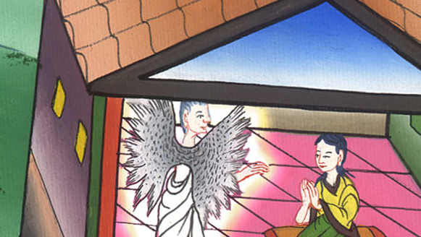
Luke 1:28,29

Slide 11
30The angel said to her, “Don’t be afraid, Mary, for you have found favor with God. 31Behold, you will conceive in your womb and give birth to a son, and shall name him ‘Jesus.’

Slide 12
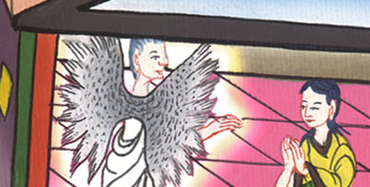
Luke 1:30,31

Slide 13
32He will be great and will be called the Son of the Most High. The Lord God will give him the throne of his father David,

Slide 14
Luke 1:32

Slide 15
33and he will reign over the house of Jacob forever. There will be no end to his Kingdom.”
34Mary said to the angel, “How can this be, seeing I am a virgin?”

Slide 16
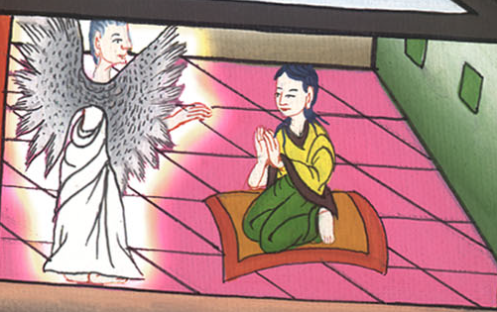
Luke 1:33,34

Slide 17
35The angel answered her, “The Holy Spirit will come on you, and the power of the Most High will overshadow you. Therefore also the holy one who is born from you will be called the Son of God.

Slide 18
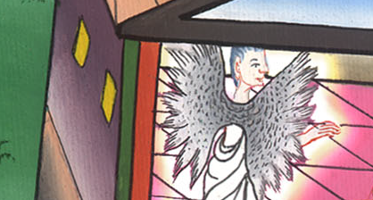
Luke 1:35

Slide 19
36Behold, Elizabeth your relative also has conceived a son in her old age; and this is the sixth month with her who was called barren. 37For nothing spoken by God is impossible.”

Slide 20
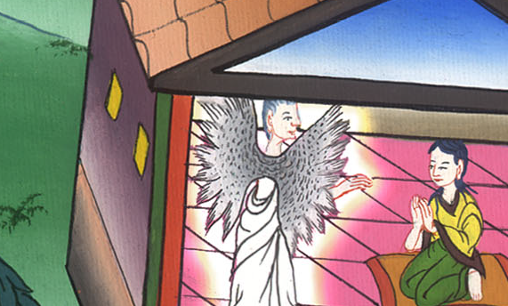
Luke 1:36,37

Slide 21
38Mary said, “Behold, the servant of the Lord; let it be done to me according to your word.”
Then the angel departed from her.

Slide 22
Luke 1:38

