Slide 1
30-3
This work is licensed under a Creative Commons Attribution-ShareAlike 4.0 International License.
Please add this statement to all the videos you create.
English Bible quotes are from the World English Bible US, which is in the public domain.
Notes:
30 Jesus’ Birth
1. John the Baptist’s birth foretold - Luke 1:5-25 (Left Top)
2. The Birth of Jesus Foretold - Luke 1:26 – 38 (Right Top)
3. Mary visits Elizabeth - Luke 1:39-56 (Center Top)
4. Birth of John - Luke 1:57-80 (Right Bottom)
5. Joseph’s Dream - Matthew 1:18-25 (Center Bottom)
6. The Trip to Bethlehem - Luke 2:1-5 (Left Bottom)
7. Birth of Jesus - Luke 2:6–7 (Center)
8. The Shepherds and the Angels - Luke 2:8–20 (Right Center)

Slide 2
Mary visits Elizabeth –Luke 1:39-56

Slide 3
Mary visits Elizabeth –
Luke 1:39-56

Slide 4
Mary visits Elizabeth –Luke 1:39-56

Slide 5
39Mary arose in those days and went into the hill country with haste, into a city of Judah, 40and entered into the house of Zacharias and greeted Elizabeth.

Slide 6
Luke 1:39,40

Slide 7
41When Elizabeth heard Mary’s greeting, the baby leaped in her womb; and Elizabeth was filled with the Holy Spirit.

Slide 8
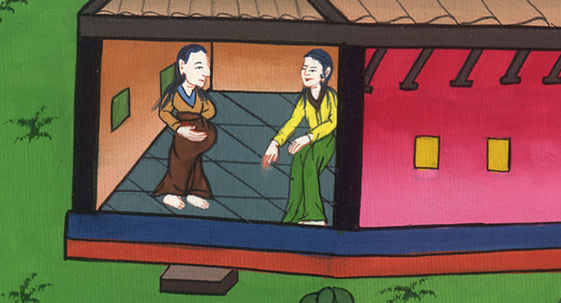
Luke 1:41

Slide 9
42She called out with a loud voice and said, “Blessed are you among women, and blessed is the fruit of your womb!

Slide 10
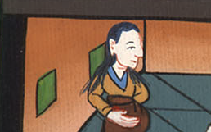
Luke 1:42

Slide 11
43Why am I so favored, that the mother of my Lord should come to me? 44For behold, when the voice of your greeting came into my ears, the baby leaped in my womb for joy!

Slide 12
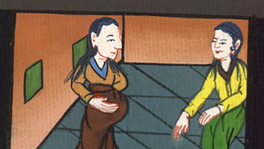
Luke 1:43,44

Slide 13
45Blessed is she who believed, for there will be a fulfillment of the things which have been spoken to her from the Lord!”

Slide 14
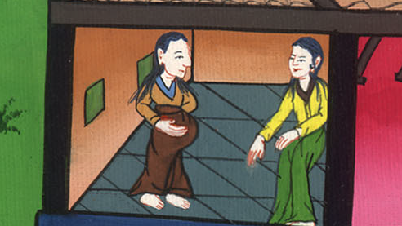
Luke 1:45

Slide 15
46Mary said,
“My soul magnifies the Lord.
47My spirit has rejoiced in God my Savior,

Slide 16
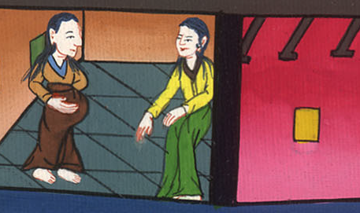
Luke 1:46,47

Slide 17
48for he has looked at the humble state of his servant.
For behold, from now on, all generations will call me blessed.

Slide 18
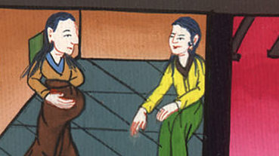
Luke 1:48

Slide 19
49For he who is mighty has done great things for me.
Holy is his name.
50His mercy is for generations and generations on those who fear him.

Slide 20
Luke 1:49,50

Slide 21
51He has shown strength with his arm.
He has scattered the proud in the imagination of their hearts.
52He has put down princes from their thrones,
and has exalted the lowly.

Slide 22
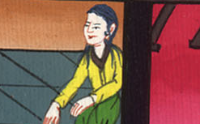
Luke 1:51,52

Slide 23
53He has filled the hungry with good things.
He has sent the rich away empty.

Slide 24
Luke 1:53

Slide 25
54He has given help to Israel, his servant, that he might remember mercy,
55as he spoke to our fathers,
to Abraham and his offspring forever.”

Slide 26
Luke 1:54,55

Slide 27
56Mary stayed with her about three months, and then returned to her house.

Slide 28
Luke 1:56

