Slide 1
30-4
This work is licensed under a Creative Commons Attribution-ShareAlike 4.0 International License.
Please add this statement to all the videos you create.
English Bible quotes are from the World English Bible US, which is in the public domain.
Notes:
30 Jesus’ Birth
1. John the Baptist’s birth foretold - Luke 1:5-25 (Left Top)
2. The Birth of Jesus Foretold - Luke 1:26 – 38 (Right Top)
3. Mary visits Elizabeth - Luke 1:39-56 (Center Top)
4. Birth of John - Luke 1:57-80 (Right Bottom)
5. Joseph’s Dream - Matthew 1:18-25 (Center Bottom)
6. The Trip to Bethlehem - Luke 2:1-5 (Left Bottom)
7. Birth of Jesus - Luke 2:6–7 (Center)
8. The Shepherds and the Angels - Luke 2:8–20 (Right Center)

Slide 2
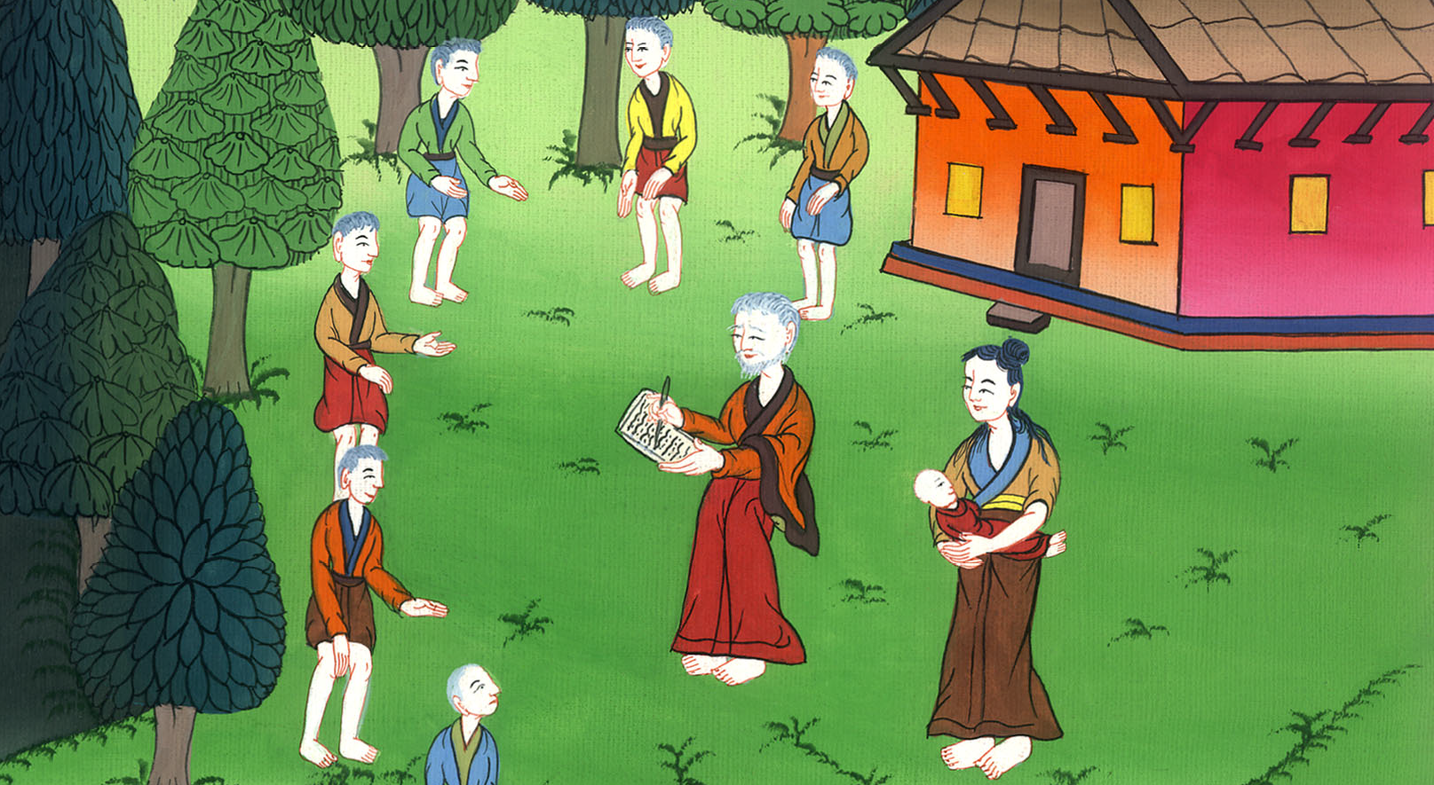
Birth of John –
Luke 1:57-80

Slide 3
Birth of John –
Luke 1:57-80

Slide 4
Birth of John –
Luke 1:57-80

Slide 5
57Now the time that Elizabeth should give birth was fulfilled, and she gave birth to a son. 58Her neighbors and her relatives heard that the Lord had magnified his mercy toward her, and they rejoiced with her.

Slide 6
Luke 1:57,58

Slide 7
59On the eighth day, they came to circumcise the child; and they would have called him Zacharias, after the name of his father.

Slide 8
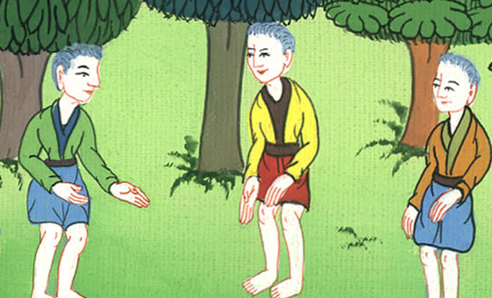
Luke 1:59

Slide 9
60His mother answered, “Not so; but he will be called John.”
61They said to her, “There is no one among your relatives who is called by this name.”

Slide 10
Luke 1:60,61

Slide 11
62They made signs to his father, what he would have him called.
63He asked for a writing tablet, and wrote, “His name is John.”
They all marveled.

Slide 12
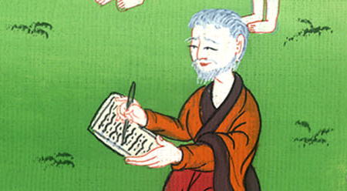
Luke 1:62,63

Slide 13
64His mouth was opened immediately and his tongue freed, and he spoke, blessing God. 65Fear came on all who lived around them, and all these sayings were talked about throughout all the hill country of Judea.

Slide 14
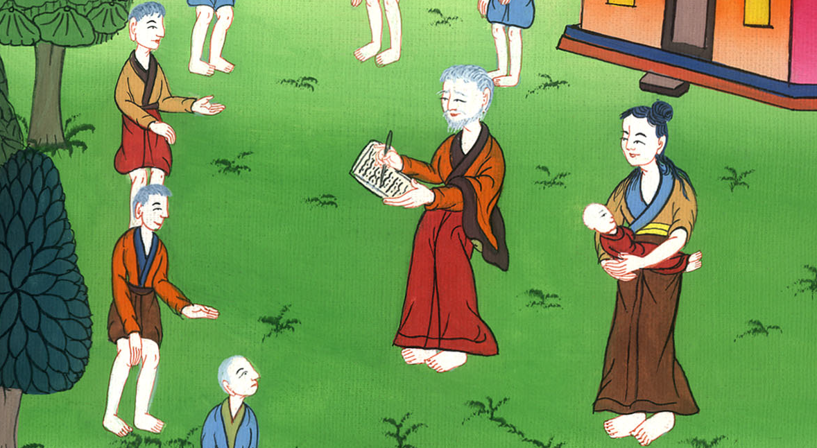
Luke 1:64,65

Slide 15
66All who heard them laid them up in their heart, saying, “What then will this child be?” The hand of the Lord was with him.

Slide 16
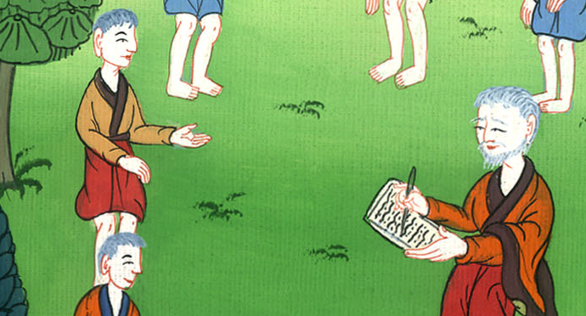
Luke 1:66

Slide 17
67His father Zacharias was filled with the Holy Spirit, and prophesied, saying,

Slide 18
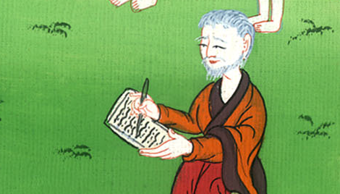
Luke 1:67

Slide 19
68“Blessed be the Lord, the God of Israel,
for he has visited and redeemed his people;
69and has raised up a horn of salvation for us in the house of his servant David

Slide 20
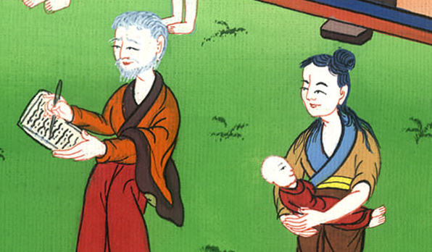
Luke 1:68,69

Slide 21
70(as he spoke by the mouth of his holy prophets who have been from of old),
71salvation from our enemies and from the hand of all who hate us;
72to show mercy toward our fathers,
to remember his holy covenant,

Slide 22
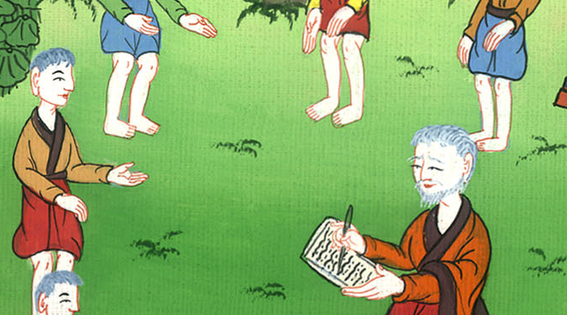
Luke 1:70-72

Slide 23
73the oath which he swore to Abraham our father,
74to grant to us that we, being delivered out of the hand of our enemies,
should serve him without fear,
75in holiness and righteousness before him all the days of our life.

Slide 24
Luke 1:73-75

Slide 25
76And you, child, will be called a prophet of the Most High;
for you will go before the face of the Lord to prepare his ways,
77to give knowledge of salvation to his people by the remission of their sins,

Slide 26
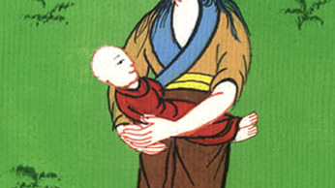
Luke 1:76,77

Slide 27
78because of the tender mercy of our God,
by which the dawn from on high will visit us,
79to shine on those who sit in darkness and the shadow of death; to guide our feet into the way of peace.”

Slide 28
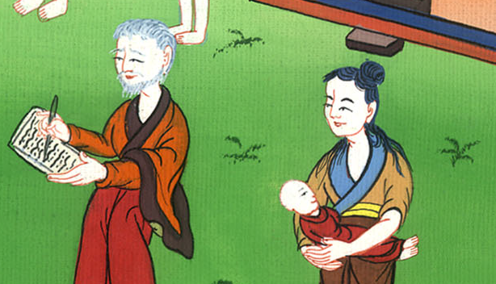
Luke 1:78,79

Slide 29
80The child was growing and becoming strong in spirit, and was in the desert until the day of his public appearance to Israel.

Slide 30
Luke 1:80

