Slide 1
30-5
This work is licensed under a Creative Commons Attribution-ShareAlike 4.0 International License.
Please add this statement to all the videos you create.
English Bible quotes are from the World English Bible US, which is in the public domain.
Notes:
30 Jesus’ Birth
1. John the Baptist’s birth foretold - Luke 1:5-25 (Left Top)
2. The Birth of Jesus Foretold - Luke 1:26 – 38 (Right Top)
3. Mary visits Elizabeth - Luke 1:39-56 (Center Top)
4. Birth of John - Luke 1:57-80 (Right Bottom)
5. Joseph’s Dream - Matthew 1:18-25 (Center Bottom)
6. The Trip to Bethlehem - Luke 2:1-5 (Left Bottom)
7. Birth of Jesus - Luke 2:6–7 (Center)
8. The Shepherds and the Angels - Luke 2:8–20 (Right Center)

Slide 2
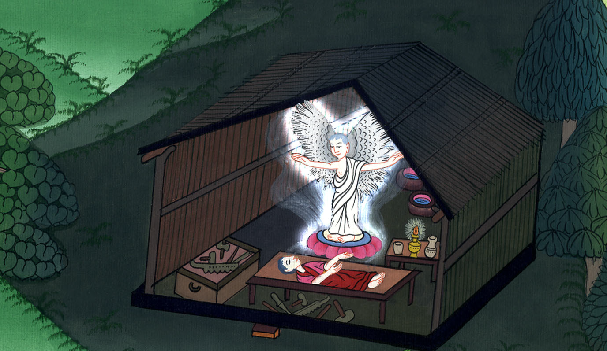
Joseph’s Dream - Matthew 1:18-25

Slide 3
Joseph’s Dream - Matthew 1:18-25

Slide 4
Joseph’s Dream - Matthew 1:18-25

Slide 5
18Now the birth of Jesus Christ was like this: After his mother, Mary, was engaged to Joseph, before they came together, she was found pregnant by the Holy Spirit.

Slide 6
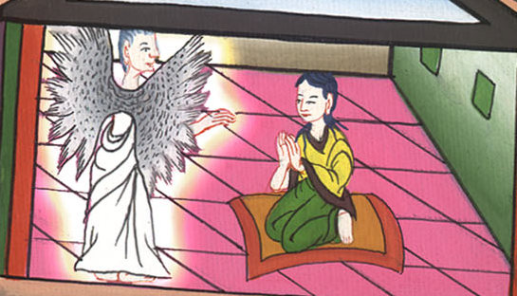
Matthew 1:18

Slide 7
19Joseph, her husband, being a righteous man, and not willing to make her a public example, intended to put her away secretly.

Slide 8
Matthew 1:19

Slide 9
20But when he thought about these things, behold, an angel of the Lord appeared to him in a dream, saying, “Joseph, son of David, don’t be afraid to take to yourself Mary as your wife, for that which is conceived in her is of the Holy Spirit.

Slide 10
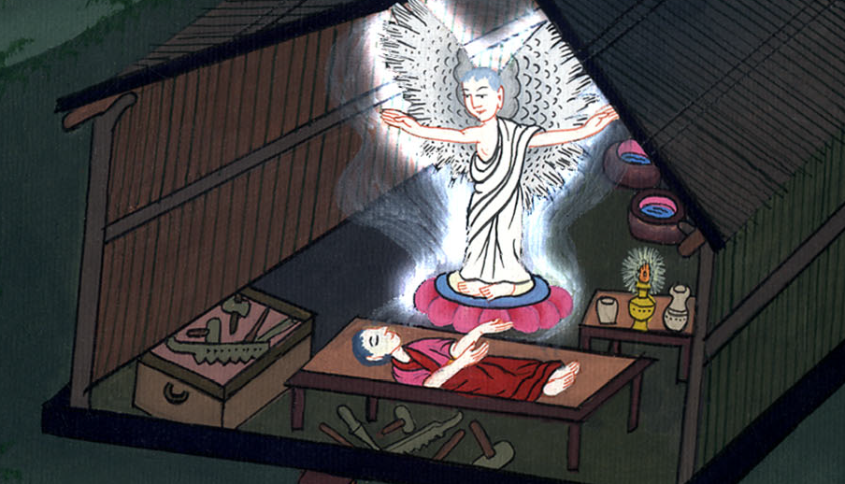
Matthew 1:20

Slide 11
21She shall give birth to a son. You shall name him Jesus, for it is he who shall save his people from their sins.”

Slide 12
Matthew 1:21

Slide 13
22Now all this has happened that it might be fulfilled which was spoken by the Lord through the prophet, saying,

Slide 14
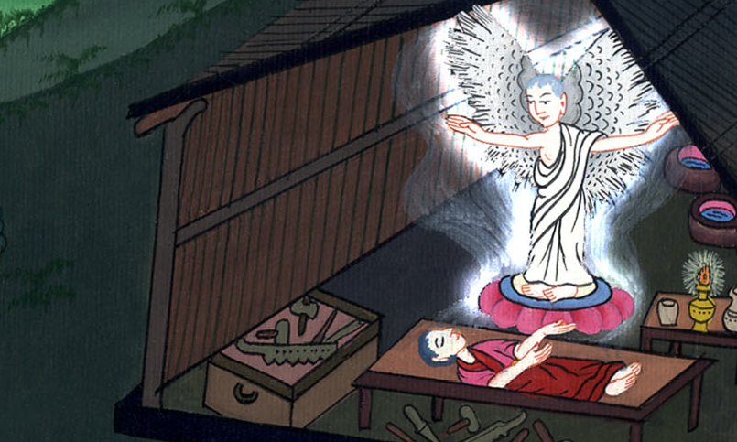
Matthew 1:22

Slide 15
23“Behold, the virgin shall be with child,
and shall give birth to a son.
They shall call his name Immanuel,”
which is, being interpreted, “God with us.”

Slide 16
Matthew 1:23

Slide 17
24Joseph arose from his sleep, and did as the angel of the Lord commanded him, and took his wife to himself;

Slide 18
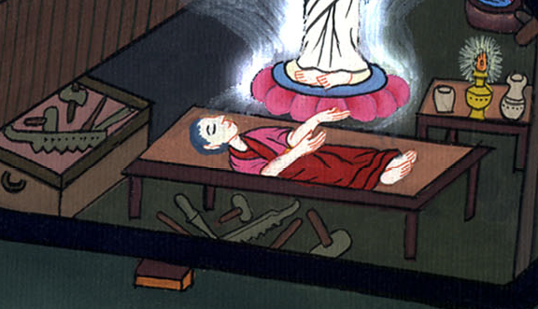
Matthew 1:24

Slide 19
25and didn’t know her sexually until she had given birth to her firstborn son. He named him Jesus.

Slide 20
Matthew 1:25

