Slide 1
30-6
This work is licensed under a Creative Commons Attribution-ShareAlike
4.0 International License.
Please add this statement to all the videos you create.
English Bible quotes are from the World English Bible US, which is in the public domain.
Notes:
Ch
30 Jesus’ Birth
1. John the Baptist’s birth foretold - Luke 1:5-25 (Left Top)
2. The Birth of Jesus Foretold - Luke 1:26 – 38 (Right Top)
3. Mary visits Elizabeth - Luke 1:39-56 (Center Top)
4. Birth of John - Luke 1:57-80 (Right Bottom)
5. Joseph’s Dream - Matthew 1:18-25 (Center Bottom)
6. The Trip to Bethlehem - Luke 2:1-5 (Left Bottom)
7. Birth of Jesus - Luke 2:6–7 (Center)
8. The Shepherds and the Angels - Luke 2:8–20 (Right Center)

Slide 2
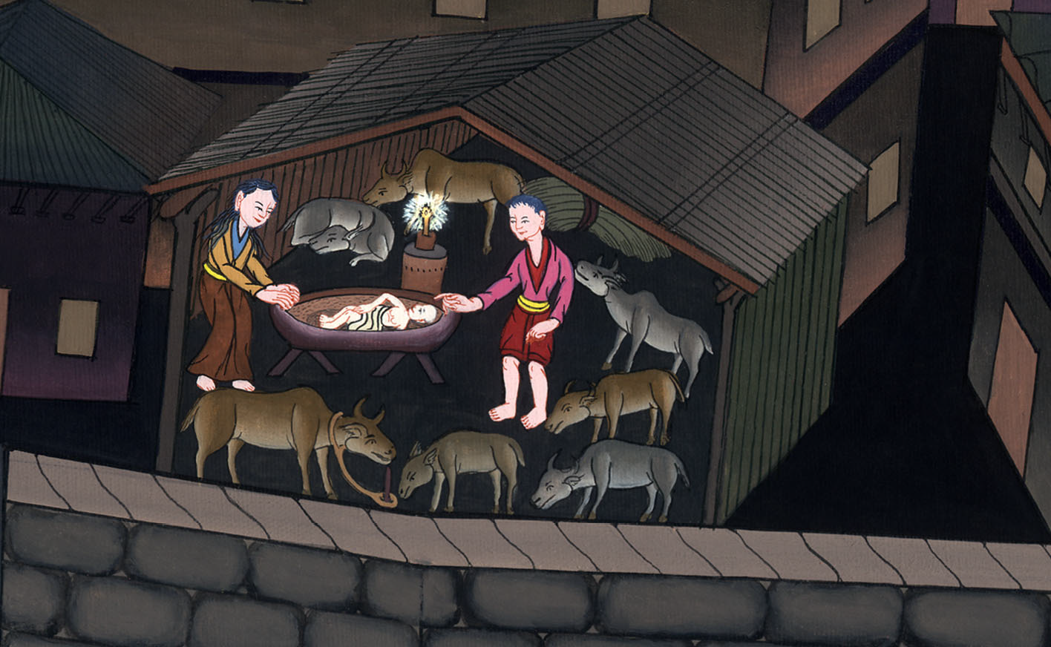
Birth of Jesus - Luke 2:1–7

Slide 3
Birth of Jesus - Luke 2:1–7

Slide 4
Birth of Jesus - Luke 2:1–7

Slide 5
1Now in those days, a decree went out from Caesar Augustus that all the world should be enrolled.

Slide 6
Luke 2:1

Slide 7
3All went to enroll themselves, everyone to his own city. 4Joseph also went up from Galilee, out of the city of Nazareth, into Judea, to David’s city, which is called Bethlehem, because he was of the house and family of David,

Slide 8
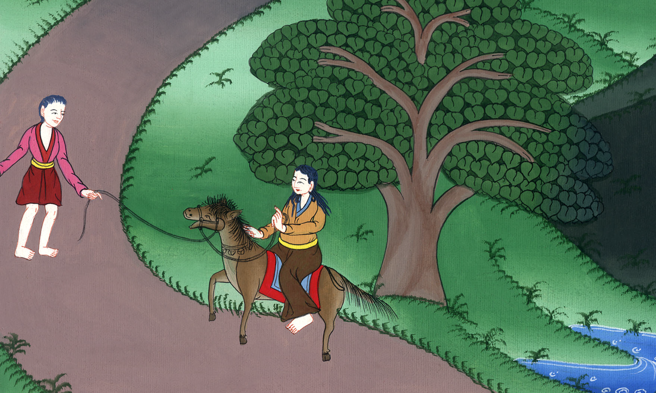
Luke 2:3,4

Slide 9
5to enroll himself with Mary, who was pledged to be married to him as wife, being pregnant.

Slide 10
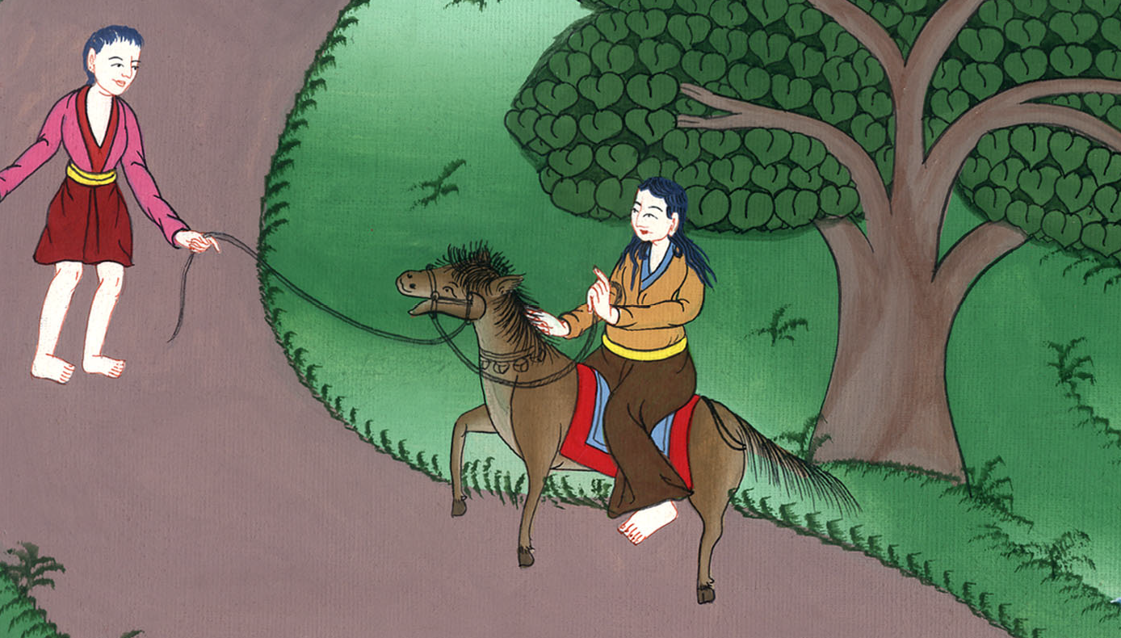
Luke 2:5

Slide 11
6While they were there, the day had come for her to give birth.

Slide 12
Luke 2:6

Slide 13
7She gave birth to her firstborn son. She wrapped him in bands of cloth and laid him in a feeding trough, because there was no room for them in the inn.

Slide 14
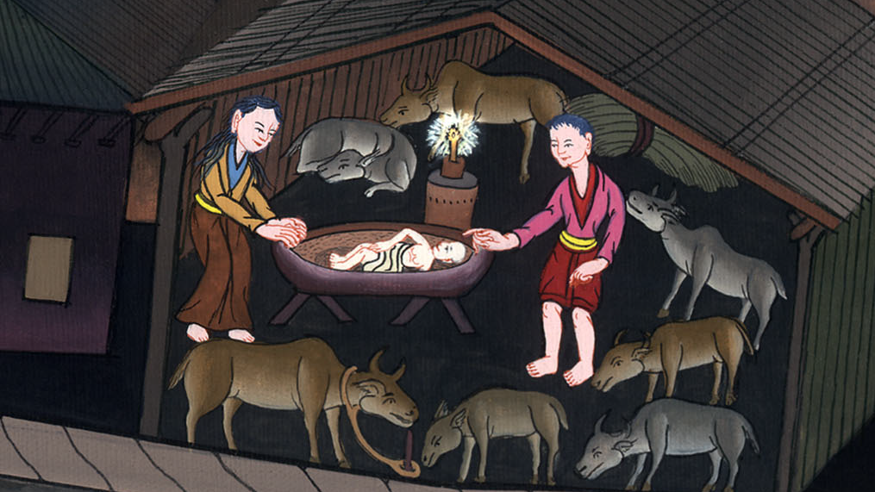
Luke 2:7

Slide 15
8There were shepherds in the same country staying in the field, and keeping watch by night over their flock.

Slide 16
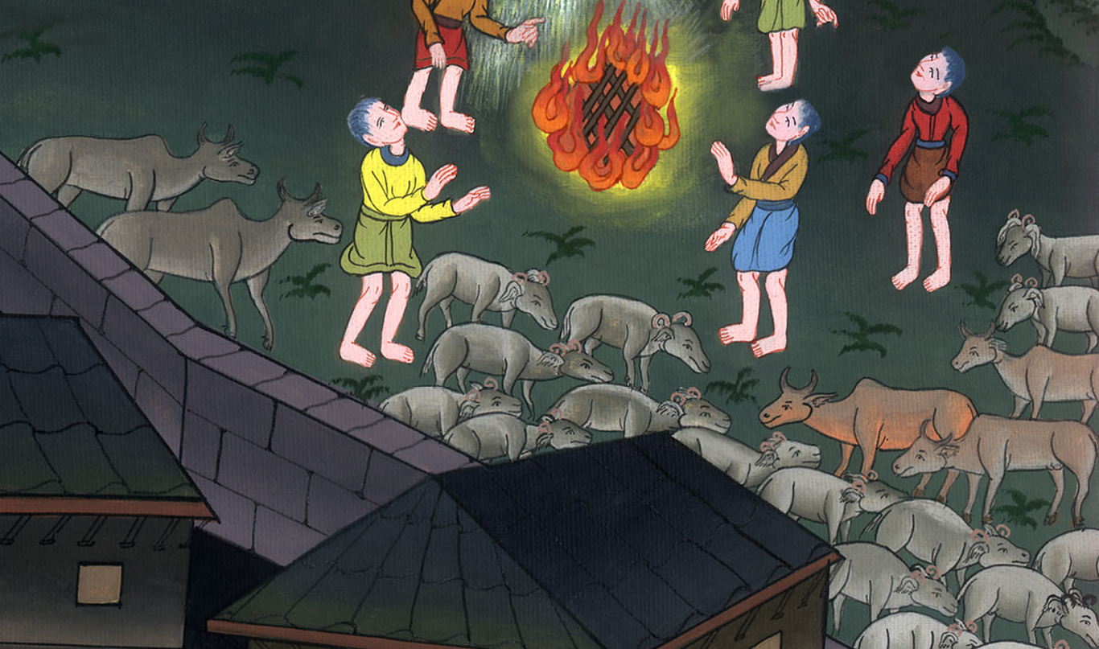
Luke 2:8

Slide 17
9Behold, an angel of the Lord stood by them, and the glory of the Lord shone around them, and they were terrified.

Slide 18
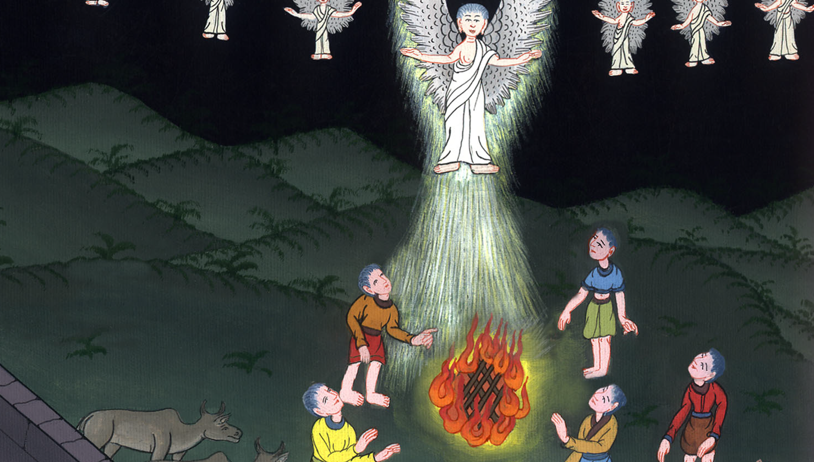
Luke 2:9

Slide 19
10The angel said to them, “Don’t be afraid, for behold, I bring you good news of great joy which will be to all the people. 11For there is born to you today, in David’s city, a Savior, who is Christ the Lord.

Slide 20
Luke 2:10,11

Slide 21
12This is the sign to you: you will find a baby wrapped in strips of cloth, lying in a feeding trough.”

Slide 22
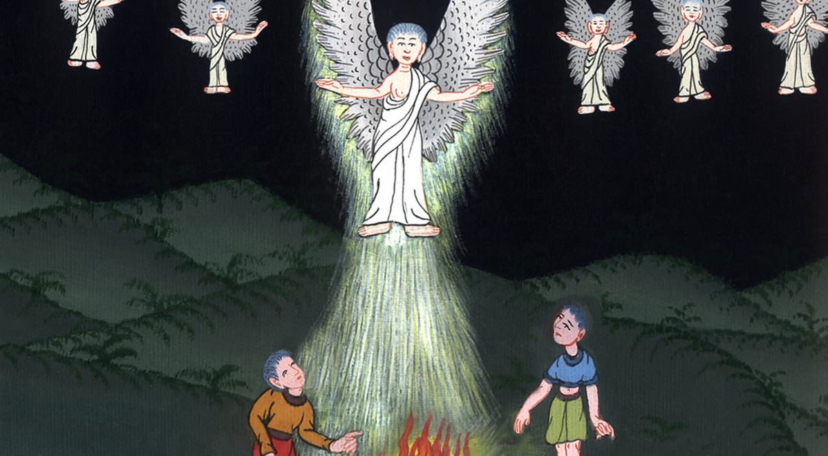
Luke 2:12

Slide 23
13Suddenly, there was with the angel a multitude of the heavenly army praising God and saying,
14“Glory to God in the highest,
on earth peace, good will toward men.”

Slide 24
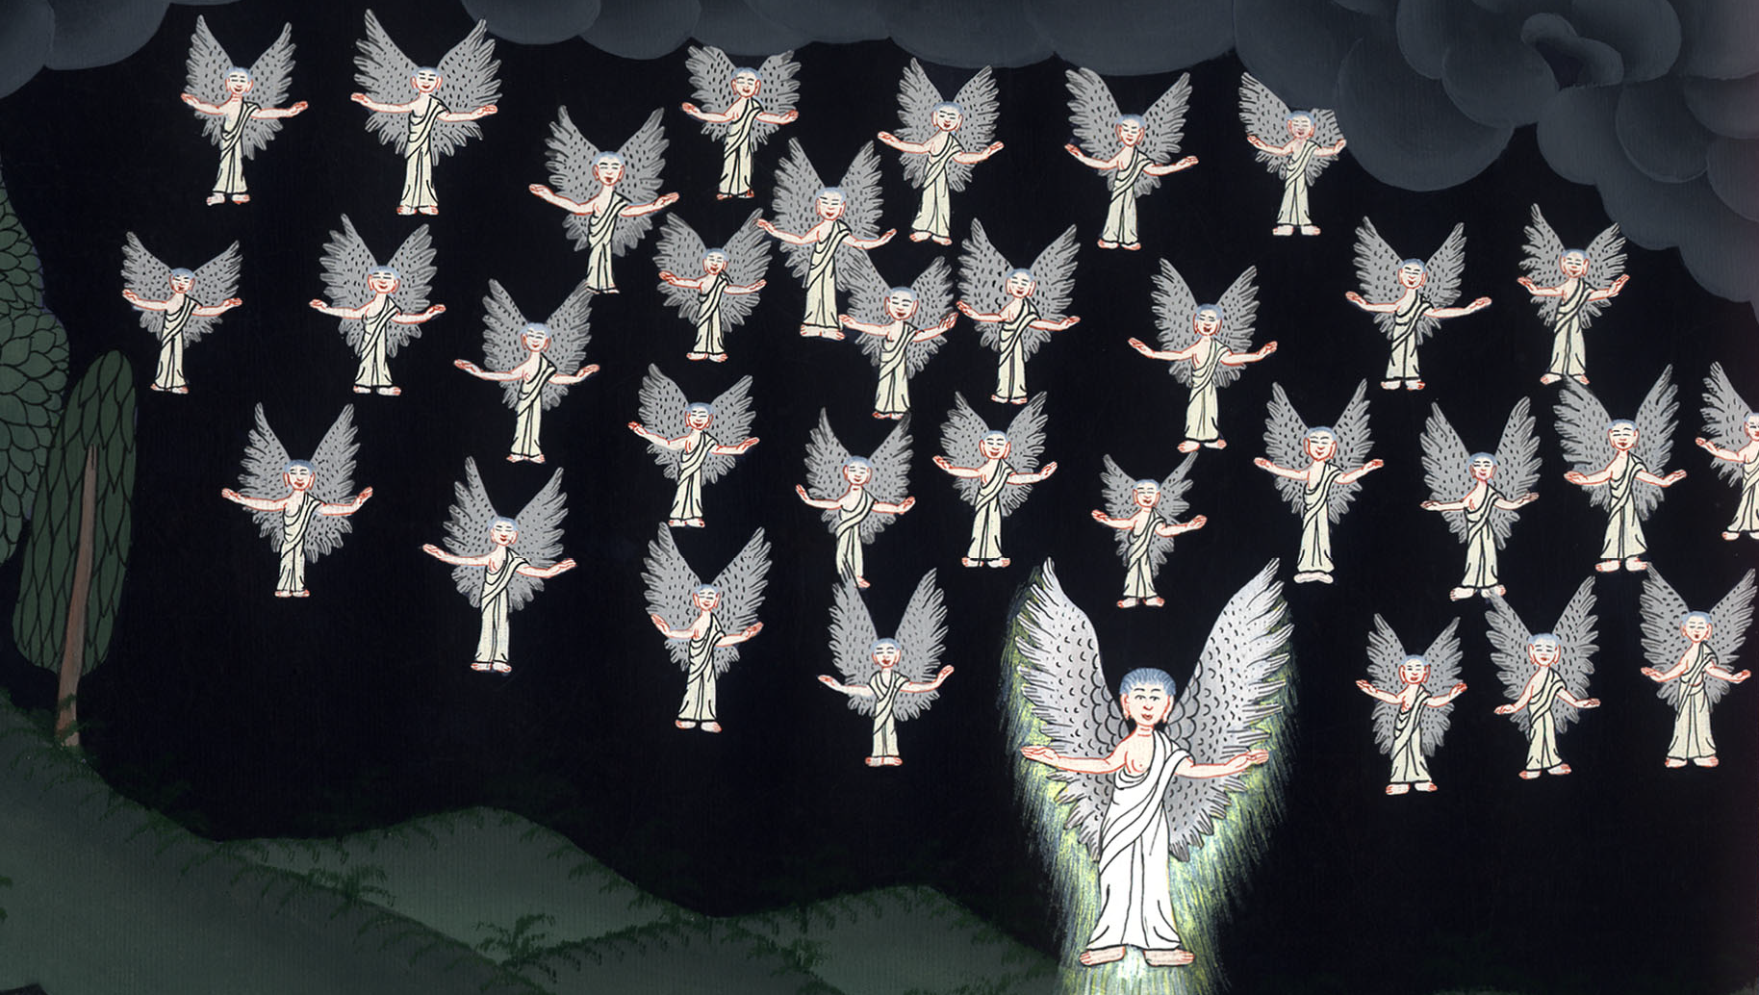
Luke 2:13,14

Slide 25
15When the angels went away from them into the sky, the shepherds said to one another, “Let’s go to Bethlehem, now, and see this thing that has happened, which the Lord has made known to us.”

Slide 26
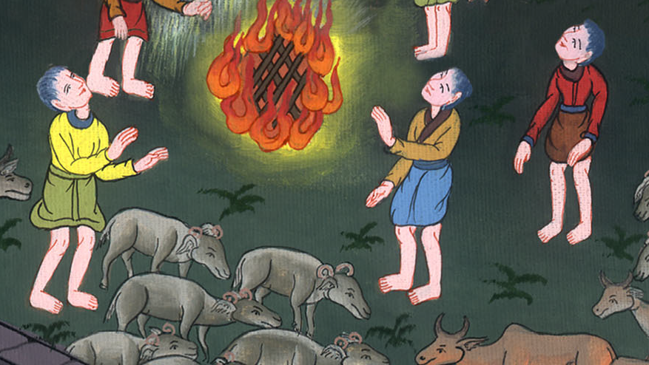
Luke 2:15

Slide 27
16They came with haste and found both Mary and Joseph, and the baby was lying in the feeding trough.

Slide 28
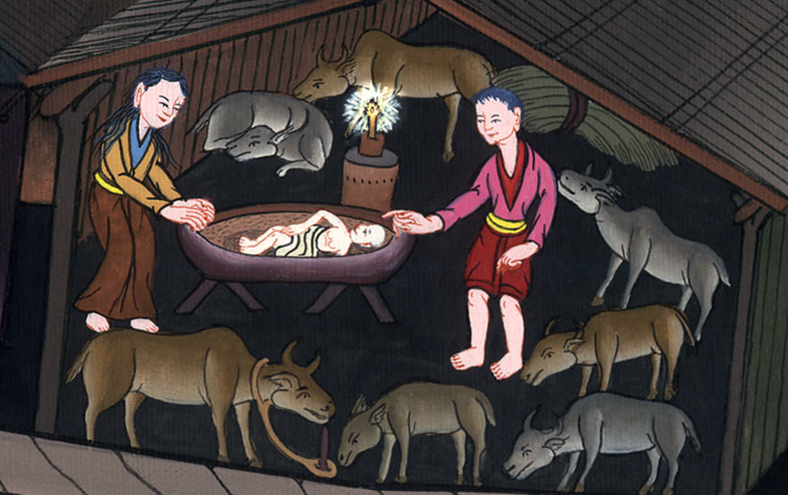
Luke 2:16

Slide 29
17When they saw it, they publicized widely the saying which was spoken to them about this child. 18All who heard it wondered at the things which were spoken to them by the shepherds.

Slide 30
ལོ་ཀུ 2:7
Luke 2:17,18

Slide 31
19But Mary kept all these sayings, pondering them in her heart.

Slide 32
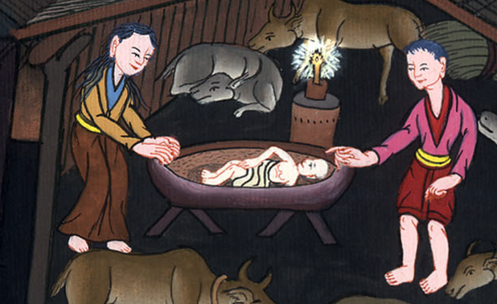
Luke 2:19

Slide 33
20The shepherds returned, glorifying and praising God for all the things that they had heard and seen, just as it was told them.

Slide 34
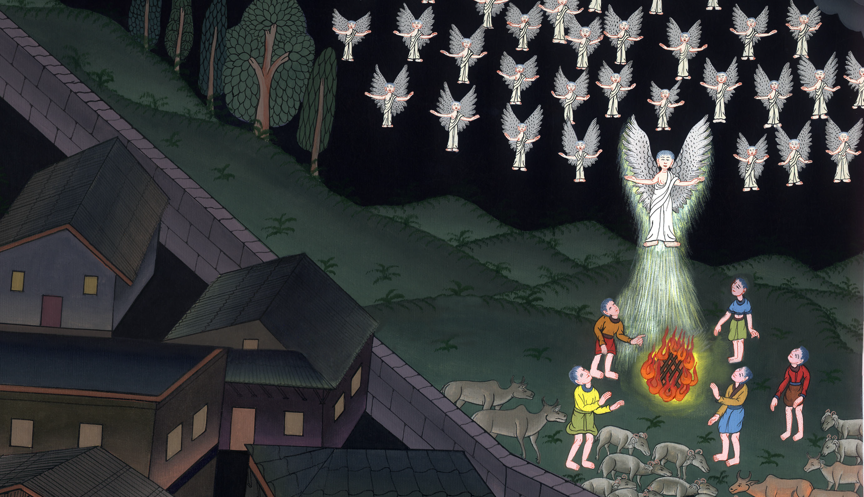
Luke 2:20

