Slide 1
31-1
This work is licensed under a Creative Commons Attribution-ShareAlike 4.0 International License.
Please add this statement to all the videos you create.
English Bible quotes are from the World English Bible US, which is in the public domain.
Notes:
Ch
Jesus’ Childhood
1. Simeon and Anna - Luke 2:21-38 (Left Top)
2. The Magi give gifts to Jesus - Matt 2:1-11 (Right Center)
3. Flight to Egypt and return to Nazareth - Matthew 2:12-23 (Left)
4. Childhood in the Temple - 2:40-52 (Right Bottom)

Slide 2
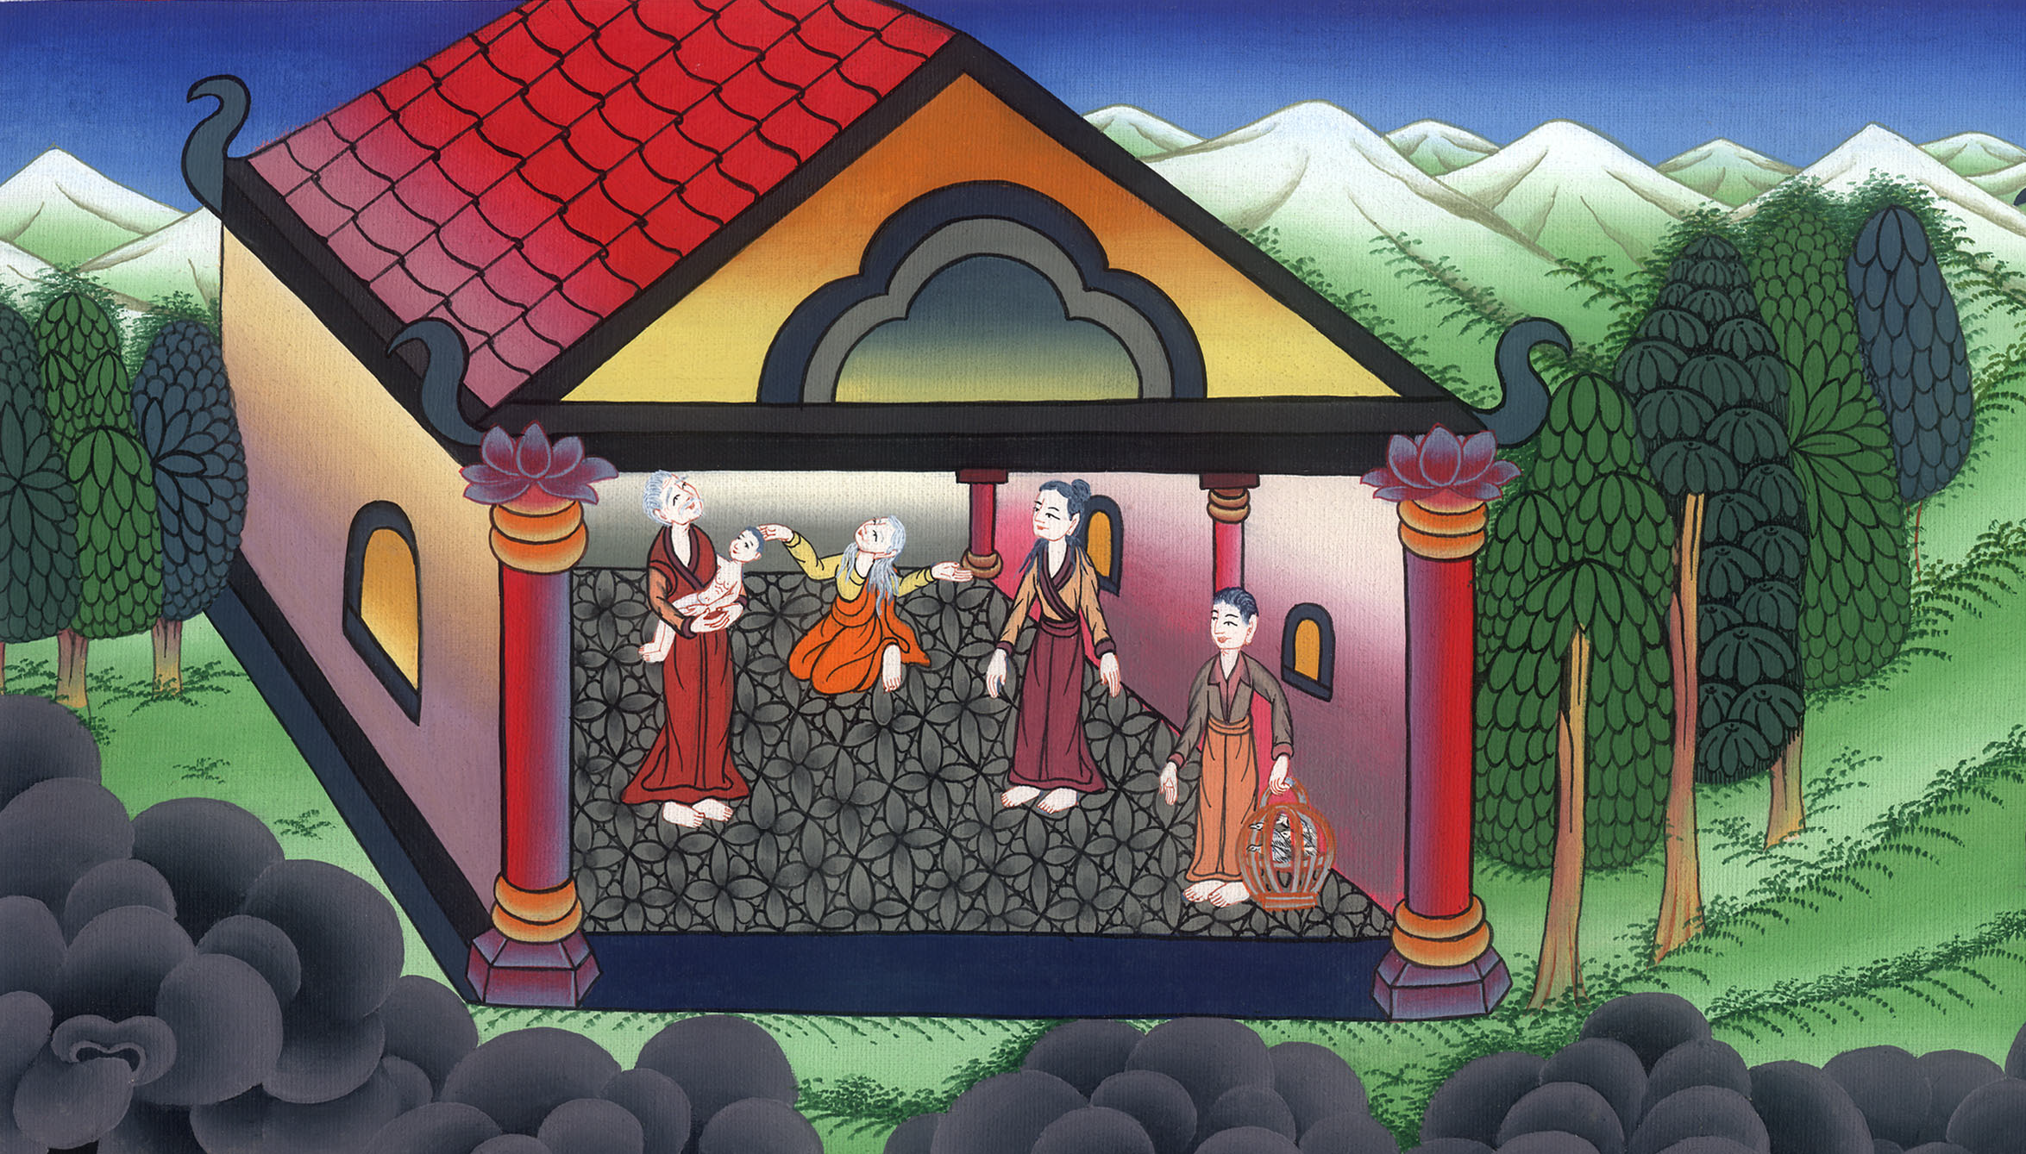
Simeon and Anna - Luke 2:21-38

Slide 3
1. Simeon and Anna - Luke 2:21-38 (Left Top)

Slide 4
Simeon and Anna - Luke 2:21-38

Slide 5
21When eight days were fulfilled for the circumcision of the child, his name was called Jesus, which was given by the angel before he was conceived in the womb.

Slide 6
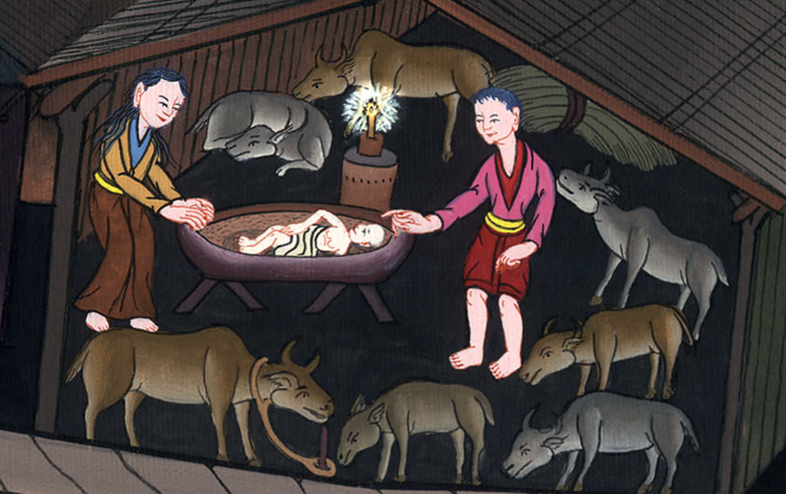
Luke 2:21

Slide 7
22When the days of their purification according to the law of Moses were fulfilled, they brought him up to Jerusalem to present him to the Lord

Slide 8
Luke 2:22

Slide 9
23(as it is written in the law of the Lord, “Every male who opens the womb shall be called holy to the Lord”), 24and to offer a sacrifice according to that which is said in the law of the Lord, “A pair of turtledoves, or two young pigeons.”

Slide 10
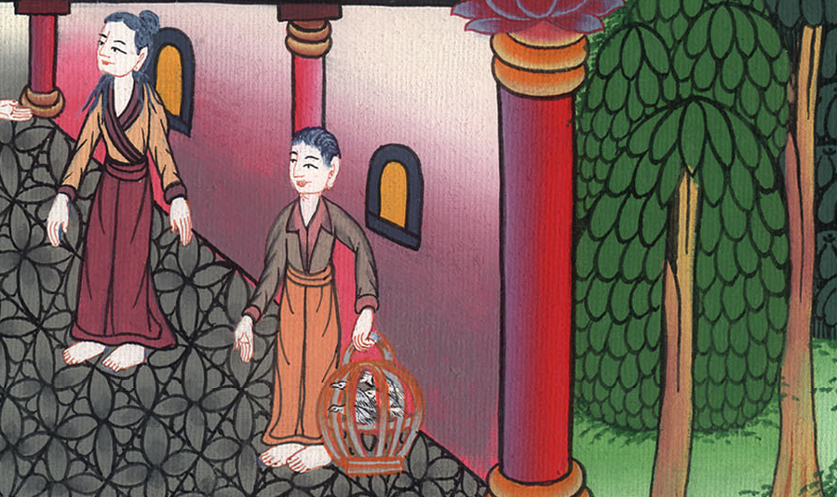
Luke 2:23,24

Slide 11
25Behold, there was a man in Jerusalem whose name was Simeon. This man was righteous and devout, looking for the consolation of Israel, and the Holy Spirit was on him. 26It had been revealed to him by the Holy Spirit that he should not see death before he had seen the Lord’s Christ.

Slide 12
Luke 2:25,26

Slide 13
27He came in the Spirit into the temple. When the parents brought in the child, Jesus, that they might do concerning him according to the custom of the law,

Slide 14
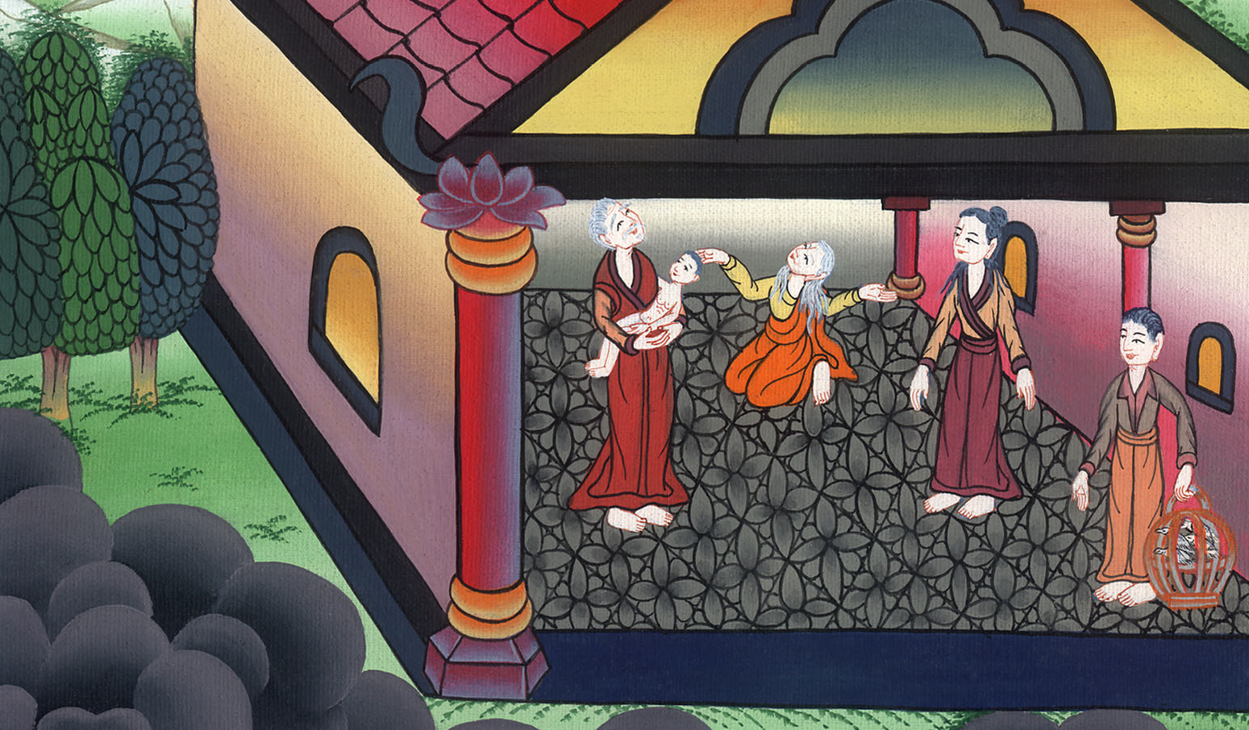
Luke 2:27

Slide 15
28then he received him into his arms and blessed God, and said,
29“Now you are releasing your servant, Master,
according to your word, in peace;

Slide 16
Luke 2:28,29

Slide 17
30for my eyes have seen your salvation,
31which you have prepared before the face of all peoples;
32a light for revelation to the nations,
and the glory of your people Israel.”

Slide 18
Luke 2:30-32

Slide 19
33Joseph and his mother were marveling at the things which were spoken concerning him.

Slide 20
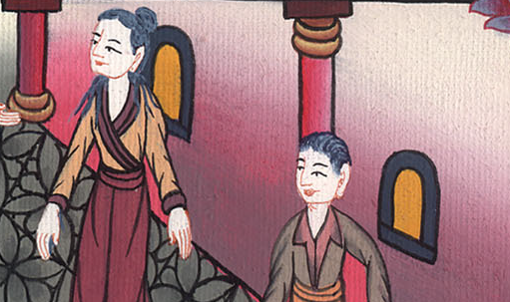
Luke 2:33

Slide 21
34Simeon blessed them, and said to Mary, his mother, “Behold, this child is appointed for the falling and the rising of many in Israel, and for a sign which is spoken against.

Slide 22
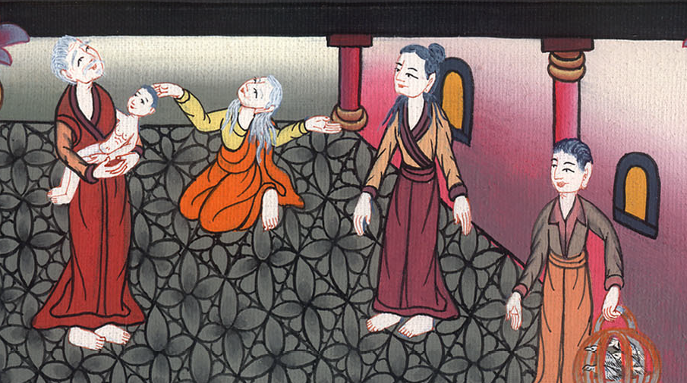
Luke 2:34

Slide 23
35Yes, a sword will pierce through your own soul, that the thoughts of many hearts may be revealed.”

Slide 24
Luke 2:35

Slide 25
36There was one Anna, a prophetess, the daughter of Phanuel, of the tribe of Asher (she was of a great age, having lived with a husband seven years from her virginity,

Slide 26
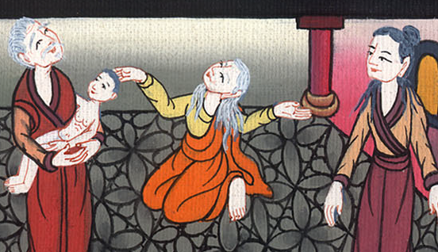
Luke 2:36

Slide 27
37and she had been a widow for about eighty-four years), who didn’t depart from the temple, worshiping with fastings and petitions night and day.

Slide 28
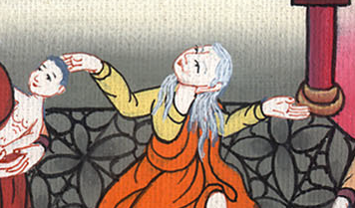
Luke 2:37

Slide 29
38Coming up at that very hour, she gave thanks to the Lord, and spoke of him to all those who were looking for redemption in Jerusalem.

Slide 30
Luke 2:38

