Slide 1
31-2
This work is licensed under a Creative Commons Attribution-ShareAlike 4.0 International License.
Please add this statement to all the videos you create.
English Bible quotes are from the World English Bible US, which is in the public domain.
Notes:
Ch
Jesus’ Childhood
1. Simeon and Anna - Luke 2:21-38 (Left Top)
2. The Magi give gifts to Jesus - Matt 2:1-11 (Right Center)
3. Flight to Egypt and return to Nazareth - Matthew 2:12-23 (Left)
4. Childhood in the Temple - 2:40-52 (Right Bottom)

Slide 2
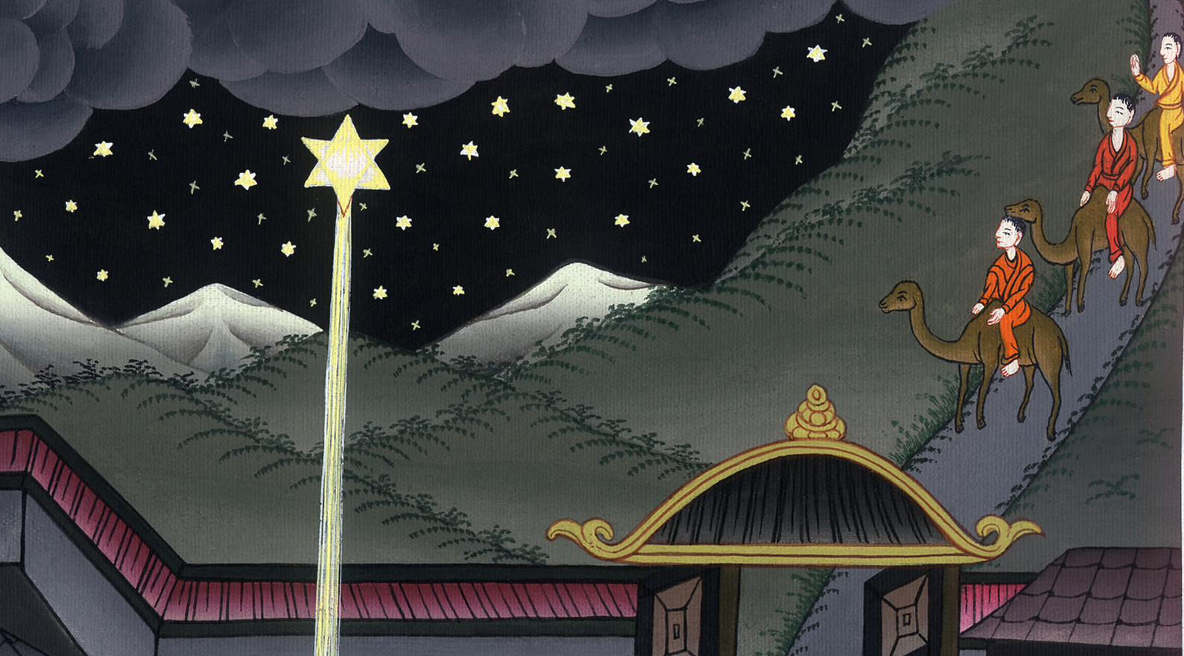
The Magi give gifts to Jesus - Matthew 2:1-11

Slide 3
2. The Magi give gifts to Jesus - Matthew 2:1-11 (Right Center)

Slide 4
The Magi give gifts to Jesus - Matthew 2:1-11

Slide 5
1Now when Jesus was born in Bethlehem of Judea in the days of King Herod, behold, wise men from the east came to Jerusalem, saying,

Slide 6
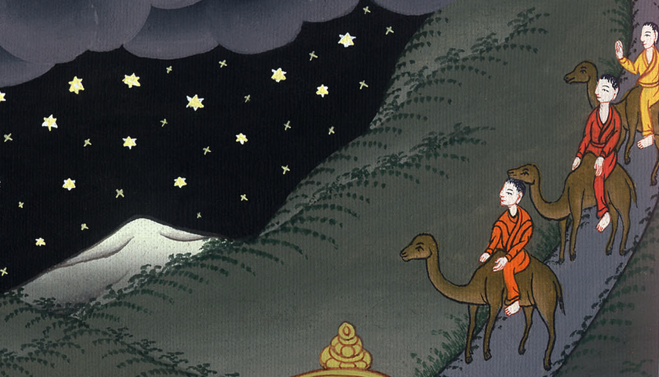
Matthew 2:1

Slide 7
2“Where is he who is born King of the Jews? For we saw his star in the east, and have come to worship him.” 3When King Herod heard it, he was troubled, and all Jerusalem with him.

Slide 8
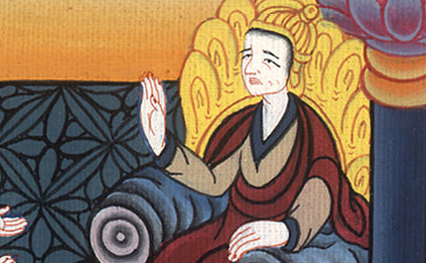
Matthew 2:2,3

Slide 9
4Gathering together all the chief priests and scribes of the people, he asked them where the Christ would be born.

Slide 10
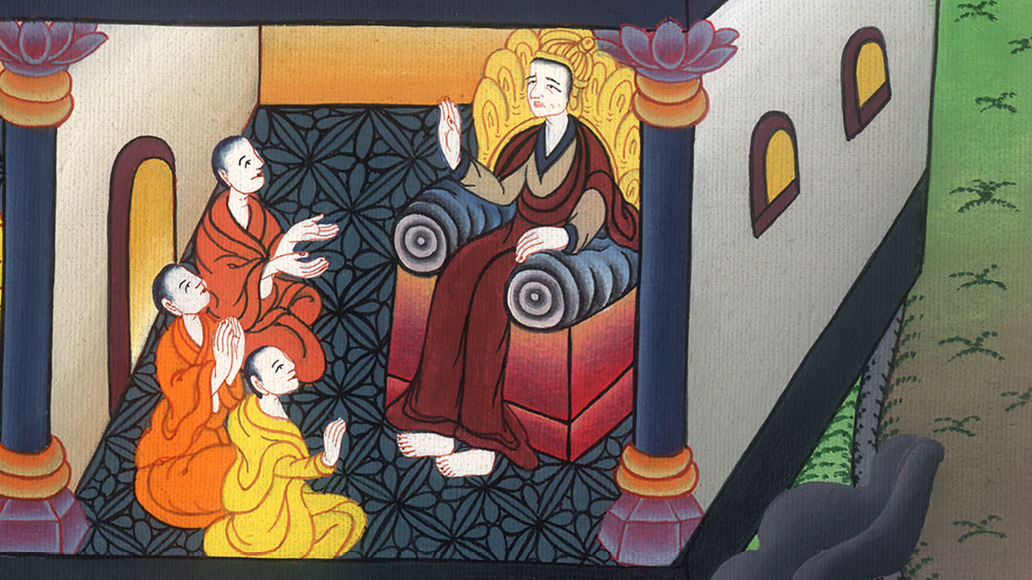
Matthew 2:4

Slide 11
5They said to him, “In Bethlehem of Judea, for this is written through the prophet,

Slide 12
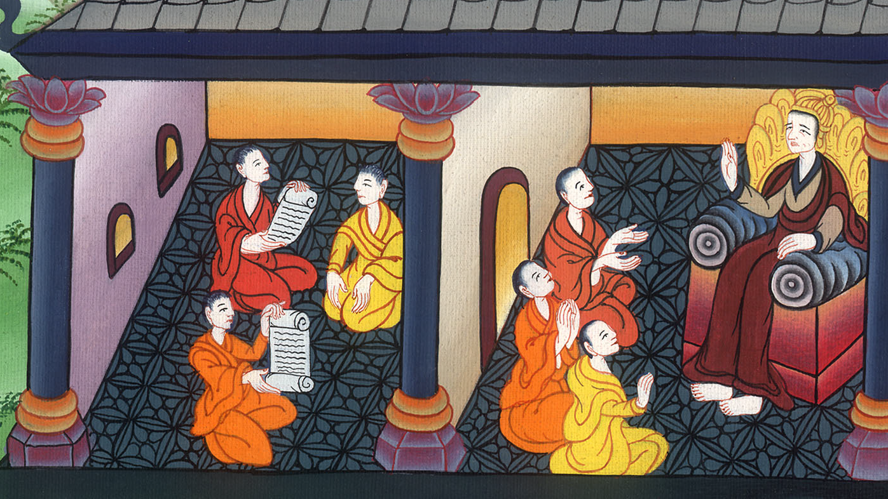
Matthew 2:5

Slide 13
6‘You Bethlehem, land of Judah,
are in no way least among the princes of Judah;
for out of you shall come a governor
who shall shepherd my people, Israel.’”

Slide 14
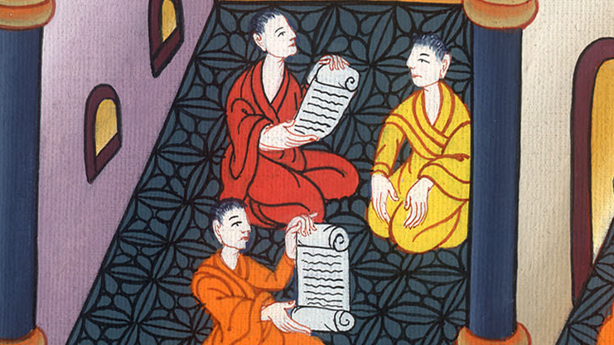
Matthew 2:6

Slide 15
7Then Herod secretly called for the Wise Men. He found out from them exactly when the star had appeared. 8He sent them to Bethlehem. He said, “Go and search carefully for the child. As soon as you find him, report it to me. Then I can go and worship him too.”

Slide 16
Matthew 2:7,8

Slide 17
9They, having heard the king, went their way; and behold, the star, which they saw in the east, went before them until it came and stood over where the young child was. 10When they saw the star, they rejoiced with exceedingly great joy.

Slide 18
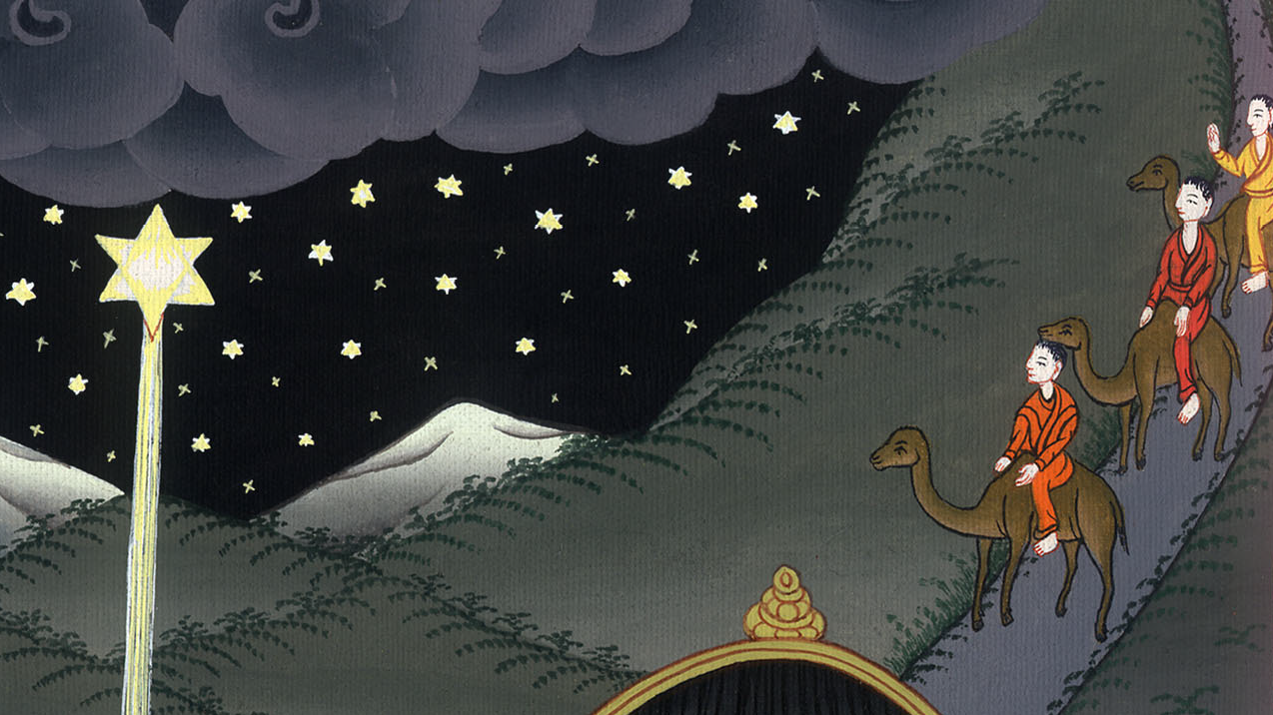
Matthew 2:9,10

Slide 19
11They came into the house and saw the young child with Mary, his mother, and they fell down and worshiped him. Opening their treasures, they offered to him gifts: gold, frankincense, and myrrh.

Slide 20
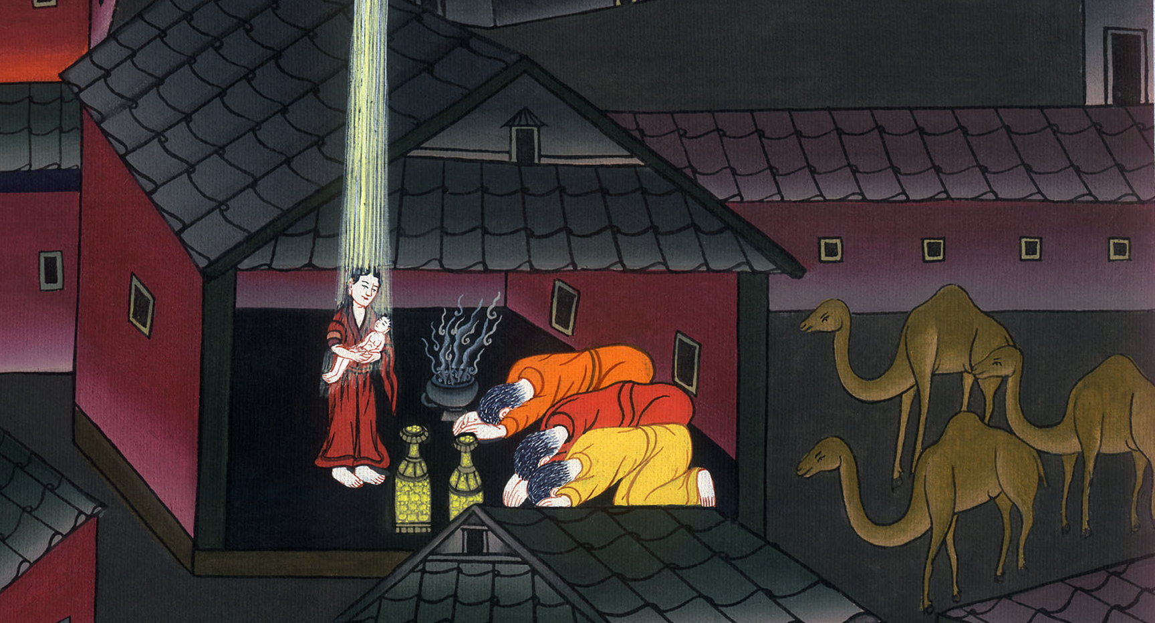
Matthew 2:11

Slide 21
12Being warned in a dream not to return to Herod, they went back to their own country another way.

Slide 22
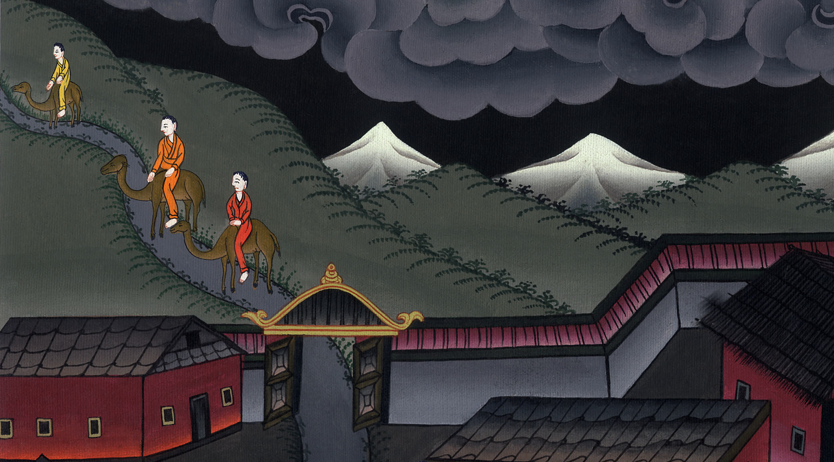
Matthew 2:12

