Slide 1
31-3
This work is licensed under a Creative Commons Attribution-ShareAlike 4.0 International License.
Please add this statement to all the videos you create.
English Bible quotes are from the World English Bible US, which is in the public domain.
Notes:
Ch
Jesus’ Childhood
1. Simeon and Anna - Luke 2:21-38 (Left Top)
2. The Magi give gifts to Jesus - Matt 2:1-11 (Right Center)
3. Flight to Egypt and return to Nazareth - Matthew 2:12-23 (Left)
4. Childhood in the Temple - 2:40-52 (Right Bottom)

Slide 2
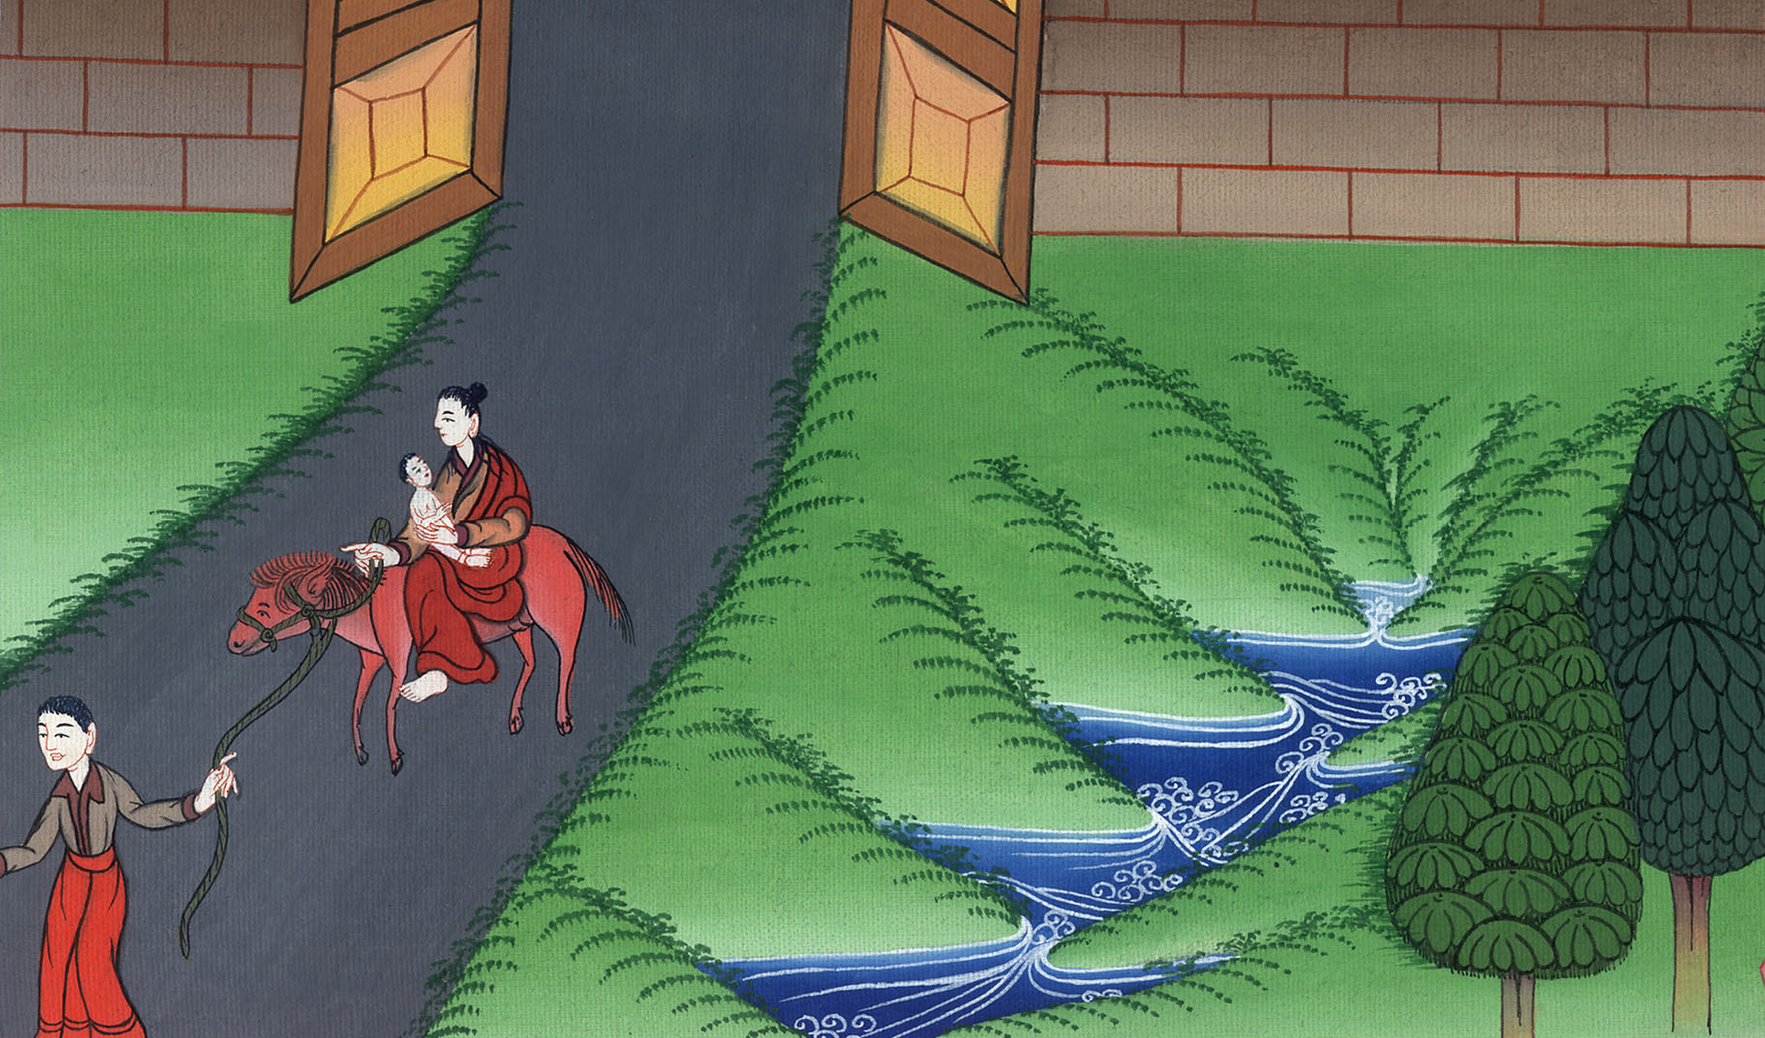
Flight to Egypt and return to Nazareth - Matthew 2:12-23

Slide 3
Flight to Egypt and return to Nazareth - Matthew 2:12-23

Slide 4
Flight to Egypt and return to Nazareth - Matthew 2:12-23

Slide 5
13Now when they had departed, behold, an angel of the Lord appeared to Joseph in a dream, saying, “Arise and take the young child and his mother, and flee into Egypt, and stay there until I tell you, for Herod will seek the young child to destroy him.”

Slide 6
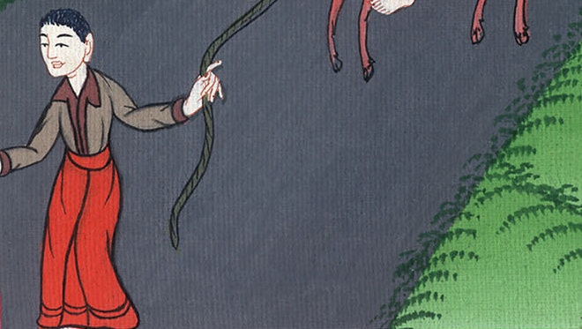
Matthew 2:13

Slide 7
14He arose and took the young child and his mother by night and departed into Egypt, 15and was there until the death of Herod, that it might be fulfilled which was spoken by the Lord through the prophet, saying, “Out of Egypt I called my son.”

Slide 8
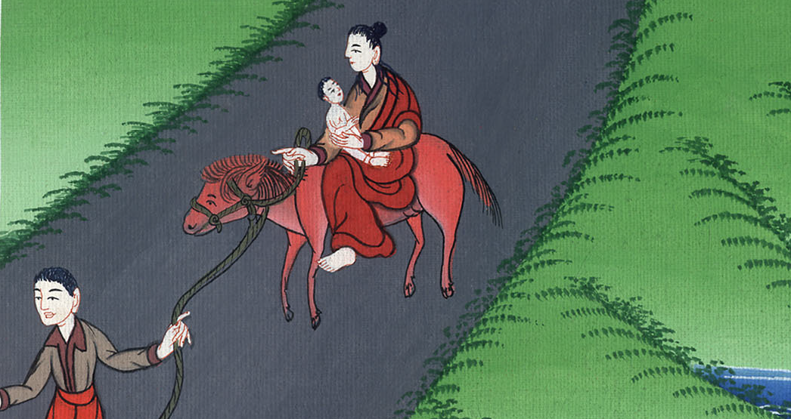
Matthew 2:14,15

Slide 9
16Then Herod, when he saw that he was mocked by the wise men, was exceedingly angry, and sent out and killed all the male children who were in Bethlehem and in all the surrounding countryside, from two years old and under, according to the exact time which he had learned from the wise men.

Slide 10
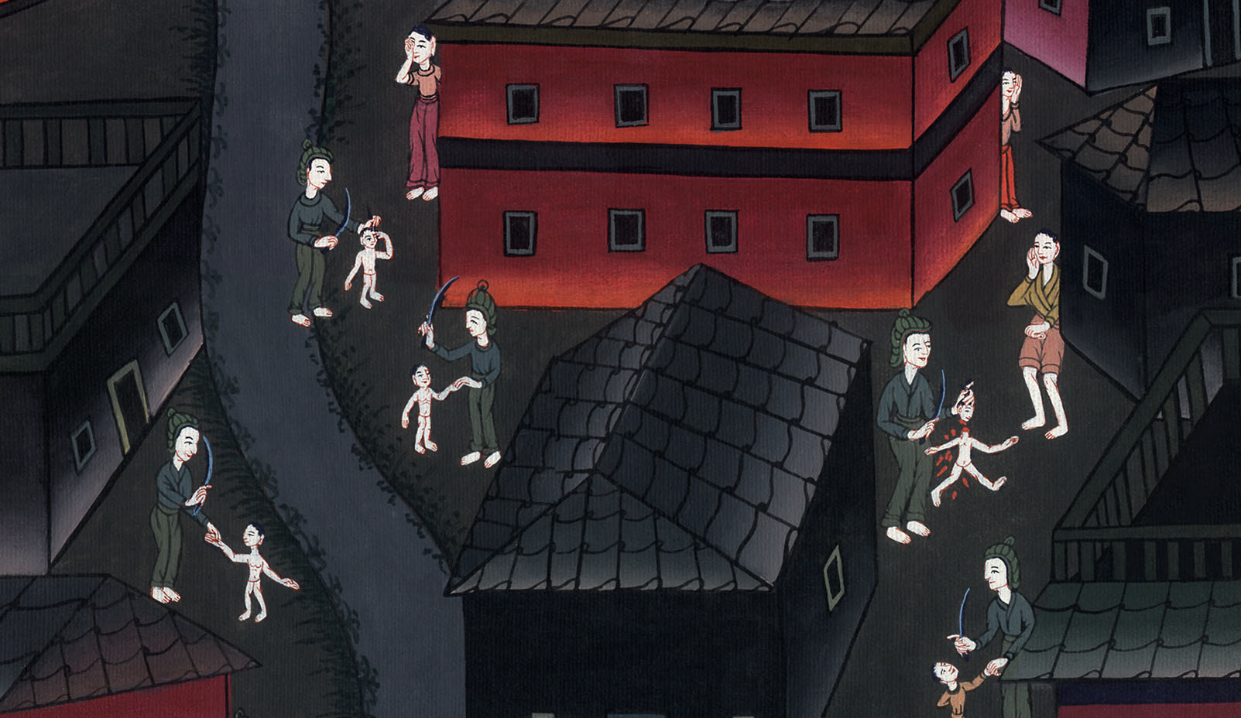
Matthew 2:16

Slide 11
17Then that which was spoken by Jeremiah the prophet was fulfilled, saying,
18“A voice was heard in Ramah,
lamentation, weeping and great mourning,
Rachel weeping for her children;
she wouldn’t be comforted,
because they are no more.”

Slide 12
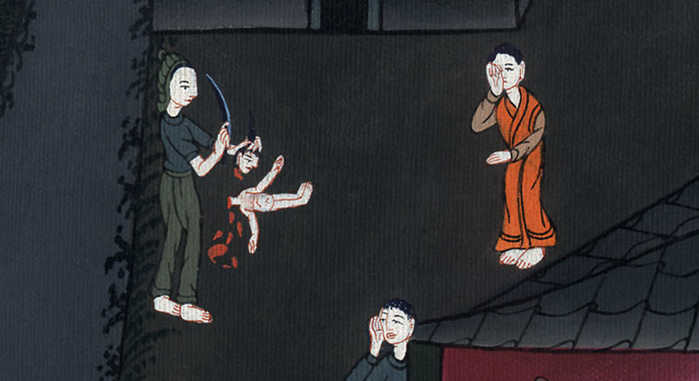
Matthew 2:17,18

Slide 13
19But when Herod was dead, behold, an angel of the Lord appeared in a dream to Joseph in Egypt, saying, 20“Arise and take the young child and his mother, and go into the land of Israel, for those who sought the young child’s life are dead.”

Slide 14
Matthew 2:19,20

Slide 15
21He arose and took the young child and his mother, and came into the land of Israel. 22But when he heard that Archelaus was reigning over Judea in the place of his father, Herod, he was afraid to go there.

Slide 16
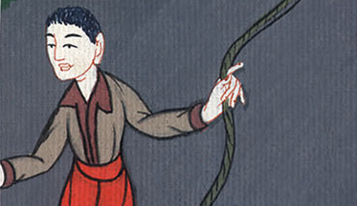
Matthew 2:21,22

Slide 17
Being warned in a dream, he withdrew into the region of Galilee,

Slide 18
Matthew 2:22

Slide 19
23and came and lived in a city called Nazareth; that it might be fulfilled which was spoken through the prophets that he will be called a Nazarene.

Slide 20
Matthew 2:23

