Slide 1
31-4
This work is licensed under a Creative Commons Attribution-ShareAlike 4.0 International License.
Please add this statement to all the videos you create.
English Bible quotes are from the World English Bible US, which is in the public domain.
Notes:
Ch
Jesus’ Childhood
1. Simeon and Anna - Luke 2:21-38 (Left Top)
2. The Magi give gifts to Jesus - Matt 2:1-11 (Right Center)
3. Flight to Egypt and return to Nazareth - Matthew 2:12-23 (Left)
4. Childhood in the Temple - 2:40-52 (Right Bottom)

Slide 2
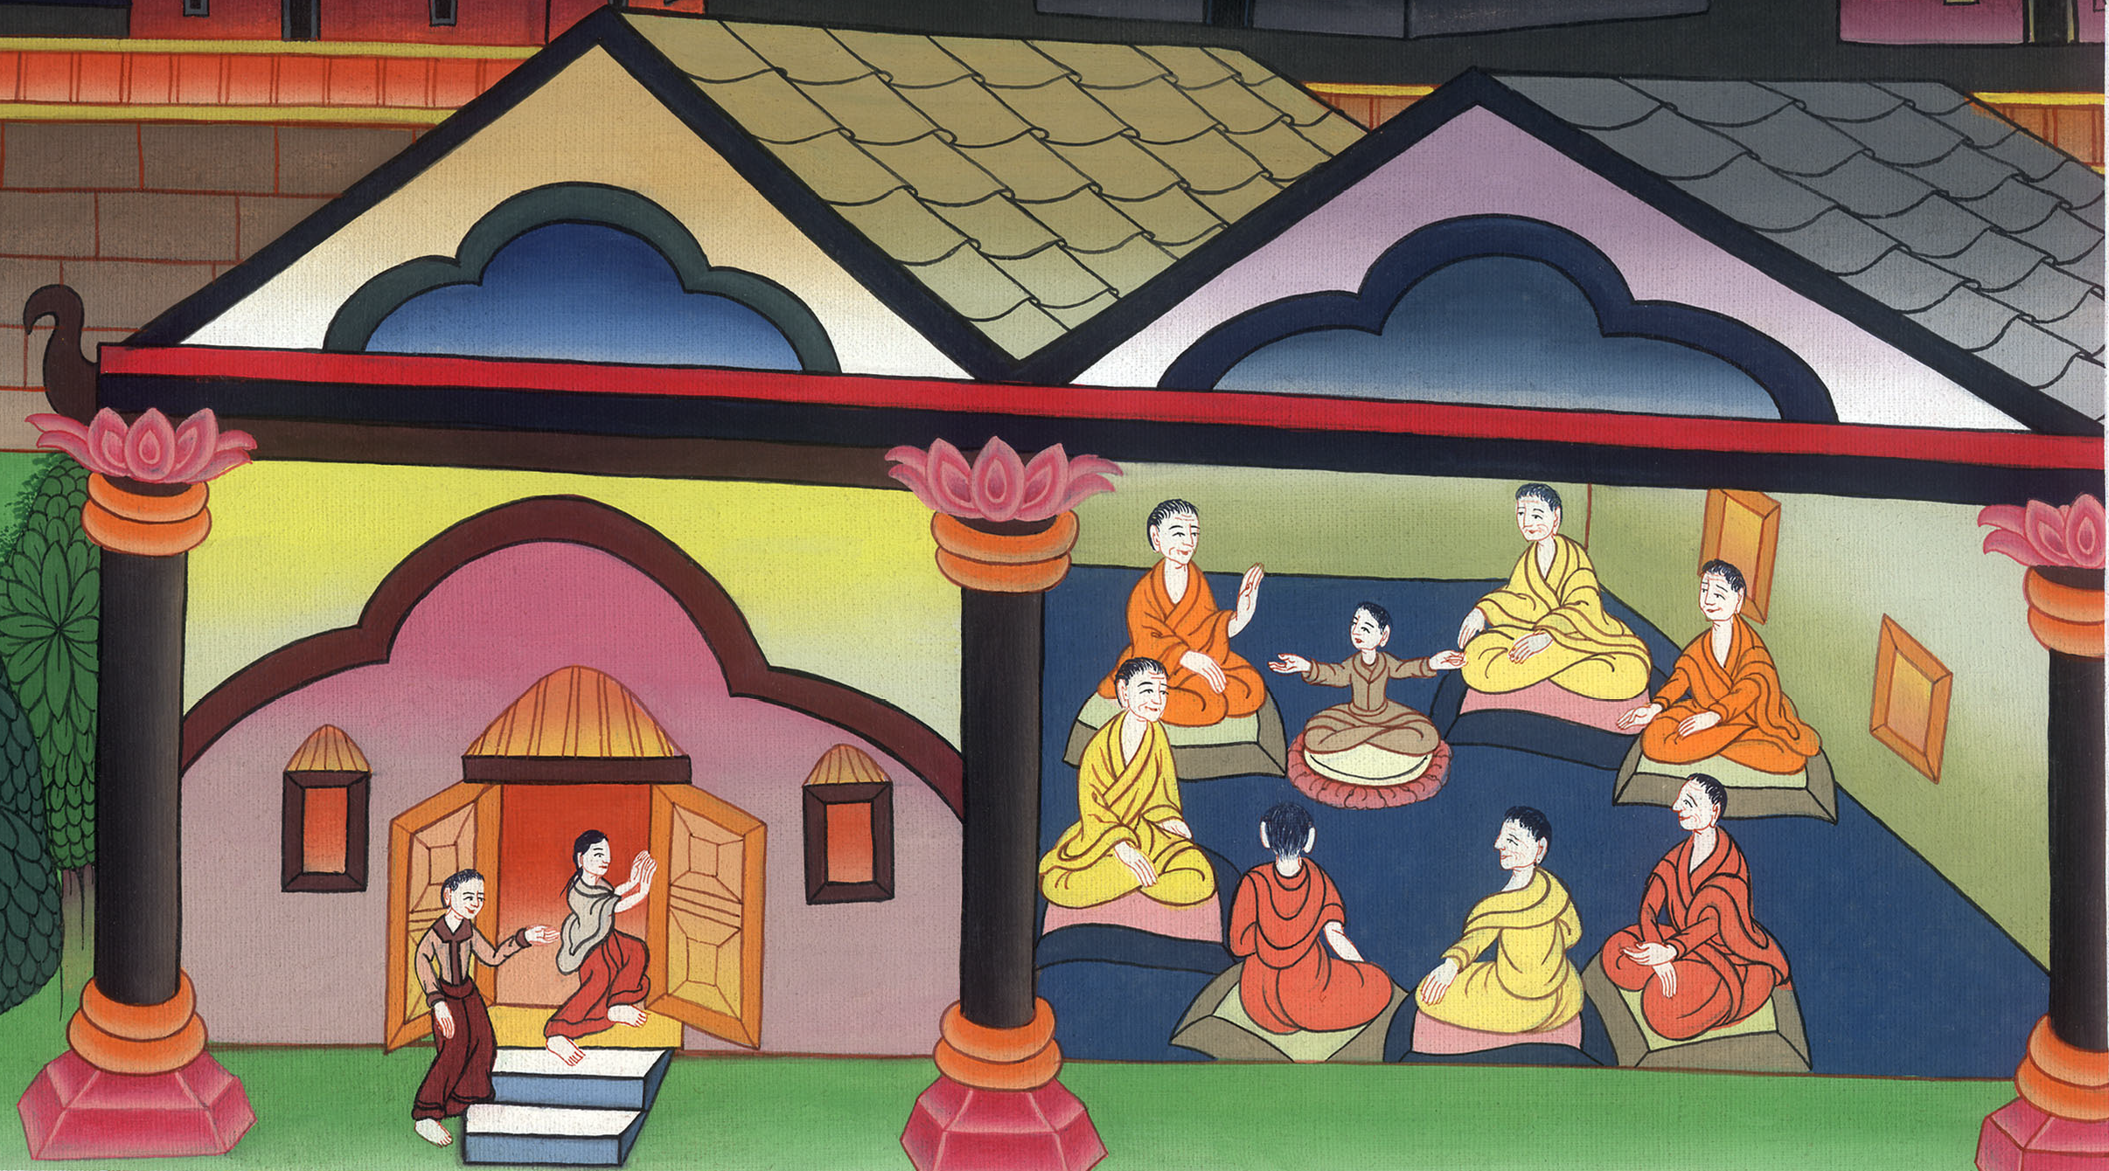
Childhood in the Temple –
Luke 2:39-52

Slide 3
Childhood in the Temple – Luke 2:39-52

Slide 4
Childhood in the Temple –
Luke 2:39-52

Slide 5
39Joseph and Mary … returned into Galilee, to their own city, Nazareth. 40The child was growing, and was becoming strong in spirit, being filled with wisdom, and the grace of God was upon him.

Slide 6
Luke 2:39,40

Slide 7
41His parents went every year to Jerusalem at the feast of the Passover. 42When he was twelve years old, they went up to Jerusalem according to the custom of the feast;

Slide 8
Luke 2:41,42

Slide 9
43and when they had fulfilled the days, as they were returning, the boy Jesus stayed behind in Jerusalem. Joseph and his mother didn’t know it,

Slide 10
Luke 2:43

Slide 11
44but supposing him to be in the company, they went a day’s journey; and they looked for him among their relatives and acquaintances. 45When they didn’t find him, they returned to Jerusalem, looking for him.

Slide 12
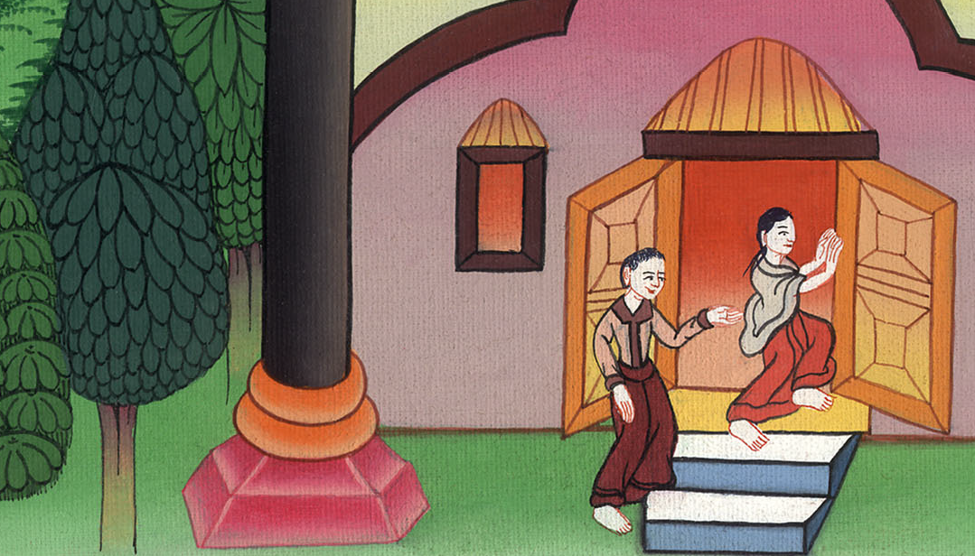
Luke 2:44,45

Slide 13
46After three days they found him in the temple, sitting in the middle of the teachers, both listening to them and asking them questions. 47All who heard him were amazed at his understanding and his answers.

Slide 14
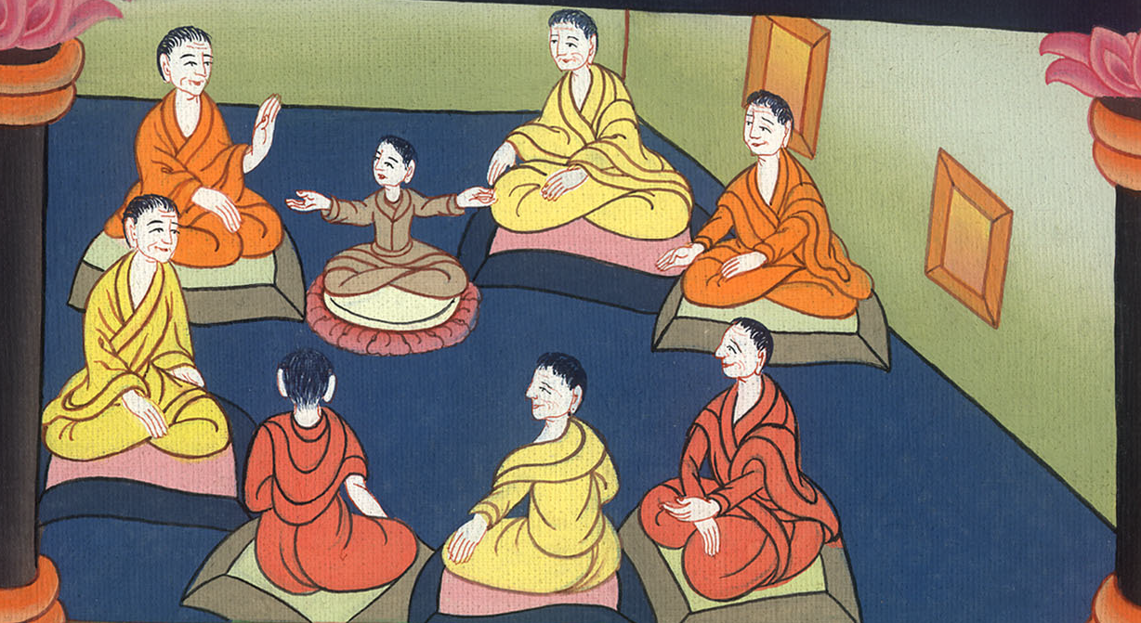
Luke 2:46,47

Slide 15
48When they saw him, they were astonished; and his mother said to him, “Son, why have you treated us this way? Behold, your father and I were anxiously looking for you.”

Slide 16
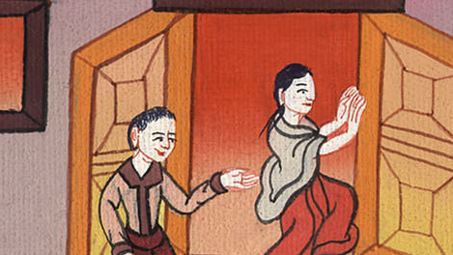
Luke 2:48

Slide 17
49He said to them, “Why were you looking for me? Didn’t you know that I must be in my Father’s house?” 50They didn’t understand the saying which he spoke to them.

Slide 18
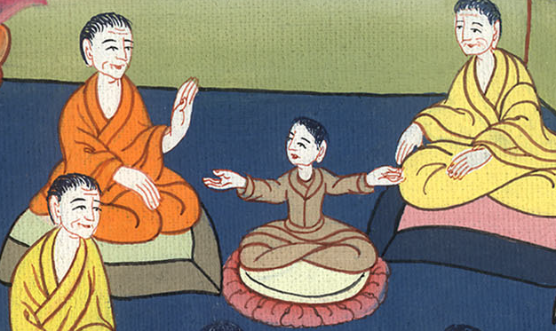
Luke 2:49,50

Slide 19
51And he went down with them and came to Nazareth. He was subject to them, and his mother kept all these sayings in her heart.

Slide 20
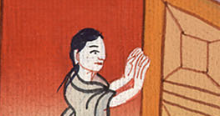
Luke 2:51

Slide 21
52And Jesus increased in wisdom and stature, and in favor with God and men.

Slide 22
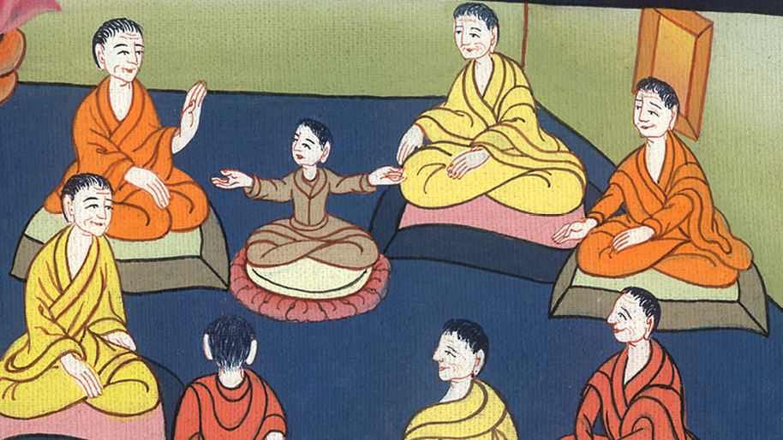
Luke 2:52

