Slide 1
32-1
This work is licensed under a Creative Commons Attribution-ShareAlike 4.0 International License.
Please add this statement to all the videos you create.
English Bible quotes are from the World English Bible US, which is in the public domain.
Notes:
Ch
32 Jesus Baptized
1. John Baptizes Jesus - Matthew 3:1 – 17 (Left Top)
2. The Temptation of Jesus (1) – Matthew 4:1–4 (Left Bottom)
3. Temptation (2) – Matt 4:5-7 (Right Bottom)
4. Temptation (3) – Matt 4:8-11 (Right Top)

Slide 2
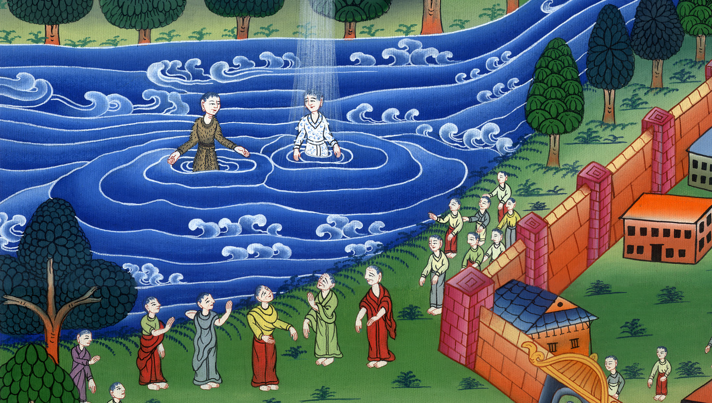
John Baptizes Jesus –
Matthew 3:1 – 17

Slide 3
Jesus Baptized
John Baptizes Jesus - Matthew 3:1 – 17

Slide 4
John Baptizes Jesus –
Matthew 3:1 – 17

Slide 5
1In those days, John the Baptizer came, preaching in the wilderness of Judea, saying, 2“Repent, for the Kingdom of Heaven is at hand!”

Slide 6
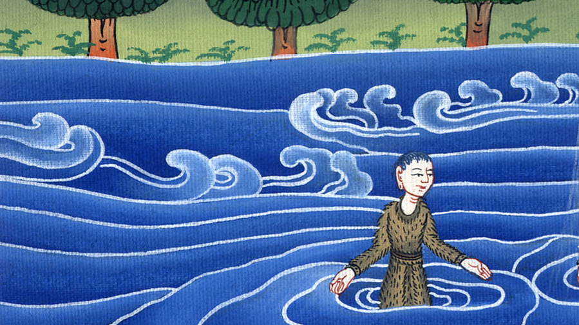
Matthew 3:1,2

Slide 7
3For this is he who was spoken of by Isaiah the prophet, saying,
“The voice of one crying in the wilderness,
make the way of the Lord ready!
Make his paths straight!”

Slide 8
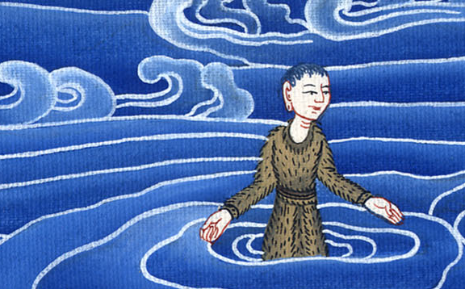
Matthew 3:3

Slide 9
4Now John himself wore clothing made of camel’s hair with a leather belt around his waist. His food was locusts and wild honey.

Slide 10
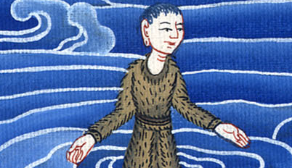
Matthew 3:4

Slide 11
5Then people from Jerusalem, all of Judea, and all the region around the Jordan went out to him. 6They were baptized by him in the Jordan, confessing their sins.

Slide 12
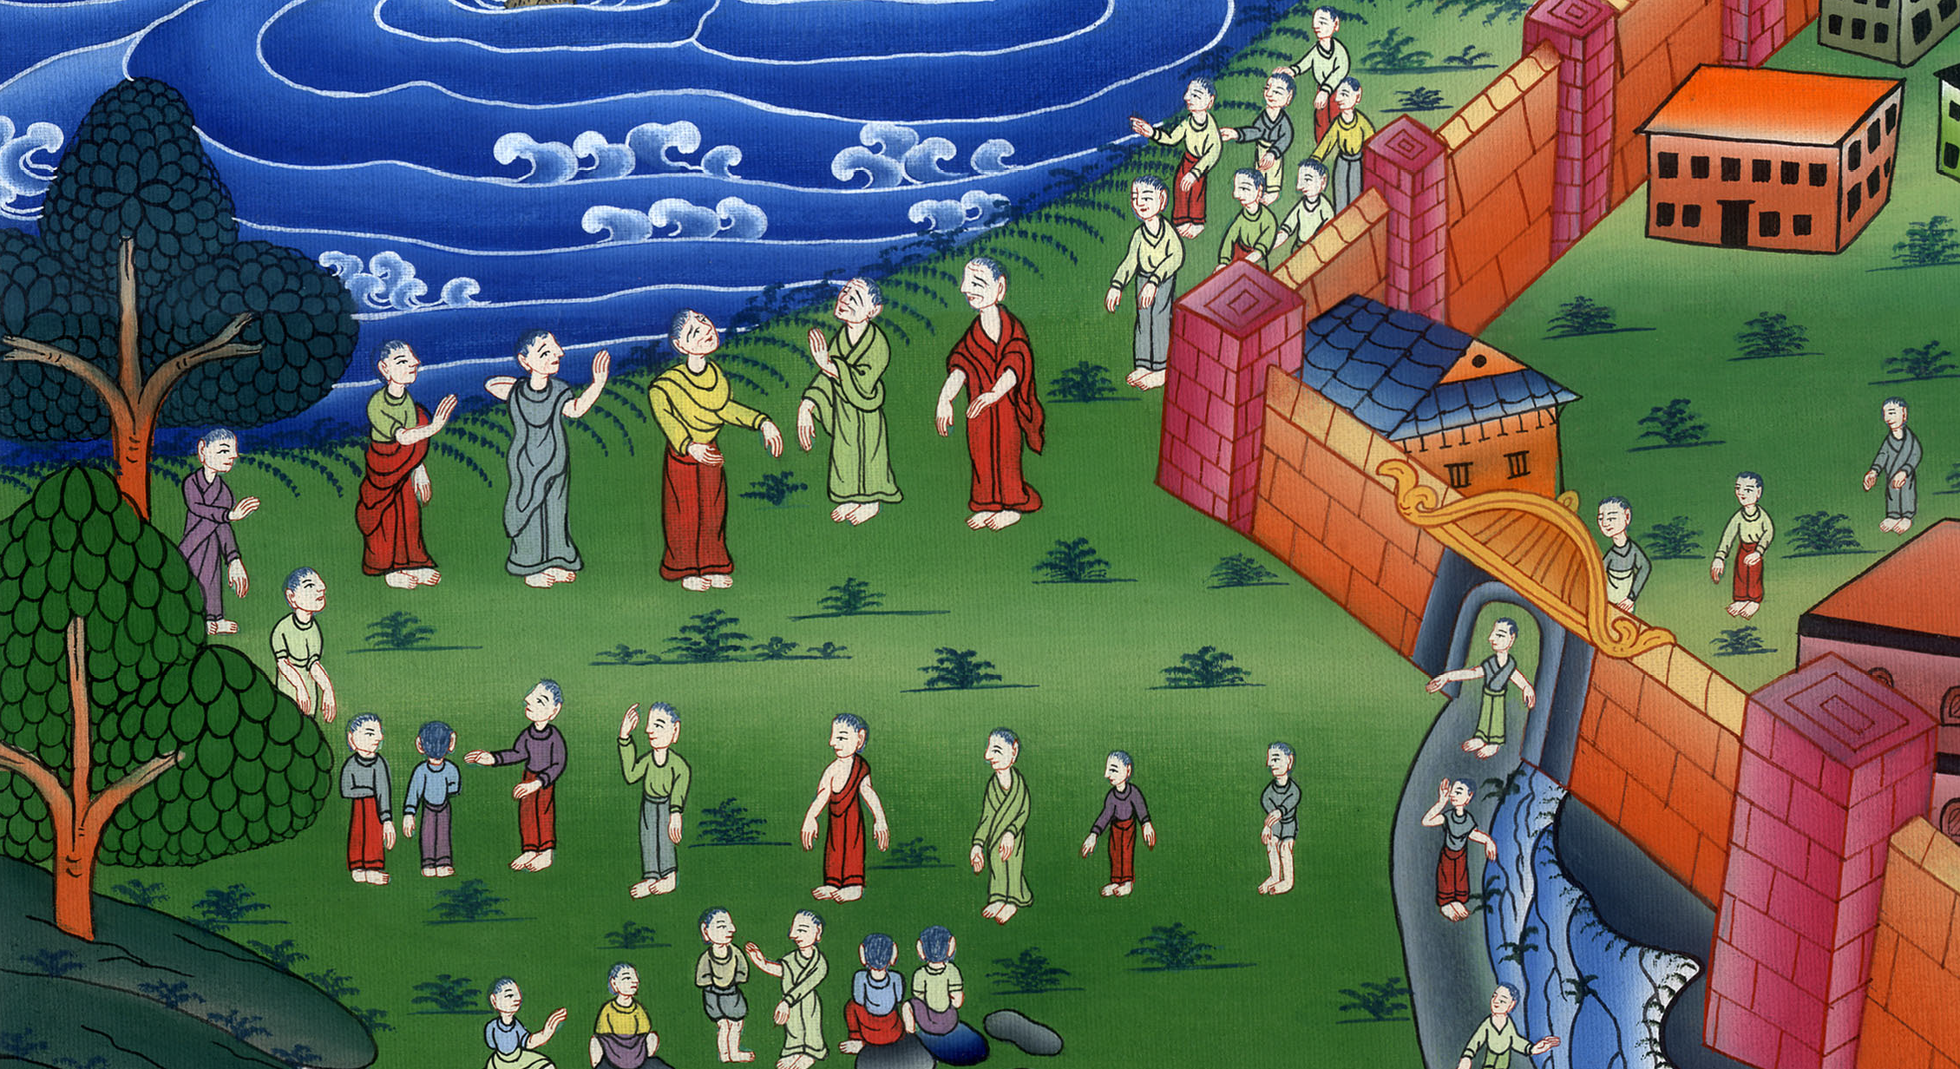
Matthew 3:5,6

Slide 13
7But when he saw many of the Pharisees and Sadducees coming for his baptism, he said to them, “You offspring of vipers, who warned you to flee from the wrath to come? 8Therefore produce fruit worthy of repentance!

Slide 14
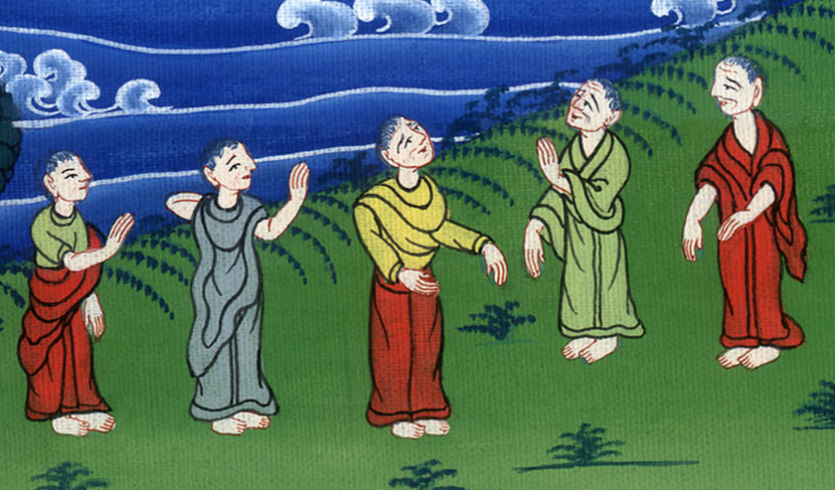
Matthew 3:7,8

Slide 15
11“I indeed baptize you in water for repentance, but he who comes after me is mightier than I, whose sandals I am not worthy to carry. He will baptize you in the Holy Spirit.

Slide 16
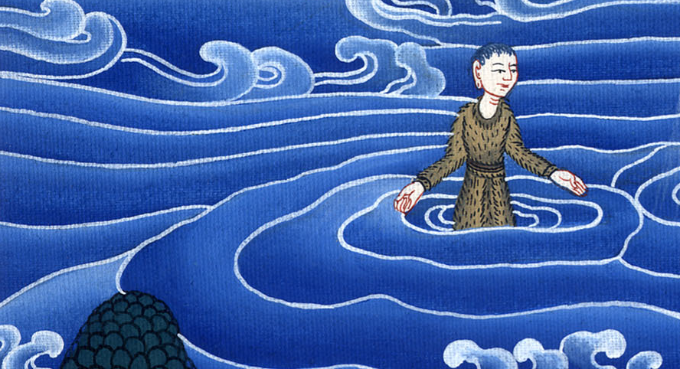
Matthew 3:11

Slide 17
13Then Jesus came from Galilee to the Jordan to John, to be baptized by him.

Slide 18
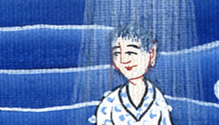
Matthew 3:13

Slide 19
14But John would have hindered him, saying, “I need to be baptized by you, and you come to me?”

Slide 20
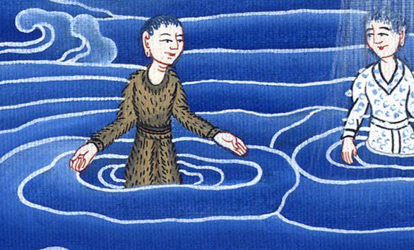
Matthew 3:14

Slide 21
15But Jesus, answering, said to him, “Allow it now, for this is the fitting way for us to fulfill all righteousness.” Then he allowed him.

Slide 22
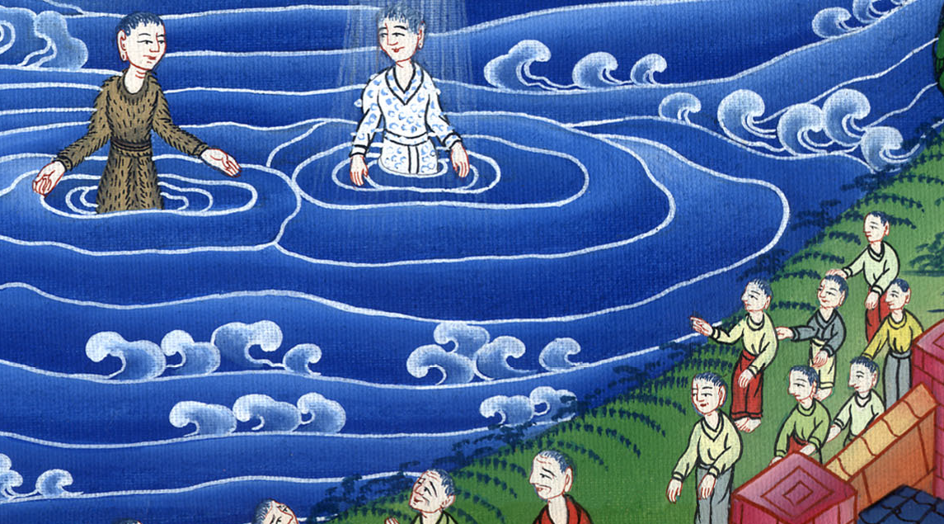
Matthew 3:15

Slide 23
16Jesus, when he was baptized, went up directly from the water: and behold, the heavens were opened to him. He saw the Spirit of God descending as a dove, and coming on him.

Slide 24
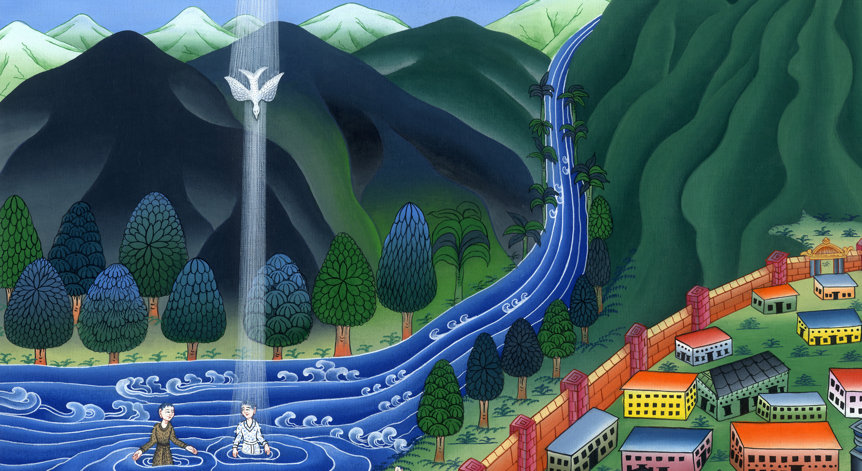
Matthew 3:16

Slide 25
17Behold, a voice out of the heavens said, “This is my beloved Son, with whom I am well pleased.”

Slide 26
མད་ཐཱ། 3:17

