Slide 1
32-2
This work is licensed under a Creative Commons Attribution-ShareAlike 4.0 International License.
Please add this statement to all the videos you create.
English Bible quotes are from the World English Bible US, which is in the public domain.
Notes:
Ch
32 Jesus Baptized
1. John Baptizes Jesus - Matthew 3:1 – 17 (Left Top)
2. The Temptation of Jesus (1) – Matthew 4:1–4 (Left Bottom)
3. Temptation (2) – Matt 4:5-7 (Right Bottom)
4. Temptation (3) – Matt 4:8-11 (Right Top)

Slide 2
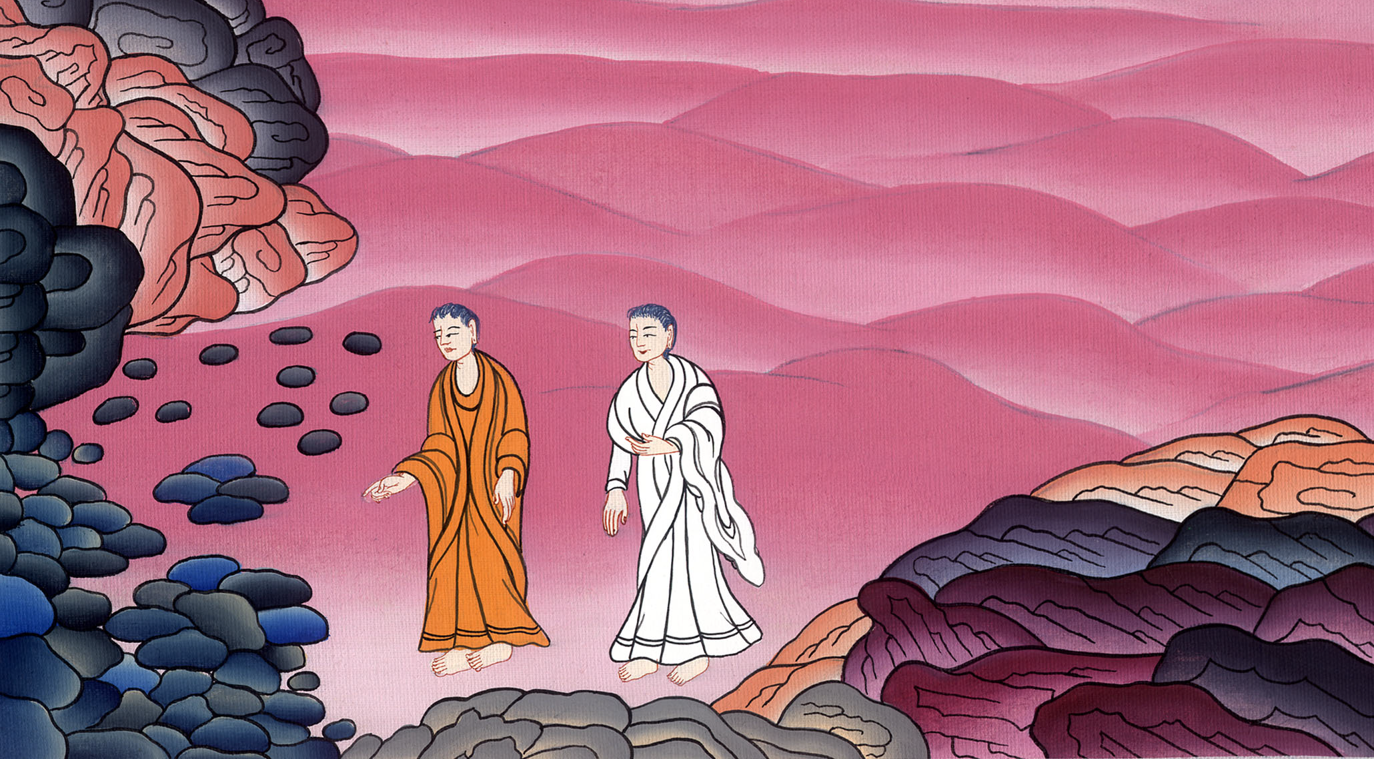
The Temptation of Jesus –
Matthew 4:1–11

Slide 3
The Temptation of Jesus –
Matthew 4:1–11

Slide 4
The Temptation of Jesus –
Matthew 4:1–11

Slide 5
1Then Jesus was led up by the Spirit into the wilderness to be tempted by the devil. 2When he had fasted forty days and forty nights, he was hungry afterward.

Slide 6
Matthew 4:1,2

Slide 7
3The tempter came and said to him, “If you are the Son of God, command that these stones become bread.”

Slide 8
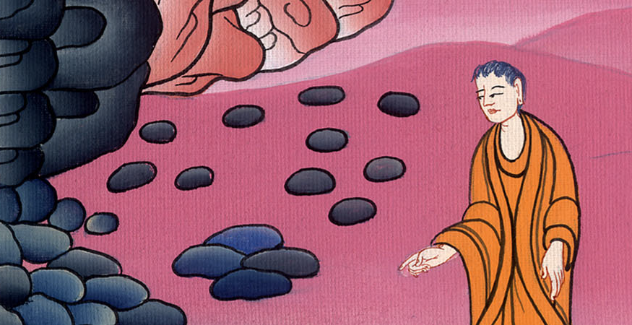
Matthew 4:3

Slide 9
4But he answered, “It is written, ‘Man shall not live by bread alone, but by every word that proceeds out of God’s mouth.’”

Slide 10
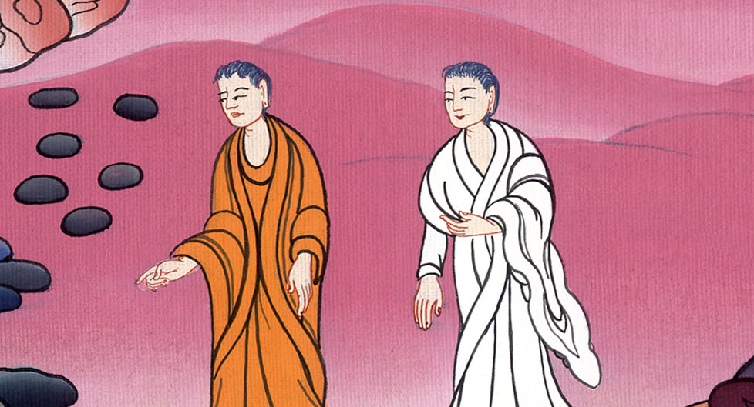
Matthew 4:4

Slide 11
5Then the devil took him into the holy city. He set him on the pinnacle of the temple,

Slide 12
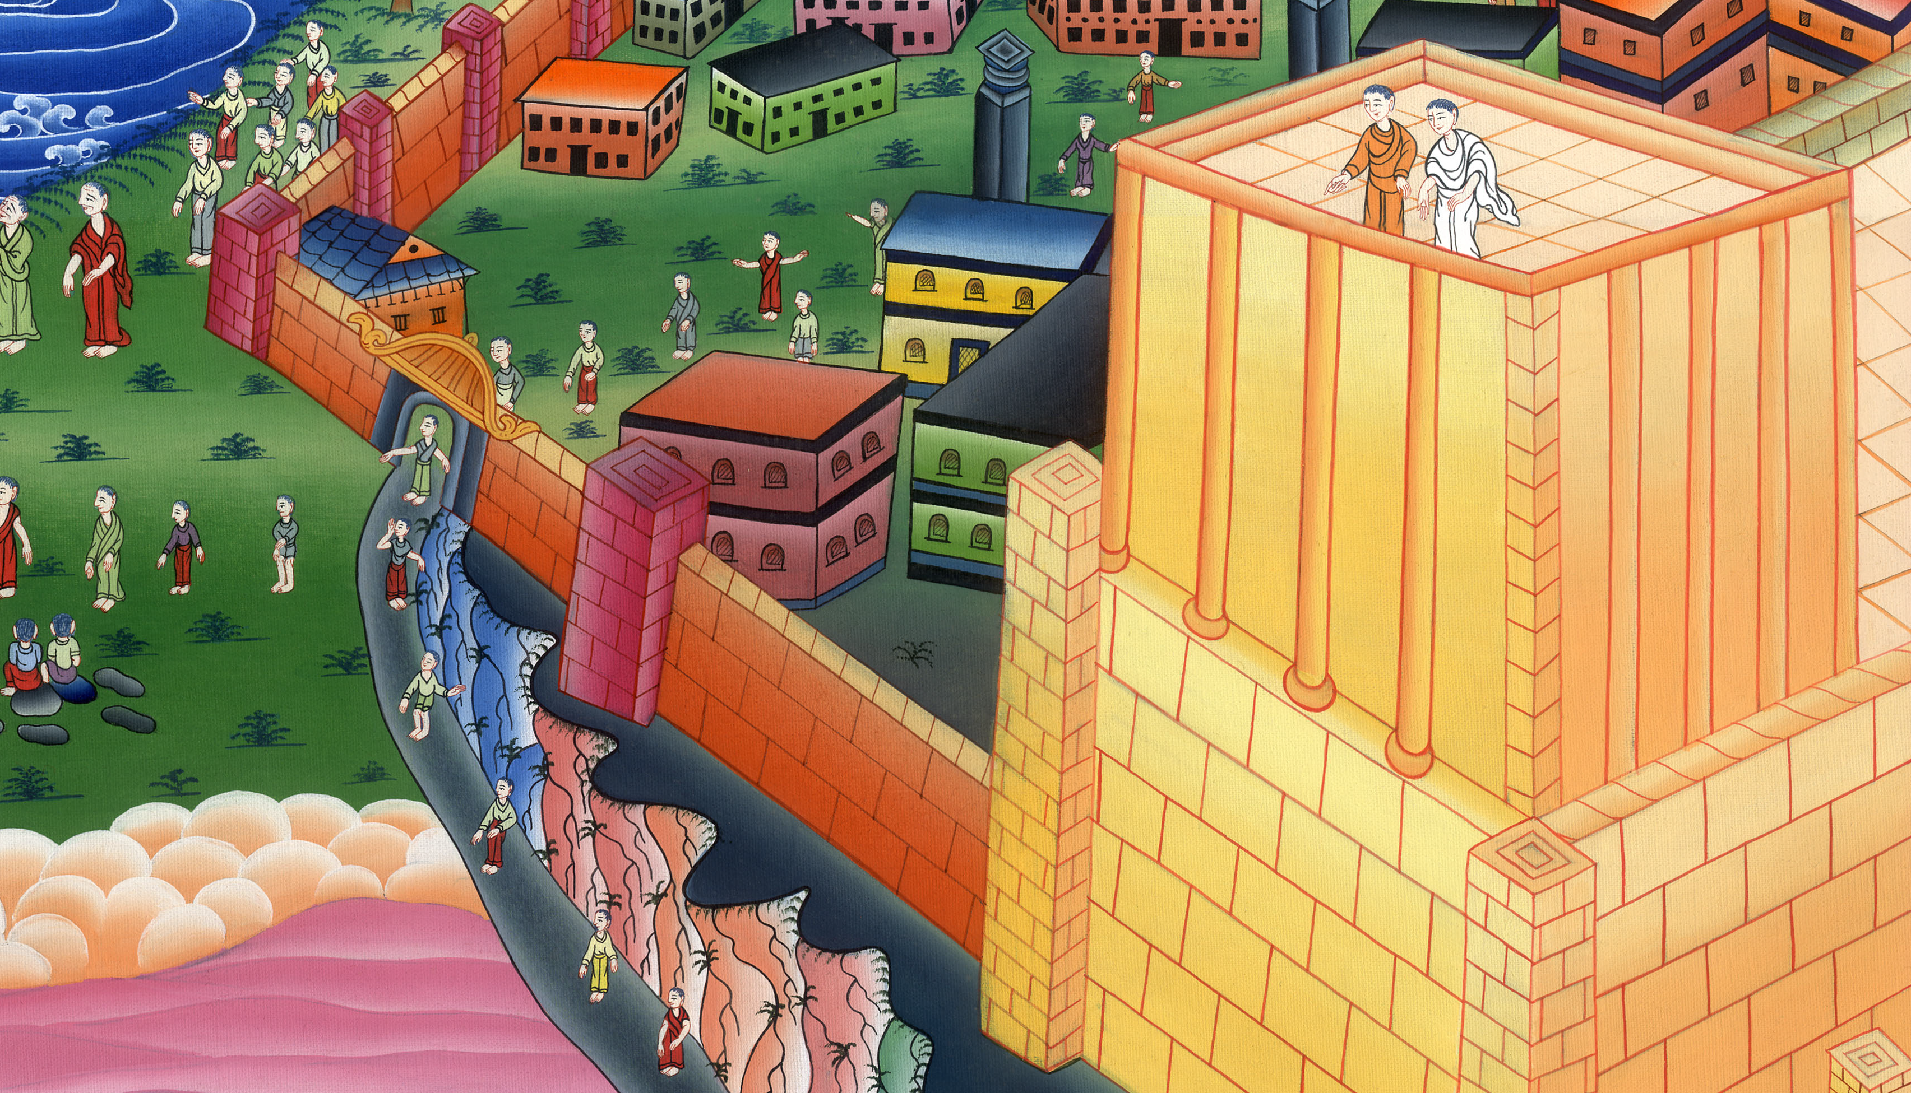
Matthew 4:5,6

Slide 13
6and said to him, “If you are the Son of God, throw yourself down, for it is written,
‘He will command his angels concerning you,’ and,
‘On their hands they will bear you up,
so that you don’t dash your foot against a stone.’”

Slide 14
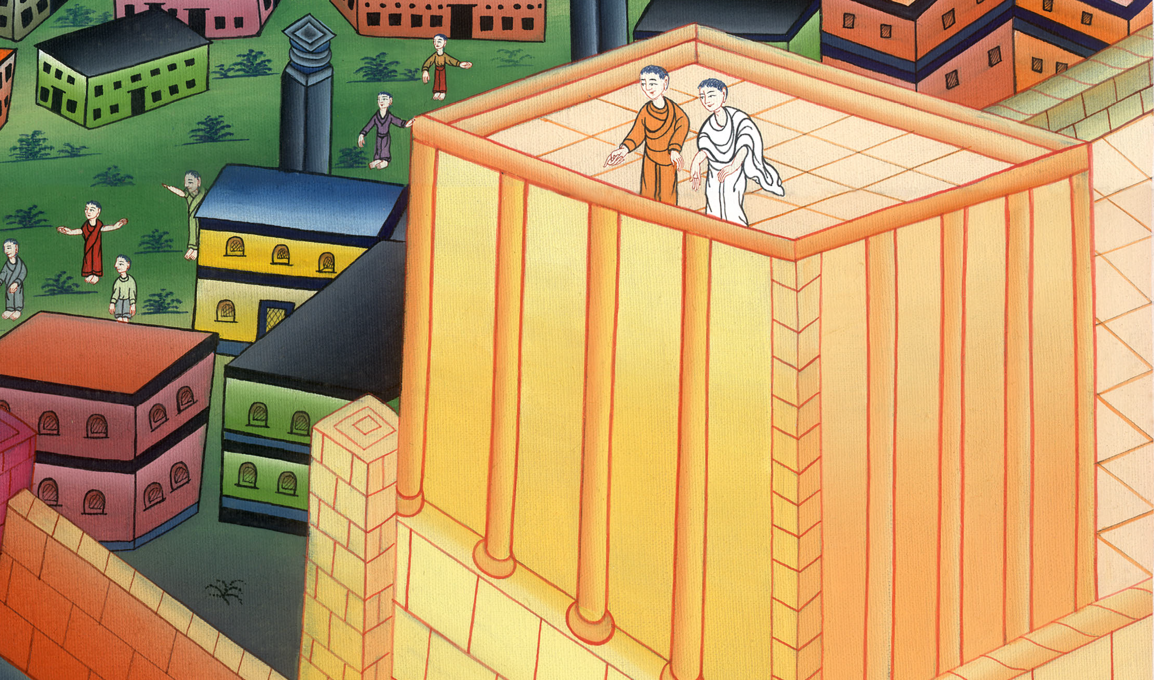
Matthew 4:6

Slide 15
7Jesus said to him, “Again, it is written, ‘You shall not test the Lord, your God.’”

Slide 16
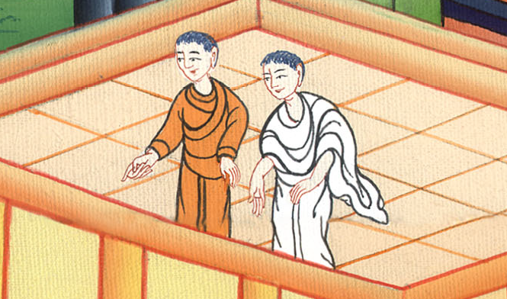
Matthew 4:7

Slide 17
8Again, the devil took him to an exceedingly high mountain, and showed him all the kingdoms of the world and their glory.

Slide 18
Matthew 4:8

Slide 19
9He said to him, “I will give you all of these things, if you will fall down and worship me.”

Slide 20
Matthew 4:9

Slide 21
10Then Jesus said to him, “Get behind me, Satan! For it is written, ‘You shall worship the Lord your God, and you shall serve him only.’”

Slide 22
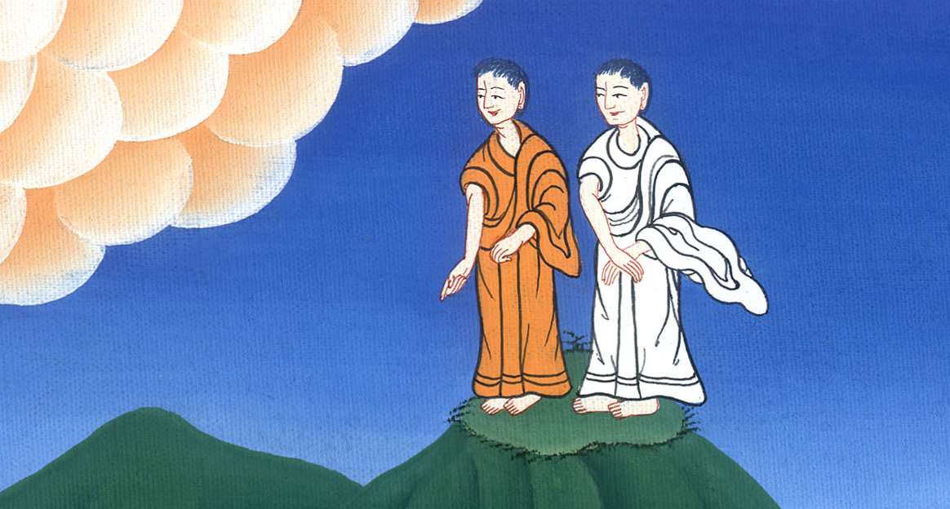
Matthew 4:10

Slide 23
11Then the devil left him, and behold, angels came and served him.

Slide 24
Matthew 4:11

