Slide 1
33-2
This work is licensed under a Creative Commons Attribution-ShareAlike 4.0 International License.
Please add this statement to all the videos you create.
English Bible quotes are from the World English Bible US, which is in the public domain.
Notes:
Ch
33 Jesus’ early ministry
1. John the Baptist tells about Jesus - John 1:19-42; John’s last witness - John 3:22-36;
and John in Prison - Luke 3:19-20 (Left Top)
2. Philip and Nathanael - John 1:43-51 (Center Top)
3. Wedding at Cana - John 2:1-12 (Right Top)
4. Nicodemus - John 3:1-21 (Right Bottom)
5. Woman at the Well - John 4:1-42 (Center Bottom)
6. Nobleman’s Son - John 4:46-54 (Left Bottom)
7. Sick man at Pool - John 5:1-47 (Left Center)
8. Jesus in Nazareth - Luke 4:16-30 (Right Center)

Slide 2
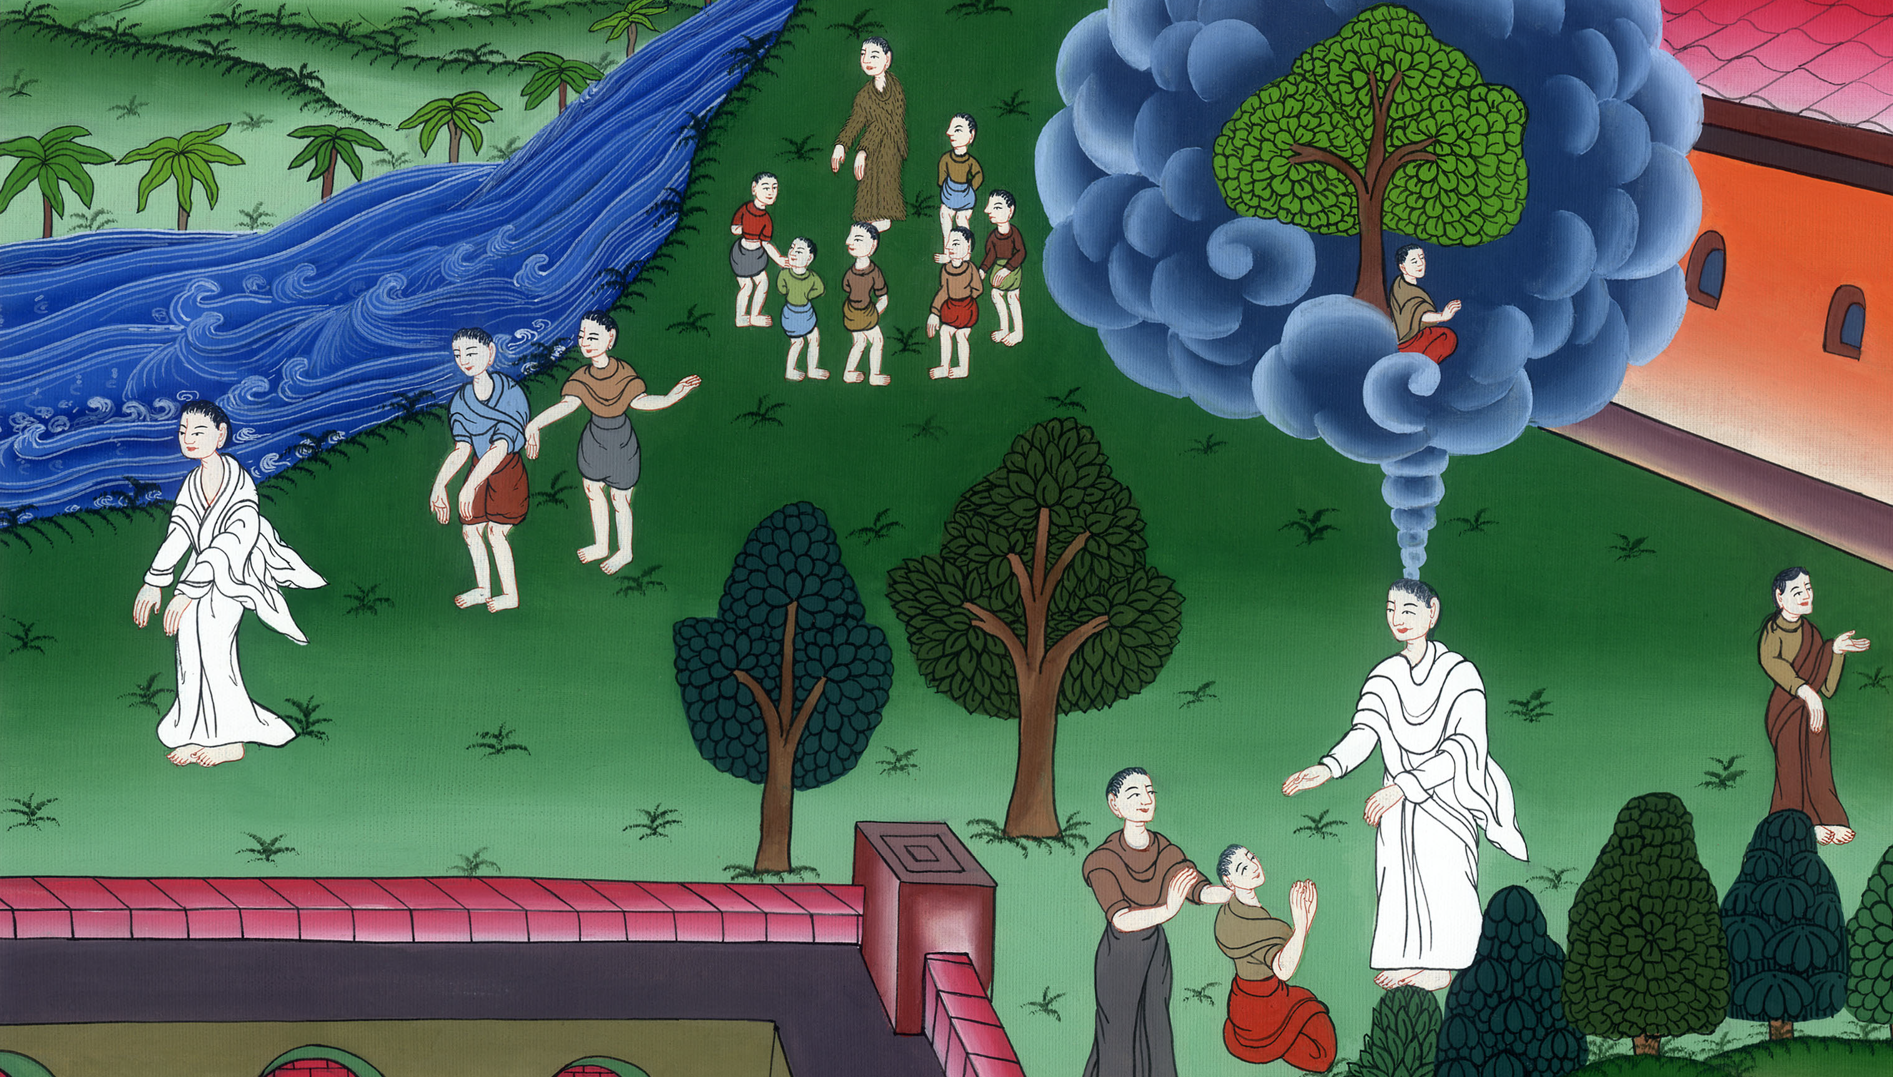
Philip and Nathanael –
John 1:35-51

Slide 3
Philip and Nathanael - John 1:35-51

Slide 4
Philip and Nathanael –
John 1:35-51

Slide 5
35Again, the next day, John was standing with two of his disciples, 36and he looked at Jesus as he walked, and said, “Behold, the Lamb of God!” 37The two disciples heard him speak, and they followed Jesus.

Slide 6
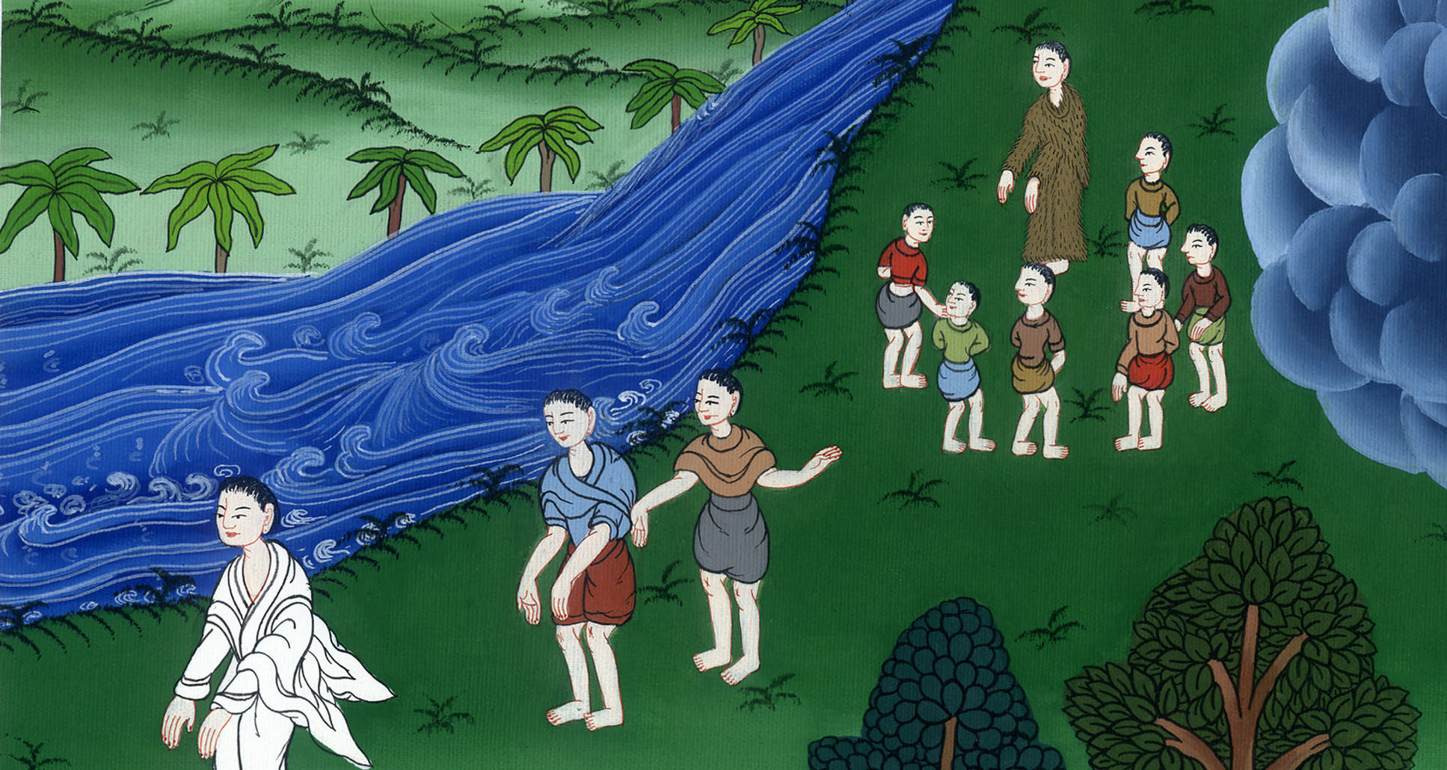
John 1:35-37

Slide 7
43On the next day, he was determined to go out into Galilee, and he found Philip. Jesus said to him, “Follow me.”

Slide 8
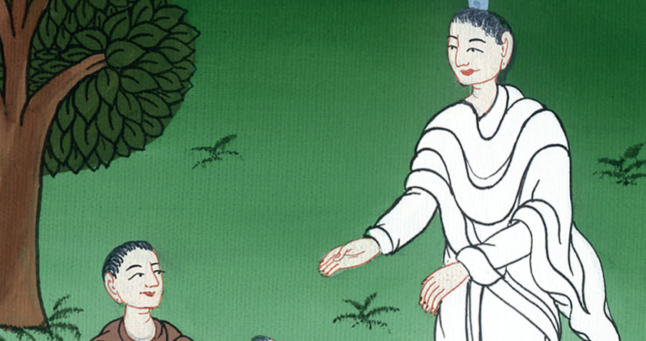
John 1:43

Slide 9
45Philip found Nathanael, and said to him, “We have found him of whom Moses in the law and also the prophets, wrote: Jesus of Nazareth, the son of Joseph.”

Slide 10
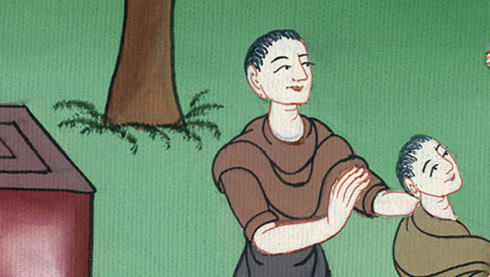
John 1:45

Slide 11
46Nathanael said to him, “Can any good thing come out of Nazareth?”
Philip said to him, “Come and see.”

Slide 12
John 1:46

Slide 13
47Jesus saw Nathanael coming to him, and said about him, “Behold, an Israelite indeed, in whom is no deceit!”

Slide 14
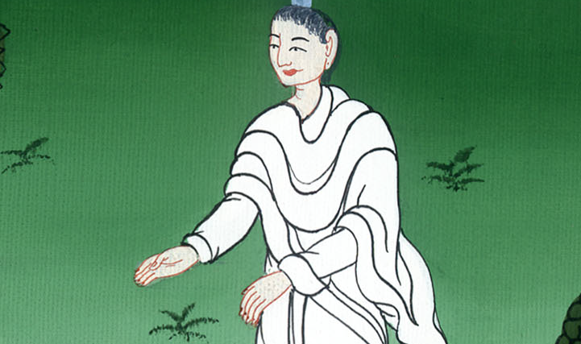
John 1:47

Slide 15
48Nathanael said to him, “How do you know me?”
Jesus answered him, “Before Philip called you, when you were under the fig tree, I saw you.”

Slide 16
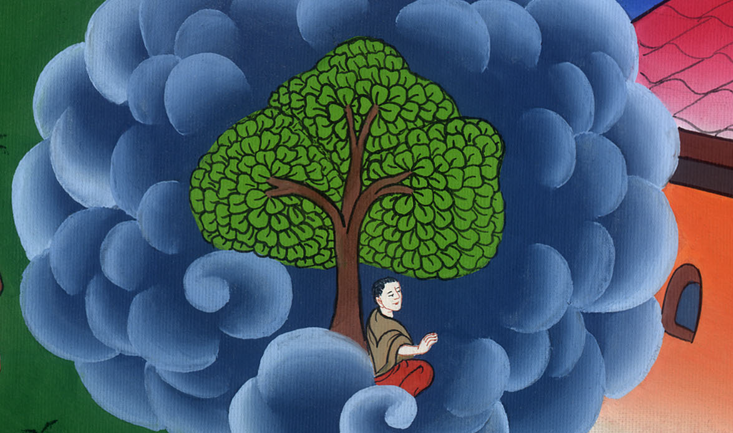
John 1:48

Slide 17
49Nathanael answered him, “Rabbi, you are the Son of God! You are King of Israel!”
50Jesus answered him, “Because I told you, ‘I saw you underneath the fig tree,’ do you believe? You will see greater things than these!”

Slide 18
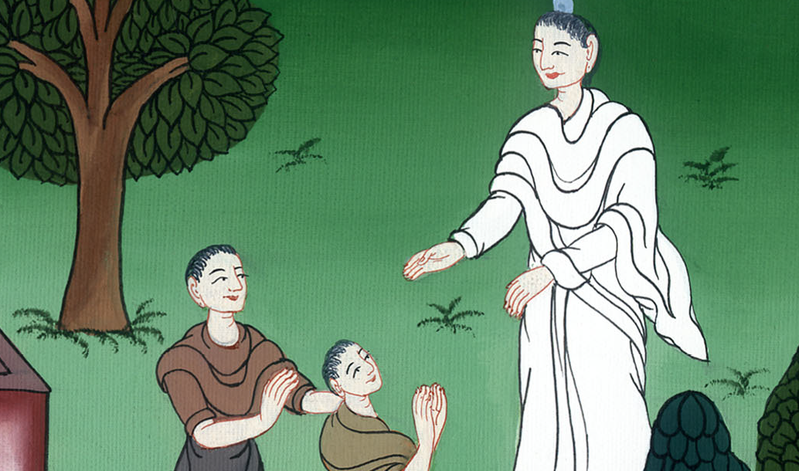
John 1:49,50

Slide 19
51He said to him, “Most certainly, I tell you all, hereafter you will see heaven opened, and the angels of God ascending and descending on the Son of Man.”

Slide 20
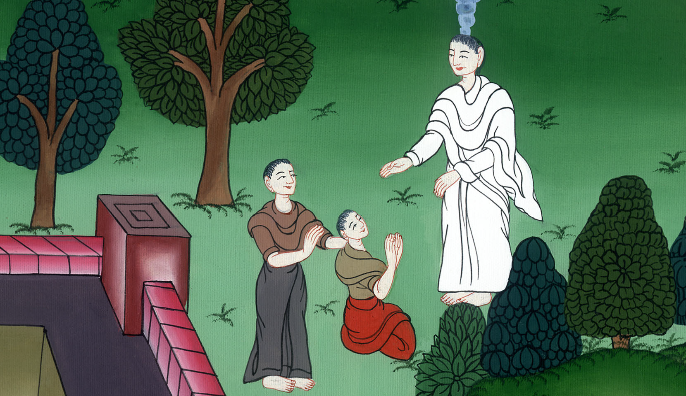
John 1:51

