Slide 1
33-3
This work is licensed under a Creative Commons Attribution-ShareAlike 4.0 International License.
Please add this statement to all the videos you create.
English Bible quotes are from the World English Bible US, which is in the public domain.
Notes:
Ch
33 Jesus’ early ministry
1. John the Baptist tells about Jesus - John 1:19-42; John’s last witness - John 3:22-36;
and John in Prison - Luke 3:19-20 (Left Top)
2. Philip and Nathanael - John 1:43-51 (Center Top)
3. Wedding at Cana - John 2:1-12 (Right Top)
4. Nicodemus - John 3:1-21 (Right Bottom)
5. Woman at the Well - John 4:1-42 (Center Bottom)
6. Nobleman’s Son - John 4:46-54 (Left Bottom)
7. Sick man at Pool - John 5:1-47 (Left Center)
8. Jesus in Nazareth - Luke 4:16-30 (Right Center)

Slide 2
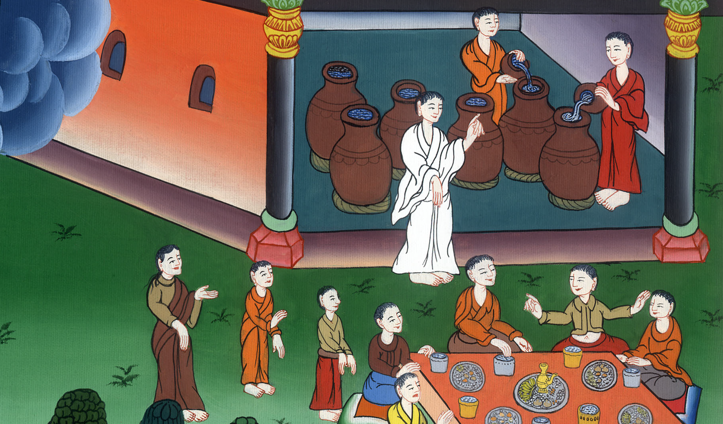
Wedding at Cana - John 2:1-12

Slide 3
Wedding at Cana - John 2:1-12

Slide 4
Wedding at Cana - John 2:1-12

Slide 5
1The third day, there was a wedding in Cana of Galilee. Jesus’ mother was there. 2Jesus also was invited, with his disciples, to the wedding.

Slide 6
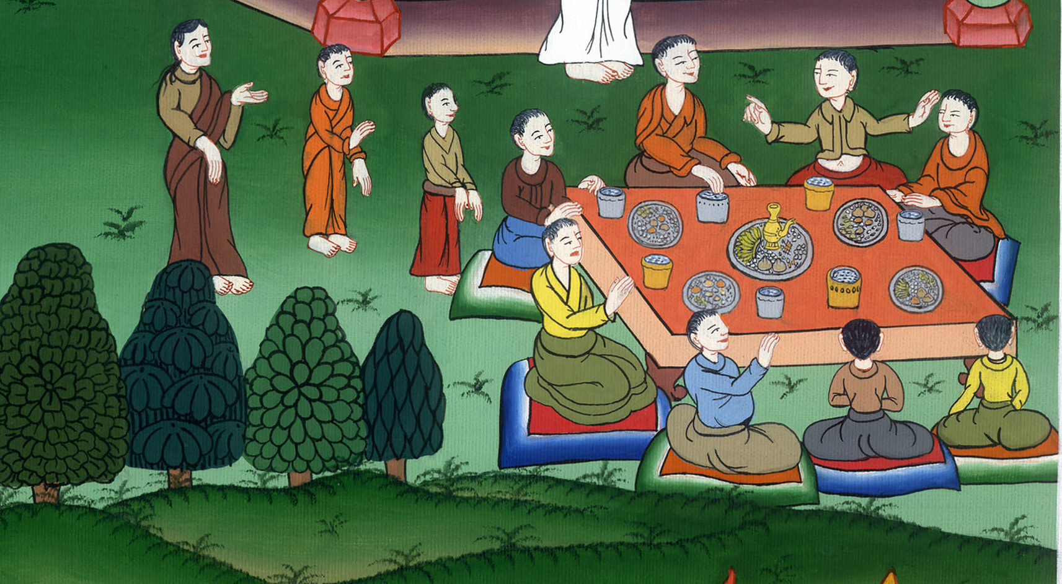
John 2:1,2

Slide 7
3When the wine ran out, Jesus’ mother said to him, “They have no wine.”
4Jesus said to her, “Woman, what does that have to do with you and me? My hour has not yet come.”

Slide 8
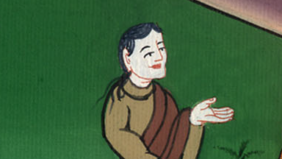
John 2:3,4

Slide 9
5His mother said to the servants, “Whatever he says to you, do it.”

Slide 10
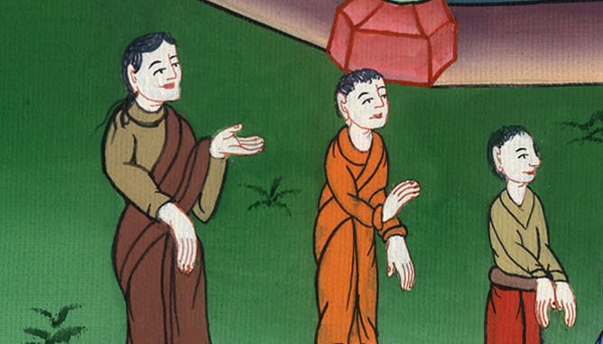
John 2:5

Slide 11
6Now there were six water pots of stone set there after the Jews’ way of purifying, containing two or three metretes apiece.

Slide 12
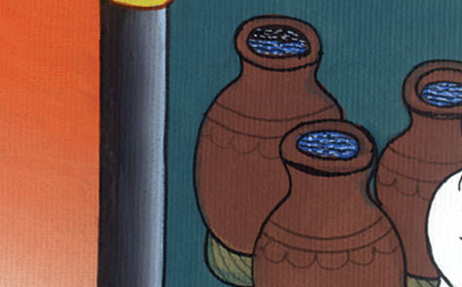
John 2:6

Slide 13
7Jesus said to them, “Fill the water pots with water.” So they filled them up to the brim.

Slide 14
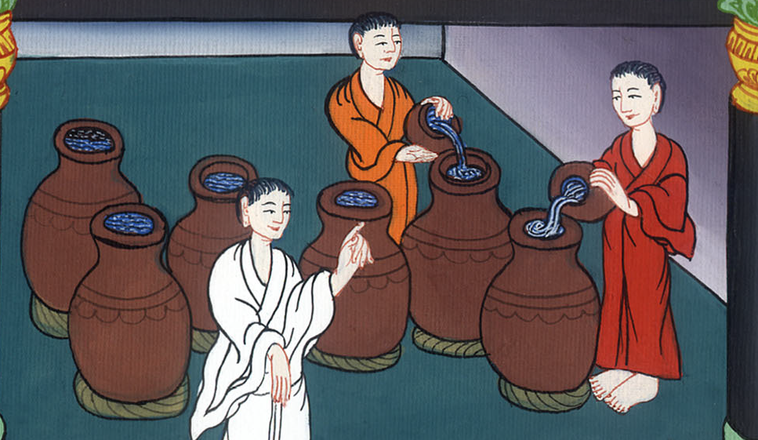
John 2:7

Slide 15
8He said to them, “Now draw some out, and take it to the ruler of the feast.” So they took it.

Slide 16
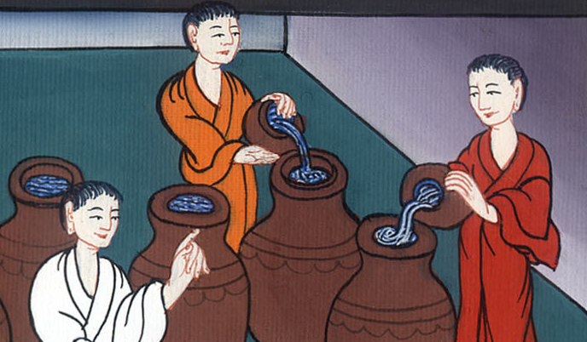
John 2:8

Slide 17
9When the ruler of the feast tasted the water now become wine, and didn’t know where it came from (but the servants who had drawn the water knew), the ruler of the feast called the bridegroom

Slide 18
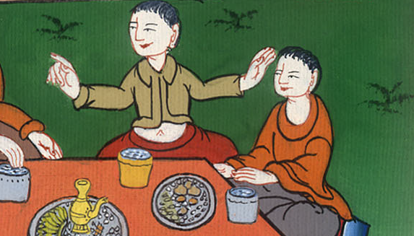
John 2:9

Slide 19
10and said to him, “Everyone serves the good wine first, and when the guests have drunk freely, then that which is worse. You have kept the good wine until now!”

Slide 20
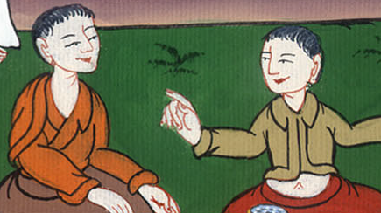
John 2:10

Slide 21
11This beginning of his signs Jesus did in Cana of Galilee, and revealed his glory; and his disciples believed in him.

Slide 22
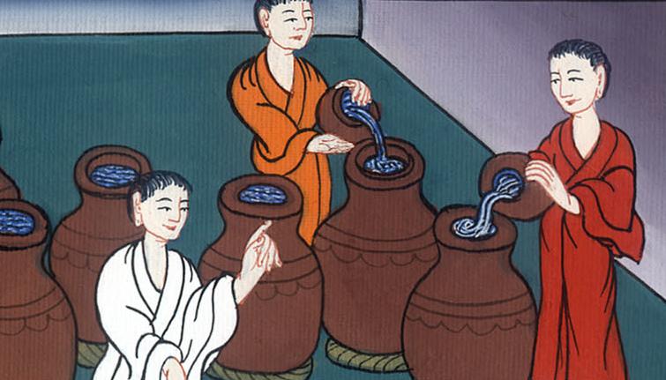
John 2:11

Slide 23
12After this, he went down to Capernaum, he, and his mother, his brothers, and his disciples; and they stayed there a few days.

Slide 24
John 2:12

