Slide 1
33-4
This work is licensed under a Creative Commons Attribution-ShareAlike 4.0 International License.
Please add this statement to all the videos you create.
English Bible quotes are from the World English Bible US, which is in the public domain.
Notes:
Ch
33 Jesus’ early ministry
1. John the Baptist tells about Jesus - John 1:19-42; John’s last witness - John 3:22-36;
and John in Prison - Luke 3:19-20 (Left Top)
2. Philip and Nathanael - John 1:43-51 (Center Top)
3. Wedding at Cana - John 2:1-12 (Right Top)
4. Nicodemus - John 3:1-21 (Right Bottom)
5. Woman at the Well - John 4:1-42 (Center Bottom)
6. Nobleman’s Son - John 4:46-54 (Left Bottom)
7. Sick man at Pool - John 5:1-47 (Left Center)
8. Jesus in Nazareth - Luke 4:16-30 (Right Center)

Slide 2
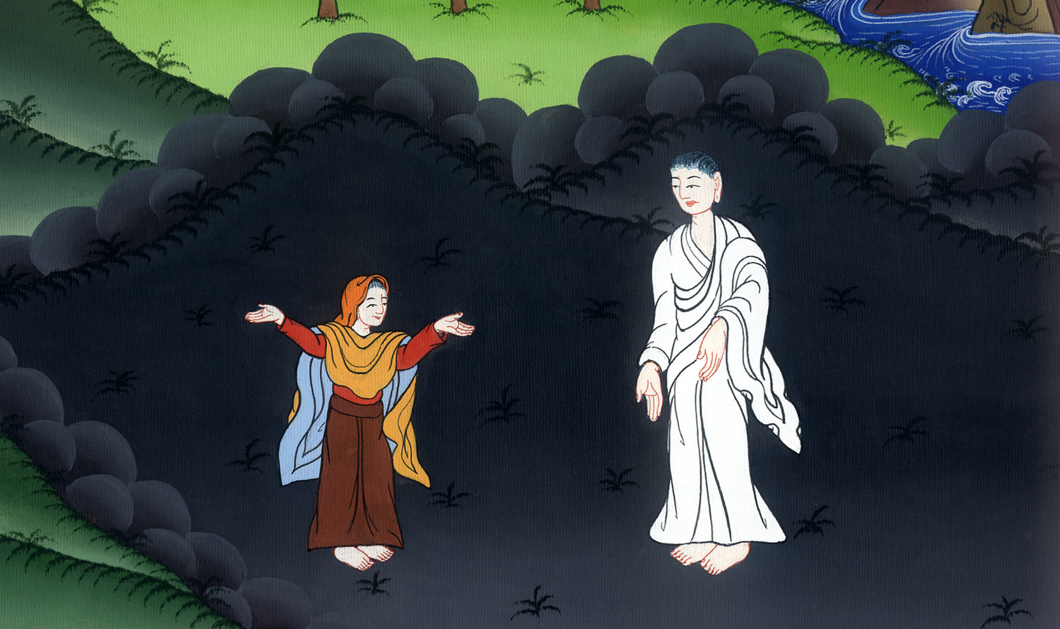
Nicodemus –
John 3:1-21

Slide 3
Nicodemus - John 3:1-21

Slide 4
Nicodemus –
John 3:1-21

Slide 5
1Now there was a man of the Pharisees named Nicodemus, a ruler of the Jews.

Slide 6
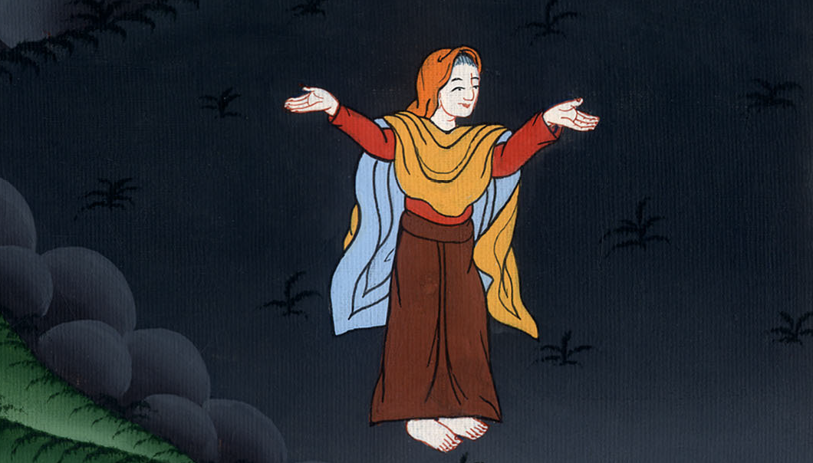
John 3:1

Slide 7
2He came to Jesus by night and said to him, “Rabbi, we know that you are a teacher come from God, for no one can do these signs that you do, unless God is with him.”

Slide 8
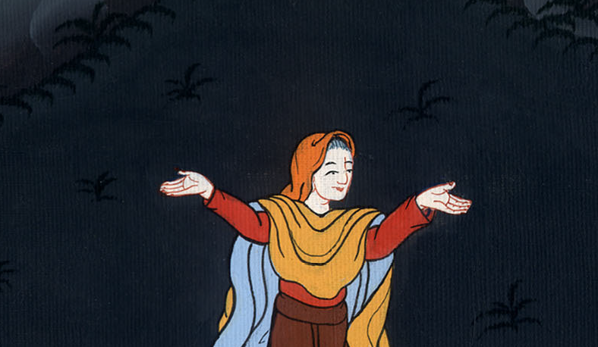
John 3:2

Slide 9
3Jesus answered him, “Most certainly I tell you, unless one is born anew, he can’t see God’s Kingdom.”

Slide 10
John 3:3

Slide 11
4Nicodemus said to him, “How can a man be born when he is old? Can he enter a second time into his mother’s womb and be born?”

Slide 12
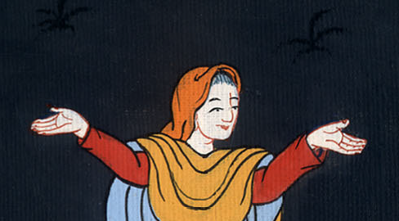
John 3:4

Slide 13
5Jesus answered, “Most certainly I tell you, unless one is born of water and Spirit, he can’t enter into God’s Kingdom.

Slide 14
John 3:4

Slide 15
6That which is born of the flesh is flesh. That which is born of the Spirit is spirit. 7Don’t marvel that I said to you, ‘You must be born anew.’

Slide 16
John 3:6,7

Slide 17
8The wind blows where it wants to, and you hear its sound, but don’t know where it comes from and where it is going. So is everyone who is born of the Spirit.”

Slide 18
John 3:8

Slide 19
9Nicodemus answered him, “How can these things be?”
10Jesus answered him, “Are you the teacher of Israel, and don’t understand these things?

Slide 20
John 3:9,10

Slide 21
11Most certainly I tell you, we speak that which we know and testify of that which we have seen, and you don’t receive our witness.

Slide 22
John 3:11

Slide 23
12If I told you earthly things and you don’t believe, how will you believe if I tell you heavenly things?

Slide 24
John 3:12

Slide 25
13No one has ascended into heaven but he who descended out of heaven, the Son of Man, who is in heaven.

Slide 26
John 3:13

Slide 27
14As Moses lifted up the serpent in the wilderness, even so must the Son of Man be lifted up, 15that whoever believes in him should not perish, but have eternal life.

Slide 28
John 3:14,15

Slide 29
16For God so loved the world, that he gave his only born Son, that whoever believes in him should not perish, but have eternal life.

Slide 30
John 3:16

Slide 31
17For God didn’t send his Son into the world to judge the world, but that the world should be saved through him.

Slide 32
John 3:17

Slide 33
18He who believes in him is not judged. He who doesn’t believe has been judged already, because he has not believed in the name of the only born Son of God.

Slide 34
John 3:18

Slide 35
19This is the judgment, that the light has come into the world, and men loved the darkness rather than the light, for their works were evil.

Slide 36
John 3:19

Slide 37
20For everyone who does evil hates the light and doesn’t come to the light, lest his works would be exposed.

Slide 38
John 3:20

Slide 39
21But he who does the truth comes to the light, that his works may be revealed, that they have been done in God.”

Slide 40
John 3:21

