Slide 1
33-5
This work is licensed under a Creative Commons Attribution-ShareAlike 4.0 International License.
Please add this statement to all the videos you create.
English Bible quotes are from the World English Bible US, which is in the public domain.
Notes:
33 Jesus’ early ministry
1. John the Baptist tells about Jesus - John 1:19-42; John’s last witness - John 3:22-36;
and John in Prison - Luke 3:19-20 (Left Top)
2. Philip and Nathanael - John 1:43-51 (Center Top)
3. Wedding at Cana - John 2:1-12 (Right Top)
4. Nicodemus - John 3:1-21 (Right Bottom)
5. Woman at the Well - John 4:1-42 (Center Bottom)
6. Nobleman’s Son - John 4:46-54 (Left Bottom)
7. Sick man at Pool - John 5:1-47 (Left Center)
8. Jesus in Nazareth - Luke 4:16-30 (Right Center)

Slide 2
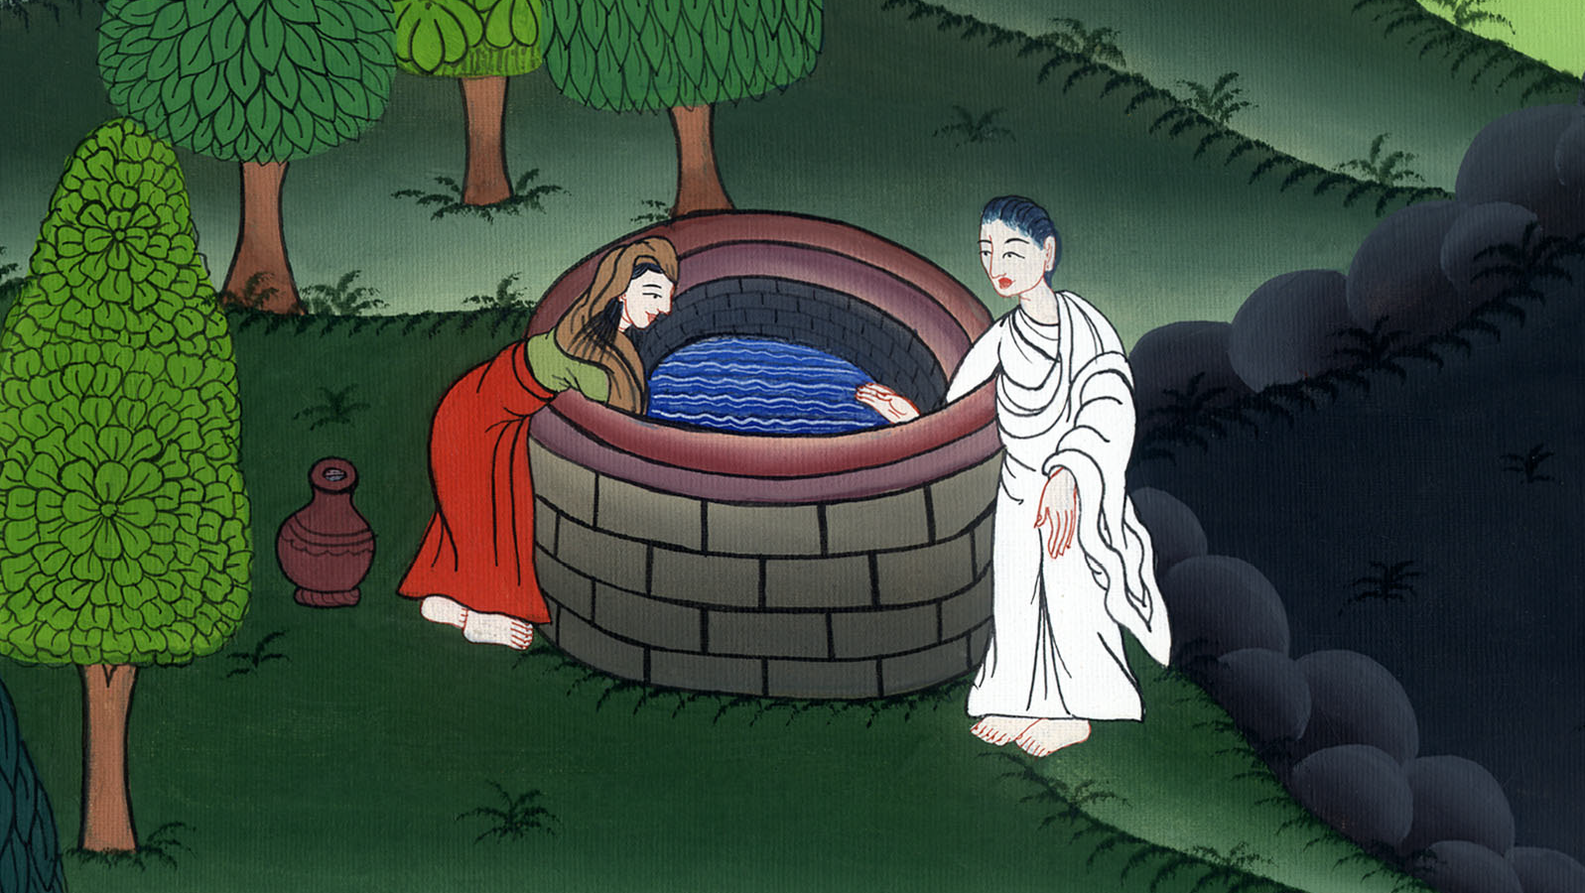
Woman at the Well - John 4:1-42

Slide 3
Woman at the Well - John 4:1-42

Slide 4
Woman at the Well - John 4:1-42

Slide 5
4He needed to pass through Samaria. 5So he came to a city of Samaria called Sychar, near the parcel of ground that Jacob gave to his son Joseph. 6Jacob’s well was there. Jesus therefore, being tired from his journey, sat down by the well. It was about the sixth hour.

Slide 6
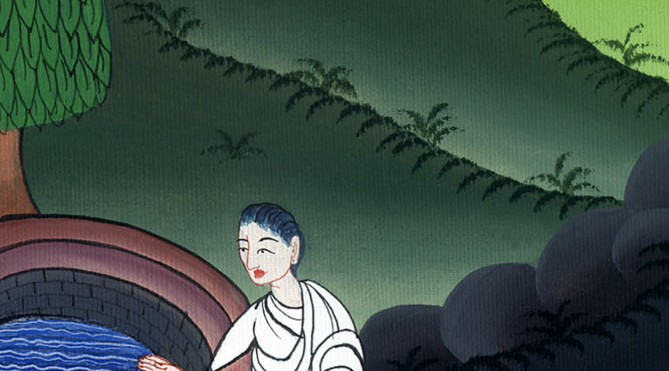
John 4:4-6

Slide 7
7A woman of Samaria came to draw water. Jesus said to her, “Give me a drink.” 8For his disciples had gone away into the city to buy food.

Slide 8
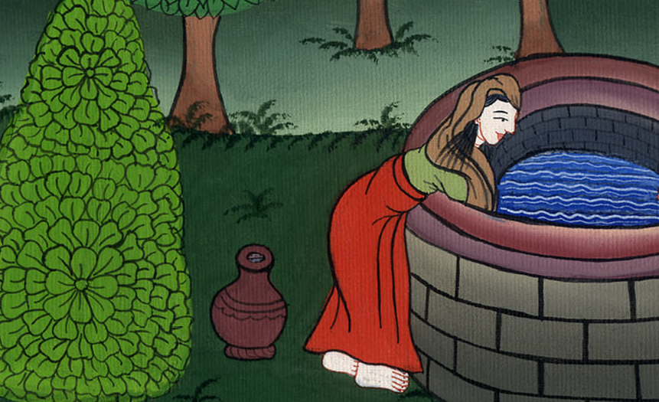
John 4:7,8

Slide 9
9The Samaritan woman therefore said to him, “How is it that you, being a Jew, ask for a drink from me, a Samaritan woman?” (For Jews have no dealings with Samaritans.)

Slide 10
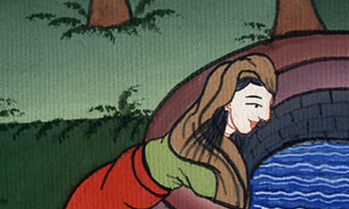
John 4:9

Slide 11
10Jesus answered her, “If you knew the gift of God, and who it is who says to you, ‘Give me a drink,’ you would have asked him, and he would have given you living water.”

Slide 12
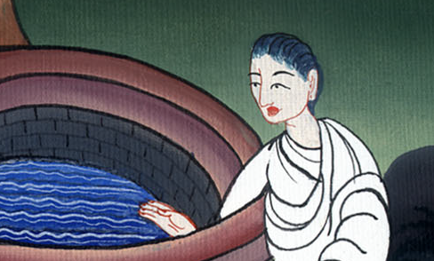
John 4:10

Slide 13
11The woman said to him, “Sir, you have nothing to draw with, and the well is deep. So where do you get that living water?

Slide 14
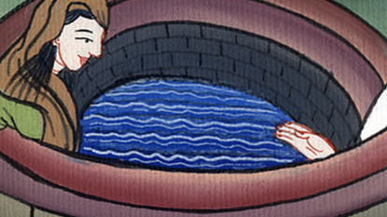
John 4:11

Slide 15
13Jesus answered her, “Everyone who drinks of this water will thirst again, 14but whoever drinks of the water that I will give him will never thirst again; but the water that I will give him will become in him a well of water springing up to eternal life.”

Slide 16
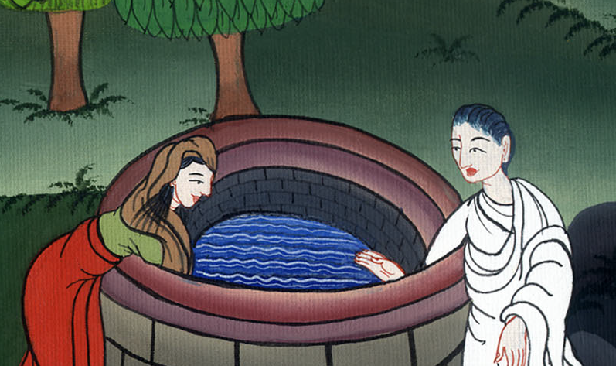
John 4:13,14

Slide 17
15The woman said to him, “Sir, give me this water, so that I don’t get thirsty, neither come all the way here to draw.”
16Jesus said to her, “Go, call your husband, and come here.”

Slide 18
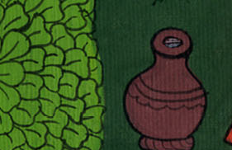
John 4:15,16

Slide 19
17The woman answered, “I have no husband.”
Jesus said to her, “You said well, ‘I have no husband,’ 18for you have had five husbands; and he whom you now have is not your husband. This you have said truly.”

Slide 20
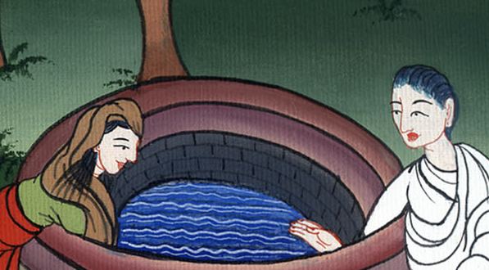
John 4:17,18

Slide 21
19The woman said to him, “Sir, I perceive that you are a prophet. 20Our fathers worshiped in this mountain, and you Jews say that in Jerusalem is the place where people ought to worship.”

Slide 22
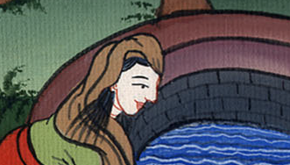
John 4:19,20

Slide 23
21Jesus said to her, “Woman, believe me, the hour is coming when neither in this mountain nor in Jerusalem will you worship the Father.

Slide 24
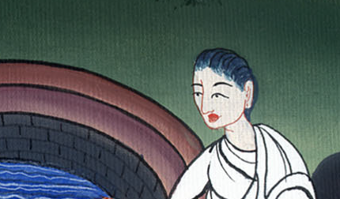
John 4:21

Slide 25
22You worship that which you don’t know. We worship that which we know; for salvation is from the Jews.

Slide 26
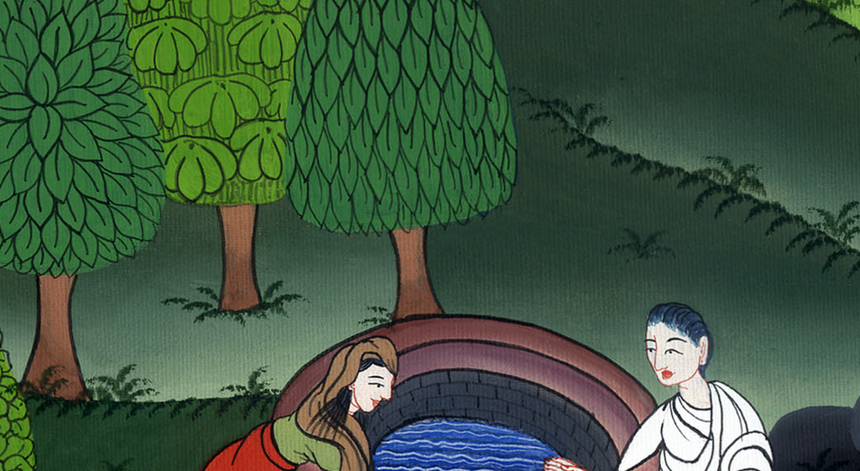
John 4:22

Slide 27
23But the hour comes, and now is, when the true worshipers will worship the Father in spirit and truth, for the Father seeks such to be his worshipers.

Slide 28
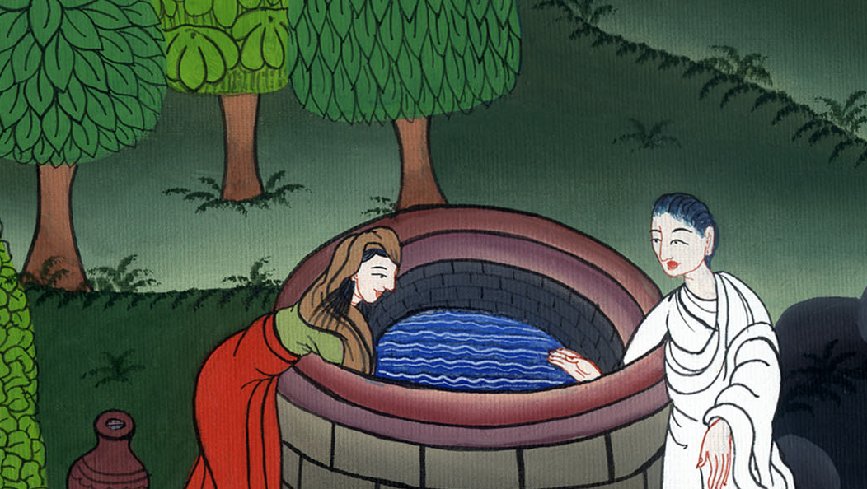
John 4:23

Slide 29
24God is spirit, and those who worship him must worship in spirit and truth.”

Slide 30
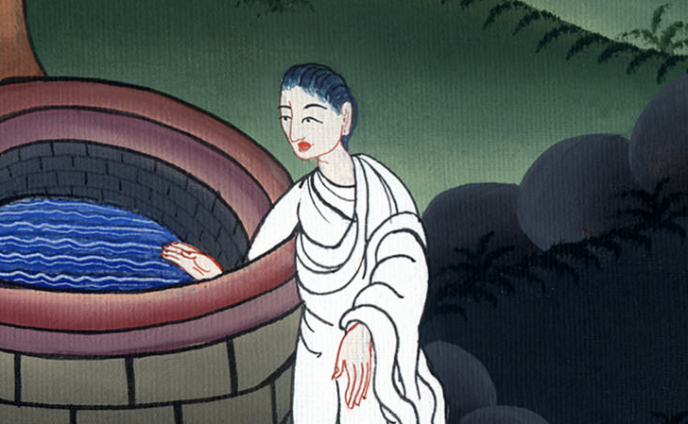
John 4:24

Slide 31
25The woman said to him, “I know that Messiah is coming, he who is called Christ. When he has come, he will declare to us all things.”
26Jesus said to her, “I am he, the one who speaks to you.”

Slide 32
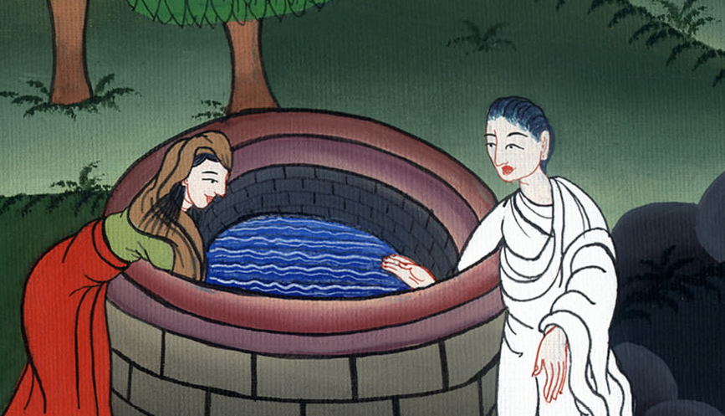
John 4:25,26

Slide 33
27Just then, his disciples came. They marveled that he was speaking with a woman; yet no one said, “What are you looking for?” or, “Why do you speak with her?”

Slide 34
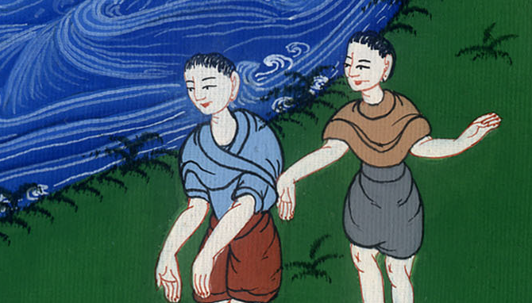
John 4:27

Slide 35
28So the woman left her water pot, went away into the city, and said to the people, 29“Come, see a man who told me everything that I have done. Can this be the Christ?” 30They went out of the city, and were coming to him.

Slide 36
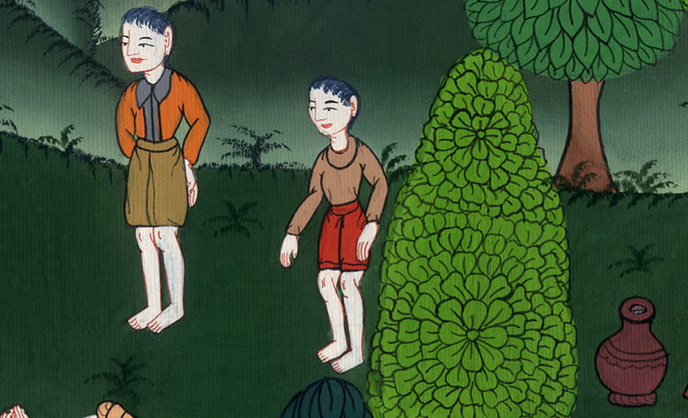
John 4:28,29

Slide 37
39From that city many of the Samaritans believed in him because of the word of the woman, who testified, “He told me everything that I have done.”

Slide 38
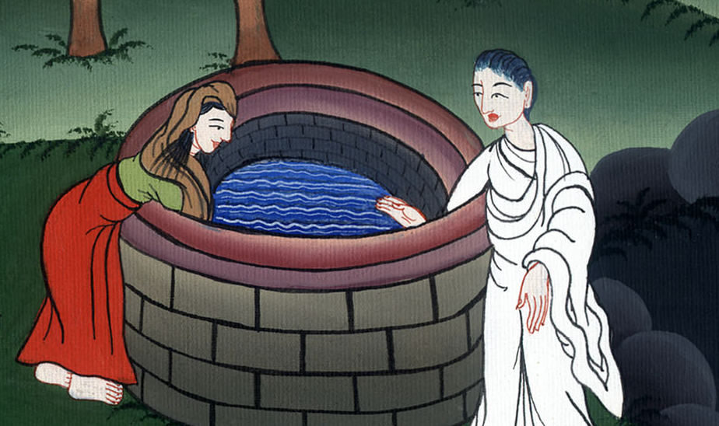
John 4:30

Slide 39
40So when the Samaritans came to him, they begged him to stay with them. He stayed there two days. 41Many more believed because of his word.

Slide 40
John 4:40,41

