Slide 1
33-6
This work is licensed under a Creative Commons Attribution-ShareAlike 4.0 International License.
Please add this statement to all the videos you create.
English Bible quotes are from the World English Bible US, which is in the public domain.
Notes:
Ch
33 Jesus’ early ministry
1. John the Baptist tells about Jesus - John 1:19-42; John’s last witness - John 3:22-36;
and John in Prison - Luke 3:19-20 (Left Top)
2. Philip and Nathanael - John 1:43-51 (Center Top)
3. Wedding at Cana - John 2:1-12 (Right Top)
4. Nicodemus - John 3:1-21 (Right Bottom)
5. Woman at the Well - John 4:1-42 (Center Bottom)
6. Nobleman’s Son - John 4:46-54 (Left Bottom)
7. Sick man at Pool - John 5:1-47 (Left Center)
8. Jesus in Nazareth - Luke 4:16-30 (Right Center)

Slide 2
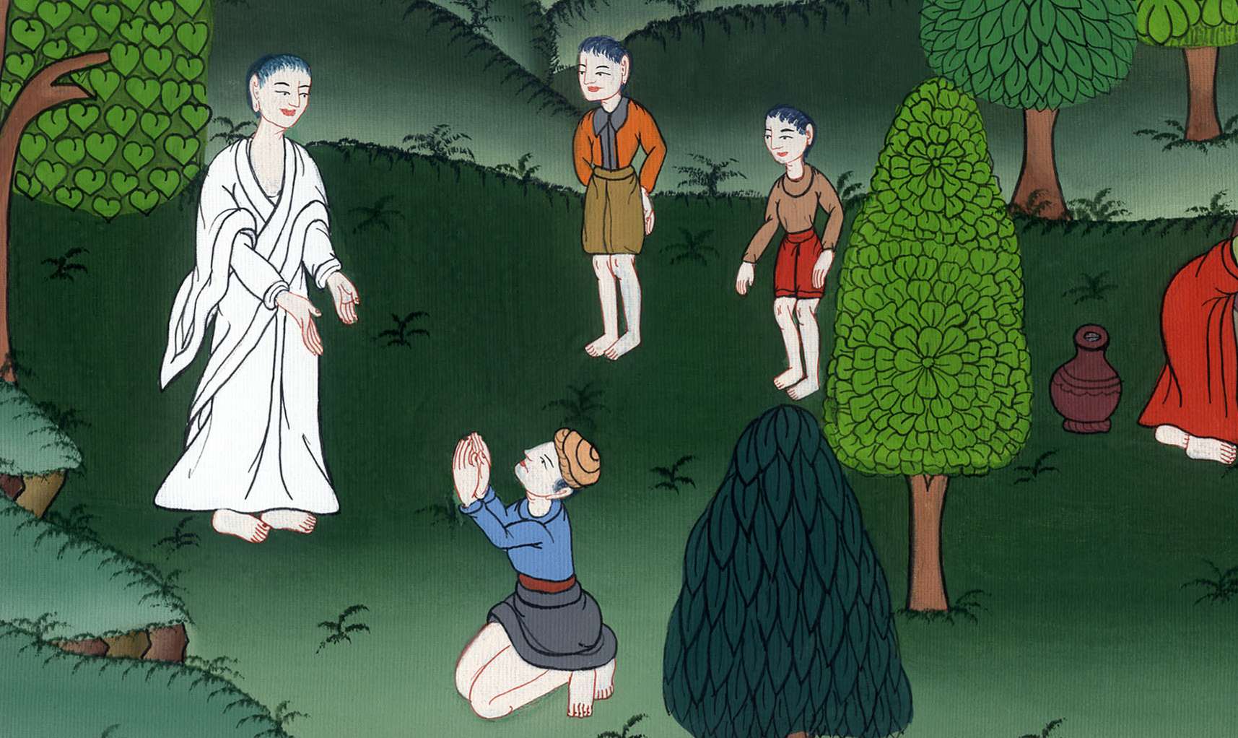
The Nobleman’s Son –
John 4:46-54

Slide 3
The Nobleman’s Son - John 4:46-54

Slide 4
The Nobleman’s Son –
John 4:46-54

Slide 5
46Jesus came therefore again to Cana of Galilee, where he made the water into wine. There was a certain nobleman whose son was sick at Capernaum.

Slide 6
John 4:46

Slide 7
47When he heard that Jesus had come out of Judea into Galilee, he went to him and begged him that he would come down and heal his son, for he was at the point of death.

Slide 8
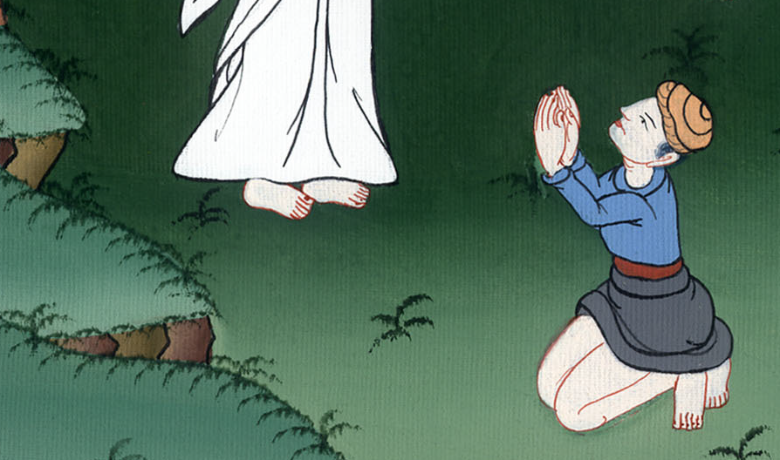
John 4:47

Slide 9
48Jesus therefore said to him, “Unless you see signs and wonders, you will in no way believe.”
49The nobleman said to him, “Sir, come down before my child dies.”

Slide 10
John 4:48,49

Slide 11
50Jesus said to him, “Go your way. Your son lives.” The man believed the word that Jesus spoke to him, and he went his way. 51As he was going down, his servants met him and reported, saying “Your child lives!”

Slide 12
John 4:50,51

Slide 13
52So he inquired of them the hour when he began to get better. They said therefore to him, “Yesterday at the seventh hour, the fever left him.”

Slide 14
John 4:52

Slide 15
53So the father knew that it was at that hour in which Jesus said to him, “Your son lives.” He believed, as did his whole house.

Slide 16
John 4:53

