Slide 1
33-7
This work is licensed under a Creative Commons Attribution-ShareAlike 4.0 International License.
Please add this statement to all the videos you create.
English Bible quotes are from the World English Bible US, which is in the public domain.
Notes:
Ch
33 Jesus’ early ministry
1. John the Baptist tells about Jesus - John 1:19-42; John’s last witness - John 3:22-36;
and John in Prison - Luke 3:19-20 (Left Top)
2. Philip and Nathanael - John 1:43-51 (Center Top)
3. Wedding at Cana - John 2:1-12 (Right Top)
4. Nicodemus - John 3:1-21 (Right Bottom)
5. Woman at the Well - John 4:1-42 (Center Bottom)
6. Nobleman’s Son - John 4:46-54 (Left Bottom)
7. Sick man at Pool - John 5:1-47 (Left Center)
8. Jesus in Nazareth - Luke 4:16-30 (Right Center)

Slide 2
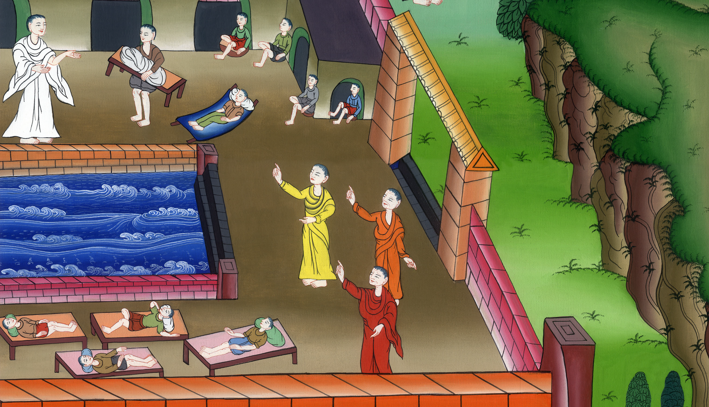
Jesus Heals a Man at the Pool - John 5:1-47

Slide 3
Jesus Heals a Man at the Pool - John 5:1-47

Slide 4
Jesus Heals a Man at the Pool - John 5:1-47

Slide 5
1After these things, there was a feast of the Jews, and Jesus went up to Jerusalem. 2Now in Jerusalem by the sheep gate, there is a pool, which is called in Hebrew, “Bethesda”, having five porches.

Slide 6
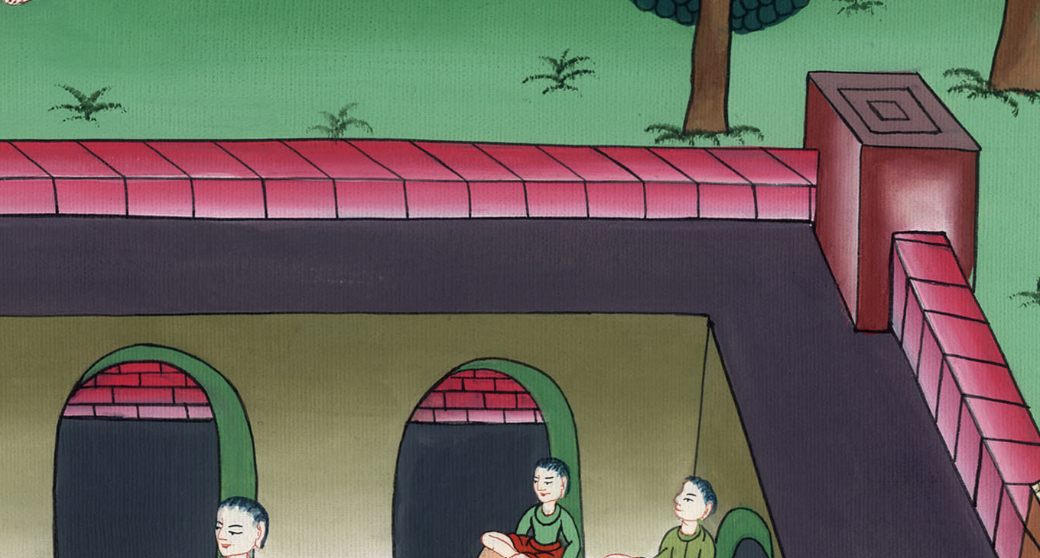
John 5:1,2

Slide 7
3In these lay a great multitude of those who were sick, blind, lame, or paralyzed, waiting for the moving of the water;

Slide 8
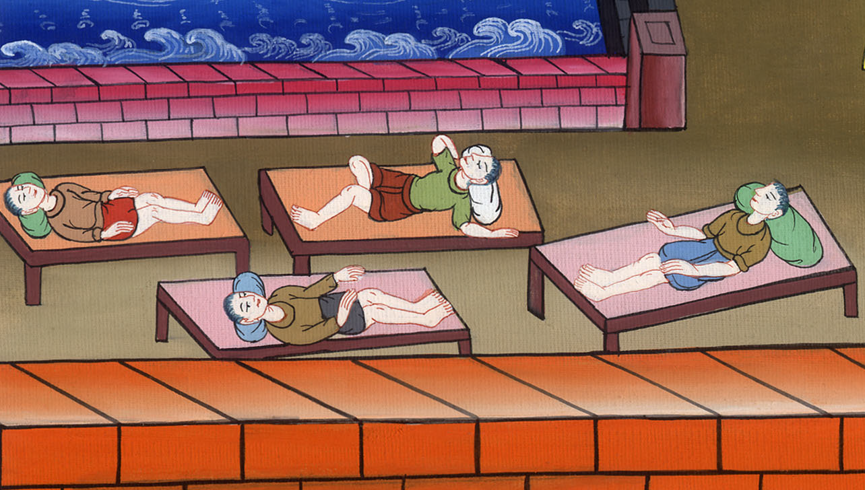
John 5:3

Slide 9
4for an angel went down at certain times into the pool and stirred up the water. Whoever stepped in first after the stirring of the water was healed of whatever disease he had.

Slide 10
John 5:4

Slide 11
5A certain man was there who had been sick for thirty-eight years. 6When Jesus saw him lying there, and knew that he had been sick for a long time, he asked him, “Do you want to be made well?”

Slide 12
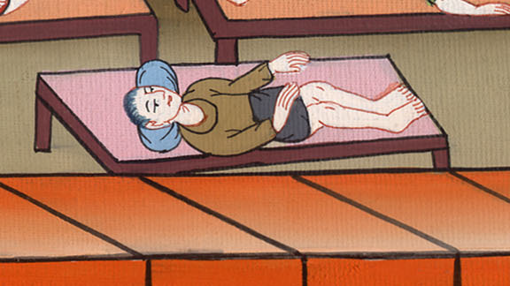
John 5:5,6

Slide 13
7The sick man answered him, “Sir, I have no one to put me into the pool when the water is stirred up, but while I’m coming, another steps down before me.”

Slide 14
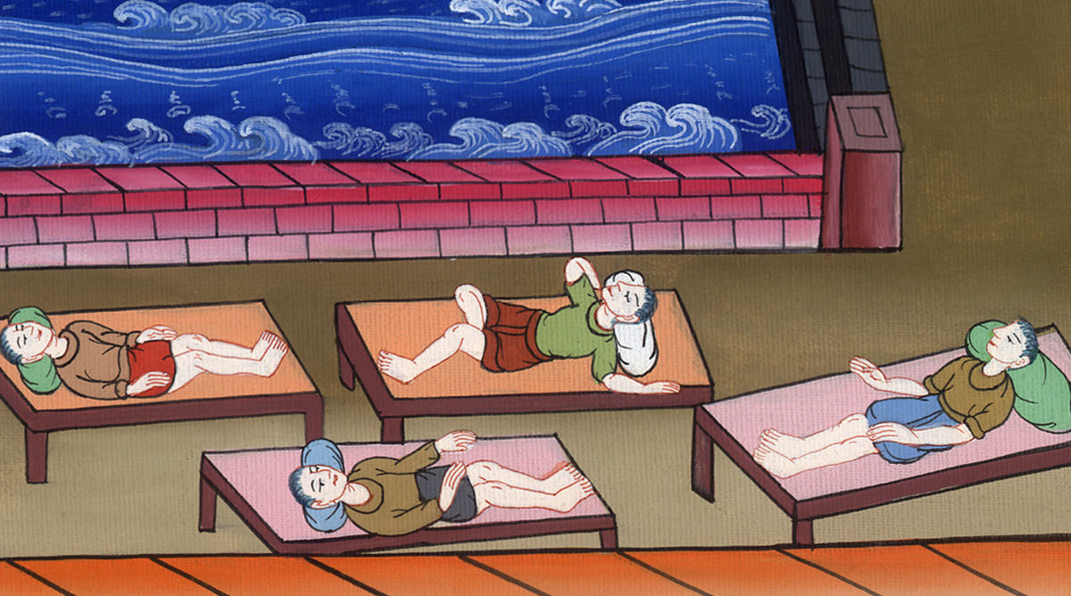
John 5:7

Slide 15
8Jesus said to him, “Arise, take up your mat, and walk.”
9Immediately, the man was made well, and took up his mat and walked.

Slide 16
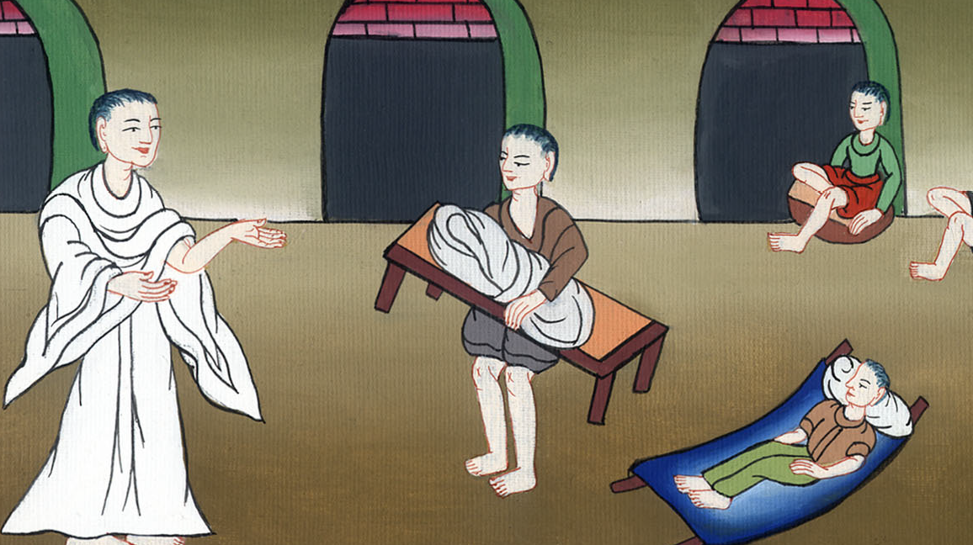
John 5:8,9

Slide 17
Now that day was a Sabbath. 10So the Jews said to him who was cured, “It is the Sabbath. It is not lawful for you to carry the mat.”

Slide 18
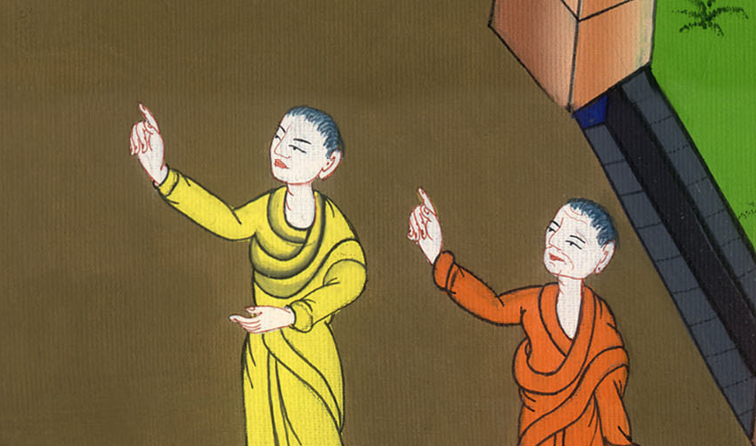
John 5:10

Slide 19
11He answered them, “He who made me well said to me, ‘Take up your mat and walk.’”

Slide 20
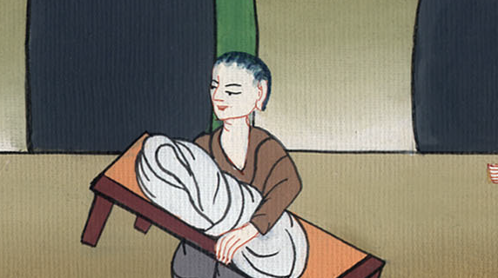
John 5:11

Slide 21
12Then they asked him, “Who is the man who said to you, ‘Take up your mat and walk’?”
13But he who was healed didn’t know who it was, for Jesus had withdrawn, a crowd being in the place.

Slide 22
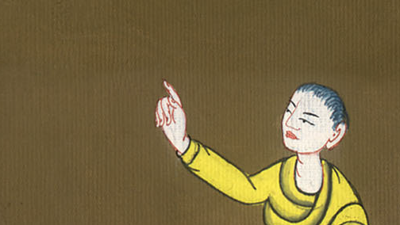
John 5:12,13

Slide 23
14Afterward Jesus found him in the temple and said to him, “Behold, you are made well. Sin no more, so that nothing worse happens to you.”

Slide 24
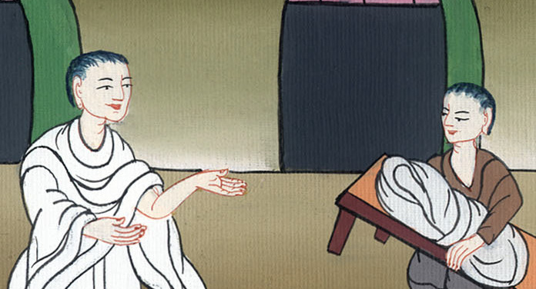
John 5:14

Slide 25
15The man went away, and told the Jews that it was Jesus who had made him well. 16For this cause the Jews persecuted Jesus and sought to kill him, because he did these things on the Sabbath.

Slide 26
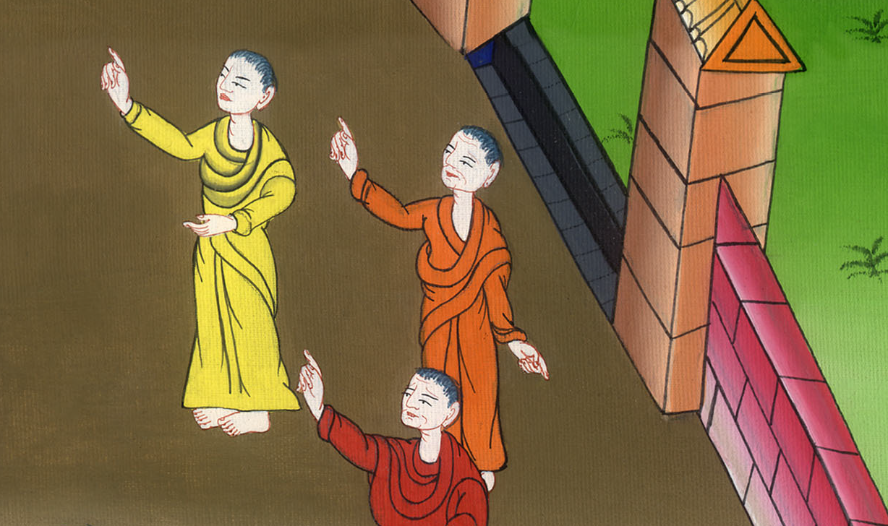
John 5:15,16

Slide 27
17But Jesus answered them, “My Father is still working, so I am working, too.”

Slide 28
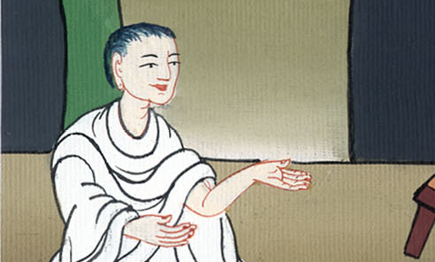
John 5:17

Slide 29
18For this cause therefore the Jews sought all the more to kill him, because he not only broke the Sabbath, but also called God his own Father, making himself equal with God.

Slide 30
John 5:18

