Slide 1
33-8
This work is licensed under a Creative Commons Attribution-ShareAlike 4.0 International License.
Please add this statement to all the videos you create.
English Bible quotes are from the World English Bible US, which is in the public domain.
Notes:
Ch
33 Jesus’ early ministry
1. John the Baptist tells about Jesus - John 1:19-42; John’s last witness - John 3:22-36;
and John in Prison - Luke 3:19-20 (Left Top)
2. Philip and Nathanael - John 1:43-51 (Center Top)
3. Wedding at Cana - John 2:1-12 (Right Top)
4. Nicodemus - John 3:1-21 (Right Bottom)
5. Woman at the Well - John 4:1-42 (Center Bottom)
6. Nobleman’s Son - John 4:46-54 (Left Bottom)
7. Sick man at Pool - John 5:1-47 (Left Center)
8. Jesus in Nazareth - Luke 4:16-30 (Right Center)

Slide 2
Jesus in Nazareth - Luke 4:14-30

Slide 3
Jesus in Nazareth - Luke 4:14-30

Slide 4
Jesus in Nazareth - Luke 4:14-30

Slide 5
14Jesus returned in the power of the Spirit into Galilee, and news about him spread through all the surrounding area. 15He taught in their synagogues, being glorified by all.

Slide 6
Luke 4:14,15

Slide 7
16He came to Nazareth, where he had been brought up. He entered, as was his custom, into the synagogue on the Sabbath day, and stood up to read.

Slide 8
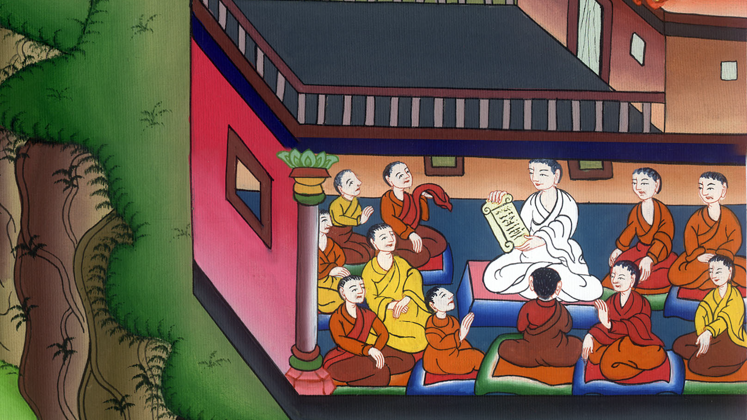
Luke 4:16

Slide 9
17The book of the prophet Isaiah was handed to him. He opened the book, and found the place where it was written,

Slide 10
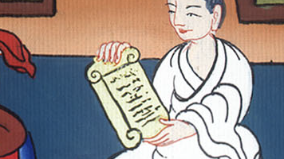
Luke 4:17

Slide 11
18 “The Spirit of the Lord is on me,
because he has anointed me to preach good news to the poor.
He has sent me to heal the broken hearted,
to proclaim release to the captives,

Slide 12
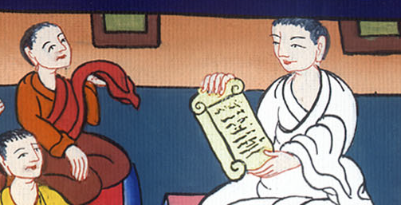
Luke 4:18

Slide 13
…
recovering of sight to the blind,
to deliver those who are crushed,
19 and to proclaim the acceptable year of the Lord.”

Slide 14
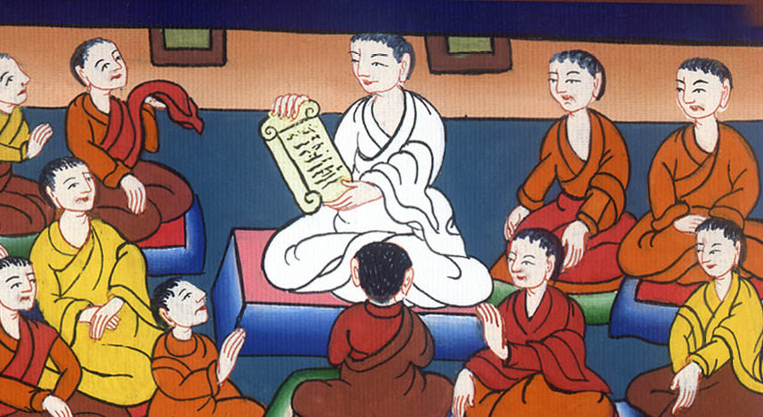
Luke 4:18,19

Slide 15
20He closed the book, gave it back to the attendant, and sat down. The eyes of all in the synagogue were fastened on him.

Slide 16
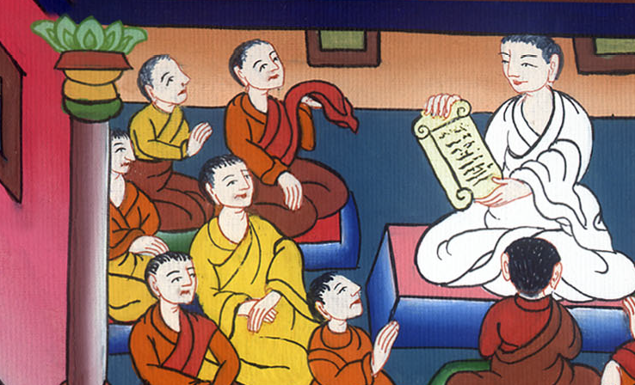
Luke 4:20

Slide 17
21He began to tell them, “Today, this Scripture has been fulfilled in your hearing.”

Slide 18
Luke 4:21

Slide 19
22All testified about him and wondered at the gracious words which proceeded out of his mouth; and they said, “Isn’t this Joseph’s son?”

Slide 20
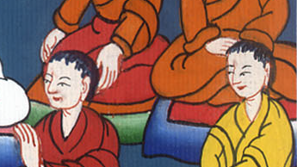
Luke 4:22

Slide 21
23He said to them, “Doubtless you will tell me this proverb, ‘Physician, heal yourself! Whatever we have heard done at Capernaum, do also here in your hometown.’”

Slide 22
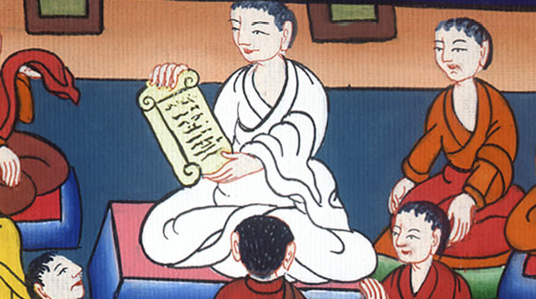
Luke 4:23

Slide 23
24He said, “Most certainly I tell you, no prophet is acceptable in his hometown.

Slide 24
Luke 4:24

Slide 25
28They were all filled with wrath in the synagogue as they heard these things. 29They rose up, threw him out of the city, and led him to the brow of the hill that their city was built on, that they might throw him off the cliff.

Slide 26
Luke 4:28,29

Slide 27
30But he, passing through the middle of them, went his way.

Slide 28
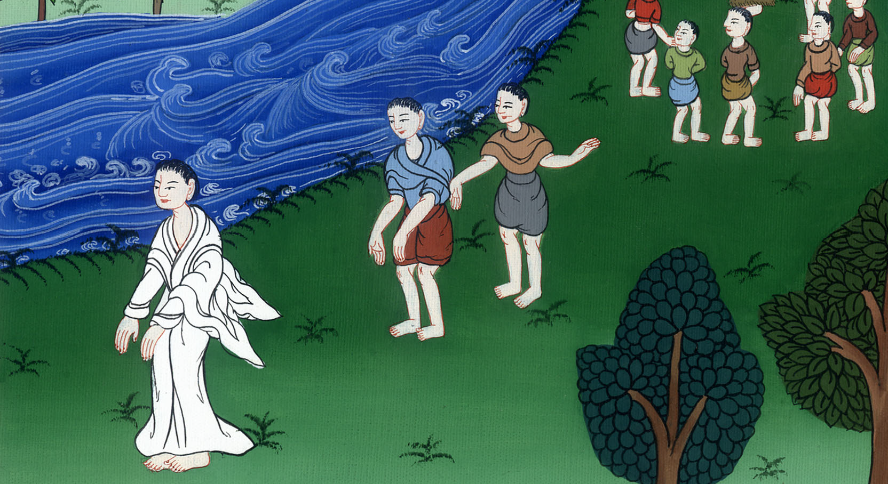
Luke 4:30

