Slide 1
34-1
This work is licensed under a Creative Commons Attribution–ShareAlike 4.0 International License.
Please add this statement to all the videos you create.
English Bible quotes are from the World English Bible US, which is in the public domain.
Notes:
Ch
34 Calling the Disciples…
1. Simon, Andrew, James and John - Luke 5:1-11 (Left Top)
2. Capernaum - Mark 1:21-34 (Right Top)
3. Cure Paralyzed Man - Luke 5:17-26 (Right Center)
4. Call of Matthew - Matt 9:9-13 (Right Bottom)
5. Sabbath - Matt 12:1-14; Mark 2:23-28 (Left Bottom)
6. Appointment of the 12 apostles and Sermon on the Mount - Luke 6:12-17; Matt
5:1-7:29 (Left Center)

Slide 2
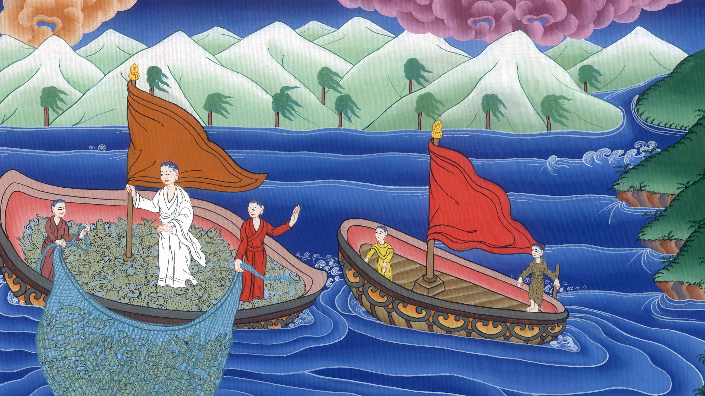
Luke 5:1-11
Simon, Andrew, James and John -

Slide 3
34 Calling the Disciples…
Simon, Andrew, James and John - Luke 5:1-11

Slide 4
Luke 5:1-11
Simon, Andrew, James and John -

Slide 5
1Now while the multitude pressed on him and heard the word of God, he was standing by the lake of Gennesaret.

Slide 6
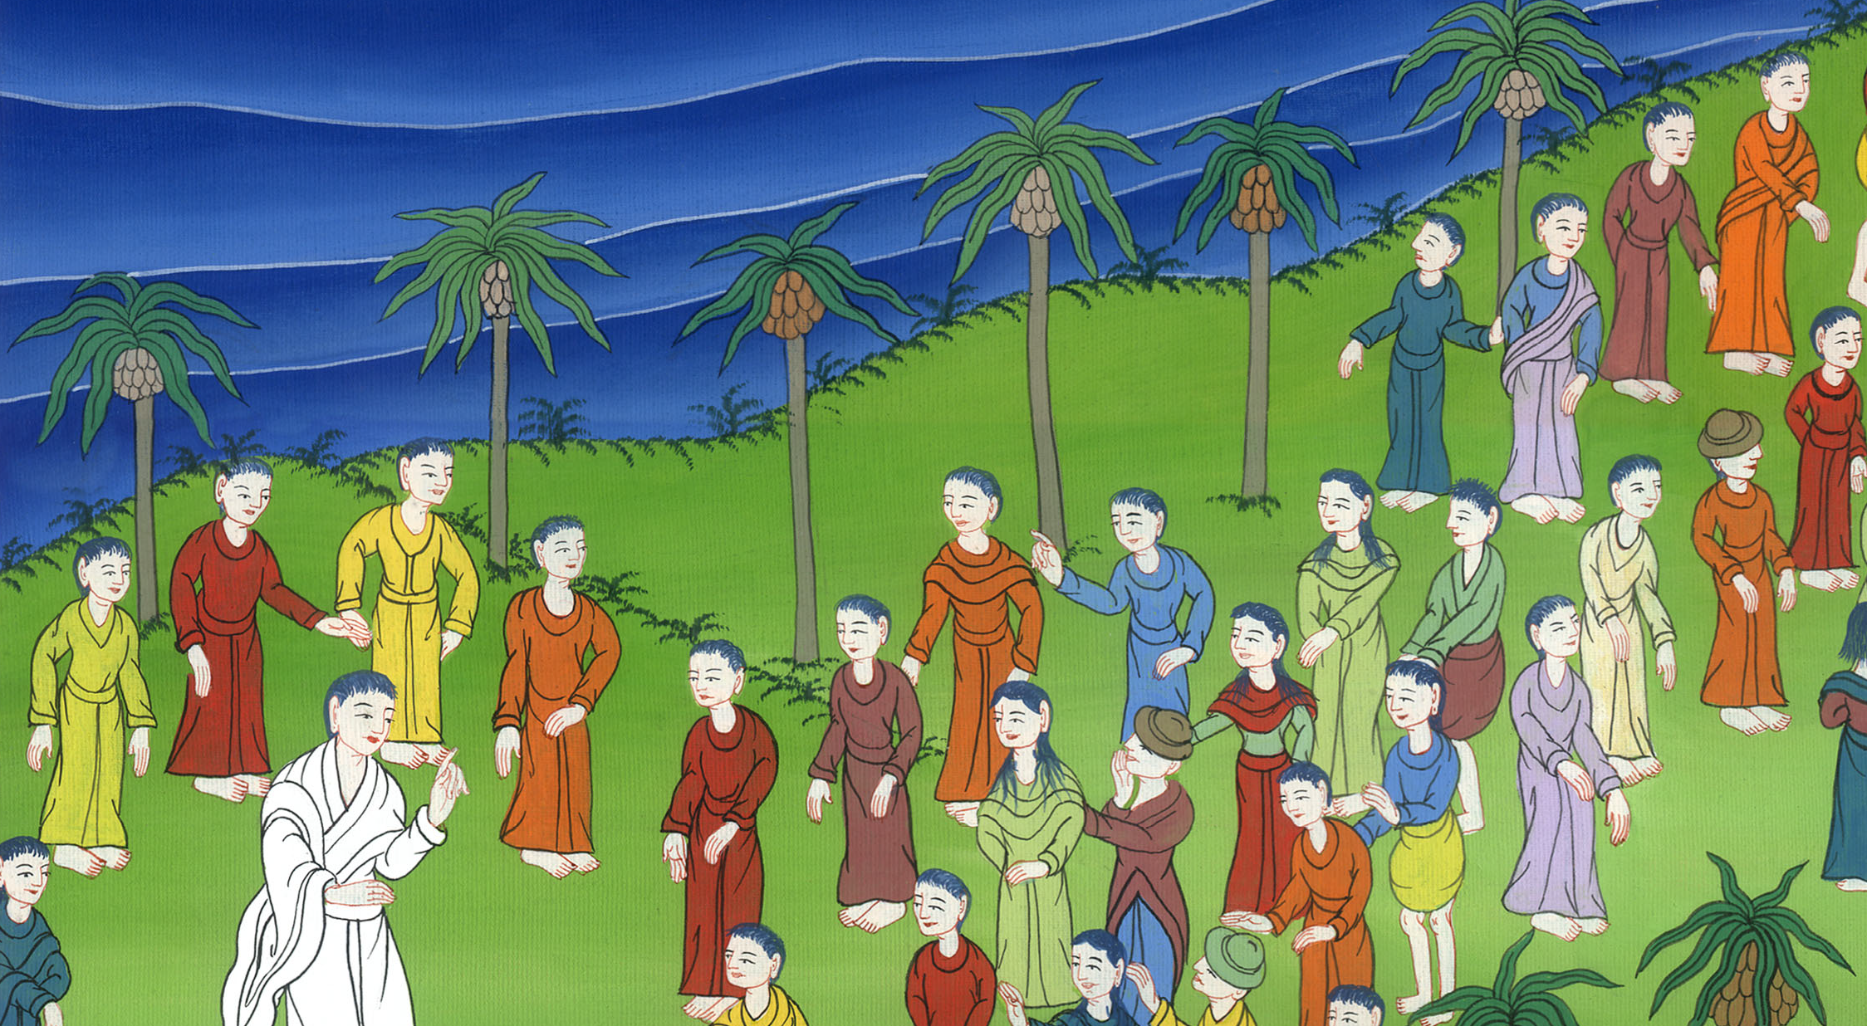
Luke 5:1

Slide 7
2He saw two boats standing by the lake, but the fishermen had gone out of them and were washing their nets.

Slide 8
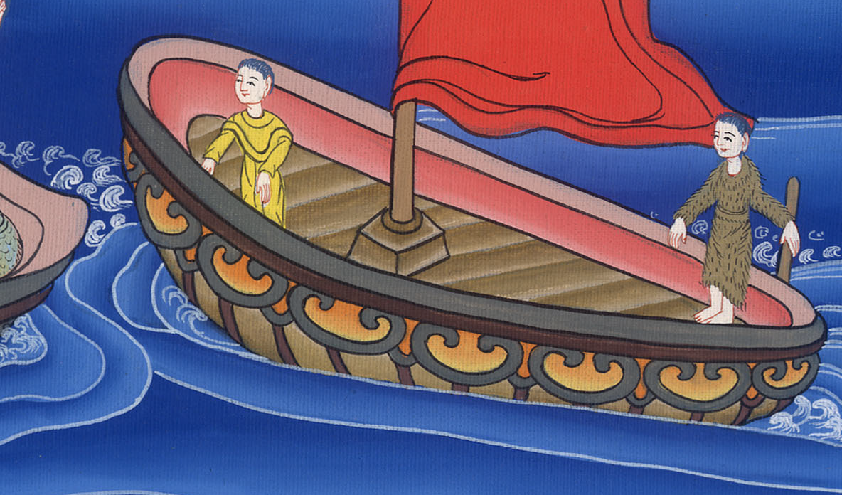
Luke 5:2

Slide 9
3He entered into one of the boats, which was Simon’s, and asked him to put out a little from the land. He sat down and taught the multitudes from the boat.

Slide 10
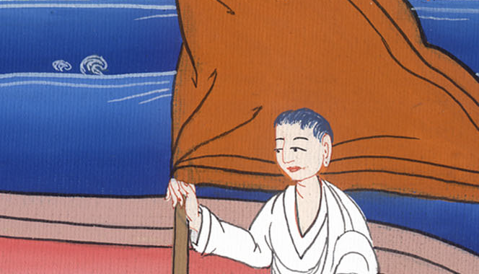
Luke 5:3

Slide 11
4When he had finished speaking, he said to Simon, “Put out into the deep and let down your nets for a catch.”

Slide 12
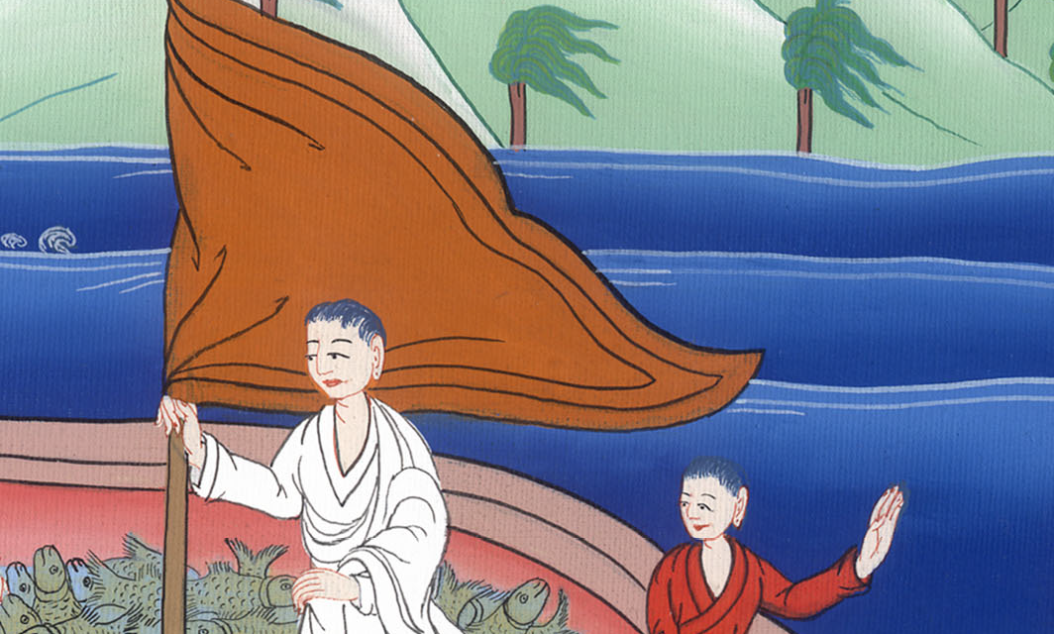
Luke 5:4

Slide 13
5Simon answered him, “Master, we worked all night and caught nothing; but at your word I will let down the net.”

Slide 14
Luke 5:5

Slide 15
6When they had done this, they caught a great multitude of fish, and their net was breaking.

Slide 16
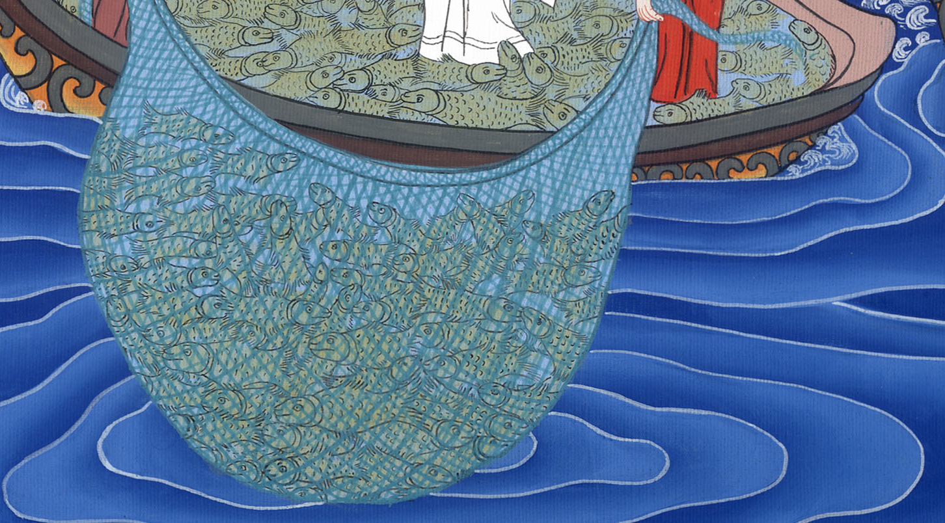
Luke 5:6

Slide 17
7They beckoned to their partners in the other boat, that they should come and help them. They came and filled both boats, so that they began to sink.

Slide 18
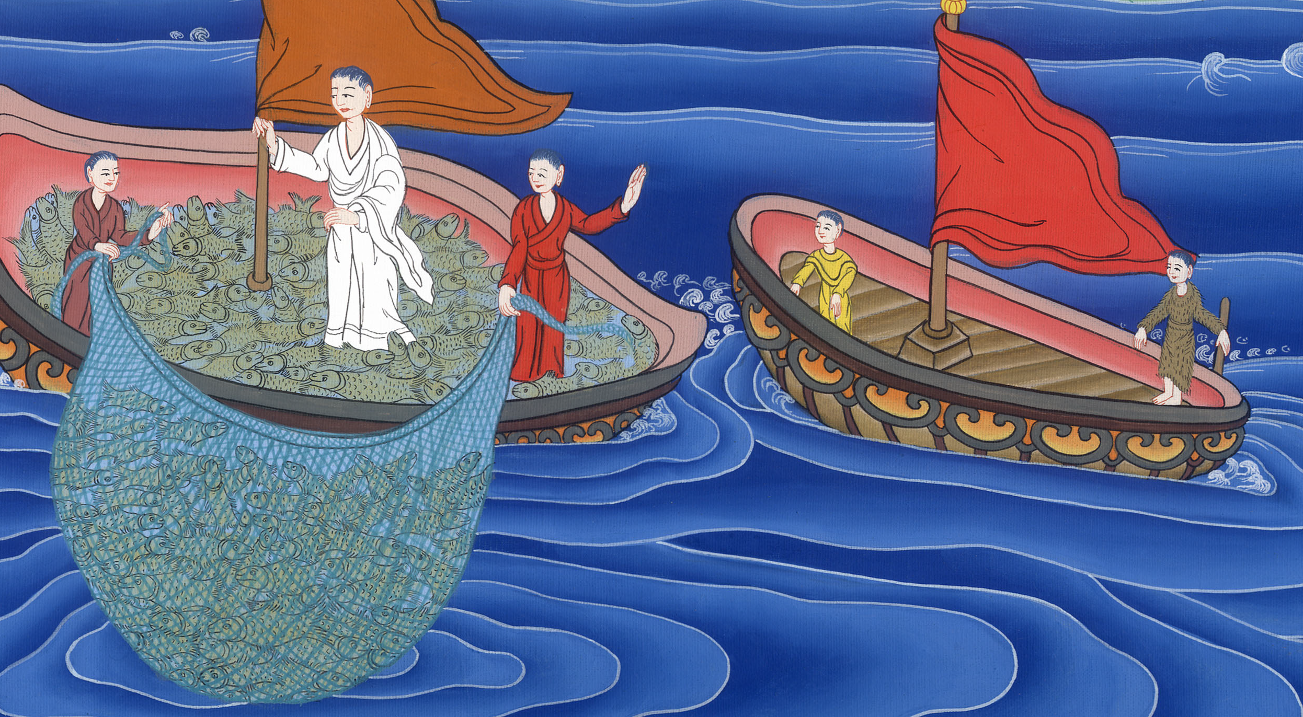
Luke 5:7

Slide 19
8But Simon Peter, when he saw it, fell down at Jesus’ knees, saying, “Depart from me, for I am a sinful man, Lord.”

Slide 20
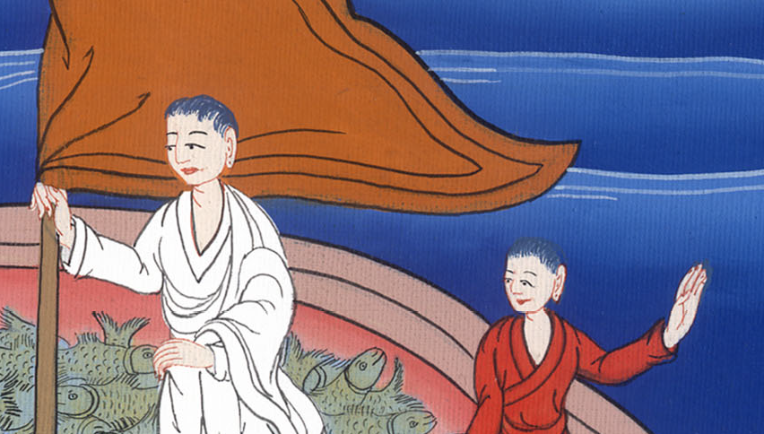
Luke 5:8

Slide 21
9For he was amazed, and all who were with him, at the catch of fish which they had caught;

Slide 22
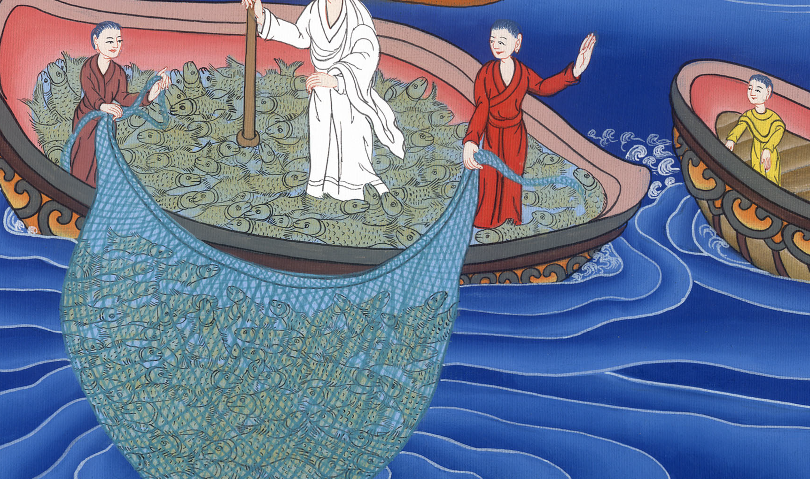
Luke 5:9

Slide 23
10and so also were James and John, sons of Zebedee, who were partners with Simon.
Jesus said to Simon, “Don’t be afraid. From now on you will be catching people alive.”

Slide 24
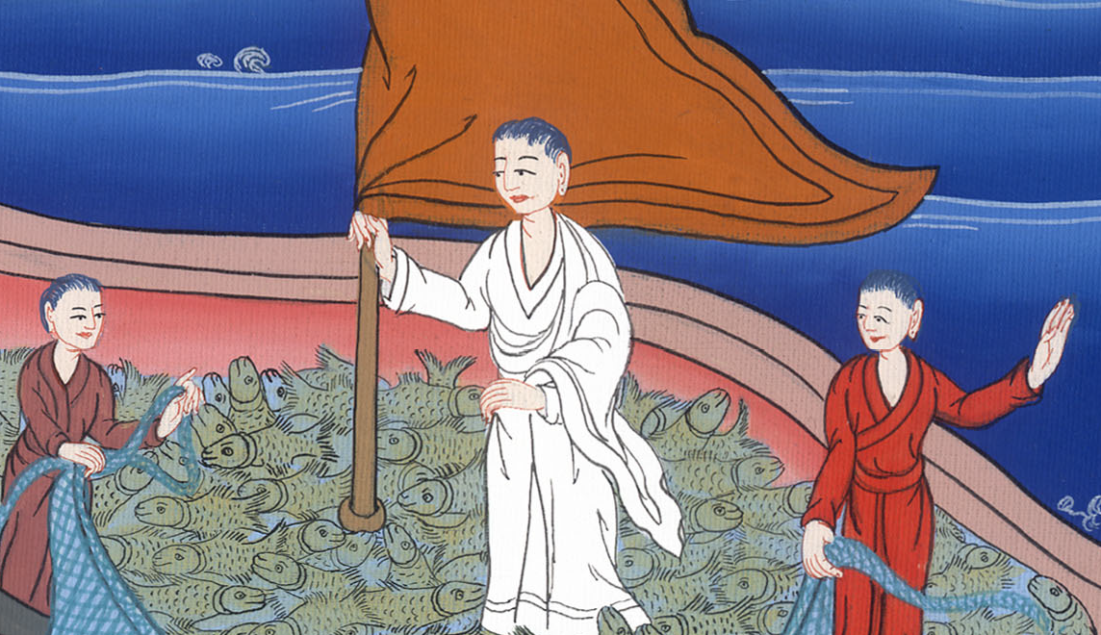
Luke 5:10

Slide 25
11When they had brought their boats to land, they left everything, and followed him.

Slide 26
Luke 5:11

