Slide 1
34-2
This work is licensed under a Creative Commons Attribution-ShareAlike 4.0 International License.
Please add this statement to all the videos you create.
English Bible quotes are from the World English Bible US, which is in the public domain.
Notes:
Ch
34 Calling the Disciples…
1. Simon, Andrew, James and John - Luke 5:1-11 (Left Top)
2. Capernaum - Mark 1:21-34 (Right Top)
3. Cure Paralyzed Man - Luke 5:17-26 (Right Center)
4. Call of Matthew - Matt 9:9-13 (Right Bottom)
5. Sabbath - Matt 12:1-14; Mark 2:23-28 (Left Bottom)
6. Appointment of the 12 apostles and Sermon on the Mount - Luke 6:12-17; Matt
5:1-7:29 (Left Center)

Slide 2
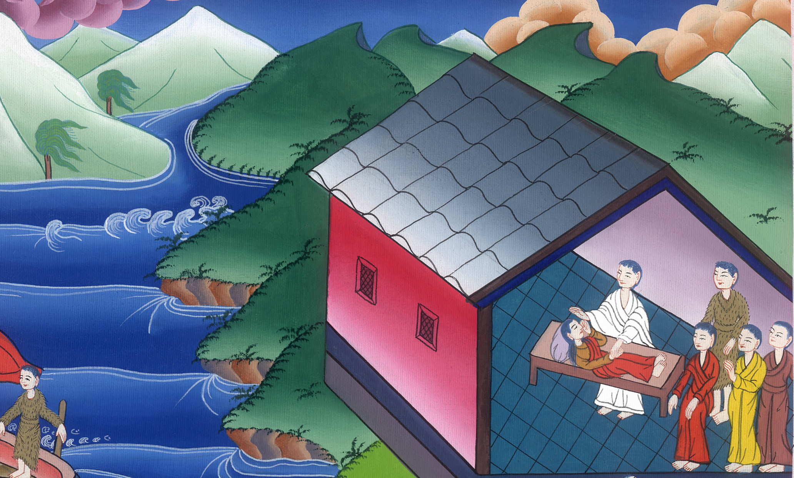
Capernaum –
Mark 1:21-34

Slide 3
Capernaum –
Mark 1:21-34

Slide 4
Capernaum –
Mark 1:21-34

Slide 5
21They went into Capernaum, and immediately on the Sabbath day he entered into the synagogue and taught.

Slide 6
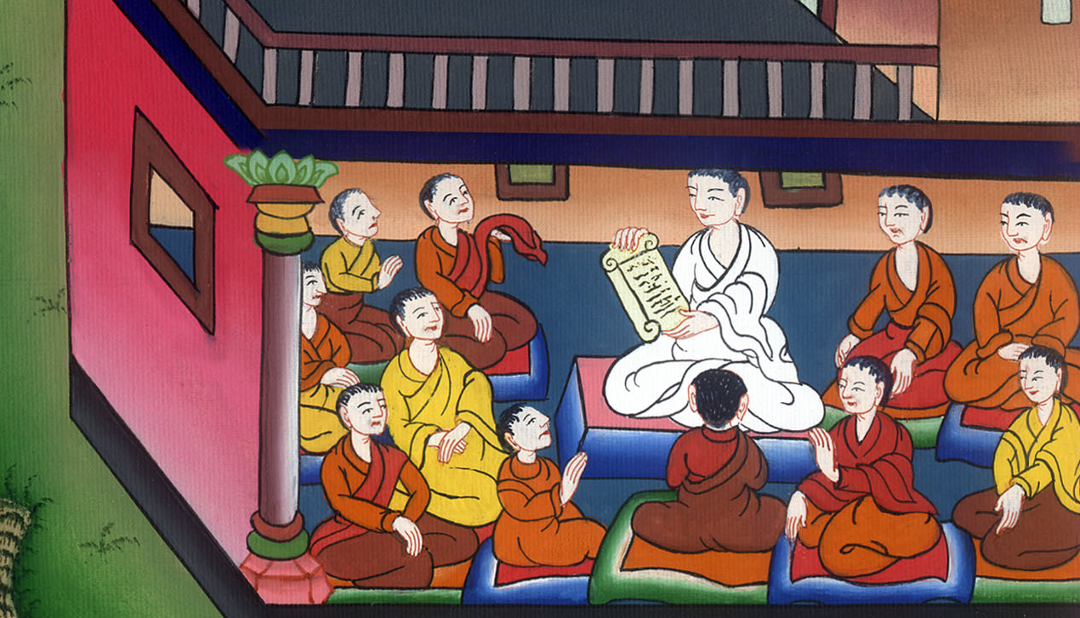
Mark 1:21

Slide 7
22They were astonished at his teaching, for he taught them as having authority, and not as the scribes.

Slide 8
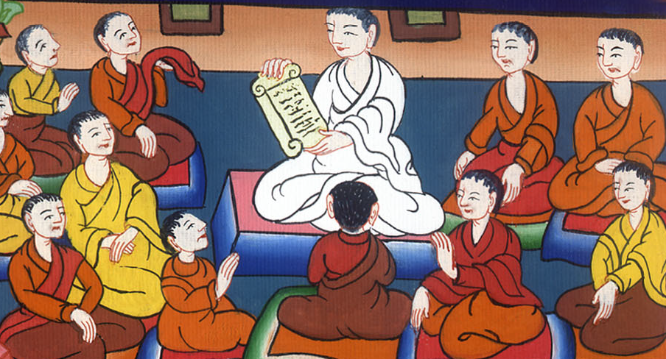
Mark 1:22

Slide 9
23Immediately there was in their synagogue a man with an unclean spirit, and he cried out, 24saying, “Ha! What do we have to do with you, Jesus, you Nazarene? Have you come to destroy us? I know who you are: the Holy One of God!”

Slide 10
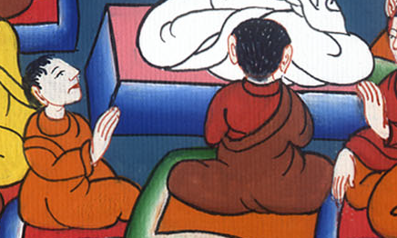
Mark 1:23,24

Slide 11
25Jesus rebuked him, saying, “Be quiet, and come out of him!”
26The unclean spirit, convulsing him and crying with a loud voice, came out of him.

Slide 12
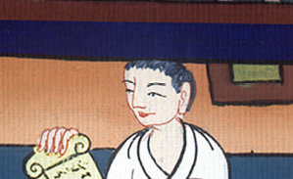
Mark 1:25,26

Slide 13
27They were all amazed, so that they questioned among themselves, saying, “What is this? A new teaching? For with authority he commands even the unclean spirits, and they obey him!” 28The report of him went out immediately everywhere into all the region of Galilee and its surrounding area.

Slide 14
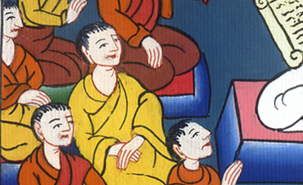
Mark 1:27,28

Slide 15
29Immediately, when they had come out of the synagogue, they came into the house of Simon and Andrew, with James and John.

Slide 16
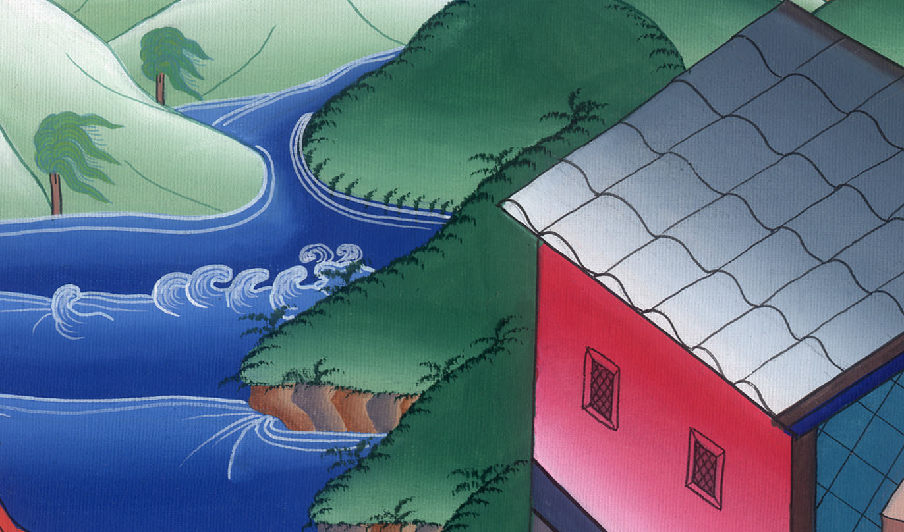
Mark 1:29

Slide 17
30Now Simon’s wife’s mother lay sick with a fever, and immediately they told him about her.

Slide 18
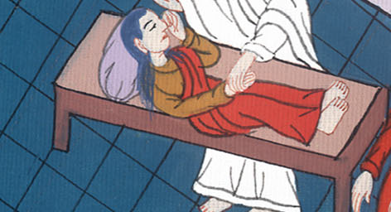
Mark 1:30

Slide 19
31He came and took her by the hand and raised her up. The fever left her immediately, and she served them.

Slide 20
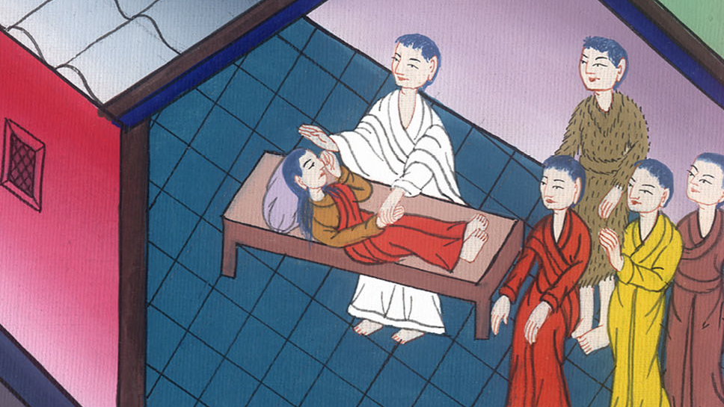
Mark 1:31

Slide 21
32At evening, when the sun had set, they brought to him all who were sick and those who were possessed by demons. 33All the city was gathered together at the door.

Slide 22
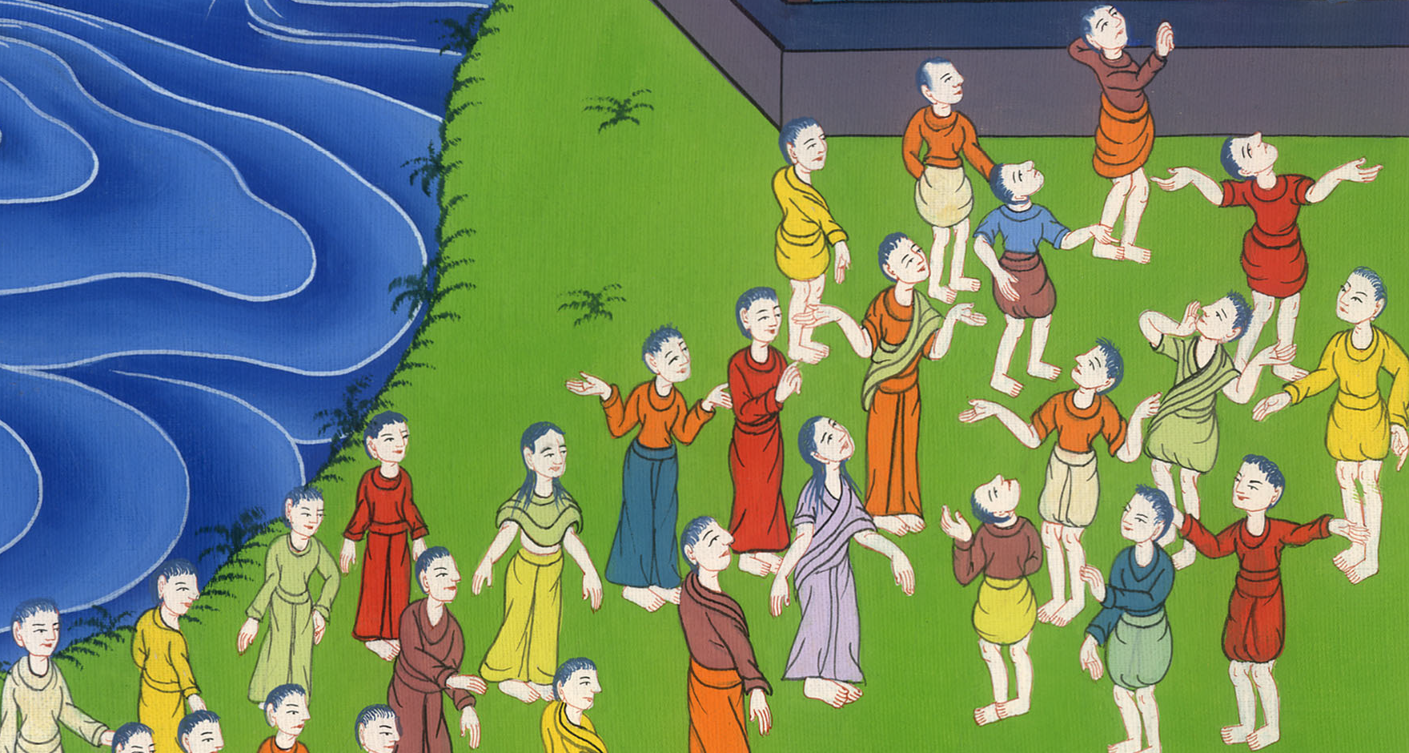
Mark 1:32,33

Slide 23
34He healed many who were sick with various diseases and cast out many demons. He didn’t allow the demons to speak, because they knew him.

Slide 24
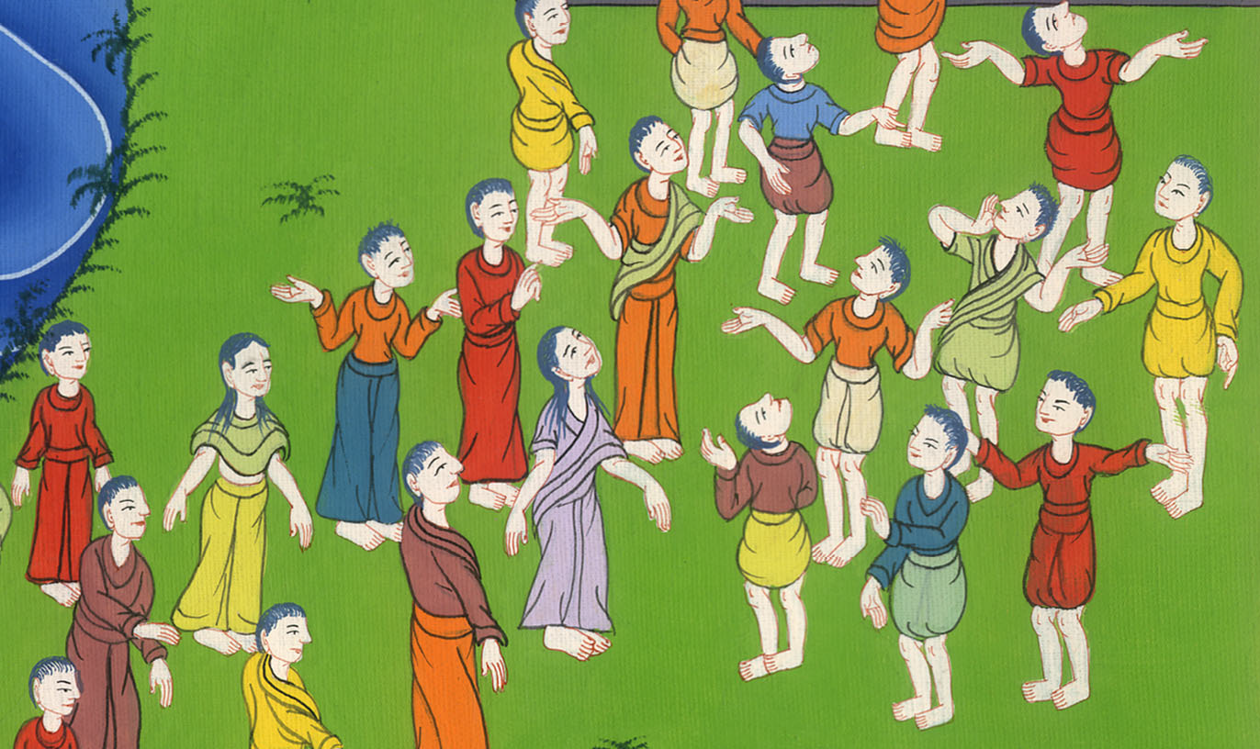
Mark 1:34

Slide 25
35Early in the morning, while it was still dark, he rose up and went out, and departed into a deserted place, and prayed there.

Slide 26
Mark 1:35

Slide 27
36Simon and those who were with him searched for him. 37They found him and told him, “Everyone is looking for you.”

Slide 28
Mark 1:36

Slide 29
38He said to them, “Let’s go elsewhere into the next towns, that I may preach there also, because I came out for this reason.”

Slide 30
Mark 1:37

Slide 31
39He went into their synagogues throughout all Galilee, preaching and casting out demons.

Slide 32
Mark 1:38,39

