Slide 1
34-3
This work is licensed under a Creative Commons Attribution-ShareAlike 4.0 International License.
Please add this statement to all the videos you create.
English Bible quotes are from the World English Bible US, which is in the public domain.
Notes:
Ch
34 Calling the Disciples…
1. Simon, Andrew, James and John - Luke 5:1-11 (Left Top)
2. Capernaum - Mark 1:21-34 (Right Top)
3. Cure Paralyzed Man - Luke 5:17-26 (Right Center)
4. Call of Matthew - Matt 9:9-13 (Right Bottom)
5. Sabbath - Matt 12:1-14; Mark 2:23-28 (Left Bottom)
6. Appointment of the 12 apostles and Sermon on the Mount - Luke 6:12-17; Matt
5:1-7:29 (Left Center)

Slide 2
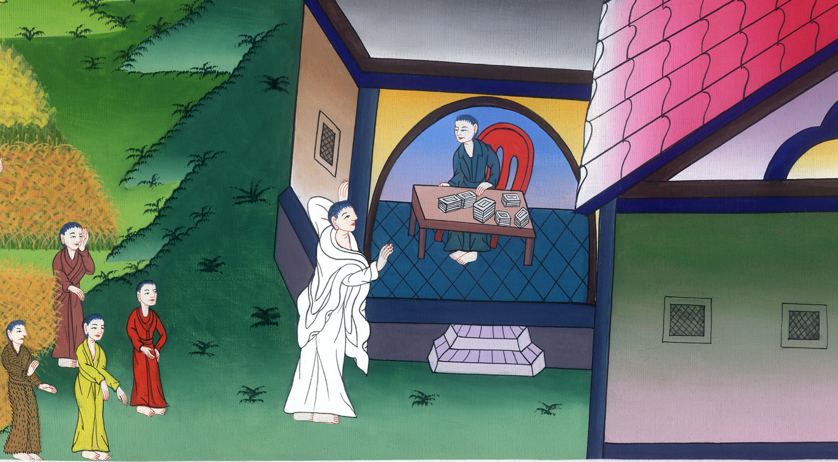
Call of Matthew - Matthew 9:9-13

Slide 3
Call of Matthew - Matthew 9:9-13

Slide 4
Call of Matthew - Matthew 9:9-13

Slide 5
9As Jesus passed by from there, he saw a man called Matthew sitting at the tax collection office. He said to him, “Follow me.” He got up and followed him.

Slide 6
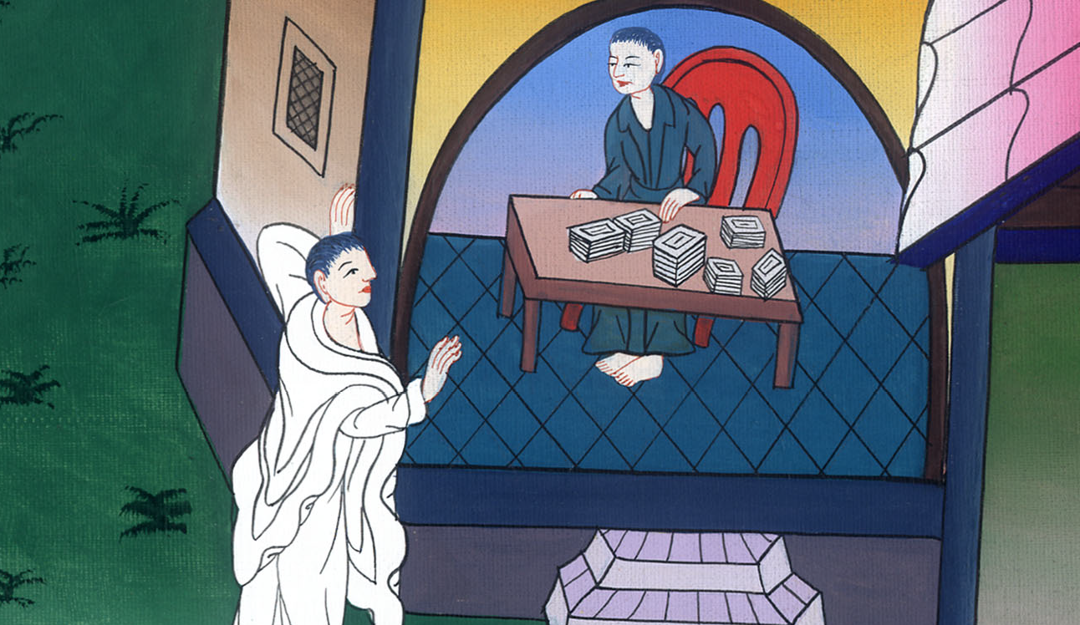
Matthew 9:9

Slide 7
10As he sat in the house, behold, many tax collectors and sinners came and sat down with Jesus and his disciples.

Slide 8
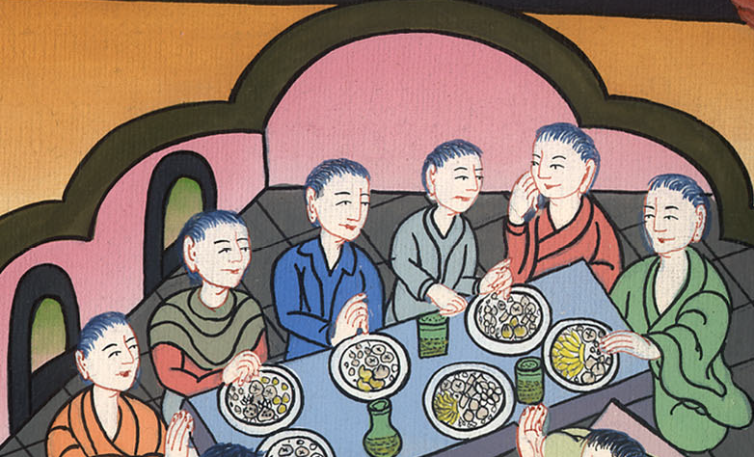
Matthew 9:10

Slide 9
11When the Pharisees saw it, they said to his disciples, “Why does your teacher eat with tax collectors and sinners?”

Slide 10
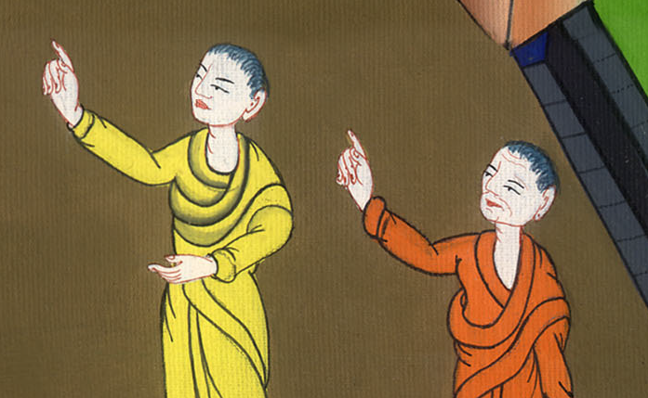
Matthew 9:11

Slide 11
12When Jesus heard it, he said to them, “Those who are healthy have no need for a physician, but those who are sick do.

Slide 12
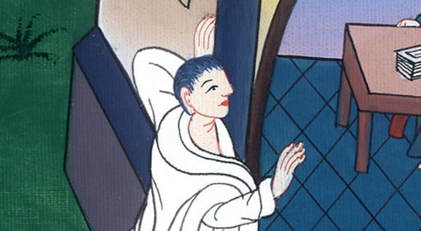
Matthew 9:12

Slide 13
13But you go and learn what this means: ‘I desire mercy, and not sacrifice,’ for I came not to call the righteous, but sinners to repentance.”

Slide 14
མད་ཐཱ། 9:13

