Slide 1
34-4
This work is licensed under a Creative Commons Attribution-ShareAlike 4.0 International License.
Please add this statement to all the videos you create.
English Bible quotes are from the World English Bible US, which is in the public domain.
Notes:
Ch
34 Calling the Disciples…
1. Simon, Andrew, James and John - Luke 5:1-11 (Left Top)
2. Capernaum - Mark 1:21-34 (Right Top)
3. Cure Paralyzed Man - Luke 5:17-26 (Right Center)
4. Call of Matthew - Matt 9:9-13 (Right Bottom)
5. Sabbath - Matt 12:1-14; Mark 2:23-28 (Left Bottom)
6. Appointment of the 12 apostles and Sermon on the Mount - Luke 6:12-17; Matt
5:1-7:29 (Left Center)

Slide 2
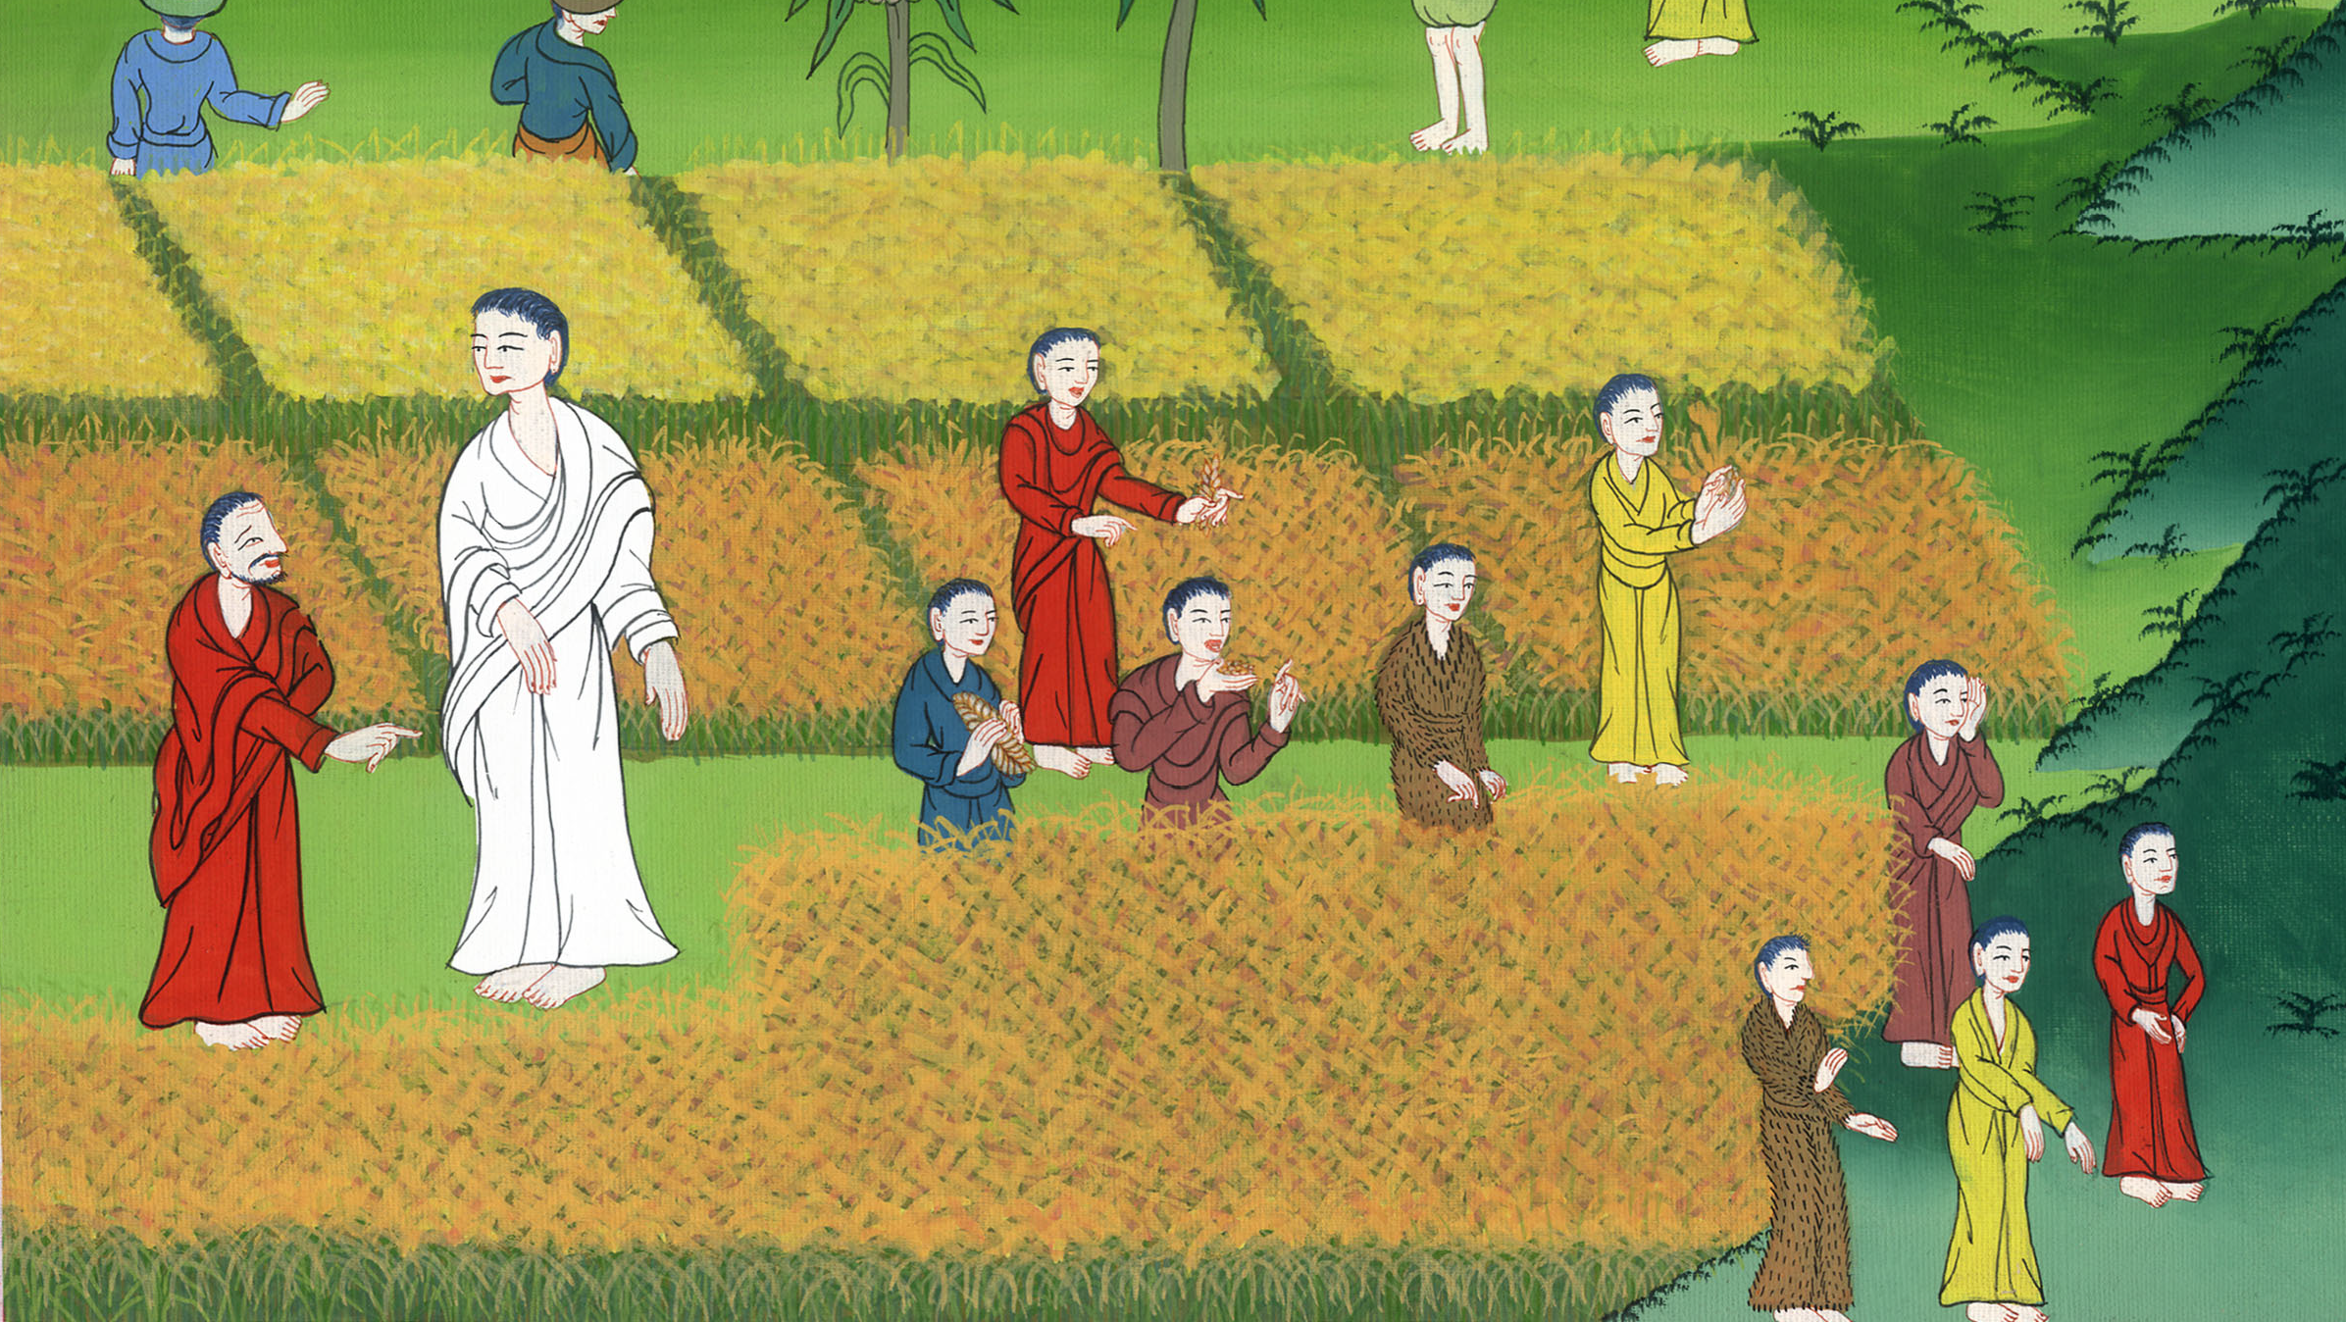
Jesus Is Lord of the Sabbath Day –
Matthew 12:1-14

Slide 3
Jesus Is Lord of the Sabbath Day –
Matthew 12:1-14

Slide 4
Jesus Is Lord of the Sabbath Day –
Matthew 12:1-14

Slide 5
1At that time, Jesus went on the Sabbath day through the grain fields. His disciples were hungry and began to pluck heads of grain and to eat.

Slide 6
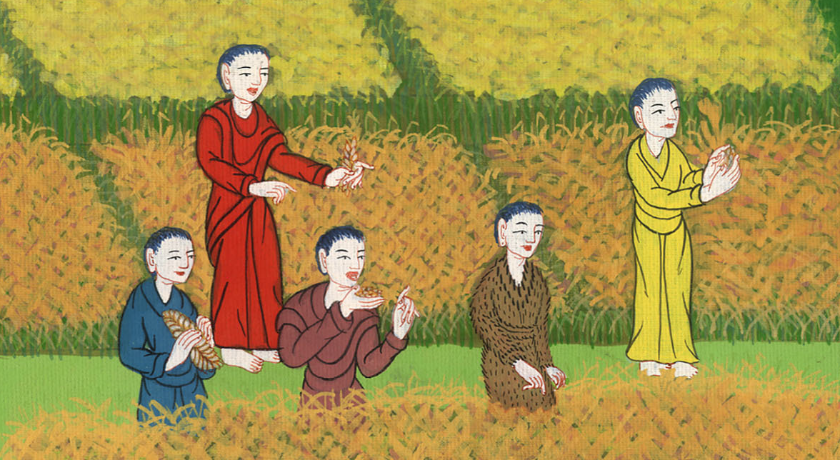
Matthew 12:1

Slide 7
2But the Pharisees, when they saw it, said to him, “Behold, your disciples do what is not lawful to do on the Sabbath.”

Slide 8
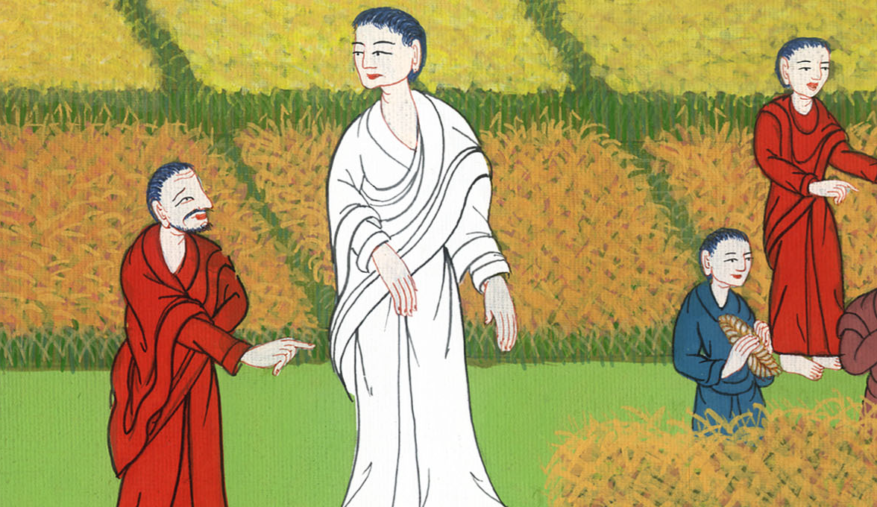
Matthew 12:2

Slide 9
3But he said to them, “Haven’t you read what David did when he was hungry, and those who were with him:

Slide 10
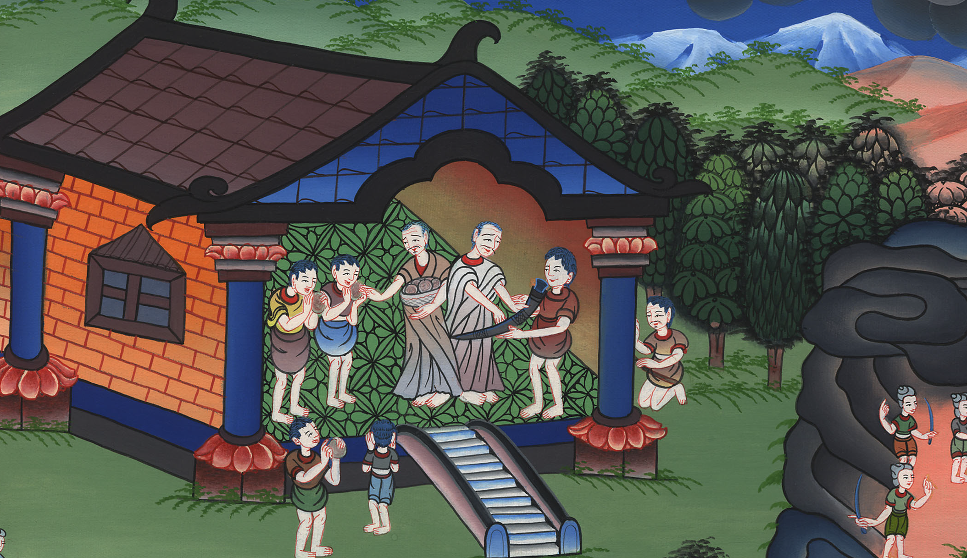
Matthew 12:3

Slide 11
4how he entered into God’s house and ate the show bread, which was not lawful for him to eat, nor for those who were with him, but only for the priests?

Slide 12
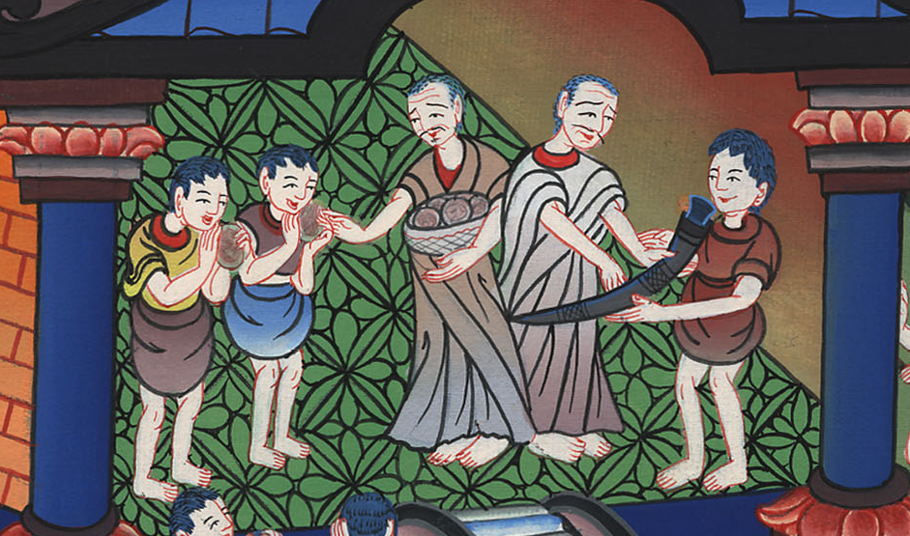
Matthew 12:4

Slide 13
5Or have you not read in the law that on the Sabbath day the priests in the temple profane the Sabbath and are guiltless? 6But I tell you that one greater than the temple is here.

Slide 14
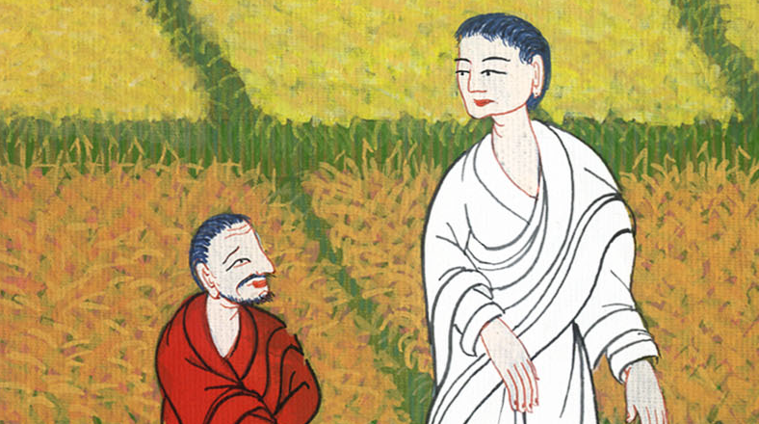
Matthew 12:5,6

Slide 15
7But if you had known what this means, ‘I desire mercy, and not sacrifice,’ you wouldn’t have condemned the guiltless. 8For the Son of Man is Lord of the Sabbath.”

Slide 16
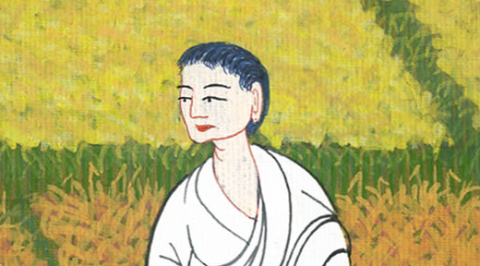
Matthew 12:7,8

Slide 17
9He departed from there and went into their synagogue. 10And behold, there was a man with a withered hand. They asked him, “Is it lawful to heal on the Sabbath day?” so that they might accuse him.

Slide 18
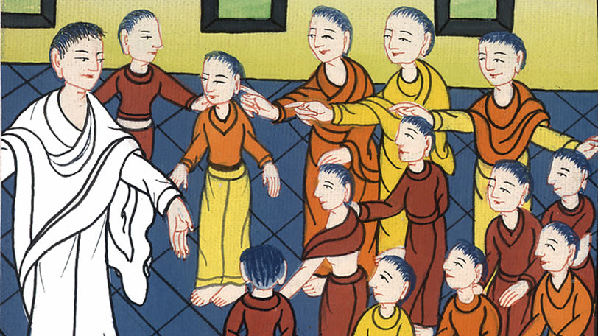
Matthew 12:9,10

Slide 19
11He said to them, “What man is there among you who has one sheep, and if this one falls into a pit on the Sabbath day, won’t he grab on to it and lift it out? 12Of how much more value then is a man than a sheep! Therefore it is lawful to do good on the Sabbath day.”

Slide 20
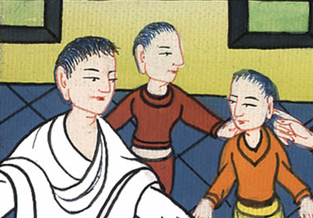
Matthew 12:11,12

Slide 21
13Then he told the man, “Stretch out your hand.” He stretched it out; and it was restored whole, just like the other. 14But the Pharisees went out and conspired against him, how they might destroy him.

Slide 22
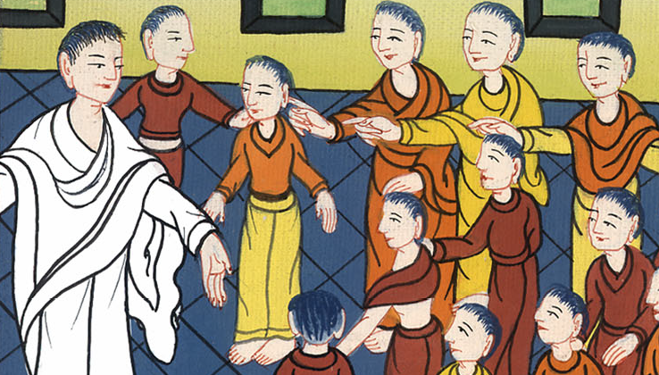
Matthew 12:13,14

