Slide 1
34-5
This work is licensed under a Creative Commons Attribution-ShareAlike 4.0 International License.
Please add this statement to all the videos you create.
English Bible quotes are from the World English Bible US, which is in the public domain.
Notes:
34 Calling the Disciples…
1. Simon, Andrew, James and John - Luke 5:1-11 (Left Top)
2. Capernaum - Mark 1:21-34 (Right Top)
3. Cure Paralyzed Man - Luke 5:17-26 (Right Center)
4. Call of Matthew - Matt 9:9-13 (Right Bottom)
5. Sabbath - Matt 12:1-14; Mark 2:23-28 (Left Bottom)
6. Appointment of the 12 apostles and Sermon on the Mount - Luke 6:12-17; Matt
5:1-7:29 (Left Center)

Slide 2
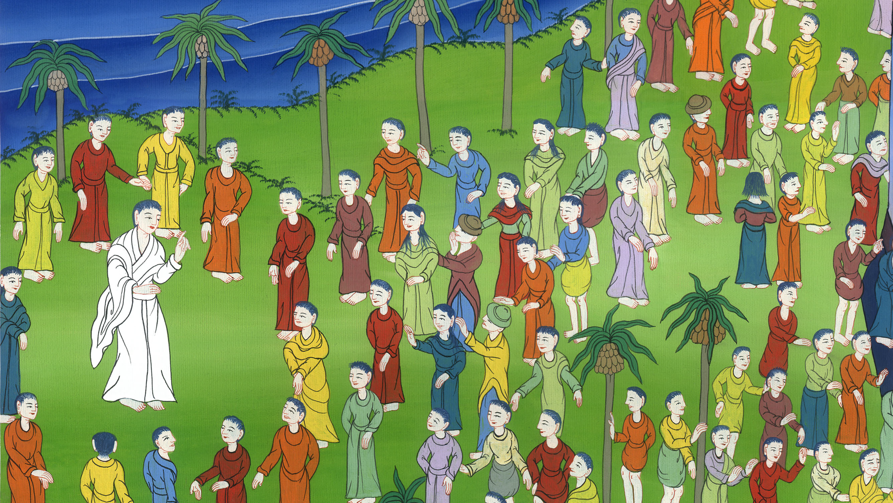
Appointment of the 12 apostles and Sermon on the Mount –
Luke 6:12-17; Matthew 5:1-7:29

Slide 3
Appointment of the 12 apostles and Sermon on the Mount - Luke 6:12-17; Matthew 5:1-7:29

Slide 4
Appointment of the 12 apostles and Sermon on the Mount –
Luke 6:12-17; Matthew 5:1-7:29

Slide 5
Luke 6:12In these days, he went out to the mountain to pray, and he continued all night in prayer to God.

Slide 6
Luke 6:12

Slide 7
13When it was day, he called his disciples, and from them he chose twelve, whom he also named apostles:

Slide 8
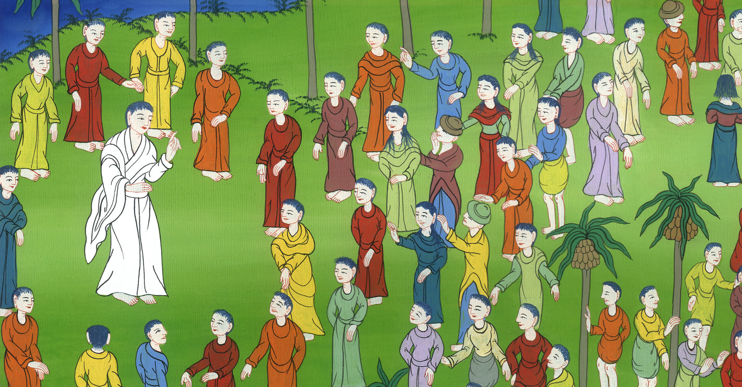
Luke 6:13

Slide 9
14Simon, whom he also named Peter; Andrew, his brother; James; John; Philip; Bartholomew;

Slide 10
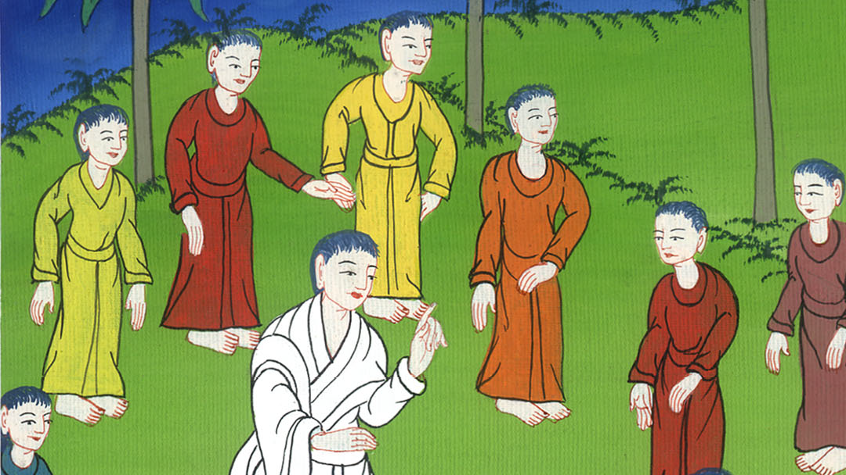
Luke 6:14

Slide 11
15Matthew; Thomas; James the son of Alphaeus; Simon who was called the Zealot; 16Judas the son of James; and Judas Iscariot, who also became a traitor.

Slide 12
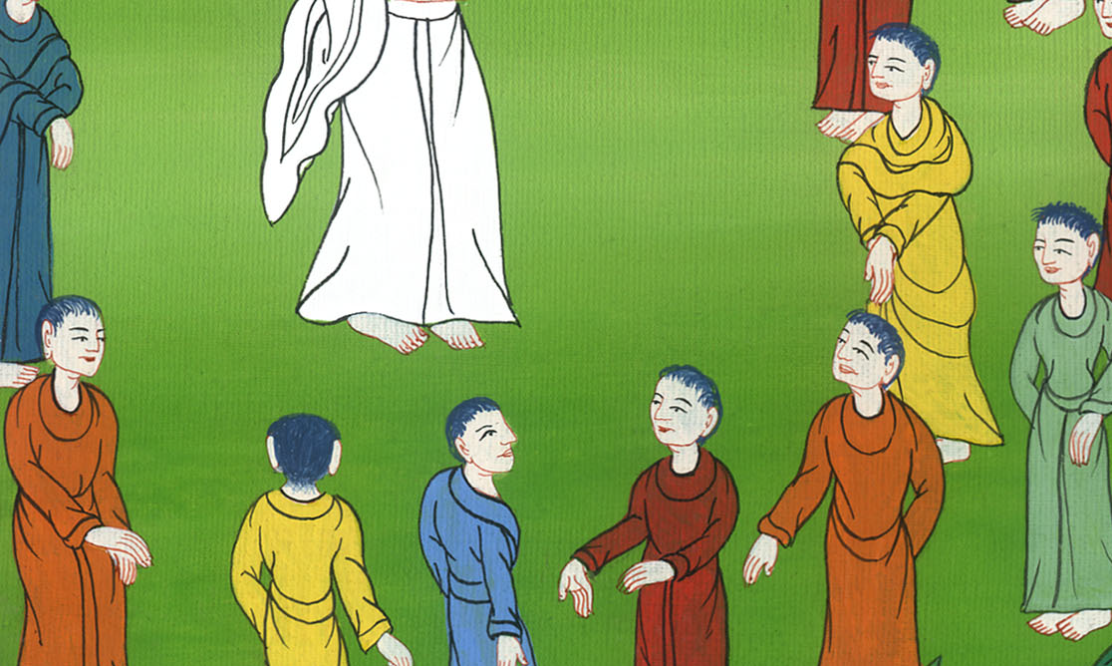
Luke 6:15,16

Slide 13
Matt 5:1Seeing the multitudes, he went up onto the mountain. When he had sat down, his disciples came to him.

Slide 14
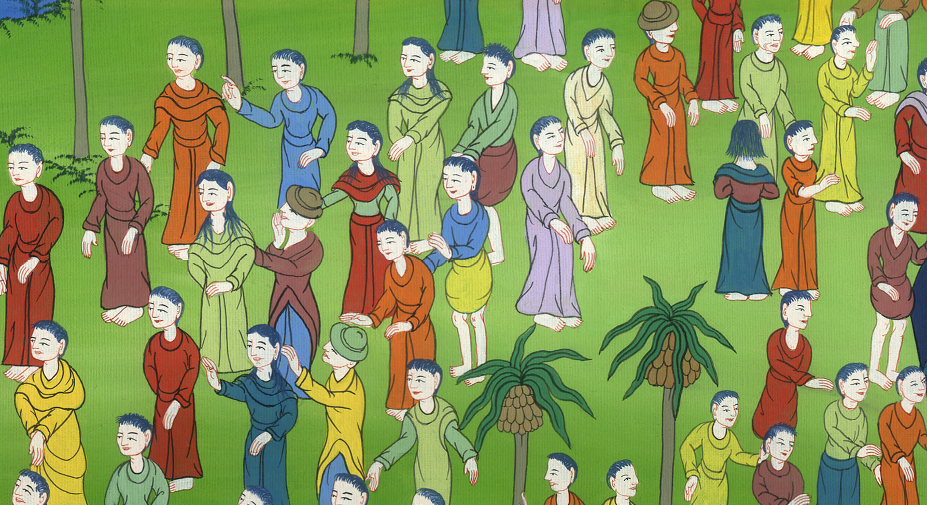
Matthew 5:1

Slide 15
2He opened his mouth and taught them, saying,
3 “Blessed are the poor in spirit,
for theirs is the Kingdom of Heaven.
4 Blessed are those who mourn,
for they shall be comforted.

Slide 16
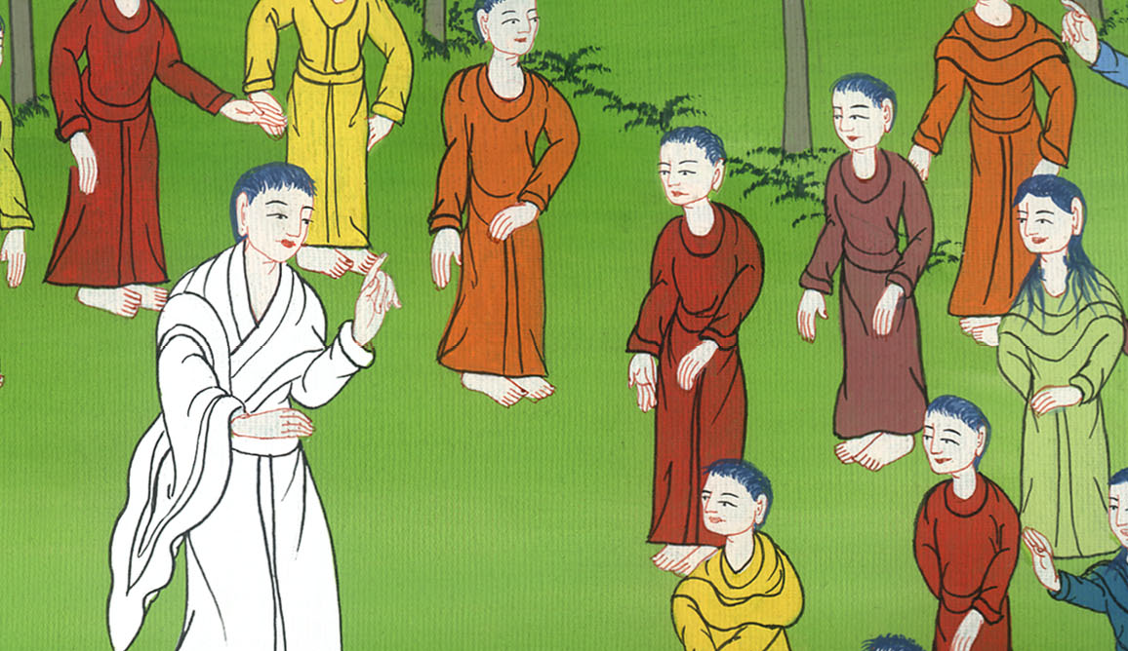
Matthew 5:2-4

Slide 17
5 Blessed are the gentle,
for they shall inherit the earth.
6 Blessed are those who hunger and thirst for righteousness,
for they shall be filled.

Slide 18
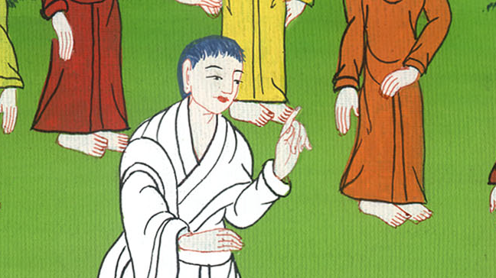
Matthew 5:5,6

Slide 19
7 Blessed are the merciful,
for they shall obtain mercy.
8 Blessed are the pure in heart,
for they shall see God.

Slide 20
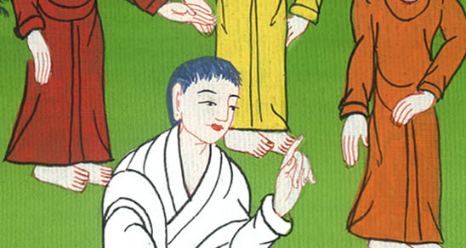
Matthew 5:7,8

Slide 21
9 Blessed are the peacemakers,
for they shall be called children of God.
10 Blessed are those who have been persecuted for righteousness’ sake,
for theirs is the Kingdom of Heaven.

Slide 22
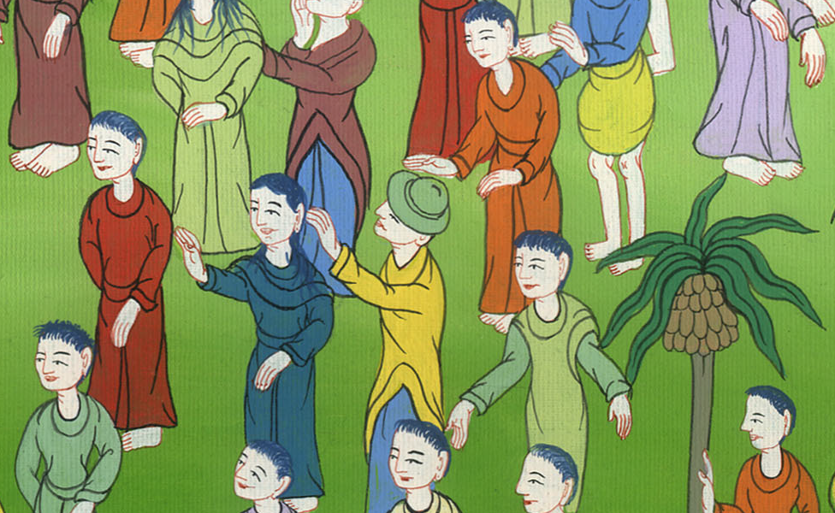
Matthew 5:9,10

Slide 23
11 “Blessed are you when people reproach you, persecute you, and say all kinds of evil against you falsely, for my sake.

Slide 24
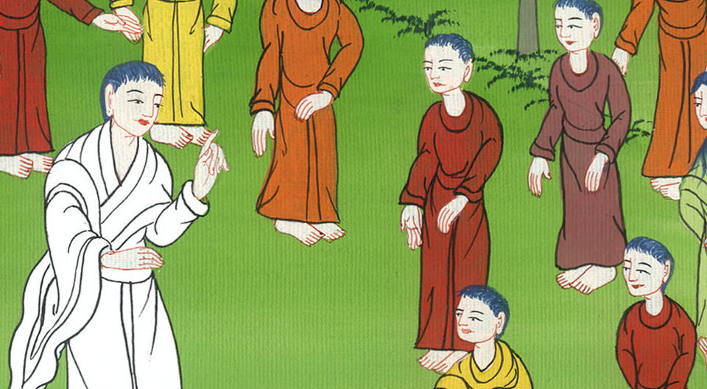
Matthew 5:11

Slide 25
12Rejoice, and be exceedingly glad, for great is your reward in heaven. For that is how they persecuted the prophets who were before you.

Slide 26
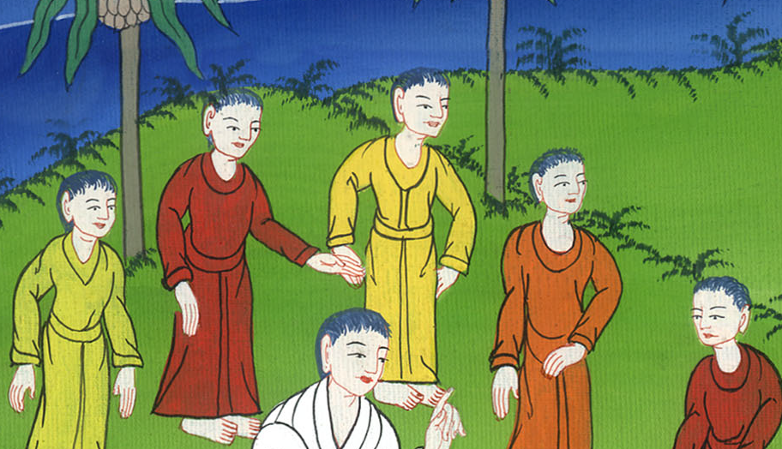
Matthew 5:12

Slide 27
13 “You are the salt of the earth, but if the salt has lost its flavor, with what will it be salted? It is then good for nothing, but to be cast out and trodden under the feet of men.

Slide 28
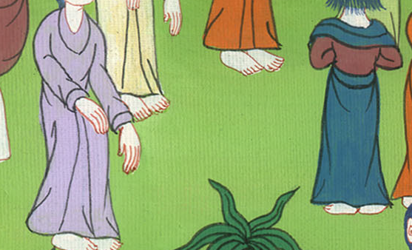
Matthew 5:13

Slide 29
14 You are the light of the world. A city located on a hill can’t be hidden.

Slide 30
Matthew 5:14

Slide 31
15Neither do you light a lamp and put it under a measuring basket, but on a stand; and it shines to all who are in the house.

Slide 32
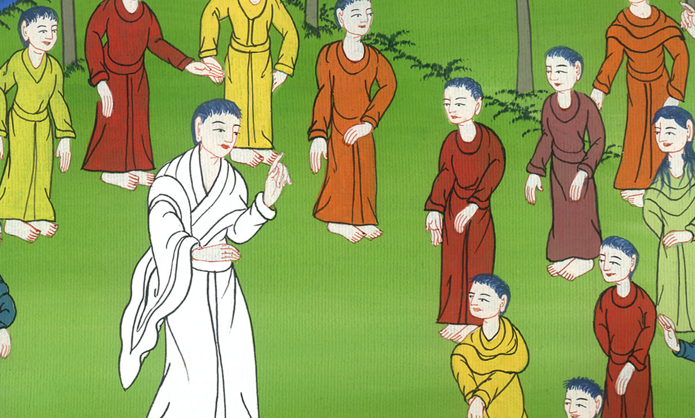
Matthew 5:15

Slide 33
16Even so, let your light shine before men, that they may see your good works and glorify your Father who is in heaven.

Slide 34
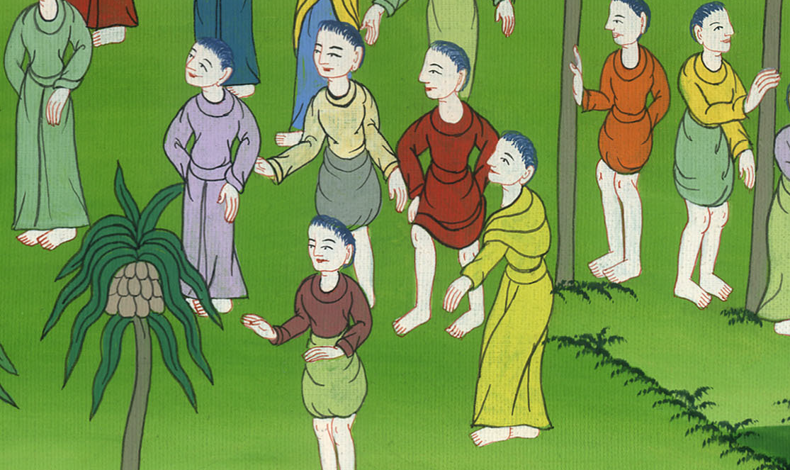
Matthew 5:16

Slide 35
38 “You have heard that it was said, ‘An eye for an eye, and a tooth for a tooth.’

Slide 36
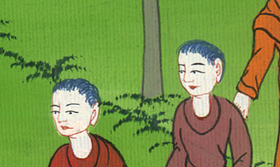
Matthew 5:38

Slide 37
39But I tell you, don’t resist him who is evil; but whoever strikes you on your right cheek, turn to him the other also.

Slide 38
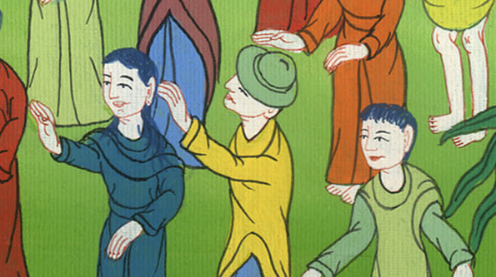
Matthew 5:39

Slide 39
40If anyone sues you to take away your coat, let him have your cloak also. 41Whoever compels you to go one mile, go with him two.

Slide 40
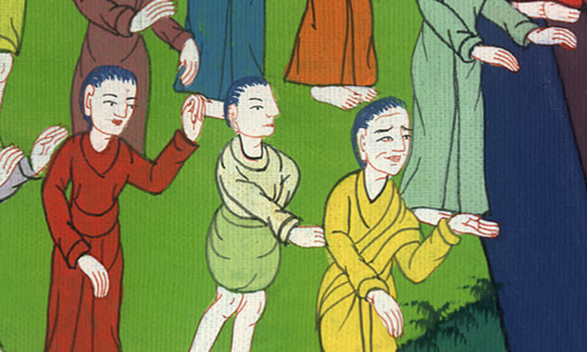
Matthew 5:40,41

Slide 41
42Give to him who asks you, and don’t turn away him who desires to borrow from you.

Slide 42
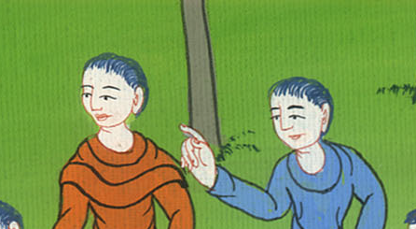
Matthew 5:42

Slide 43
43 “You have heard that it was said, ‘You shall love your neighbor and hate your enemy.’

Slide 44
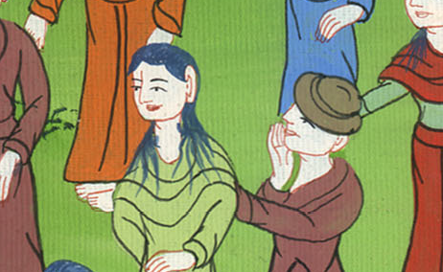
Matthew 5:43

Slide 45
44But I tell you, love your enemies, bless those who curse you, do good to those who hate you, and pray for those who mistreat you and persecute you, 45that you may be children of your Father who is in heaven.

Slide 46
Matthew 5:44,45

