Slide 1
35-1
This work is licensed under a Creative Commons Attribution-ShareAlike 4.0 International License.
Please add this statement to all the videos you create.
English Bible quotes are from the World English Bible US, which is in the public domain.
Notes:
Ch
35 Cure Leper…
1. Cure Leper - Mark 1:40-45 (Left Top)
2. The Centurion’s Faith - Luke 7:1-10; Matt 8:5-13 (Right Top)
3. The Widow’s Son - Luke 7:11-17 (Right Center)
4. Woman washes Jesus’ Feet - Luke 7:36-50 (Right Bottom)
5. Jesus’ relatives - Mark 3:20-35 (Left Bottom)
6. Calming the Storm - Matt 8:18-27 (left Center)

Slide 2
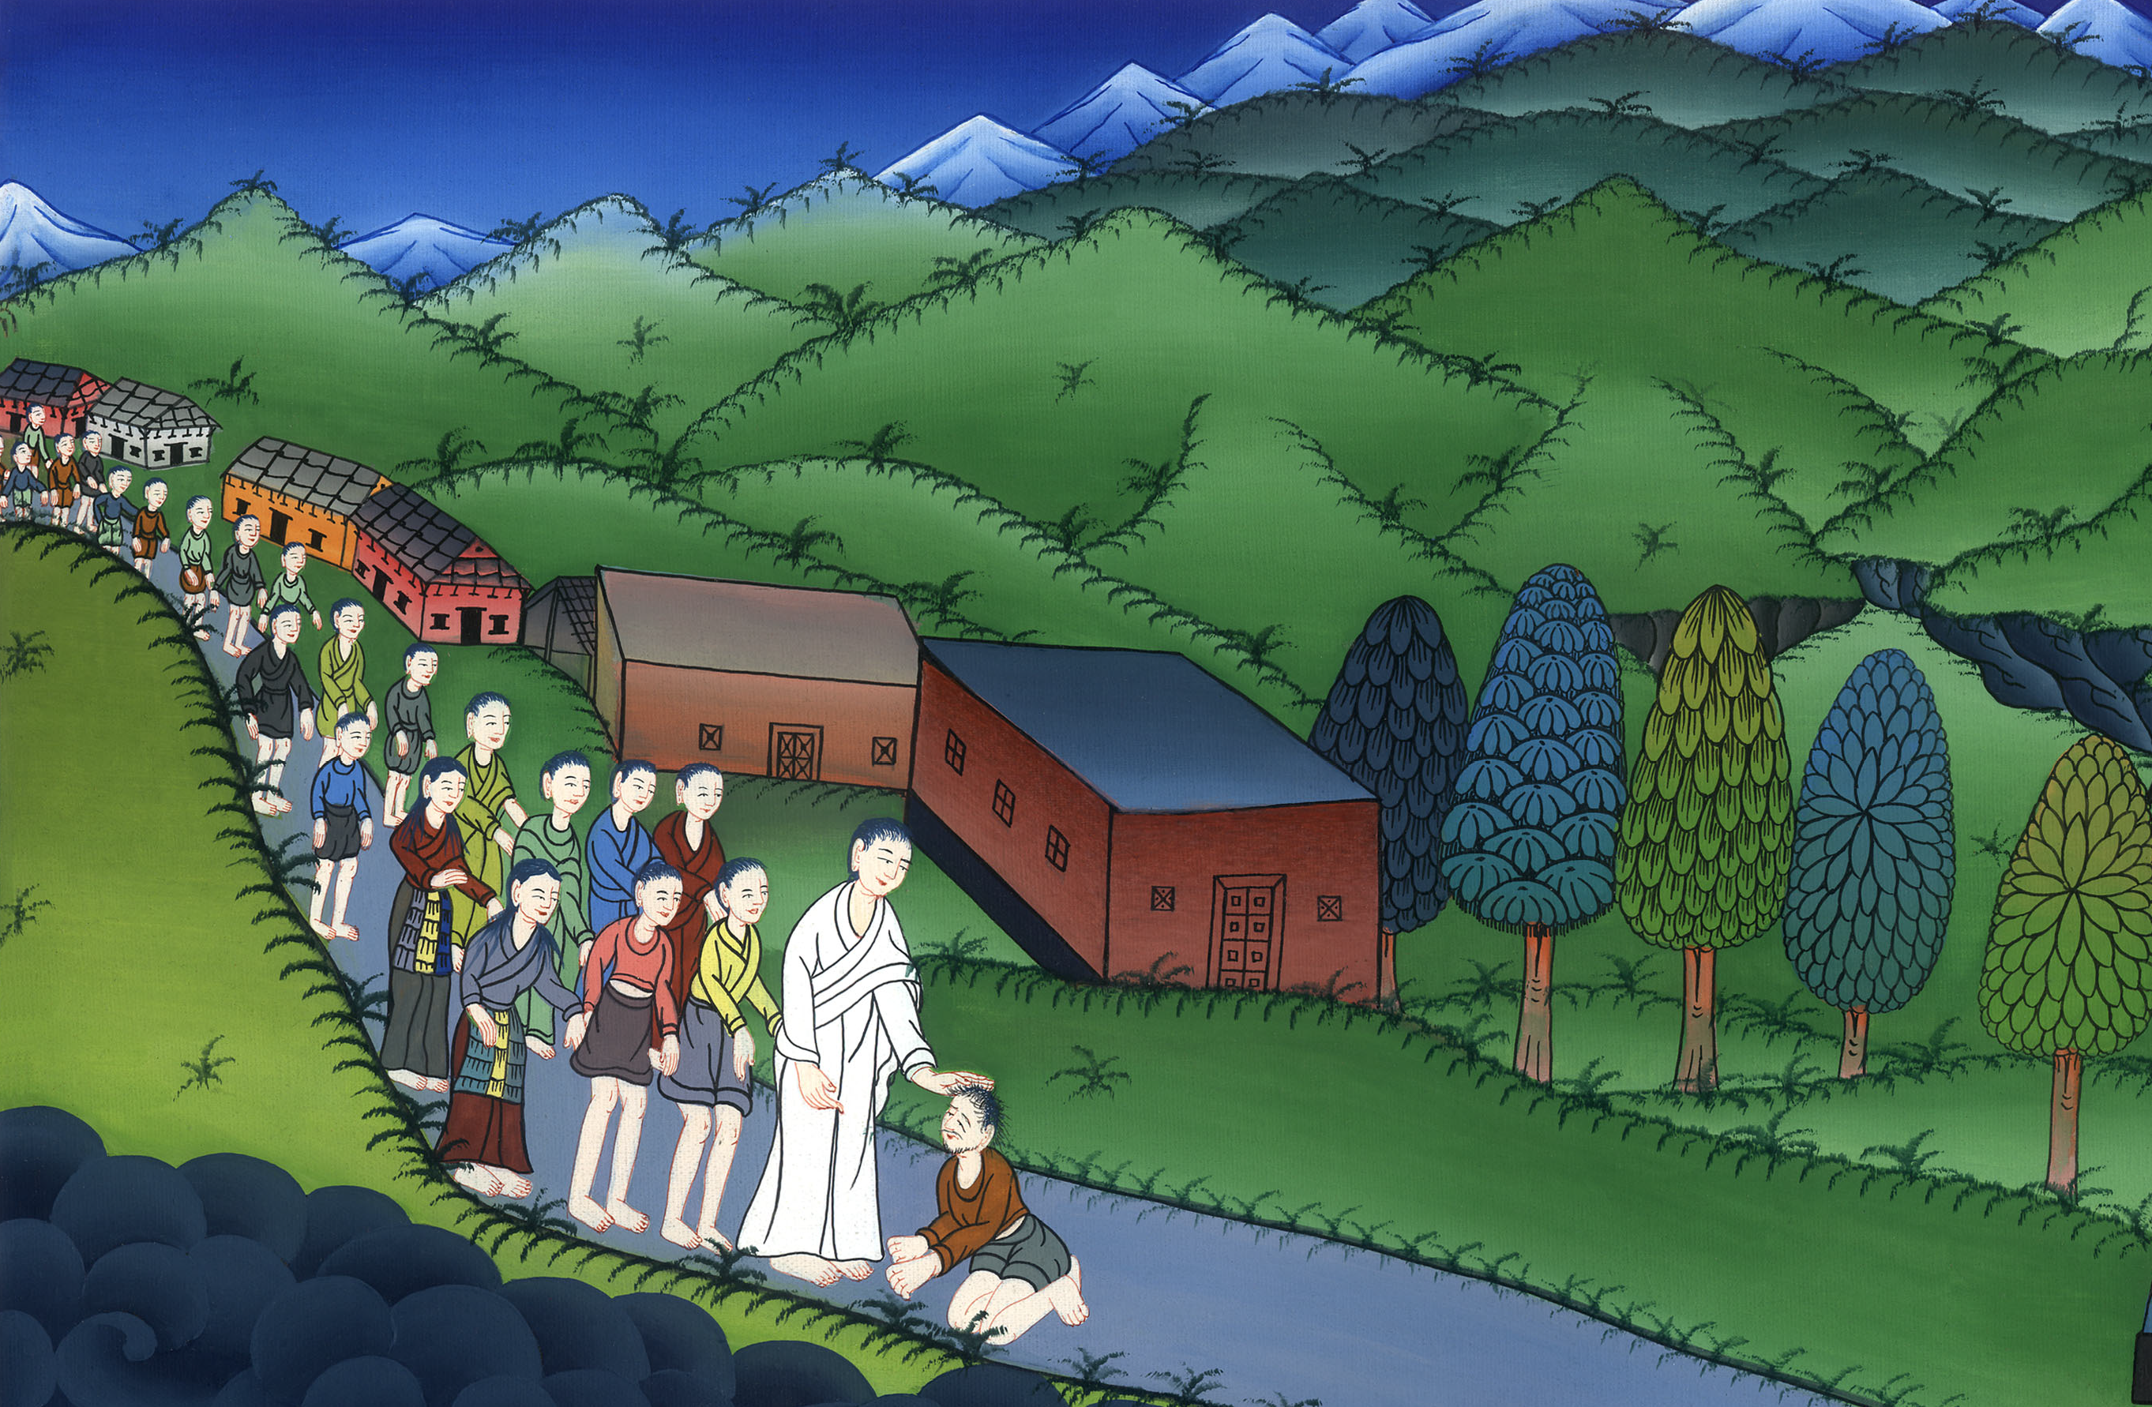
Jesus Cure a Leper - Mark 1:40-45

Slide 3
Jesus Cure a Leper - Mark 1:40-45

Slide 4
Jesus Cure a Leper - Mark 1:40-45

Slide 5
40A leper came to him, begging him, kneeling down to him, and saying to him, “If you want to, you can make me clean.”

Slide 6
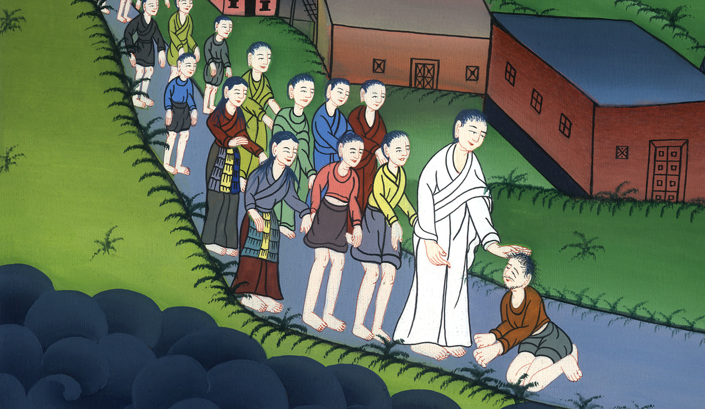
Mark 1:40

Slide 7
41Being moved with compassion, he stretched out his hand, and touched him, and said to him, “I want to. Be made clean.” 42When he had said this, immediately the leprosy departed from him and he was made clean.

Slide 8
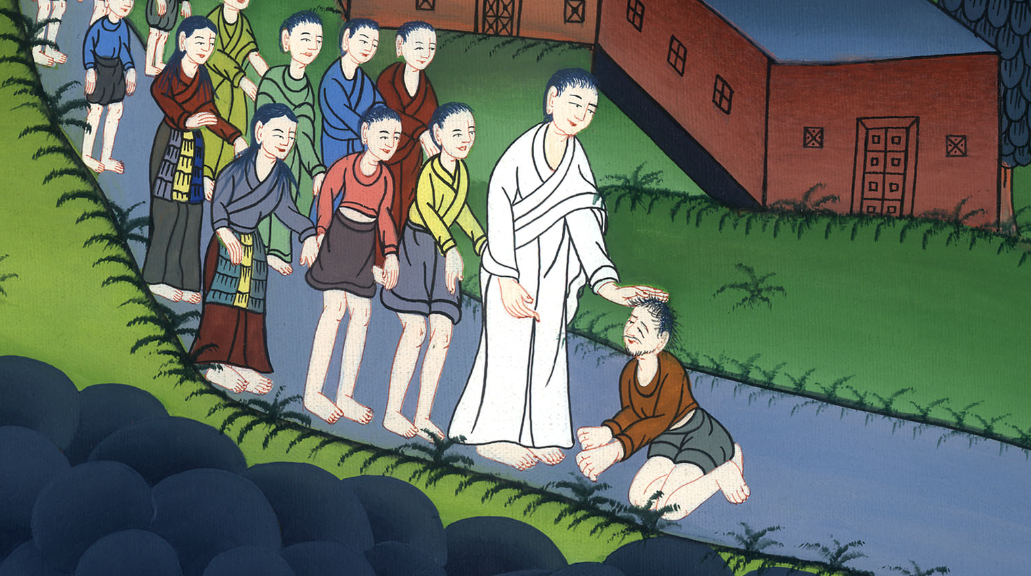
Mark 1:41,42

Slide 9
43He strictly warned him and immediately sent him out, 44and said to him, “See that you say nothing to anybody,

Slide 10
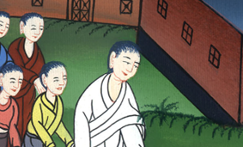
Mark 1:43,44

Slide 11
but go show yourself to the priest and offer for your cleansing the things which Moses commanded, for a testimony to them.”

Slide 12
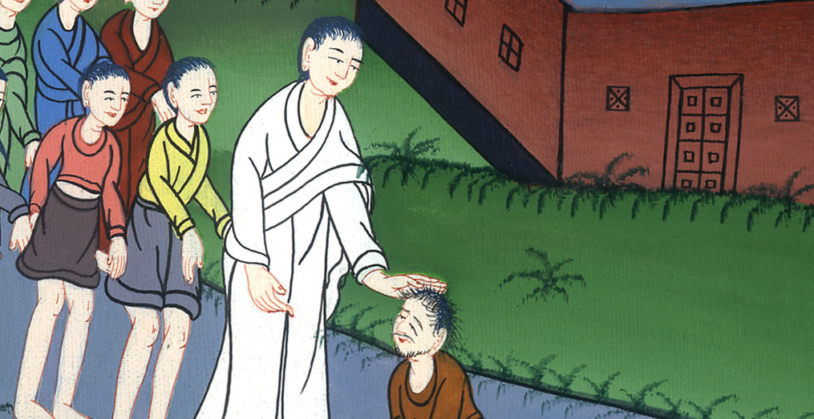
Mark 1:44

Slide 13
45But he went out, and began to proclaim it much, and to spread about the matter,

Slide 14
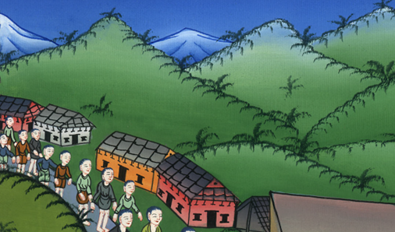
Mark 1:45

Slide 15
so that Jesus could no more openly enter into a city, but was outside in desert places. People came to him from everywhere.

Slide 16
Mark 1:45

