Slide 1
35-2
This work is licensed under a Creative Commons Attribution-ShareAlike 4.0 International License.
Please add this statement to all the videos you create.
English Bible quotes are from the World English Bible US, which is in the public domain.
Notes:
Ch
35 Cure Leper…
1. Cure Leper - Mark 1:40-45 (Left Top)
2. The Centurion’s Faith - Luke 7:1-10; Matt 8:5-13 (Right Top)
3. The Widow’s Son - Luke 7:11-17 (Right Center)
4. Woman washes Jesus’ Feet - Luke 7:36-50 (Right Bottom)
5. Jesus’ relatives - Mark 3:20-35 (Left Bottom)
6. Calming the Storm - Matt 8:18-27 (left Center)

Slide 2
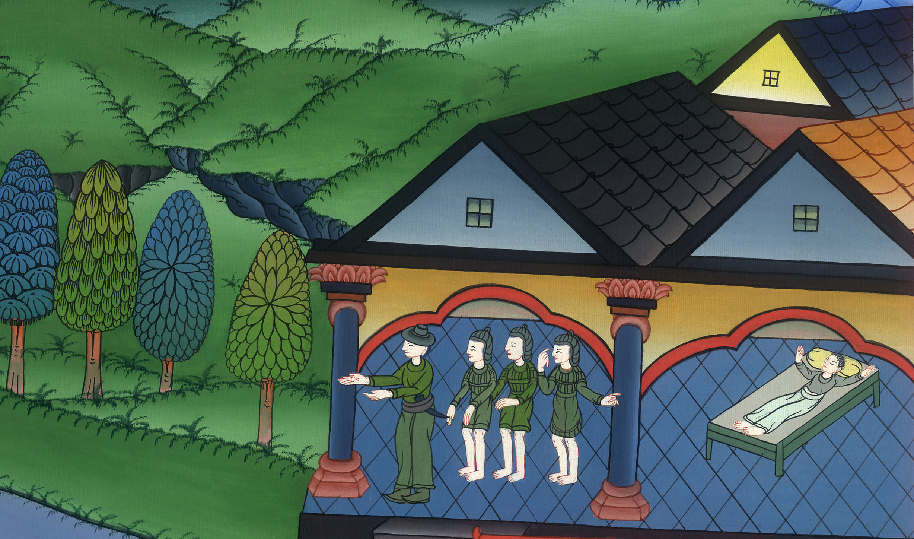
The Centurion’s Faith –
Luke 7:1-10

Slide 3
The Centurion’s Faith - Luke 7:1-10

Slide 4
The Centurion’s Faith –
Luke 7:1-10

Slide 5
1After he had finished speaking in the hearing of the people, he entered into Capernaum. 2A certain centurion’s servant, who was dear to him, was sick and at the point of death.

Slide 6
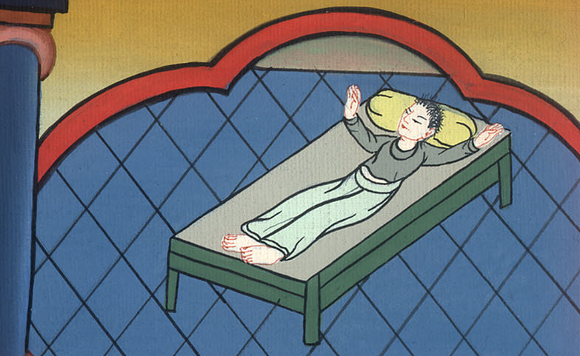
Luke 7:1,2

Slide 7
3When he heard about Jesus, he sent to him elders of the Jews, asking him to come and save his servant.

Slide 8
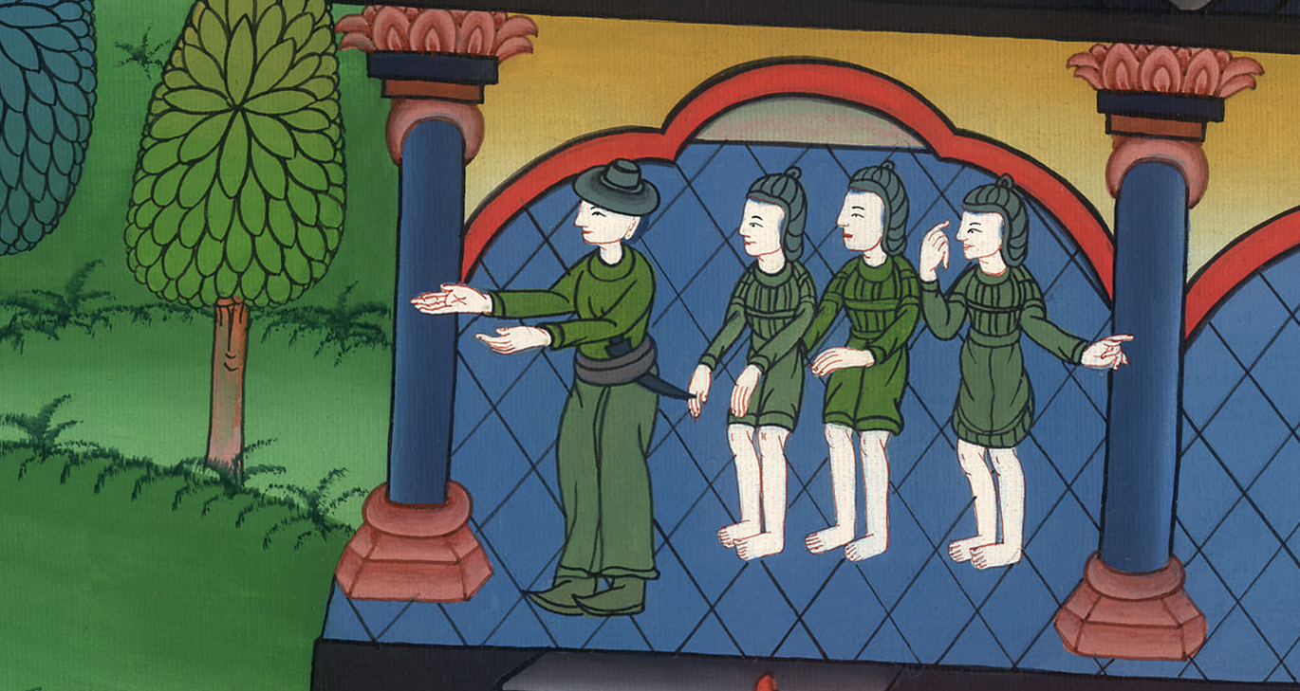
Luke 7:3

Slide 9
4When they came to Jesus, they begged him earnestly, saying, “He is worthy for you to do this for him, 5for he loves our nation, and he built our synagogue for us.”

Slide 10
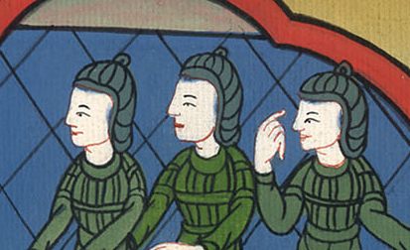
Luke 7:4,5

Slide 11
6Jesus went with them. When he was now not far from the house, the centurion sent friends to him, saying to him, “Lord, don’t trouble yourself, for I am not worthy for you to come under my roof.

Slide 12
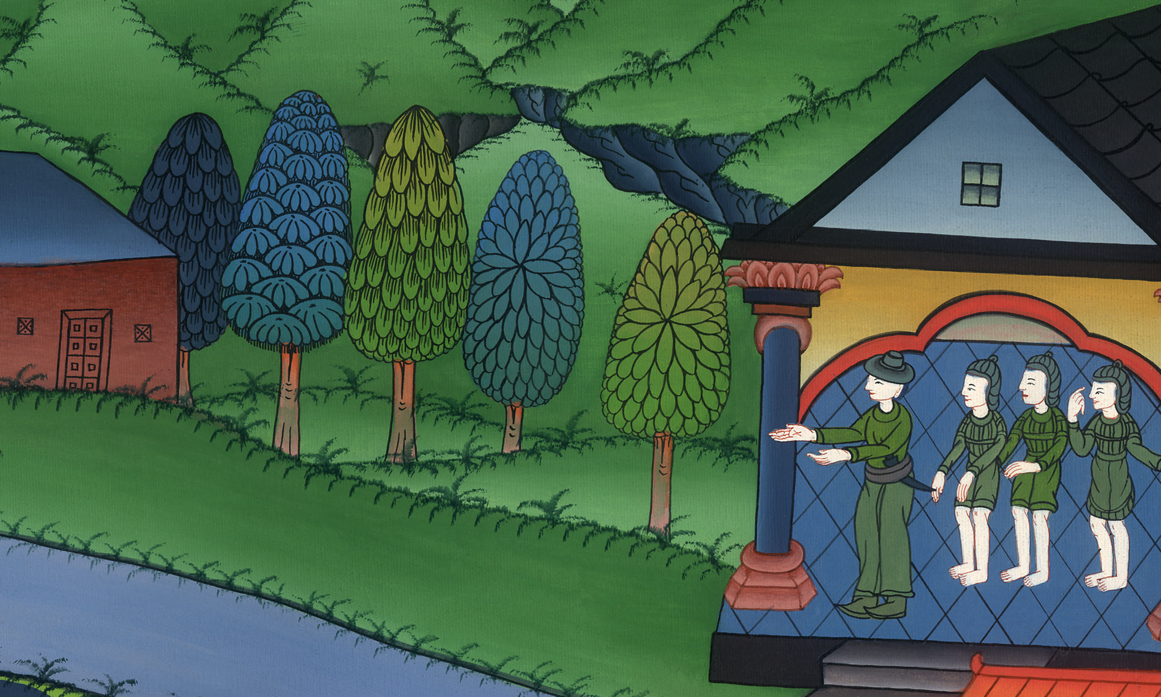
Luke 7:6

Slide 13
7Therefore I didn’t even think myself worthy to come to you; but say the word, and my servant will be healed.

Slide 14
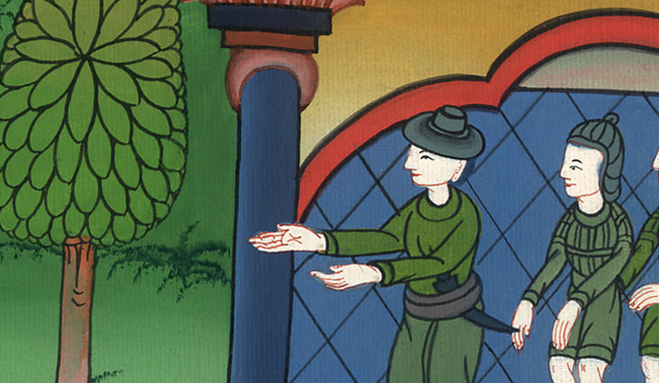
Luke 7:7

Slide 15
8For I also am a man placed under authority, having under myself soldiers. I tell this one, ‘Go!’ and he goes; and to another, ‘Come!’ and he comes; and to my servant, ‘Do this,’ and he does it.”

Slide 16
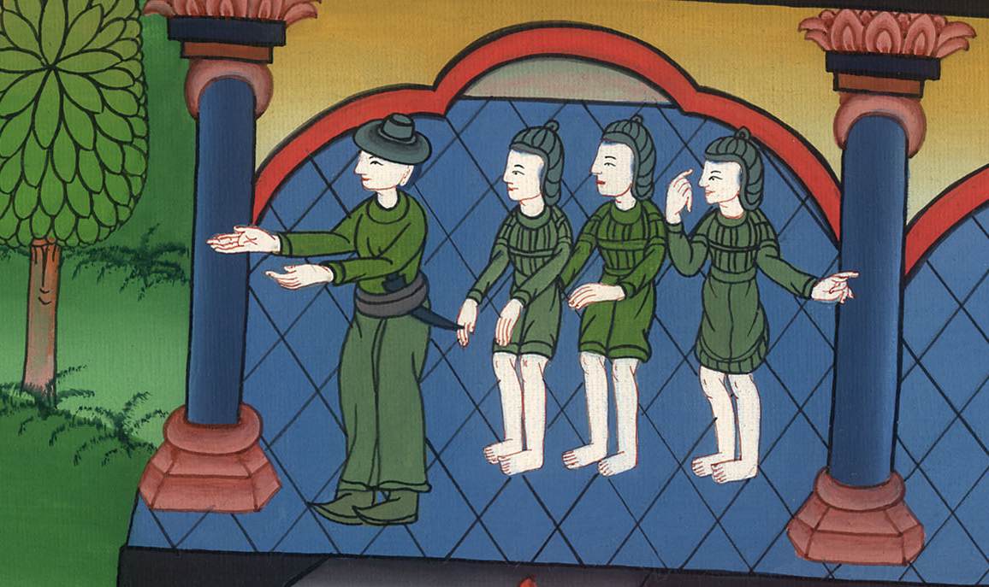
Luke 7:8

Slide 17
9When Jesus heard these things, he marveled at him, and turned and said to the multitude who followed him, “I tell you, I have not found such great faith, no, not in Israel.”

Slide 18
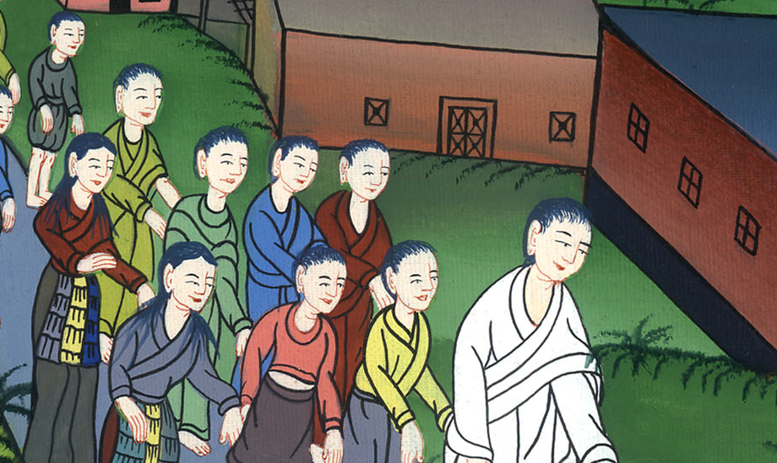
Luke 7:9

Slide 19
10Those who were sent, returning to the house, found that the servant who had been sick was well.

Slide 20
Luke 7:10

