Slide 1
35-3
This work is licensed under a Creative Commons Attribution-ShareAlike 4.0 International License.
Please add this statement to all the videos you create.
English Bible quotes are from the World English Bible US, which is in the public domain.
Notes:
Ch
35 Cure Leper…
1. Cure Leper - Mark 1:40-45 (Left Top)
2. The Centurion’s Faith - Luke 7:1-10; Matt 8:5-13 (Right Top)
3. The Widow’s Son - Luke 7:11-17 (Right Center)
4. Woman washes Jesus’ Feet - Luke 7:36-50 (Right Bottom)
5. Jesus’ relatives - Mark 3:20-35 (Left Bottom)
6. Calming the Storm - Matt 8:18-27 (left Center)

Slide 2
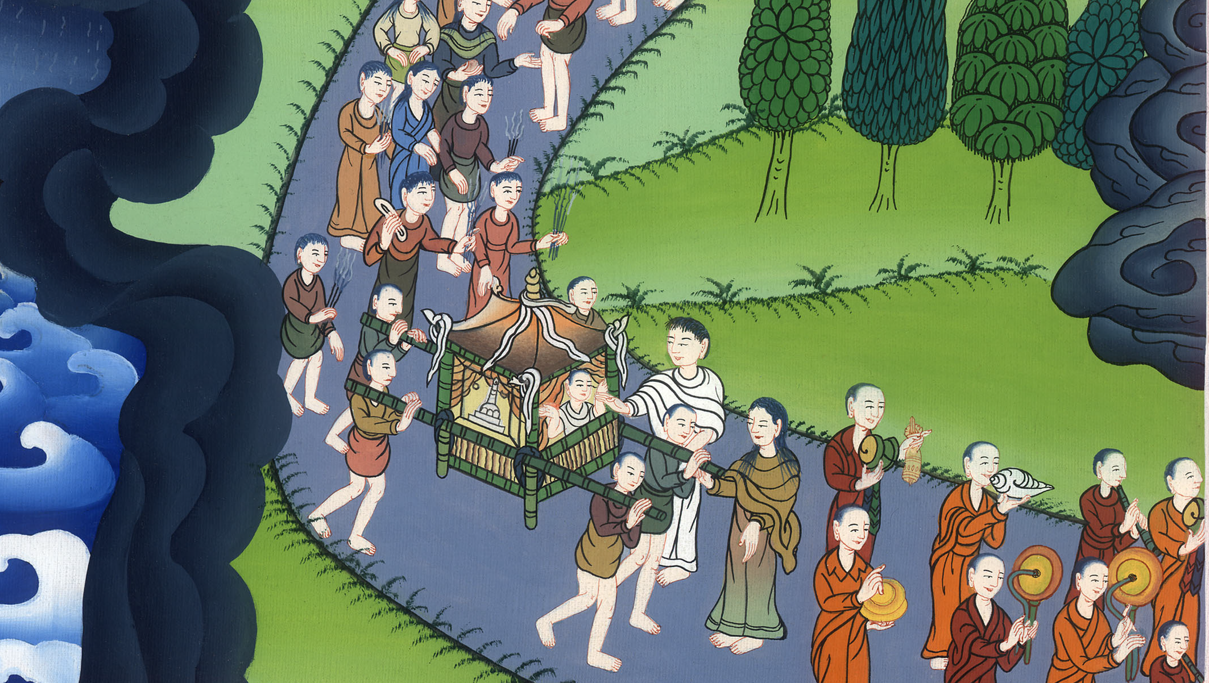
The Widow’s Son - Luke 7:11-17

Slide 3
The Widow’s Son - Luke 7:11-17

Slide 4
The Widow’s Son - Luke 7:11-17

Slide 5
11Soon afterwards, he went to a city called Nain. Many of his disciples, along with a great multitude, went with him.

Slide 6
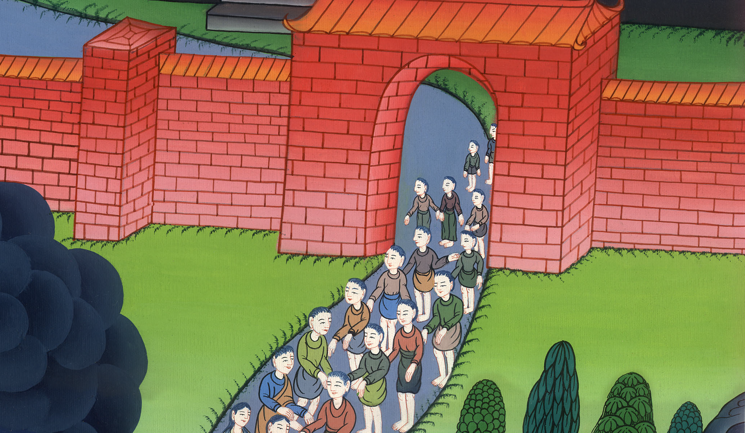
Luke 7:11

Slide 7
12Now when he came near to the gate of the city, behold, one who was dead was carried out, the only born son of his mother, and she was a widow. Many people of the city were with her.

Slide 8
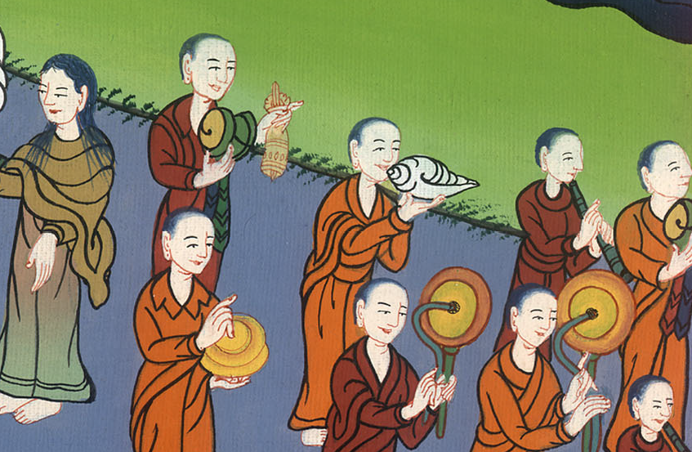
Luke 7:12

Slide 9
13When the Lord saw her, he had compassion on her and said to her, “Don’t cry.”

Slide 10
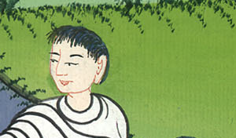
Luke 7:13

Slide 11
14He came near and touched the coffin, and the bearers stood still. He said, “Young man, I tell you, arise!”

Slide 12
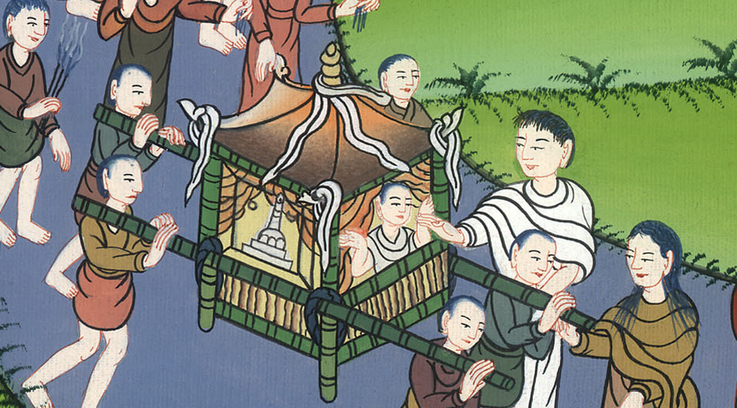
Luke 7:14

Slide 13
15He who was dead sat up and began to speak. Then he gave him to his mother.

Slide 14
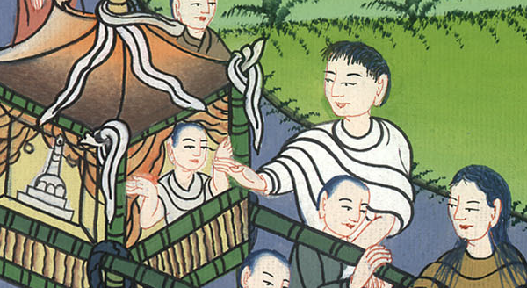
Luke 7:15

Slide 15
16Fear took hold of all, and they glorified God, saying, “A great prophet has arisen among us!” and, “God has visited his people!”

Slide 16
Luke 7:16

Slide 17
17This report went out concerning him in the whole of Judea and in all the surrounding region.

Slide 18
Luke 7:17

