Slide 1
35-4
This work is licensed under a Creative Commons Attribution-ShareAlike 4.0 International License.
Please add this statement to all the videos you create.
English Bible quotes are from the World English Bible US, which is in the public domain.
Notes:
Ch
35 Cure Leper…
1. Cure Leper - Mark 1:40-45 (Left Top)
2. The Centurion’s Faith - Luke 7:1-10; Matt 8:5-13 (Right Top)
3. The Widow’s Son - Luke 7:11-17 (Right Center)
4. Woman washes Jesus’ Feet - Luke 7:36-50 (Right Bottom)
5. Jesus’ relatives - Mark 3:20-35 (Left Bottom)
6. Calming the Storm - Matt 8:18-27 (left Center)

Slide 2
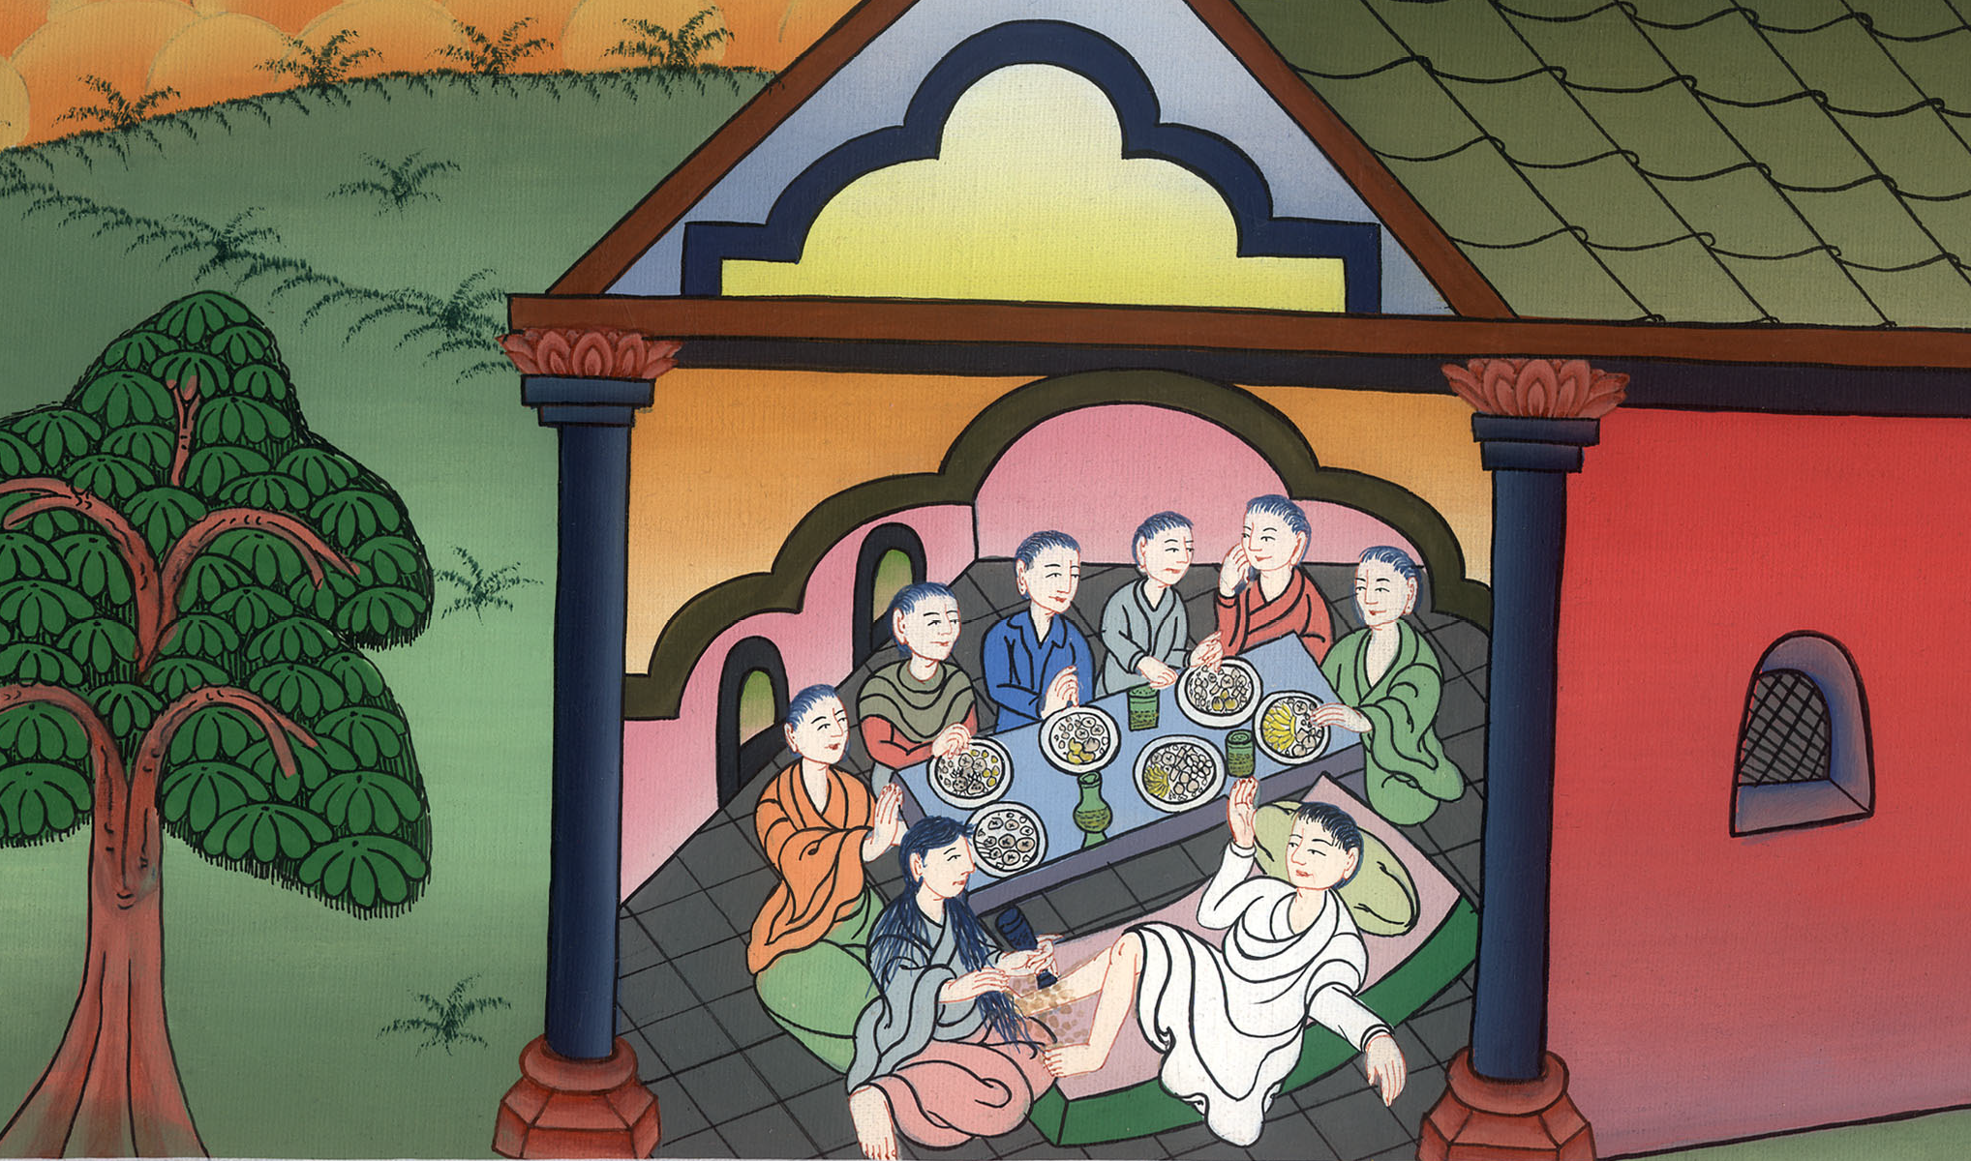
Woman washes Jesus’s Feet - Luke 7:36-50

Slide 3
Woman washes Jesus’s Feet - Luke 7:36-50

Slide 4
Woman washes Jesus’s Feet - Luke 7:36-50

Slide 5
36One of the Pharisees invited him to eat with him. He entered into the Pharisee’s house and sat at the table.

Slide 6
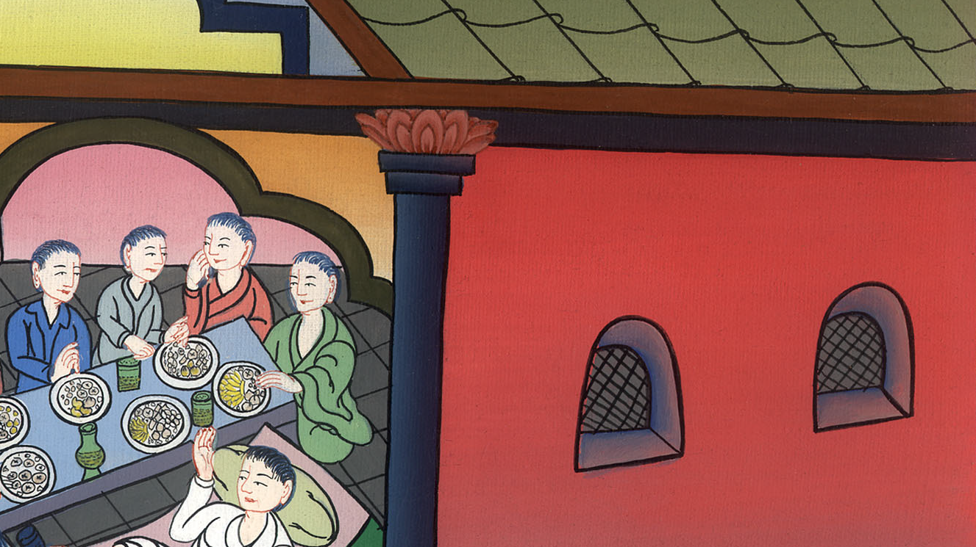
Luke 7:36

Slide 7
37Behold, a woman in the city who was a sinner, when she knew that he was reclining in the Pharisee’s house, brought an alabaster jar of ointment.

Slide 8
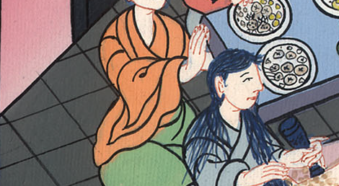
Luke 7:37

Slide 9
38Standing behind at his feet weeping, she began to wet his feet with her tears, and she wiped them with the hair of her head, kissed his feet, and anointed them with the ointment.

Slide 10
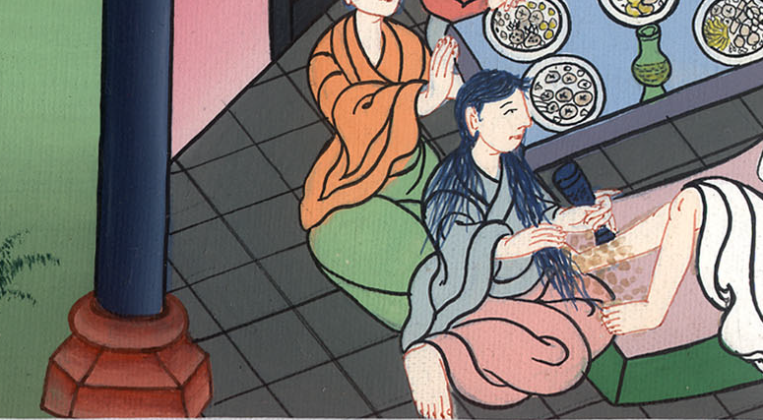
Luke 7:38

Slide 11
39Now when the Pharisee who had invited him saw it, he said to himself, “This man, if he were a prophet, would have perceived who and what kind of woman this is who touches him, that she is a sinner.”

Slide 12
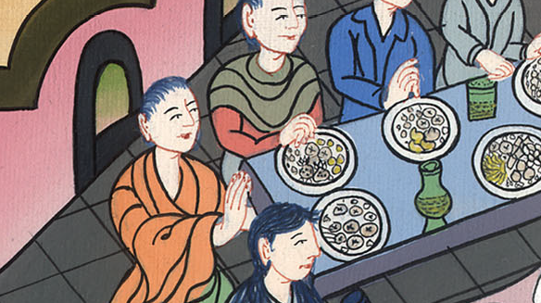
Luke 7:39

Slide 13
40Jesus answered him, “Simon, I have something to tell you.”
He said, “Teacher, say on.”

Slide 14
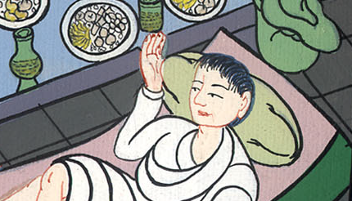
Luke 7:40

Slide 15
41 “A certain lender had two debtors. The one owed five hundred denarii, and the other fifty.

Slide 16
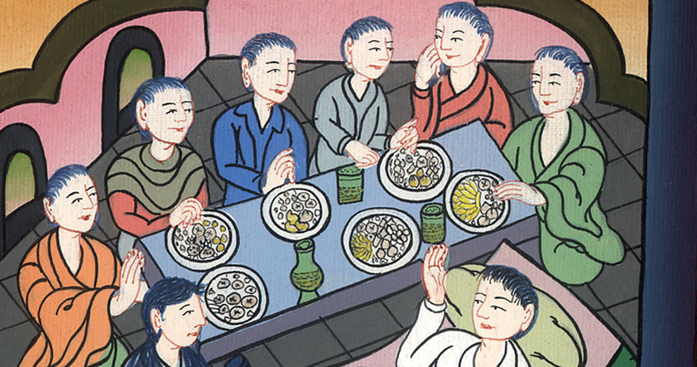
Luke 7:41

Slide 17
42When they couldn’t pay, he forgave them both. Which of them therefore will love him most?”

Slide 18
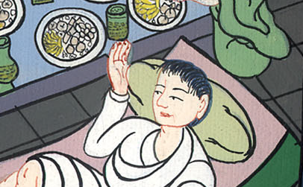
Luke 7:42

Slide 19
43Simon answered, “He, I suppose, to whom he forgave the most.”
He said to him, “You have judged correctly.”

Slide 20
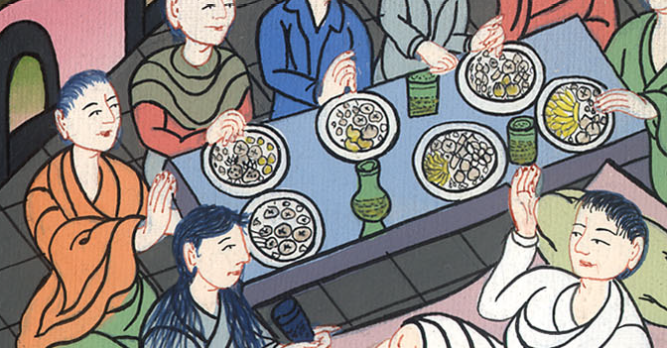
Luke 7:43

Slide 21
44Turning to the woman, he said to Simon, “Do you see this woman? I entered into your house, and you gave me no water for my feet, but she has wet my feet with her tears, and wiped them with the hair of her head.

Slide 22
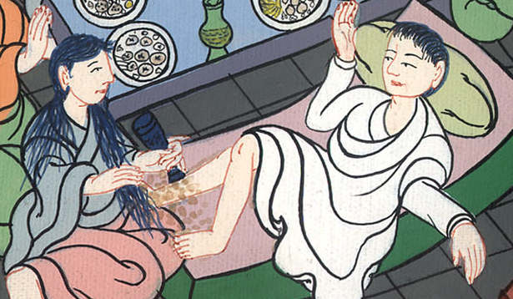
Luke 7:44

Slide 23
45You gave me no kiss, but she, since the time I came in, has not ceased to kiss my feet. 46You didn’t anoint my head with oil, but she has anointed my feet with ointment.

Slide 24
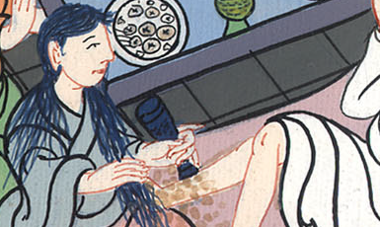
Luke 7:45,46

Slide 25
47Therefore I tell you, her sins, which are many, are forgiven, for she loved much. But one to whom little is forgiven, loves little.” 48He said to her, “Your sins are forgiven.”

Slide 26
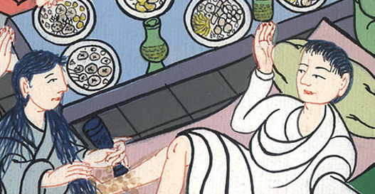
Luke 7:47,48

Slide 27
49Those who sat at the table with him began to say to themselves, “Who is this who even forgives sins?”

Slide 28
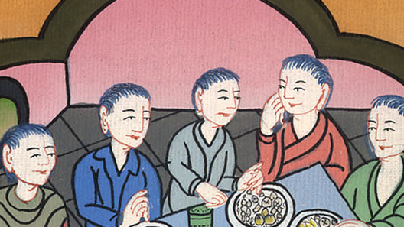
Luke 7:49

Slide 29
50He said to the woman, “Your faith has saved you. Go in peace.”

Slide 30
Luke 7:50

