Slide 1
35-5
This work is licensed under a Creative Commons Attribution-ShareAlike 4.0 International License.
Please add this statement to all the videos you create.
English Bible quotes are from the World English Bible US, which is in the public domain.
Notes:
Ch
35 Cure Leper…
1. Cure Leper - Mark 1:40-45 (Left Top)
2. The Centurion’s Faith - Luke 7:1-10; Matt 8:5-13 (Right Top)
3. The Widow’s Son - Luke 7:11-17 (Right Center)
4. Woman washes Jesus’ Feet - Luke 7:36-50 (Right Bottom)
5. Jesus’ relatives - Mark 3:20-35 (Left Bottom)
6. Calming the Storm - Matt 8:18-27 (left Center)

Slide 2
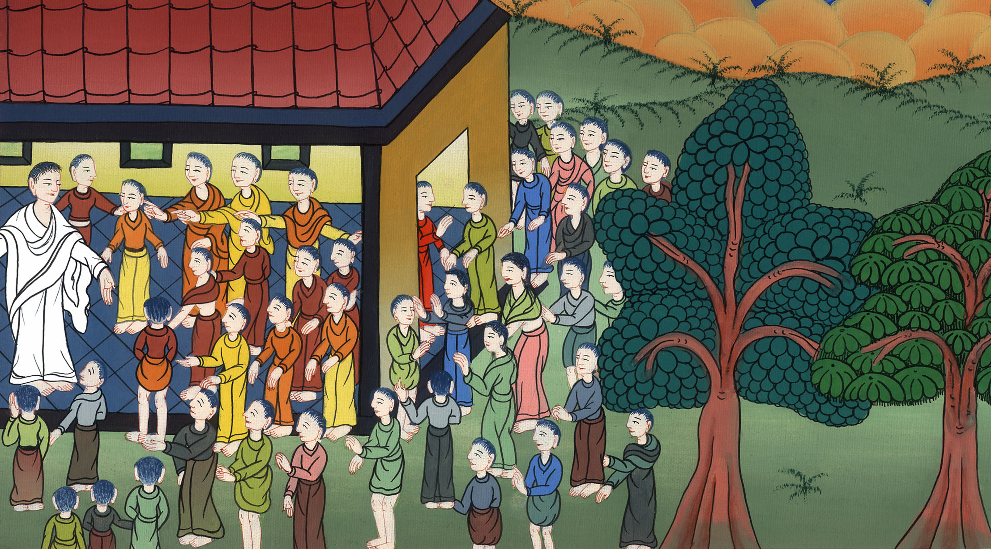
Jesus’s relatives - Mark 3:20-35

Slide 3
Jesus’s relatives - Mark 3:20-35

Slide 4
Jesus’s relatives - Mark 3:20-35

Slide 5
20The multitude came together again, so that they could not so much as eat bread.

Slide 6
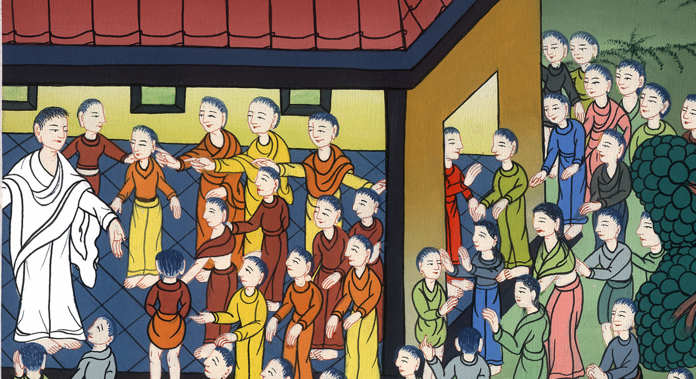
Mark 3:20

Slide 7
21When his friends heard it, they went out to seize him; for they said, “He is insane.”

Slide 8
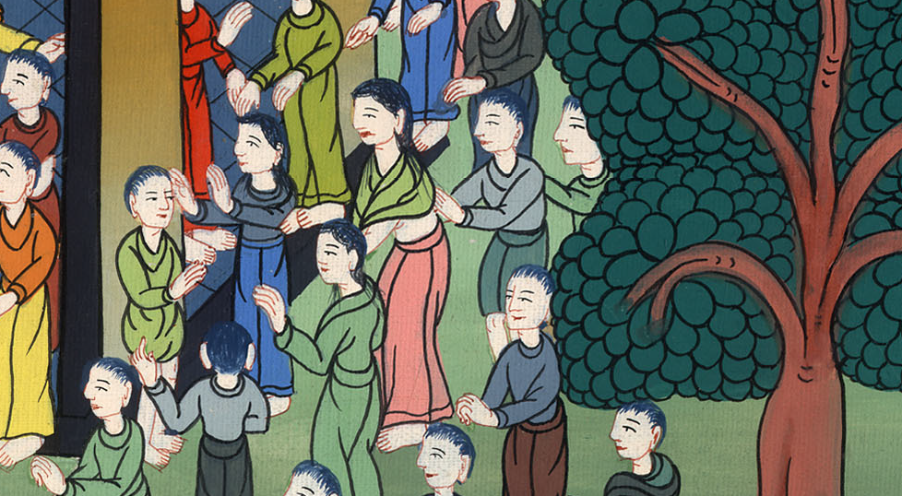
Mark 3:21

Slide 9
22The scribes who came down from Jerusalem said, “He has Beelzebul,” and, “By the prince of the demons he casts out the demons.”

Slide 10
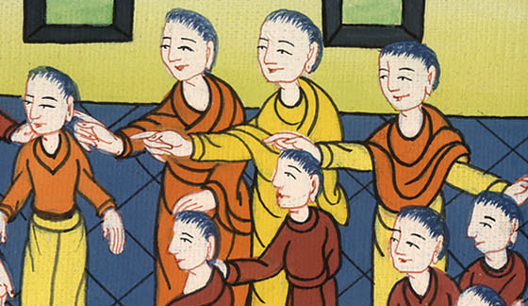
Mark 3:22

Slide 11
23He summoned them and said to them in parables, “How can Satan cast out Satan?

Slide 12
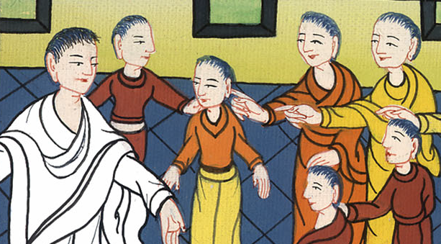
Mark 3:23

Slide 13
24If a kingdom is divided against itself, that kingdom cannot stand. 25If a house is divided against itself, that house cannot stand.

Slide 14
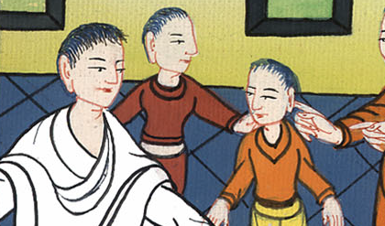
Mark 3:24,25

Slide 15
26If Satan has risen up against himself, and is divided, he can’t stand, but has an end.

Slide 16
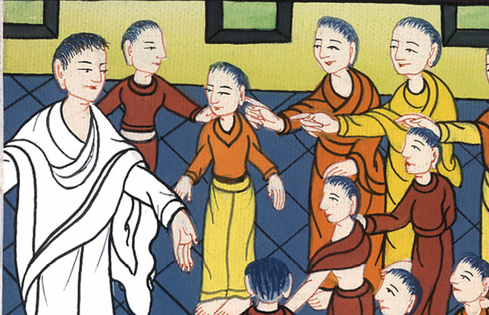
Mark 3:26

Slide 17
27But no one can enter into the house of the strong man to plunder unless he first binds the strong man; then he will plunder his house.

Slide 18
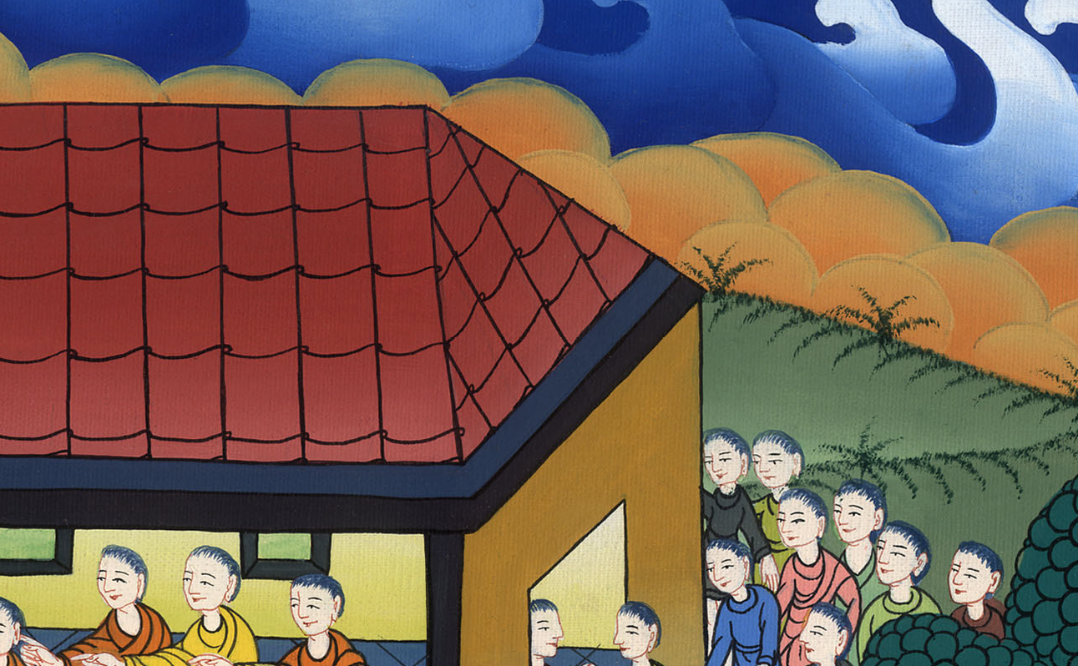
Mark 3:27

Slide 19
28 “Most certainly I tell you, all sins of the descendants of man will be forgiven, including their blasphemies with which they may blaspheme;

Slide 20
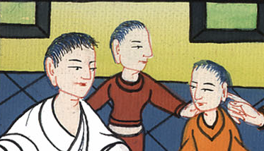
Mark 3:28

Slide 21
29but whoever may blaspheme against the Holy Spirit never has forgiveness, but is subject to eternal condemnation.”

Slide 22
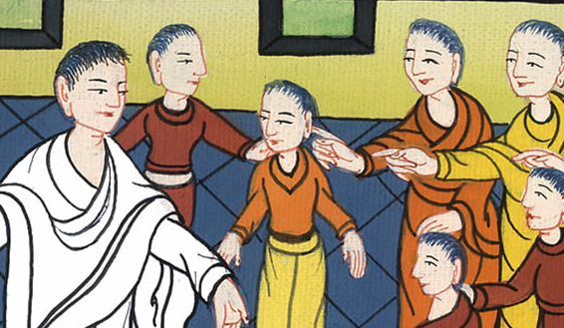
Mark 3:29

Slide 23
30—because they said, “He has an unclean spirit.”

Slide 24
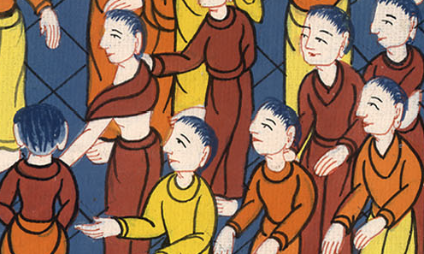
Mark 3:30

Slide 25
31His mother and his brothers came, and standing outside, they sent to him, calling him.

Slide 26
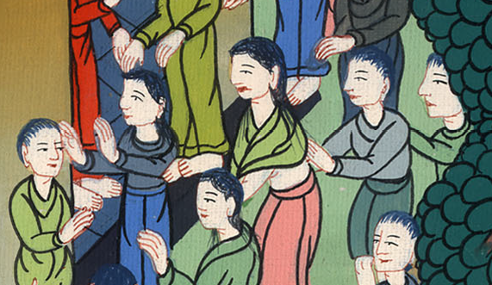
Mark 3:31

Slide 27
32A multitude was sitting around him, and they told him, “Behold, your mother, your brothers, and your sisters are outside looking for you.”

Slide 28
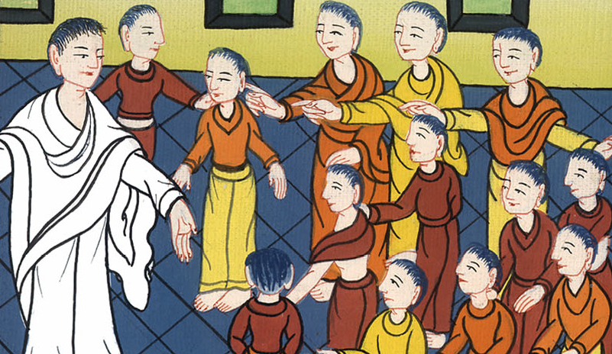
Mark 3:32

Slide 29
33He answered them, “Who are my mother and my brothers?” 34Looking around at those who sat around him, he said, “Behold, my mother and my brothers!

Slide 30
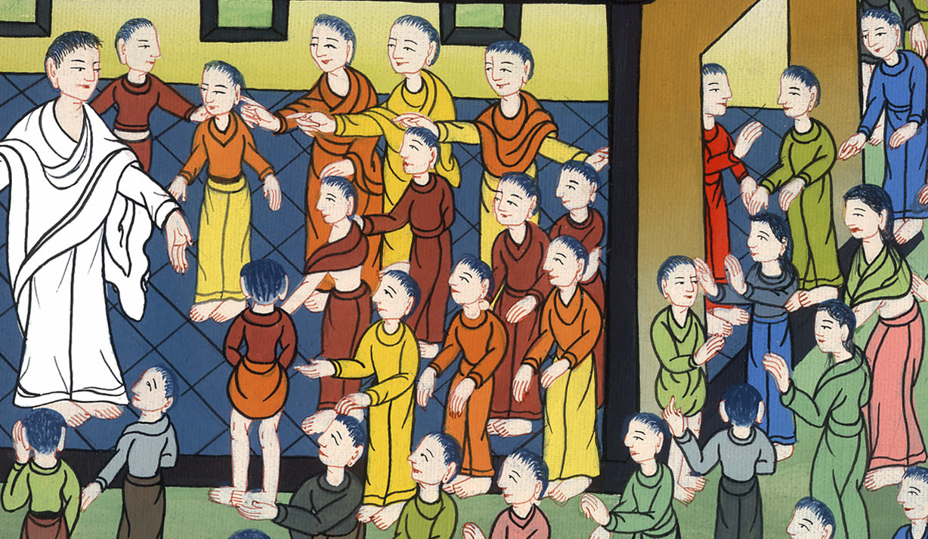
Mark 3:33,34

Slide 31
35For whoever does the will of God is my brother, my sister, and mother.”

Slide 32
Mark 3:35

