Slide 1
36-1
This work is licensed under a Creative Commons Attribution-ShareAlike 4.0 International License.
Please add this statement to all the videos you create.
English Bible quotes are from the World English Bible US, which is in the public domain.
Notes:
Ch
36 Legion
1. Legion - Matt 8:28-34; Mark 5:1-20; Luke 8:26-39 (Left Center)
2. Woman touching Jesus’ cloak & Jairus’ daughter - Matthew 9:18-26; Mark 5:21-
43; Luke 8:40-56 (Top)
3. John Beheaded - Matt 14:1-12; Mark 6:14-29; Luke 9:7-9 (Right Bottom)
4. 1st Miracle with loaves - Matt 14:13-21; Mark 6:30-44;luke 9:10-17; John 6:1-15
(Left Bottom)
5. Jesus walks on Water - Matt 14:22-33; Mark 6:45-52; John 6:16-21 (Center)

Slide 2
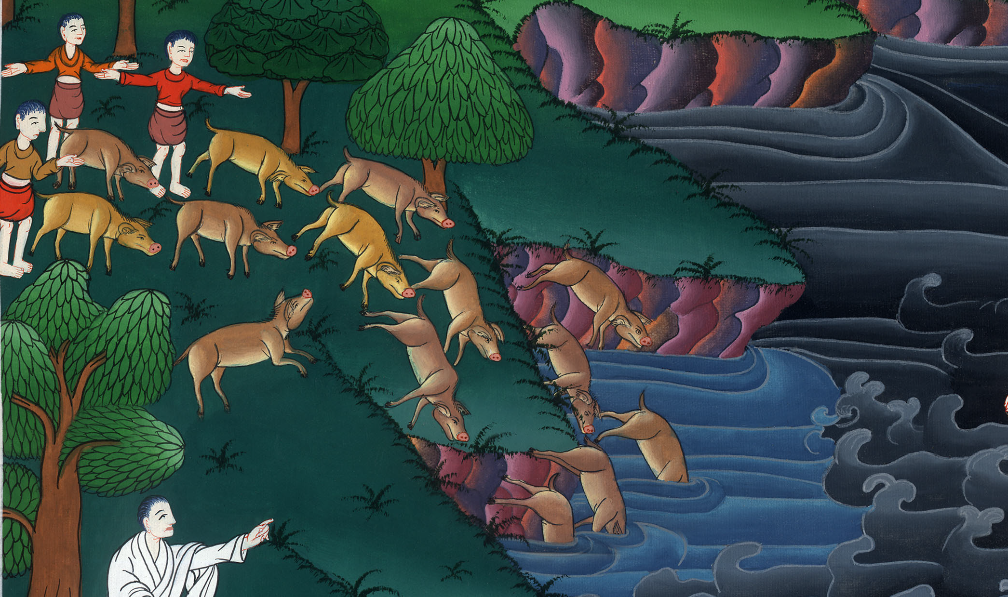
Legion –
Luke 8:26-39

Slide 3
36 Legion
Legion - Luke 8:26-39

Slide 4
Legion –
Luke 8:26-39

Slide 5
26Then they arrived at the country of the Gadarenes, which is opposite Galilee.

Slide 6
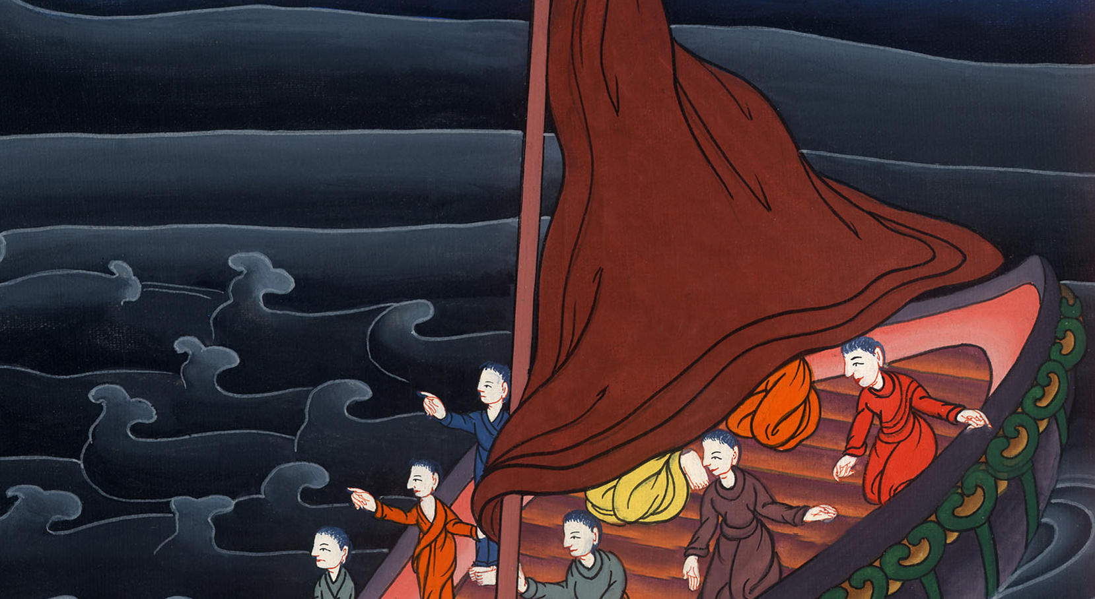
Luke 8:26

Slide 7
27When Jesus stepped ashore, a certain man out of the city who had demons for a long time met him. He wore no clothes, and didn’t live in a house, but in the tombs.

Slide 8
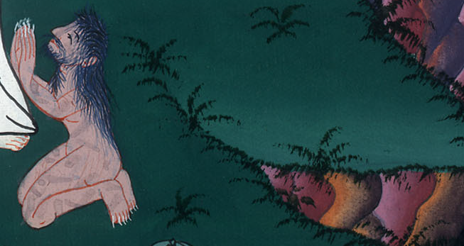
Luke 8:27

Slide 9
28When he saw Jesus, he cried out and fell down before him, and with a loud voice said, “What do I have to do with you, Jesus, you Son of the Most High God? I beg you, don’t torment me!”

Slide 10
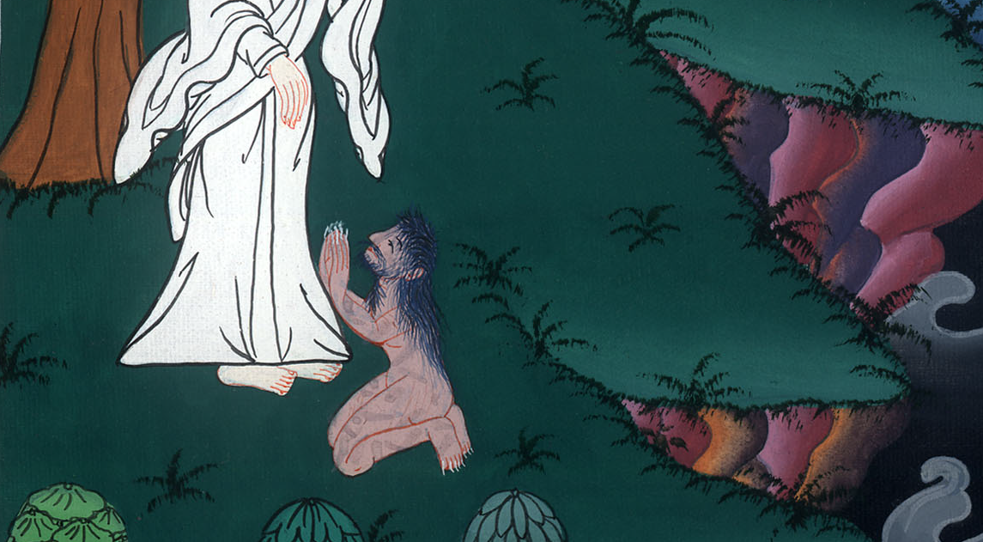
Luke 8:28

Slide 11
30Jesus asked him, “What is your name?”
He said, “Legion,” for many demons had entered into him. 31They begged him that he would not command them to go into the abyss.

Slide 12
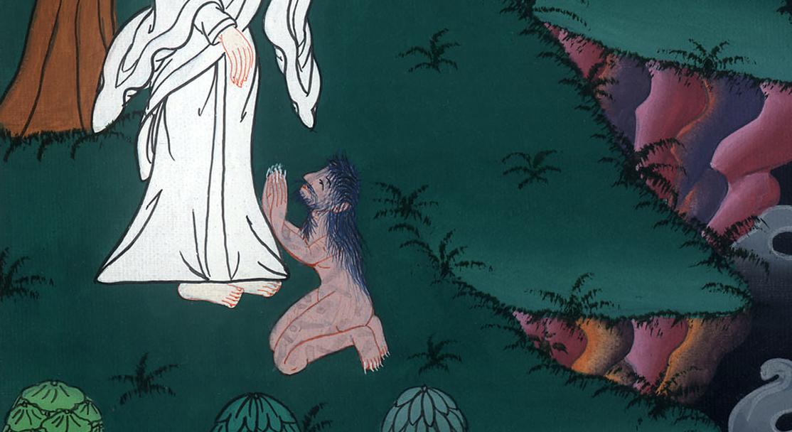
Luke 8:30,31

Slide 13
32Now there was there a herd of many pigs feeding on the mountain, and they begged him that he would allow them to enter into those. Then he allowed them.

Slide 14
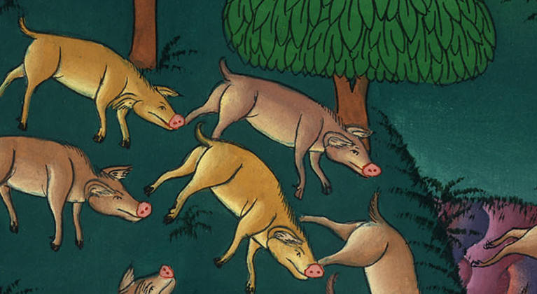
Luke 8:32

Slide 15
33The demons came out of the man and entered into the pigs, and the herd rushed down the steep bank into the lake and were drowned.

Slide 16
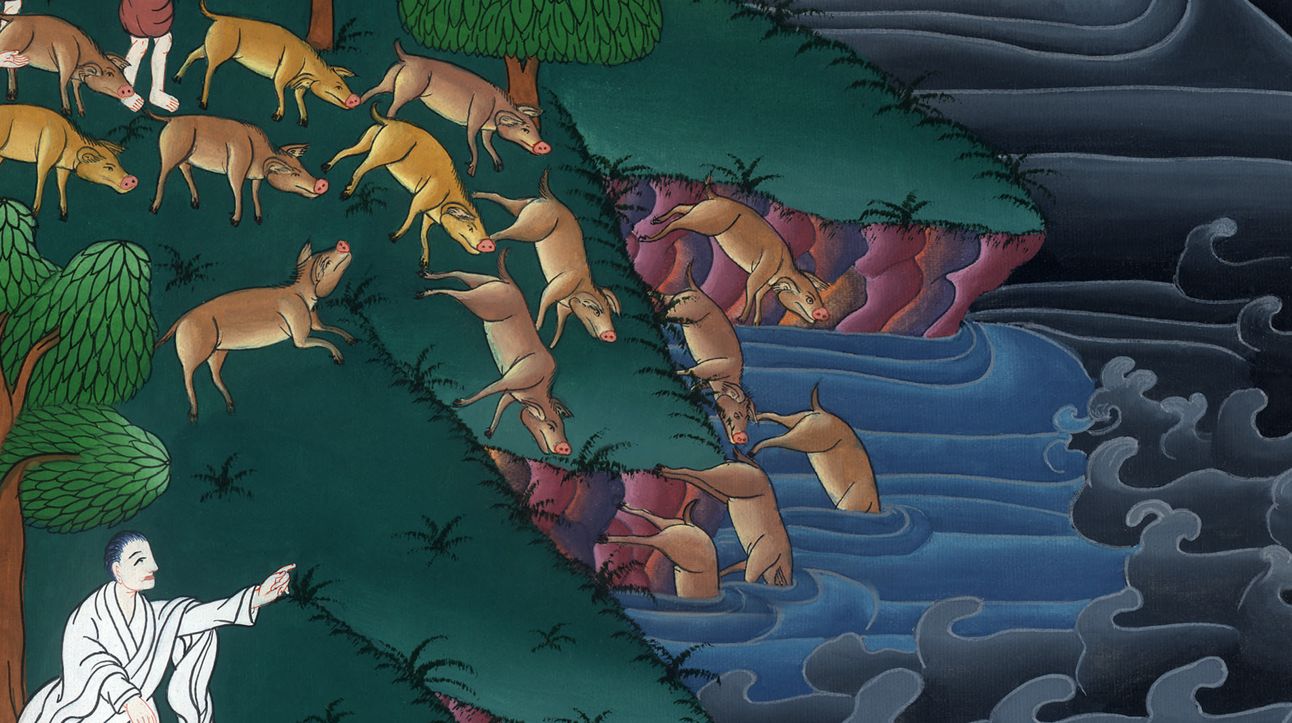
Luke 8:33

Slide 17
34When those who fed them saw what had happened, they fled and told it in the city and in the country.

Slide 18
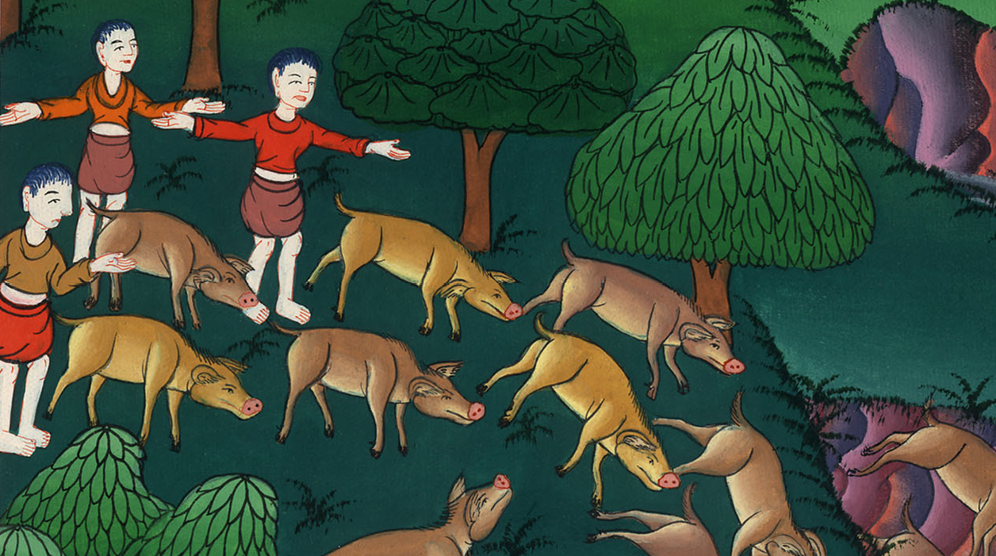
Luke 8:34

Slide 19
35People went out to see what had happened. They came to Jesus and found the man from whom the demons had gone out, sitting at Jesus’ feet, clothed and in his right mind; and they were afraid.

Slide 20
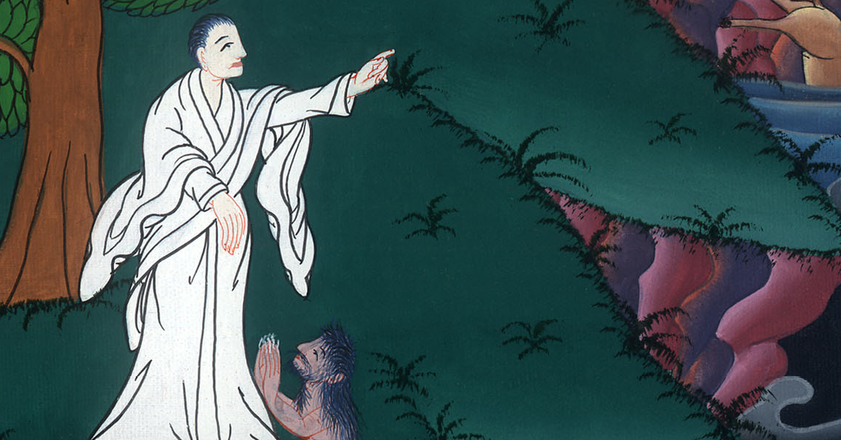
Luke 8:35

Slide 21
37All the people of the surrounding country of the Gadarenes asked him to depart from them, for they were very much afraid. Then he entered into the boat and returned.

Slide 22
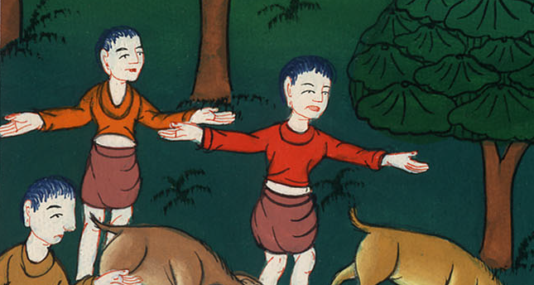
Luke 8:37

Slide 23
38But the man from whom the demons had gone out begged him that he might go with him, but Jesus sent him away, saying,

Slide 24
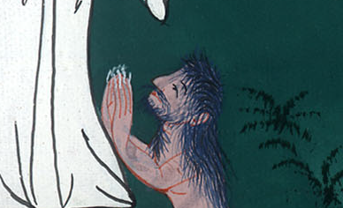
Luke 8:38

Slide 25
39“Return to your house, and declare what great things God has done for you.” He went his way, proclaiming throughout the whole city what great things Jesus had done for him.

Slide 26
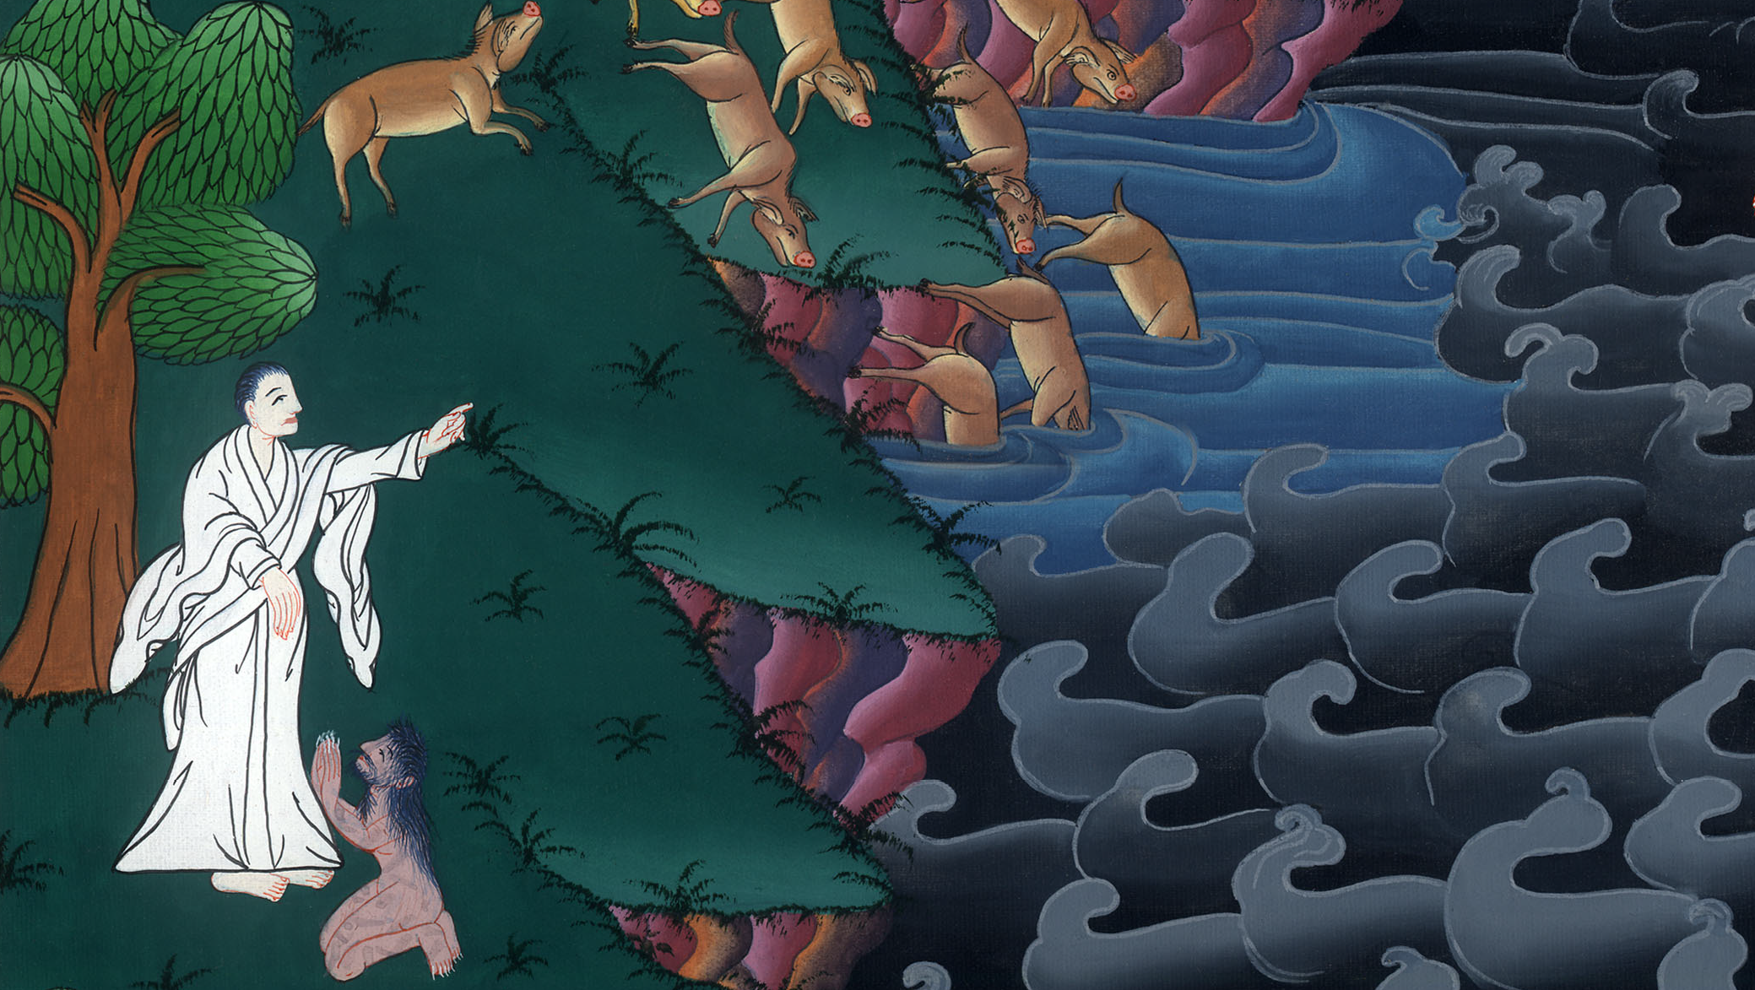
Luke 8:39

