Slide 1
36-2
This work is licensed under a Creative Commons Attribution-ShareAlike 4.0 International License.
Please add this statement to all the videos you create.
English Bible quotes are from the World English Bible US, which is in the public domain.
Notes:
Ch
36 Legion
1. Legion - Matt 8:28-34; Mark 5:1-20; Luke 8:26-39 (Left Center)
2. Woman touching Jesus’ cloak & Jairus’ daughter - Matthew 9:18-26; Mark 5:21-
43; Luke 8:40-56 (Top)
3. John Beheaded - Matt 14:1-12; Mark 6:14-29; Luke 9:7-9 (Right Bottom)
4. 1st Miracle with loaves - Matt 14:13-21; Mark 6:30-44;luke 9:10-17; John 6:1-15
(Left Bottom)
5. Jesus walks on Water - Matt 14:22-33; Mark 6:45-52; John 6:16-21 (Center)

Slide 2
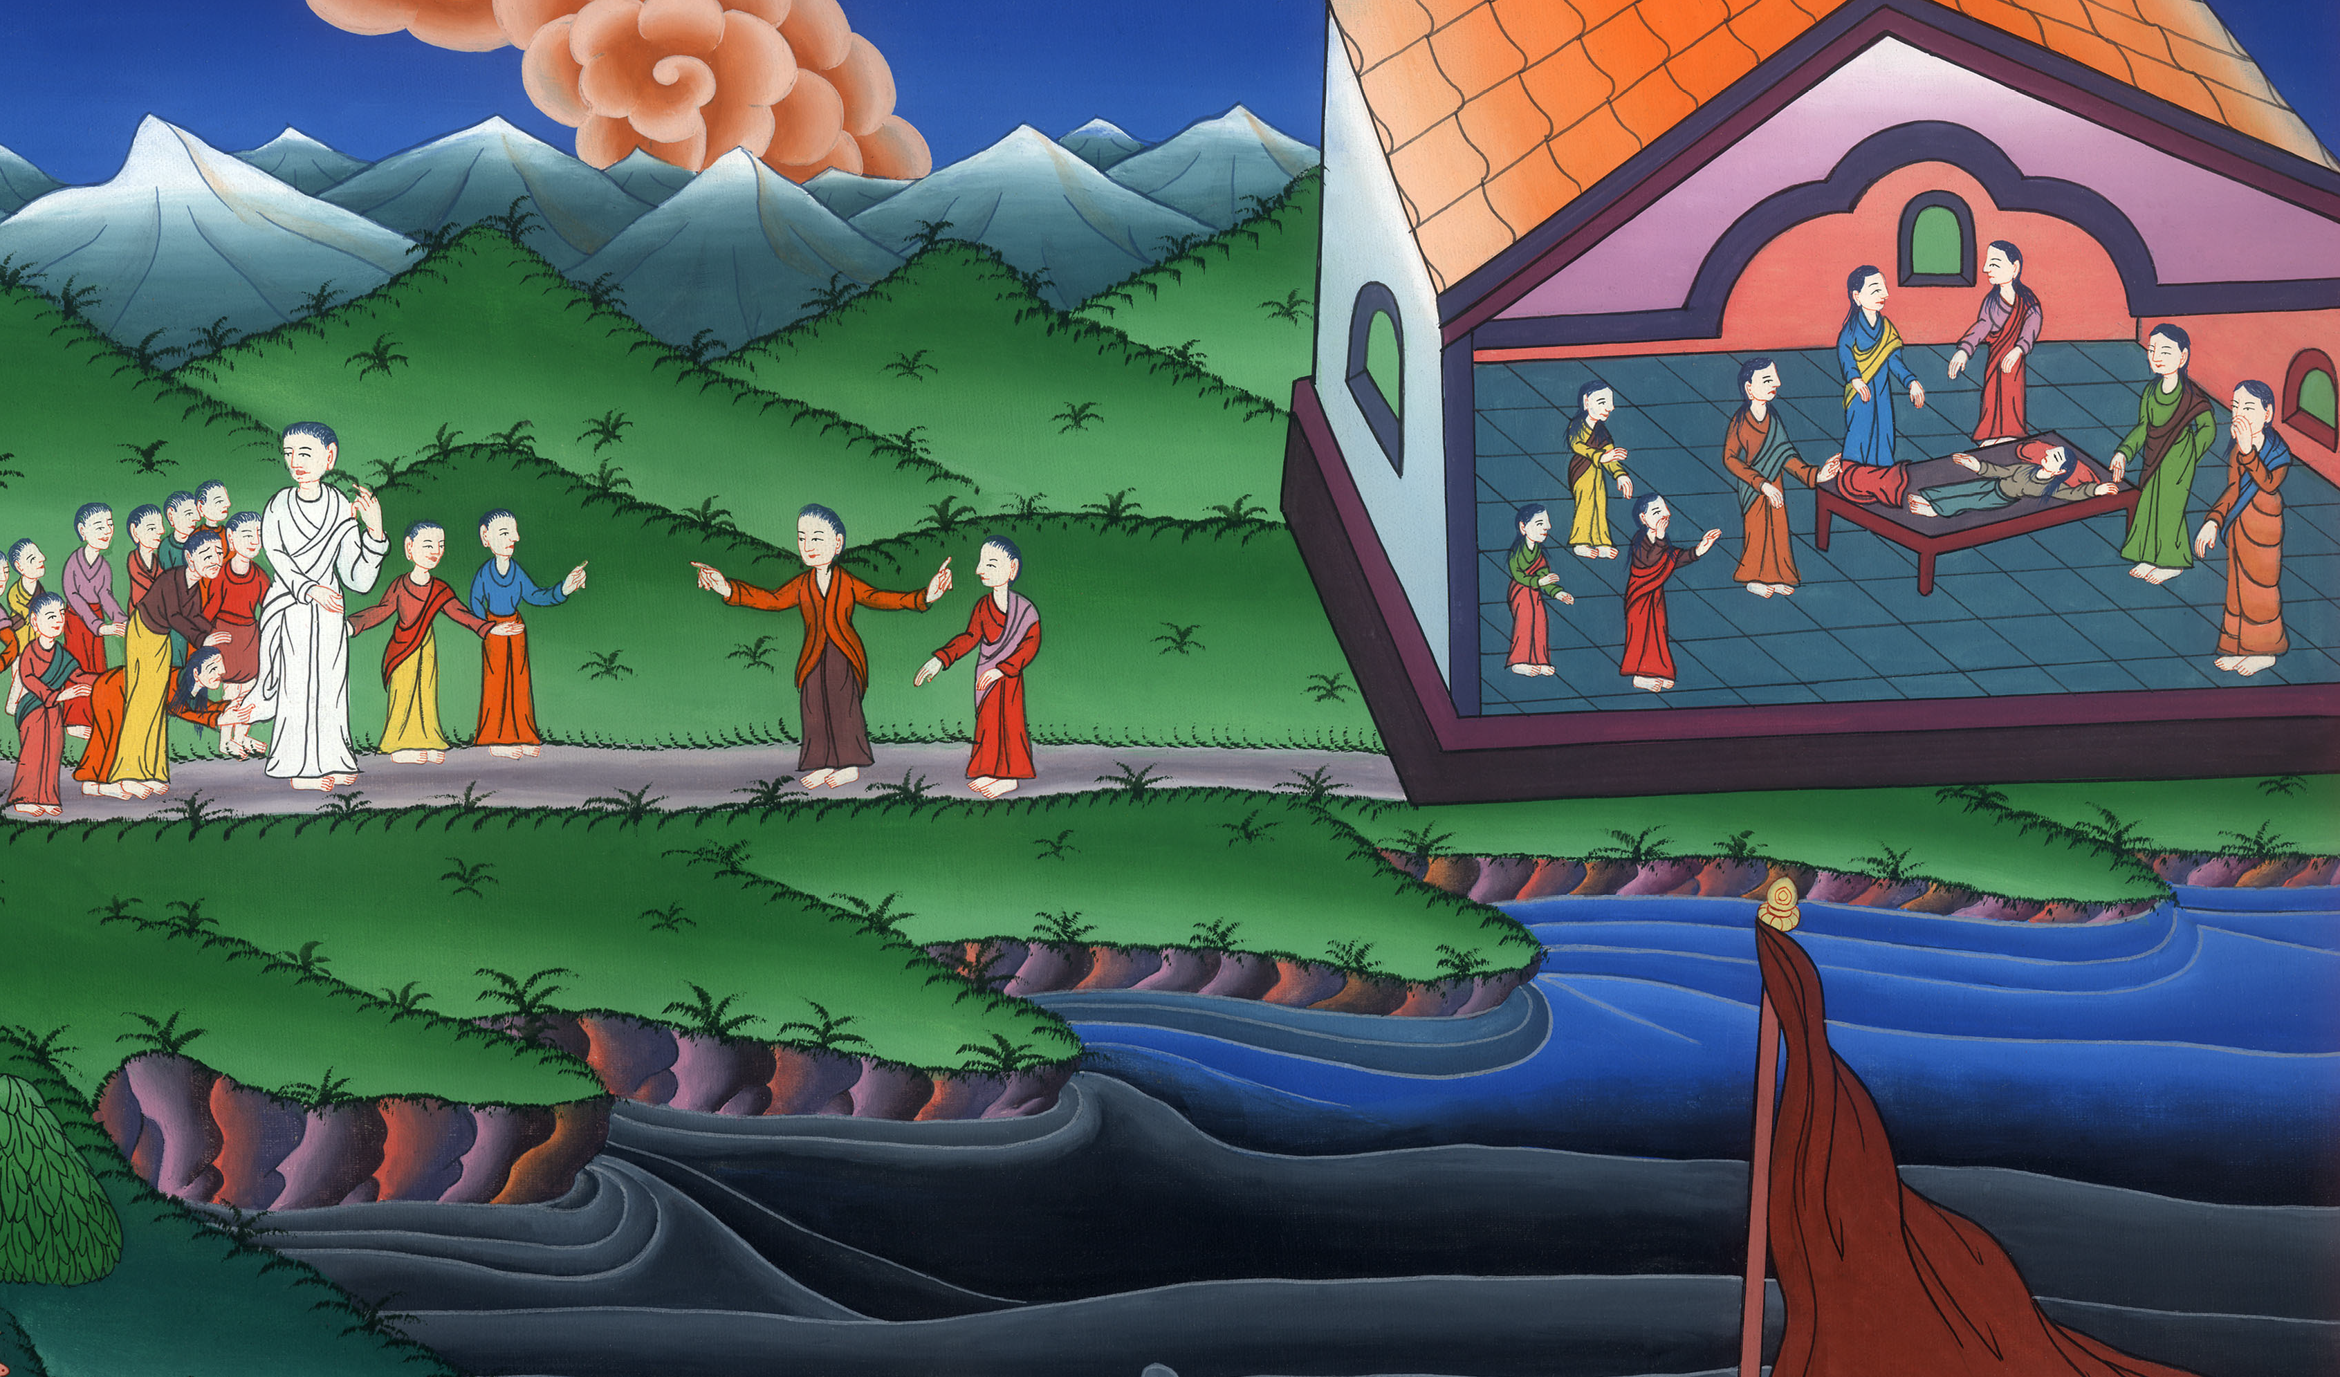
Woman touching Jesus’s cloak and Jairus’ daughter –
Mark 5:21-43

Slide 3
Woman touching Jesus’ cloak and Jairus’ daughter - Matthew 9:18-26; Mark 5:21-
43; Luke 8:40-56

Slide 4
Woman touching Jesus’s cloak and Jairus’ daughter –
Mark 5:21-43

Slide 5
Mark 5:21When Jesus had crossed back over in the boat to the other side, a great multitude was gathered to him; and he was by the sea.

Slide 6
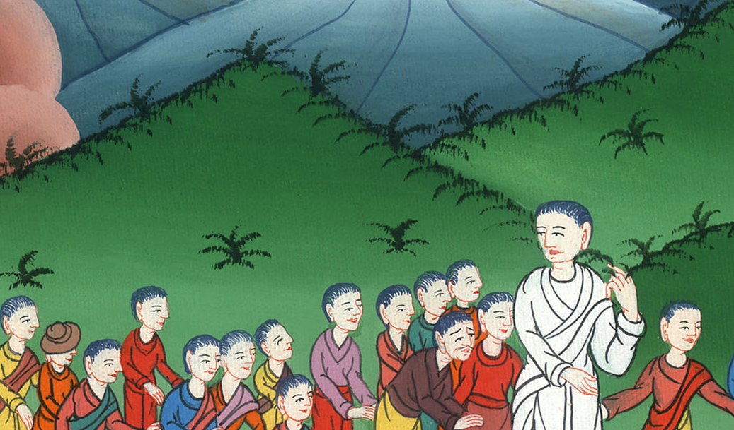
Mark 5:21

Slide 7
22Behold, one of the rulers of the synagogue, Jairus by name, came; and seeing him, he fell at his feet

Slide 8
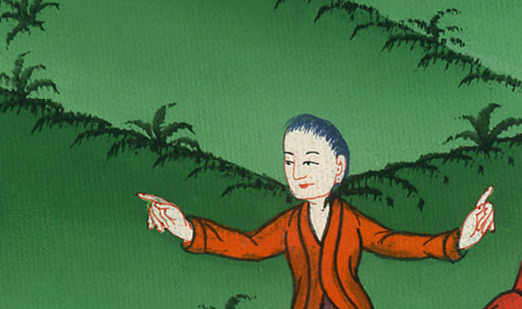
Mark 5:22

Slide 9
23and begged him much, saying, “My little daughter is at the point of death. Please come and lay your hands on her, that she may be made healthy, and live.”

Slide 10
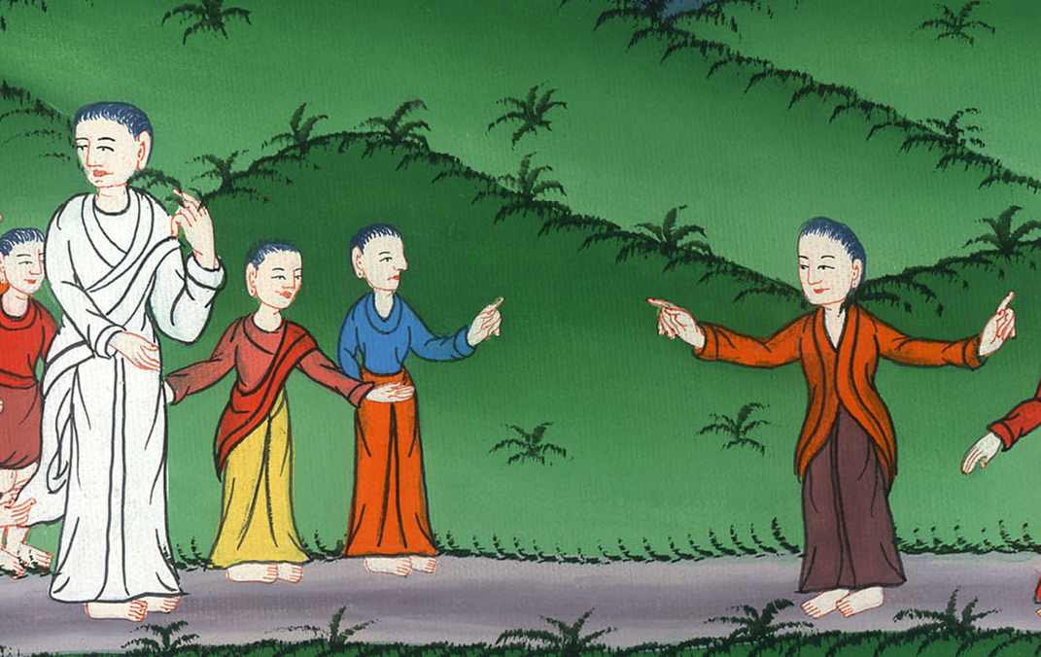
Mark 5:23

Slide 11
24He went with him, and a great multitude followed him, and they pressed upon him on all sides.

Slide 12
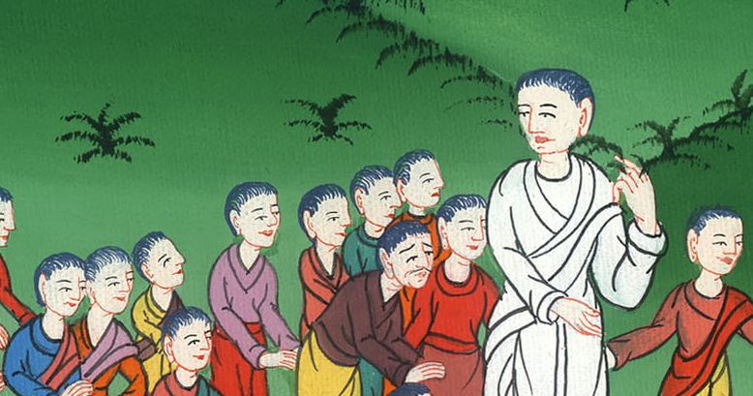
Mark 5:24

Slide 13
25A certain woman who had a discharge of blood for twelve years,

Slide 14
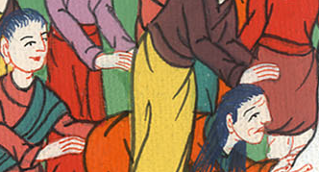
Mark 5:25

Slide 15
26and had suffered many things by many physicians, and had spent all that she had, and was no better, but rather grew worse,

Slide 16
Mark 5:26

Slide 17
27having heard the things concerning Jesus, came up behind him in the crowd and touched his clothes. 28For she said, “If I just touch his clothes, I will be made well.”

Slide 18
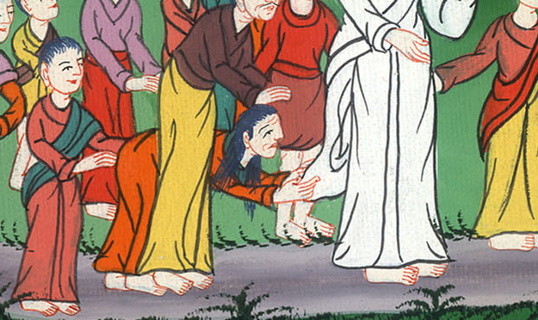
Mark 5:27,28

Slide 19
29Immediately the flow of her blood was dried up, and she felt in her body that she was healed of her affliction.

Slide 20
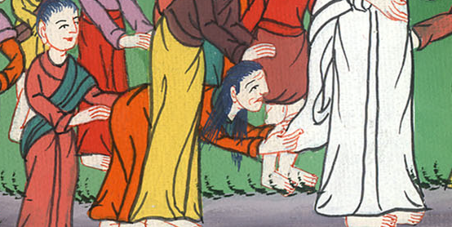
Mark 5:29

Slide 21
30Immediately Jesus, perceiving in himself that the power had gone out from him, turned around in the crowd and asked, “Who touched my clothes?”

Slide 22
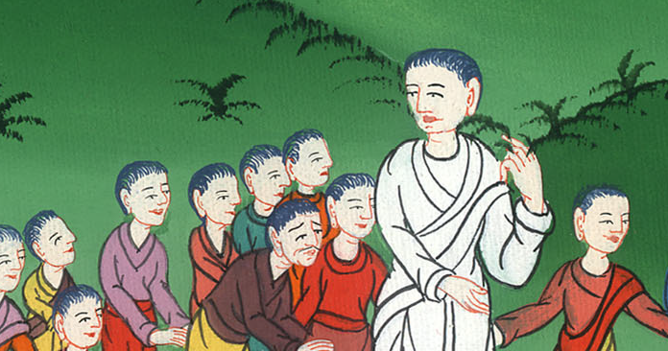
Mark 5:30

Slide 23
31His disciples said to him, “You see the multitude pressing against you, and you say, ‘Who touched me?’”
32He looked around to see her who had done this thing.

Slide 24
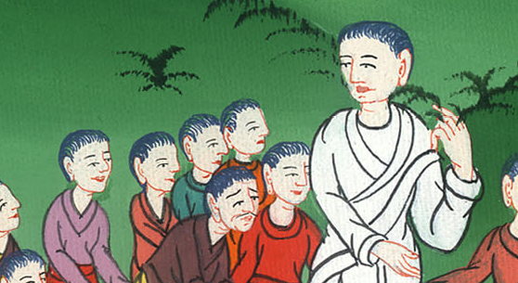
Mark 5:31,32

Slide 25
33But the woman, fearing and trembling, knowing what had been done to her, came and fell down before him, and told him all the truth.

Slide 26
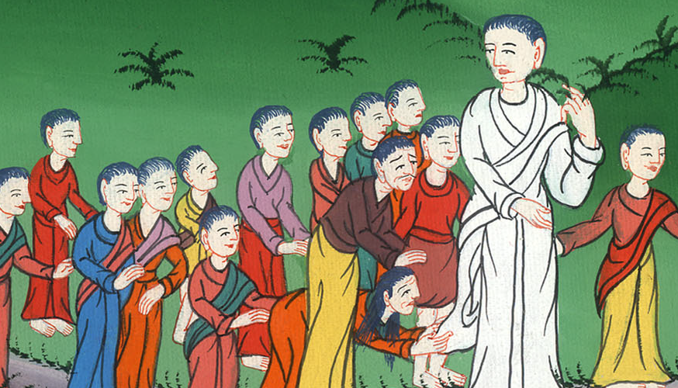
Mark 5:33

Slide 27
34He said to her, “Daughter, your faith has made you well. Go in peace, and be cured of your disease.”

Slide 28
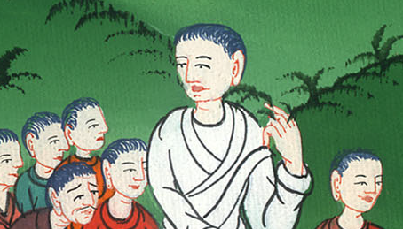
Mark 5:34

Slide 29
35While he was still speaking, people came from the synagogue ruler’s house, saying, “Your daughter is dead. Why bother the Teacher any more?”

Slide 30
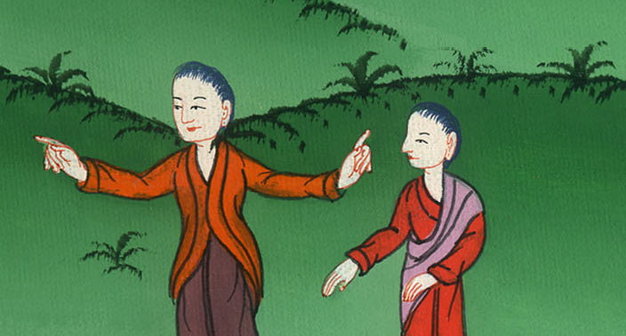
Mark 5:35

Slide 31
36But Jesus, when he heard the message spoken, immediately said to the ruler of the synagogue, “Don’t be afraid, only believe.”

Slide 32
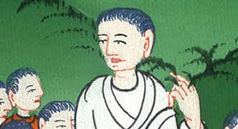
Mark 5:36

Slide 33
37He allowed no one to follow him except Peter, James, and John the brother of James. 38He came to the synagogue ruler’s house, and he saw an uproar, weeping, and great wailing.

Slide 34
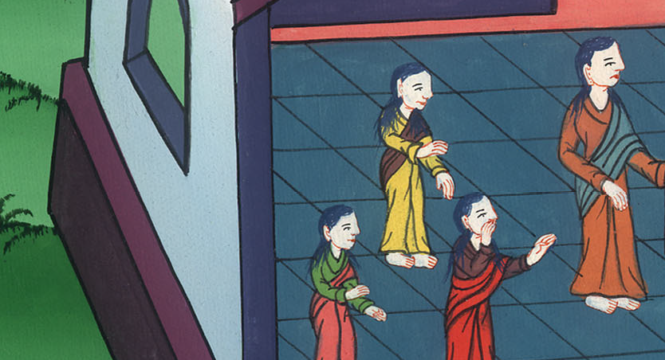
Mark 5:37,38

Slide 35
39When he had entered in, he said to them, “Why do you make an uproar and weep? The child is not dead, but is asleep.”

Slide 36
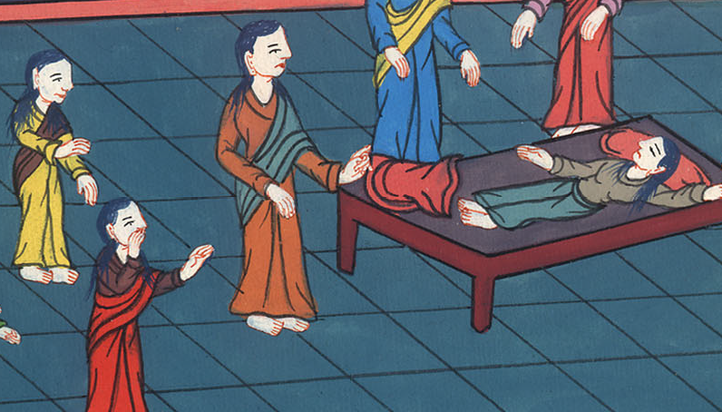
Mark 5:39

Slide 37
41Taking the child by the hand, he said to her, “Talitha cumi!” which means, being interpreted, “Girl, I tell you, get up!”

Slide 38
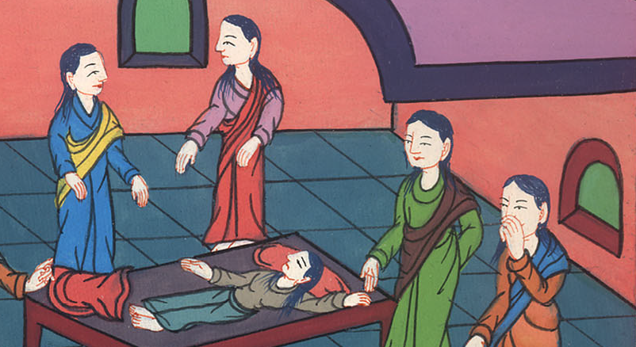
Mark 5:40

Slide 39
41He took her by the hand. Then he said to her, “Talitha koum!” This means, “Little girl, I say to you, get up!”

Slide 40
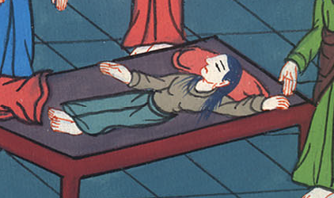
Mark 5:41

Slide 41
42Immediately the girl rose up and walked, for she was twelve years old. They were amazed with great amazement.

Slide 42
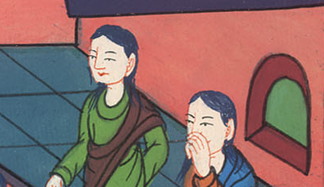
Mark 5:42

Slide 43
43He strictly ordered them that no one should know this, and commanded that something should be given to her to eat.

Slide 44
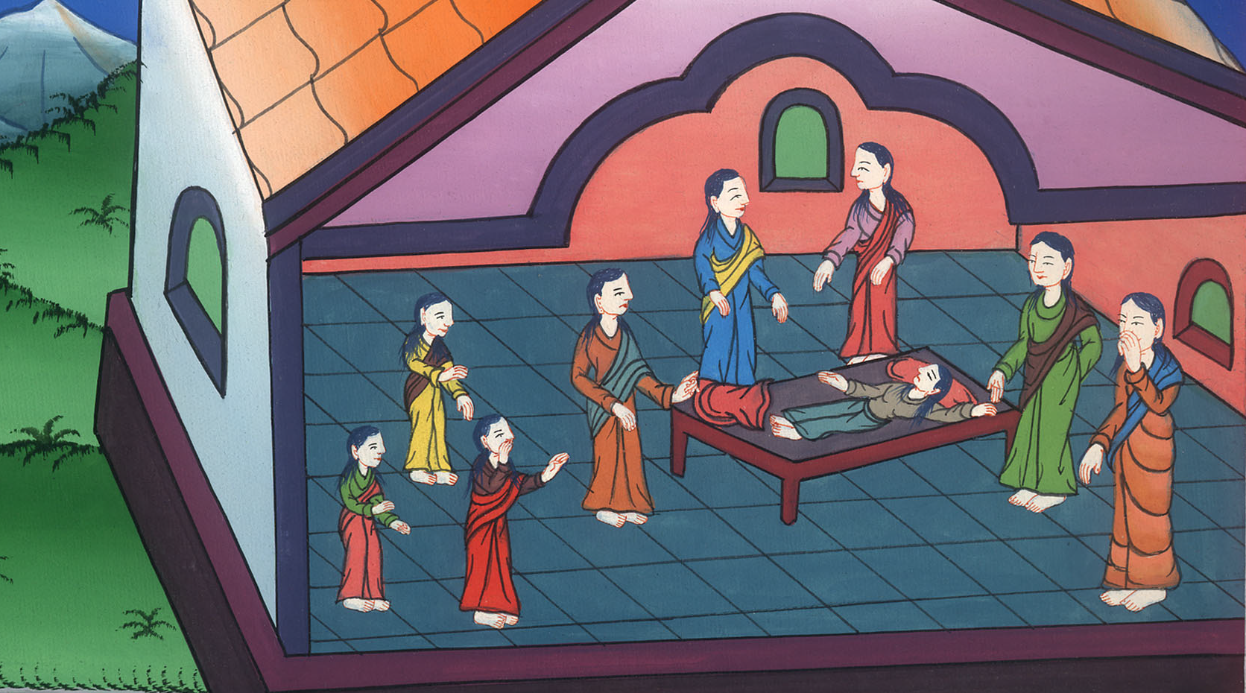
Mark 5:43

