Slide 1
36-3
This work is licensed under a Creative Commons Attribution-ShareAlike 4.0 International License.
Please add this statement to all the videos you create.
English Bible quotes are from the World English Bible US, which is in the public domain.
Notes:
Ch
36 Legion
1. Legion - Matt 8:28-34; Mark 5:1-20; Luke 8:26-39 (Left Center)
2. Woman touching Jesus’ cloak & Jairus’ daughter - Matthew 9:18-26; Mark 5:21-
43; Luke 8:40-56 (Top)
3. John Beheaded - Matt 14:1-12; Mark 6:14-29; Luke 9:7-9 (Right Bottom)
4. 1st Miracle with loaves - Matt 14:13-21; Mark 6:30-44;luke 9:10-17; John 6:1-15
(Left Bottom)
5. Jesus walks on Water - Matt 14:22-33; Mark 6:45-52; John 6:16-21 (Center)

Slide 2
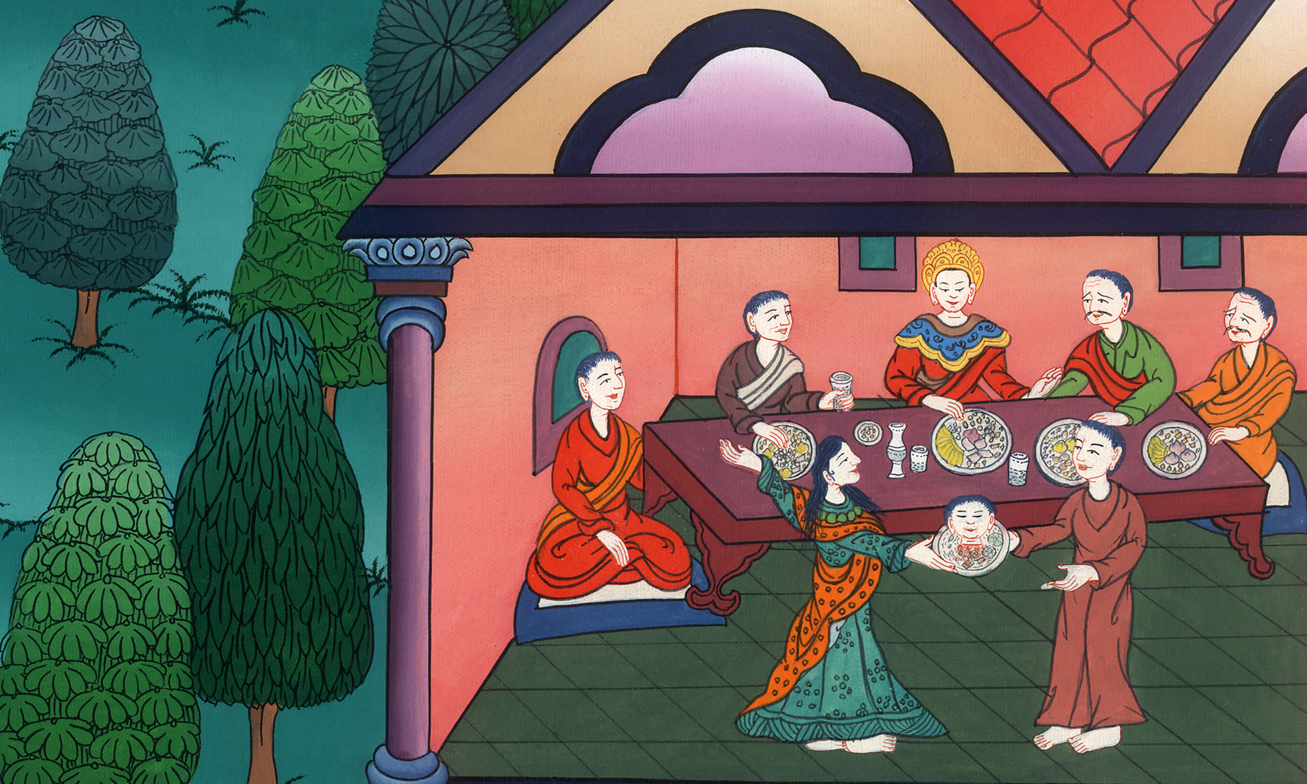
John Beheaded - Matt 14:1-12; Mark 6:14-29; Luke 9:7-9

Slide 3
3. John Beheaded - Matt 14:1-12; Mark 6:14-29; Luke 9:7-9 (Right Bottom)

Slide 4
John Beheaded - Matt 14:1-12; Mark 6:14-29; Luke 9:7-9

Slide 5
(Herod was the king. He gave orders to have John the Baptist arrested)
Mark6:17For Herod himself had sent out and arrested John and bound him in prison for the sake of Herodias, his brother Philip’s wife, for he had married her. 18For John had said to Herod, “It is not lawful for you to have your brother’s wife.”

Slide 6
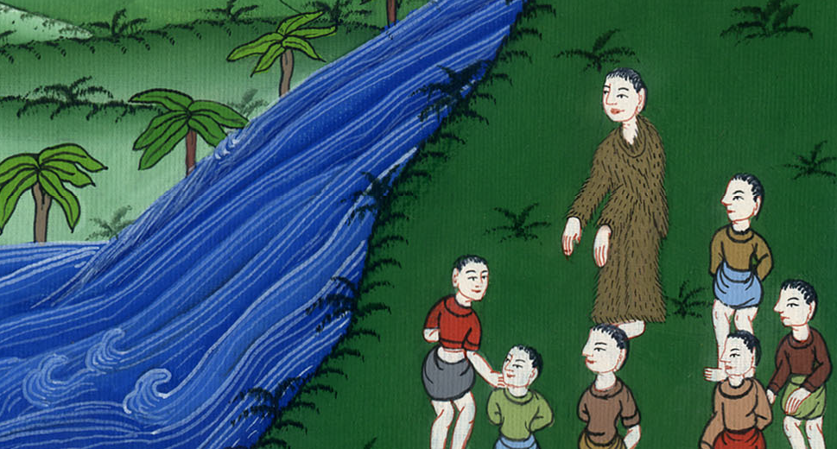
Mark 6:17,18

Slide 7
19Herodias set herself against him and desired to kill him, but she couldn’t, 20for Herod feared John, knowing that he was a righteous and holy man, and kept him safe. When he heard him, he did many things, and he heard him gladly.

Slide 8
Mark 6:19,20

Slide 9
21Then a convenient day came when Herod on his birthday made a supper for his nobles, the high officers, and the chief men of Galilee.

Slide 10
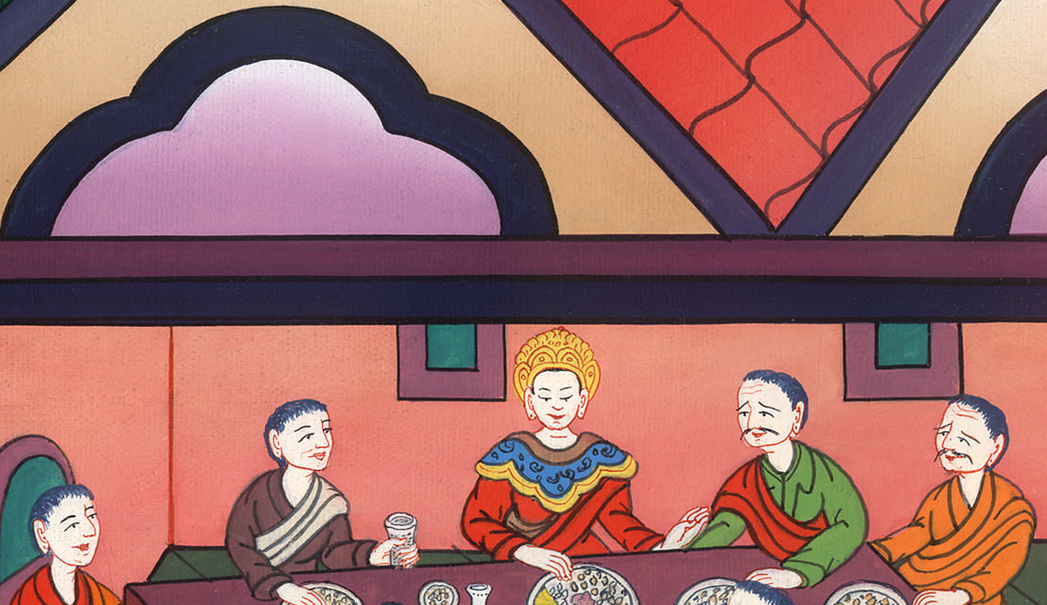
Mark 6:21

Slide 11
22When the daughter of Herodias herself came in and danced, she pleased Herod and those sitting with him. The king said to the young lady, “Ask me whatever you want, and I will give it to you.”

Slide 12
Mark 6:22

Slide 13
24She went out and said to her mother, “What shall I ask?”
She said, “The head of John the Baptizer.”

Slide 14
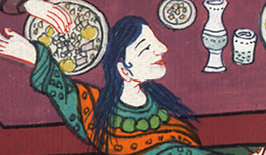
Mark 6:24

Slide 15
25She came in immediately with haste to the king and requested, “I want you to give me right now the head of John the Baptizer on a platter.”

Slide 16
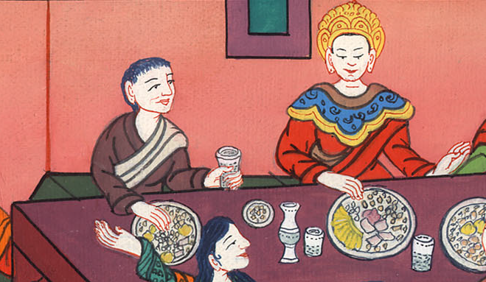
Mark 6:25

Slide 17
26The king was exceedingly sorry, but for the sake of his oaths and of his dinner guests, he didn’t wish to refuse her.

Slide 18
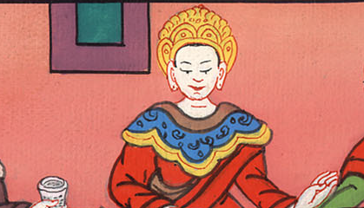
Mark 6:26

Slide 19
27Immediately the king sent out a soldier of his guard and commanded to bring John’s head; and he went and beheaded him in the prison, 28and brought his head on a platter, and gave it to the young lady; and the young lady gave it to her mother.

Slide 20
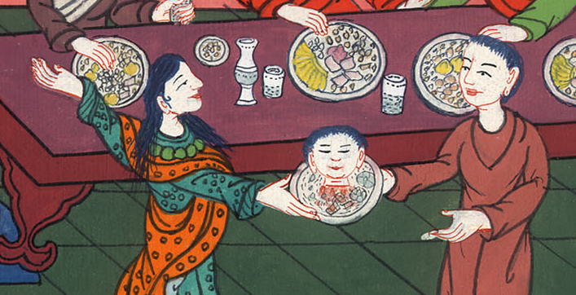
Mark 6:27,28

Slide 21
29When his disciples heard this, they came and took up his corpse and laid it in a tomb.

Slide 22
Mark 6:29

