Slide 1
36-4
This work is licensed under a Creative Commons Attribution-ShareAlike 4.0 International License.
Please add this statement to all the videos you create.
English Bible quotes are from the World English Bible US, which is in the public domain.
Notes:
Ch
36 Legion
1. Legion - Matt 8:28-34; Mark 5:1-20; Luke 8:26-39 (Left Center)
2. Woman touching Jesus’ cloak & Jairus’ daughter - Matthew 9:18-26; Mark 5:21-
43; Luke 8:40-56 (Top)
3. John Beheaded - Matt 14:1-12; Mark 6:14-29; Luke 9:7-9 (Right Bottom)
4. 1st Miracle with loaves - Matt 14:13-21; Mark 6:30-44;luke 9:10-17; John 6:1-15
(Left Bottom)
5. Jesus walks on Water - Matt 14:22-33; Mark 6:45-52; John 6:16-21 (Center)

Slide 2
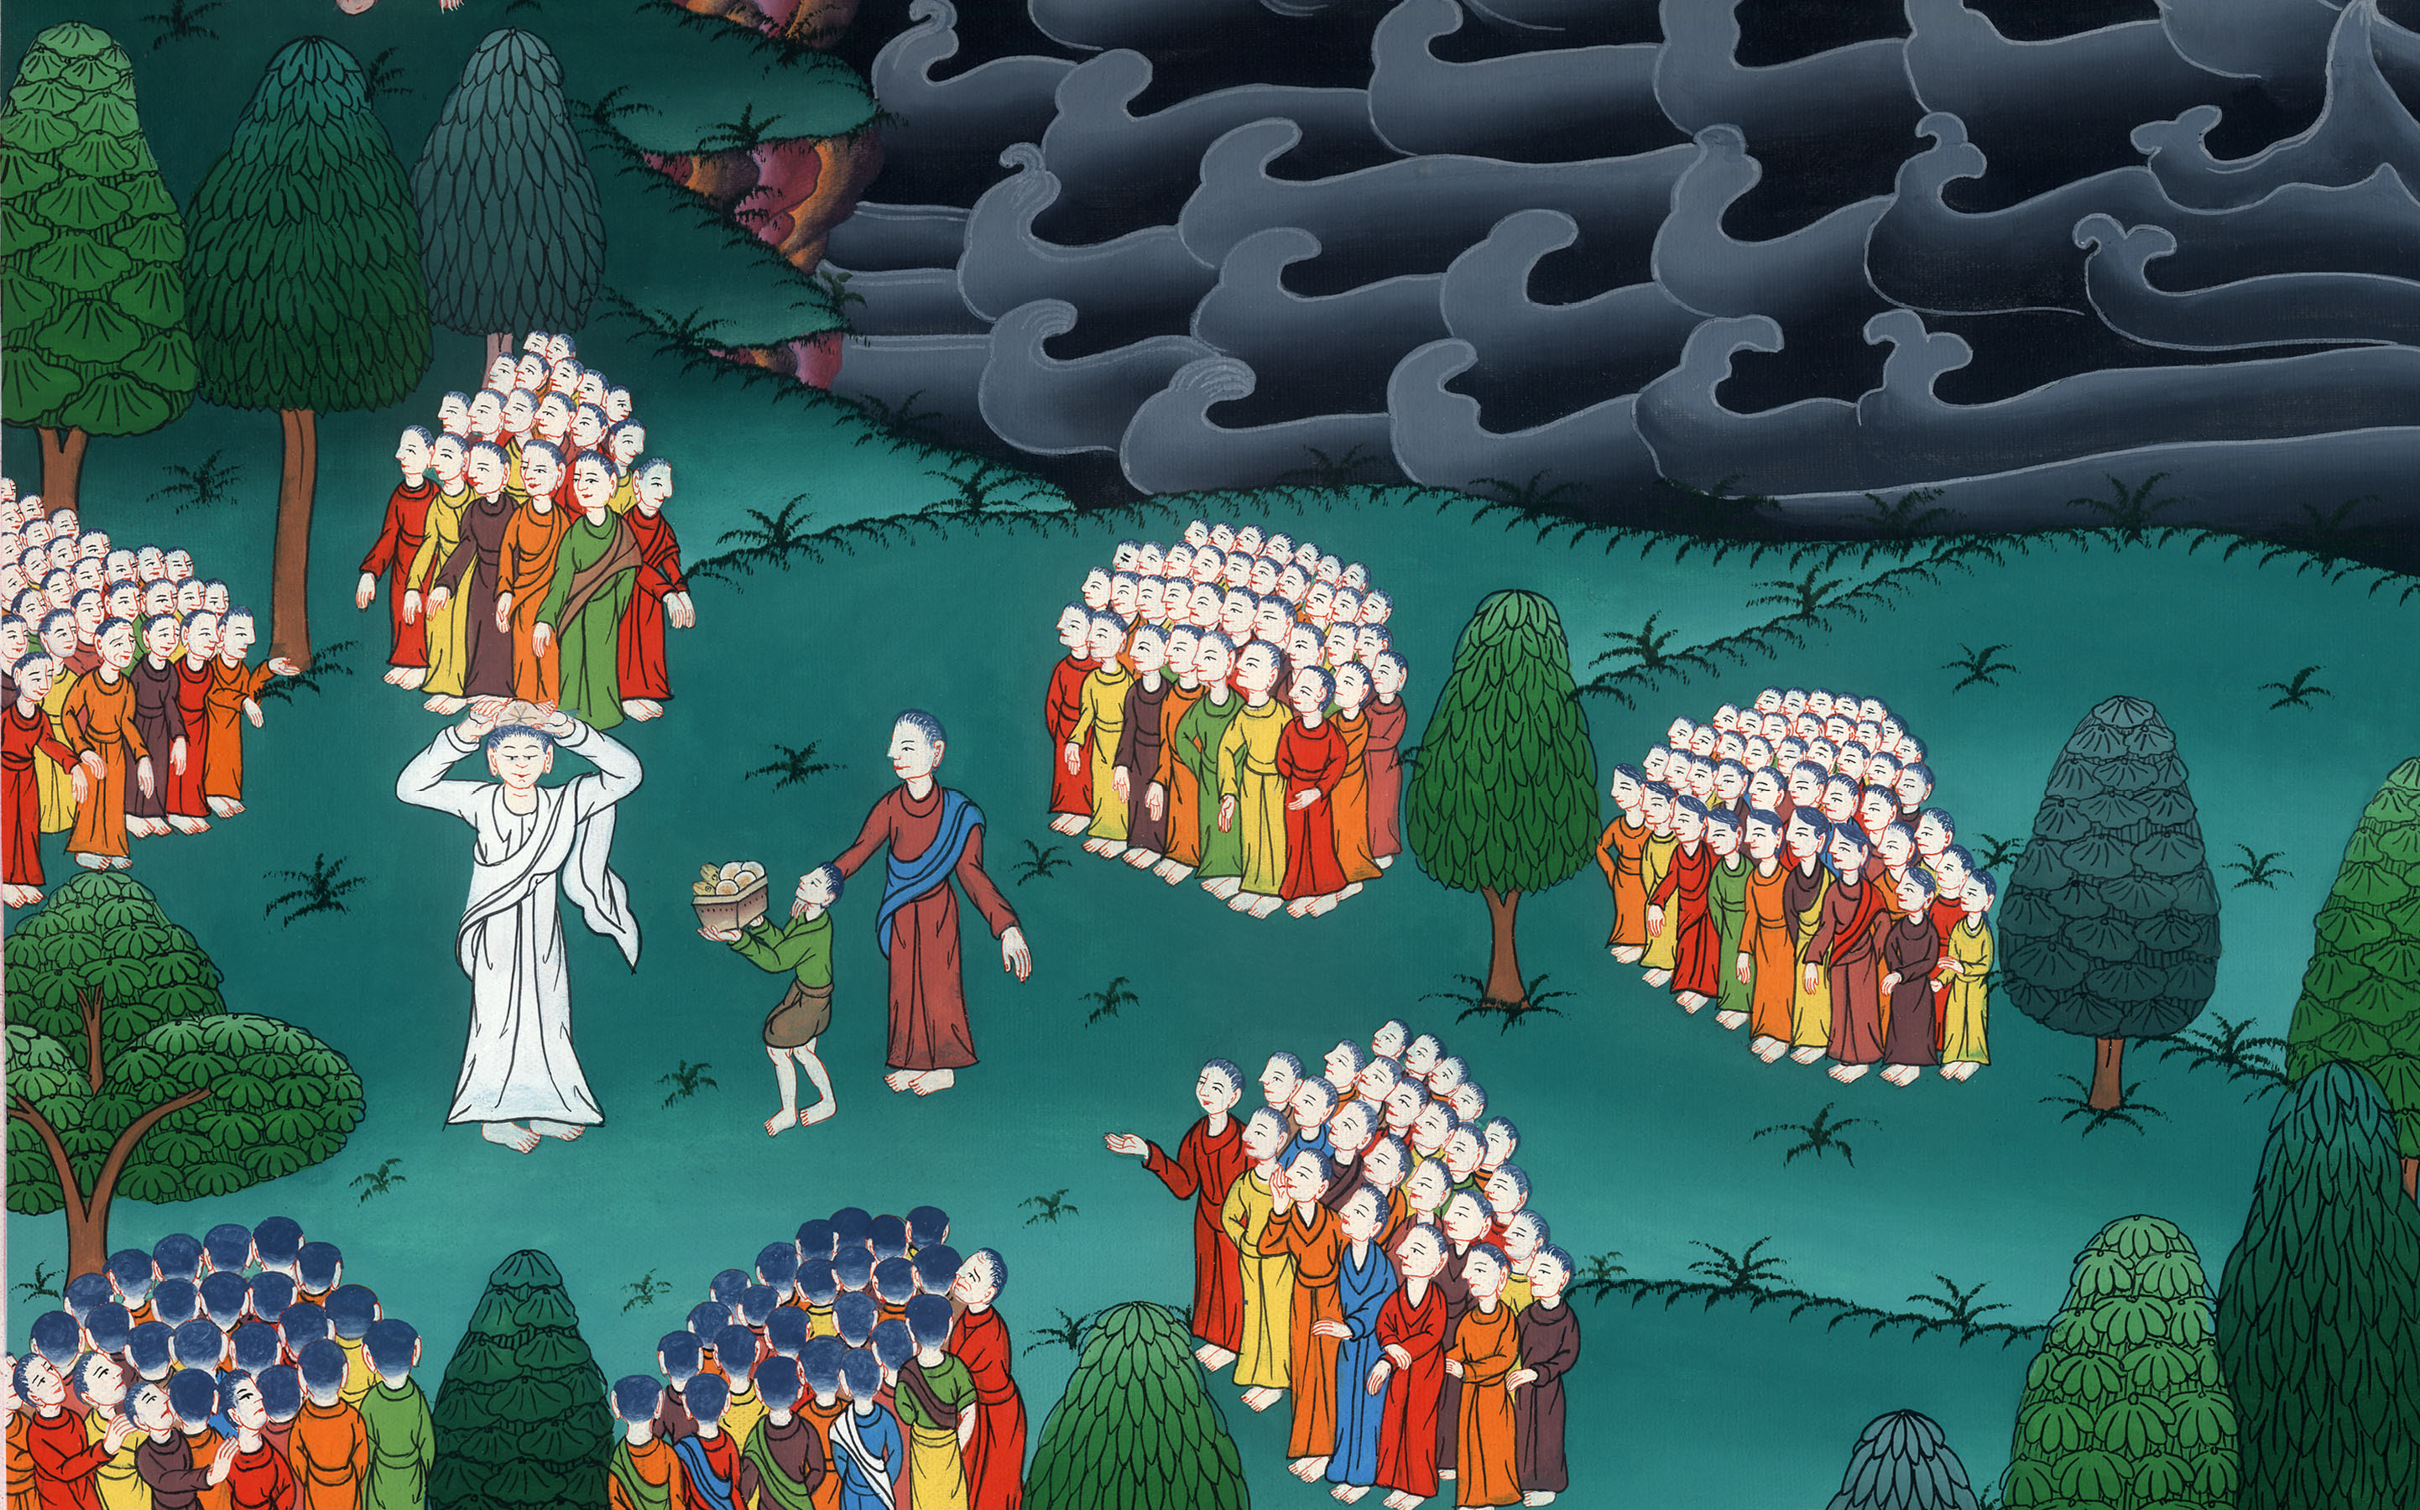
མད་ཐཱ། 14, མར་ཀུ 6
མི་ལྔ་སྟོང་ཙམ་གྱི་བཀྲེས་ལྟོགས་བསལ་བ།
1st Miracle with loaves - Matt 14:13-21; Mark 6:30-44;luke 9:10-17; John 6:1-15

Slide 3
1st Miracle with loaves - Matt 14:13-21; Mark 6:30-44;luke 9:10-17; John 6:1-15

Slide 4
1st Miracle with loaves - Matt 14:13-21; Mark 6:30-44;luke 9:10-17; John 6:1-15

Slide 5
Matt 1413 Now when Jesus heard this, he withdrew from there in a boat to a deserted place apart. When the multitudes heard it, they followed him on foot from the cities.

Slide 6
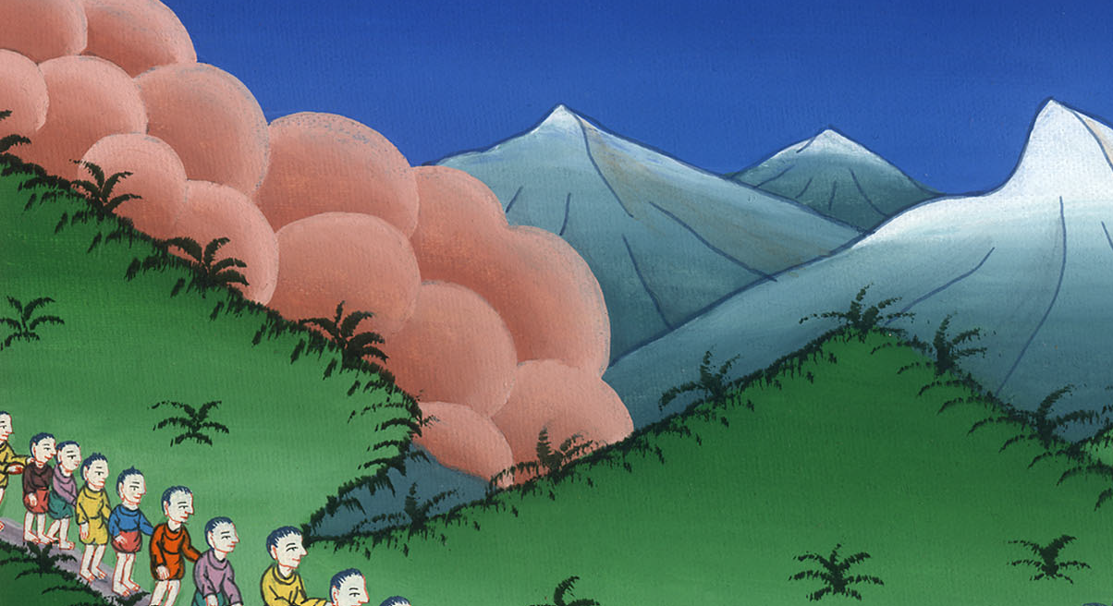
Matthew 14:13

Slide 7
14Jesus went out, and he saw a great multitude. He had compassion on them and healed their sick. Mark Mark 6 34Jesus came out, saw a great multitude, and he had compassion on them because they were like sheep without a shepherd; and he began to teach them many things.

Slide 8
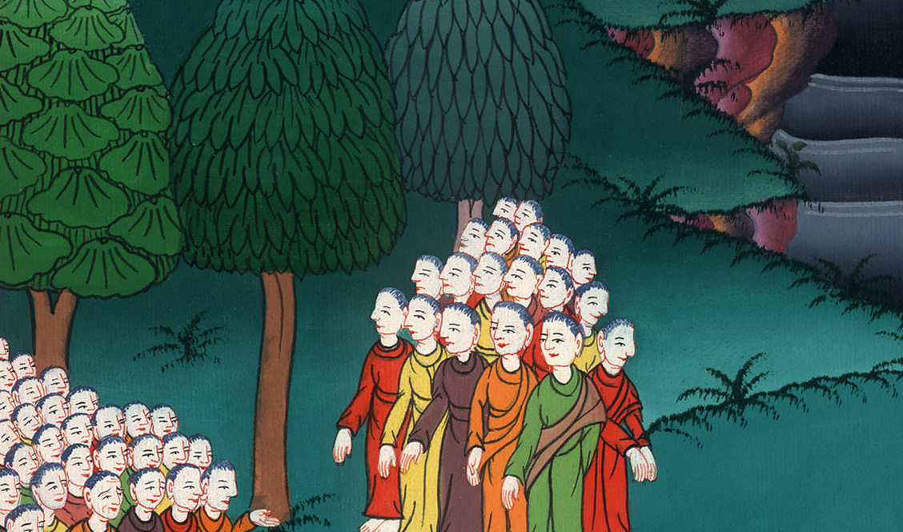
Matthew 14:14
Mark 6:34

Slide 9
Mark 6 35When it was late in the day, his disciples came to him and said, “This place is deserted, and it is late in the day. 36Send them away, that they may go into the surrounding country and villages and buy themselves bread, for they have nothing to eat.”

Slide 10
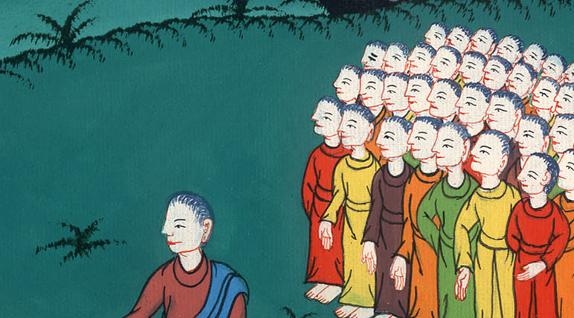
Mark 6:35,36

Slide 11
37But he answered them, “You give them something to eat.”
They asked him, “Shall we go and buy two hundred denarii worth of bread and give them something to eat?”

Slide 12
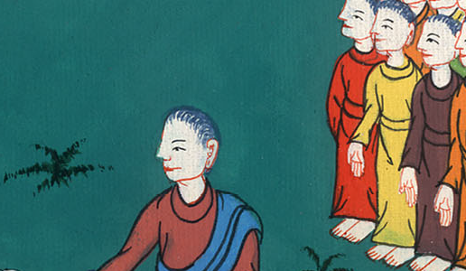
Mark 6:37

Slide 13
38He said to them, “How many loaves do you have? Go see.”
When they knew, they said, “Five, and two fish.”

Slide 14
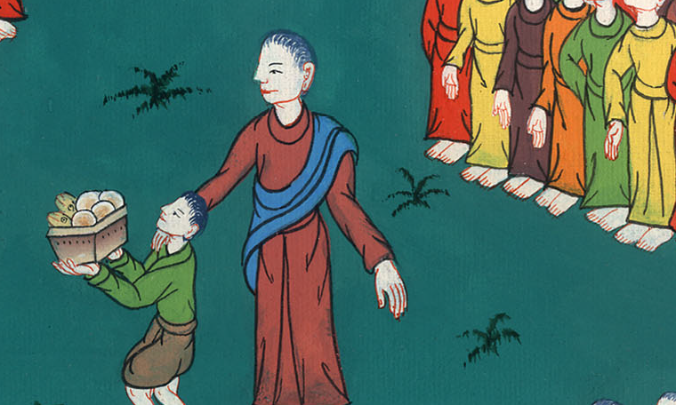
Mark 6:38

Slide 15
39He commanded them that everyone should sit down in groups on the green grass. 40They sat down in ranks, by hundreds and by fifties.

Slide 16
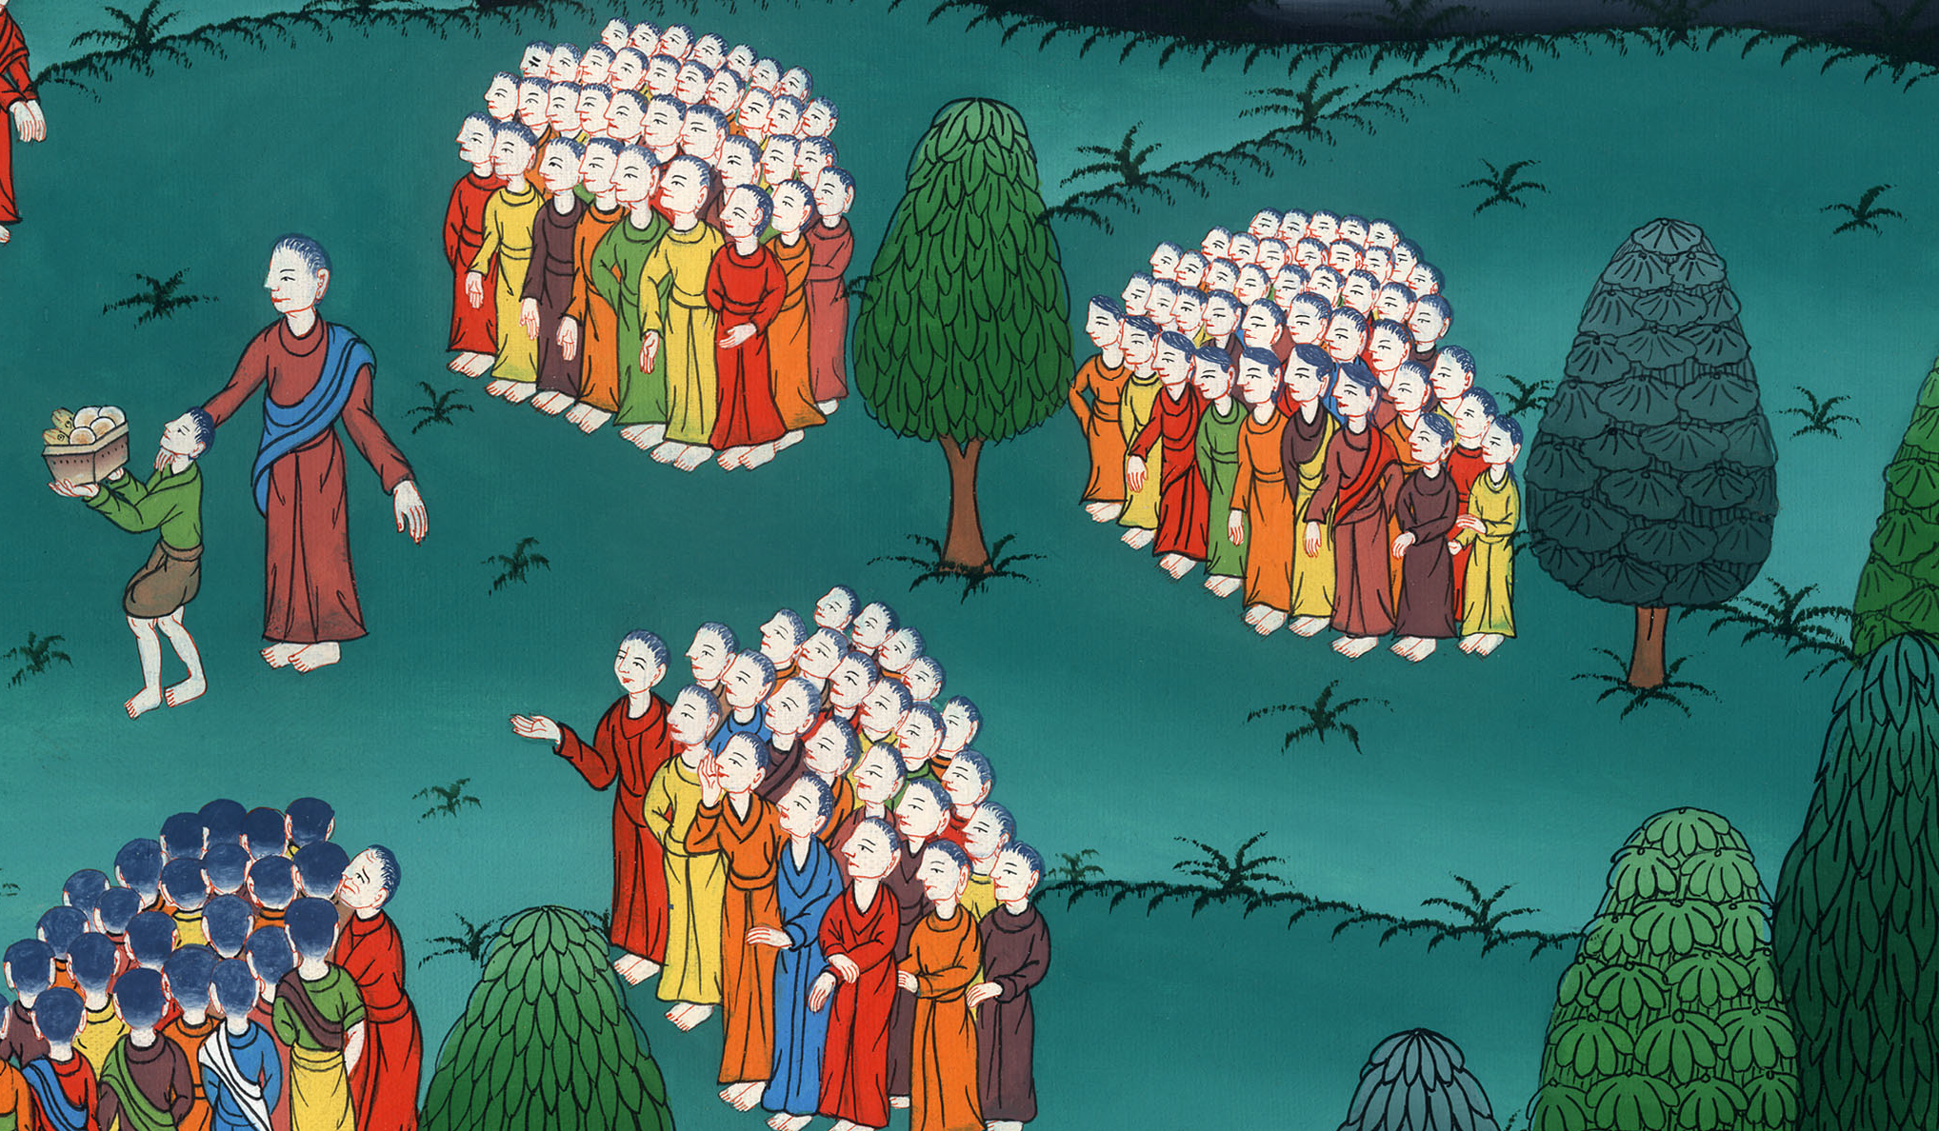
Mark 6:39,40

Slide 17
41He took the five loaves and the two fish; and looking up to heaven, he blessed and broke the loaves, and he gave to his disciples to set before them, and he divided the two fish among them all.

Slide 18
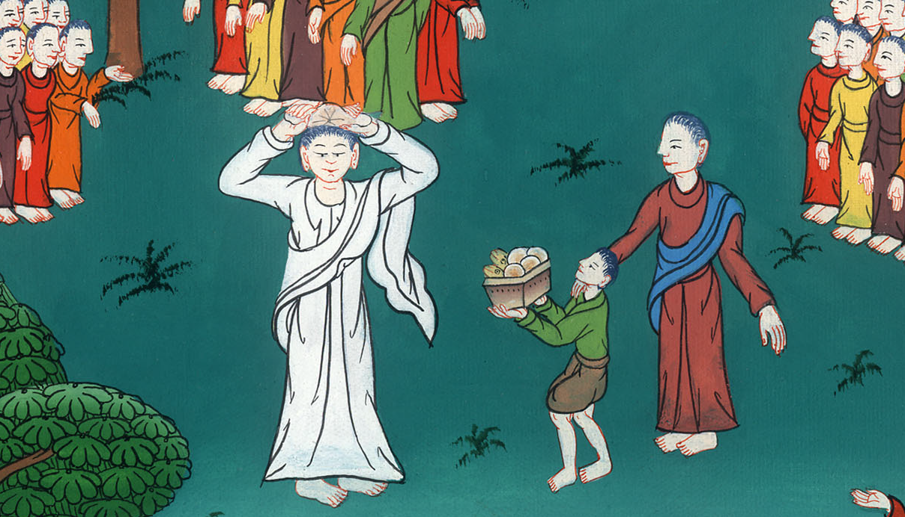
Mark 6:41

Slide 19
42They all ate and were filled. 43They took up twelve baskets full of broken pieces and also of the fish.

Slide 20
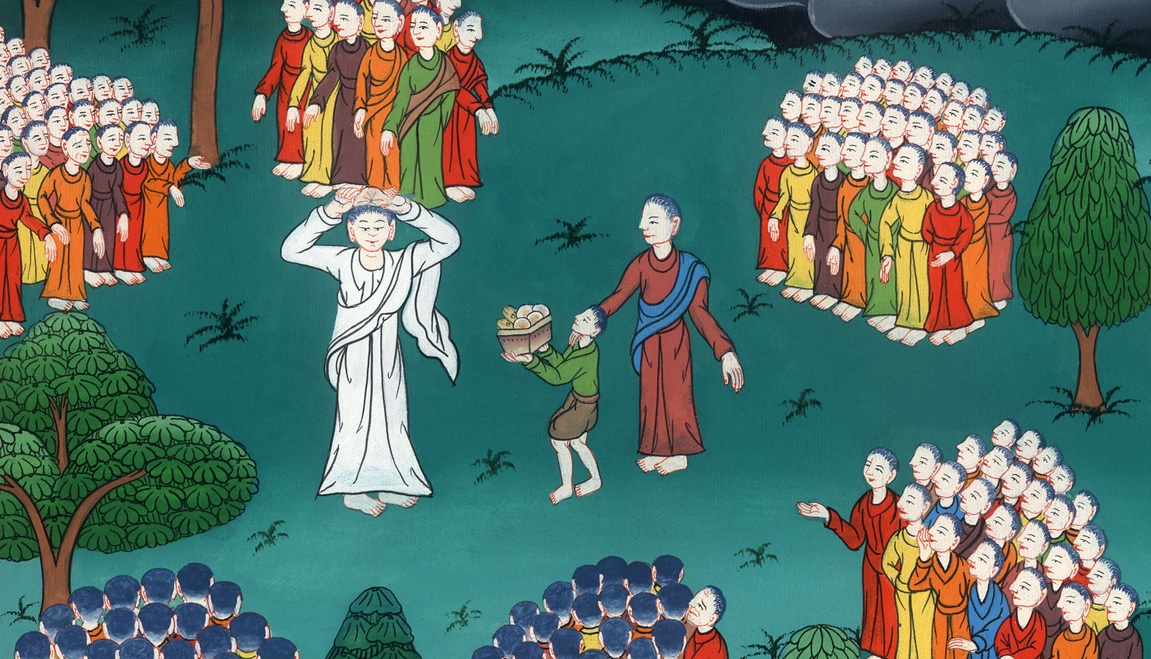
Mark 6:42,43

Slide 21
44Those who ate the loaves were five thousand men.

Slide 22
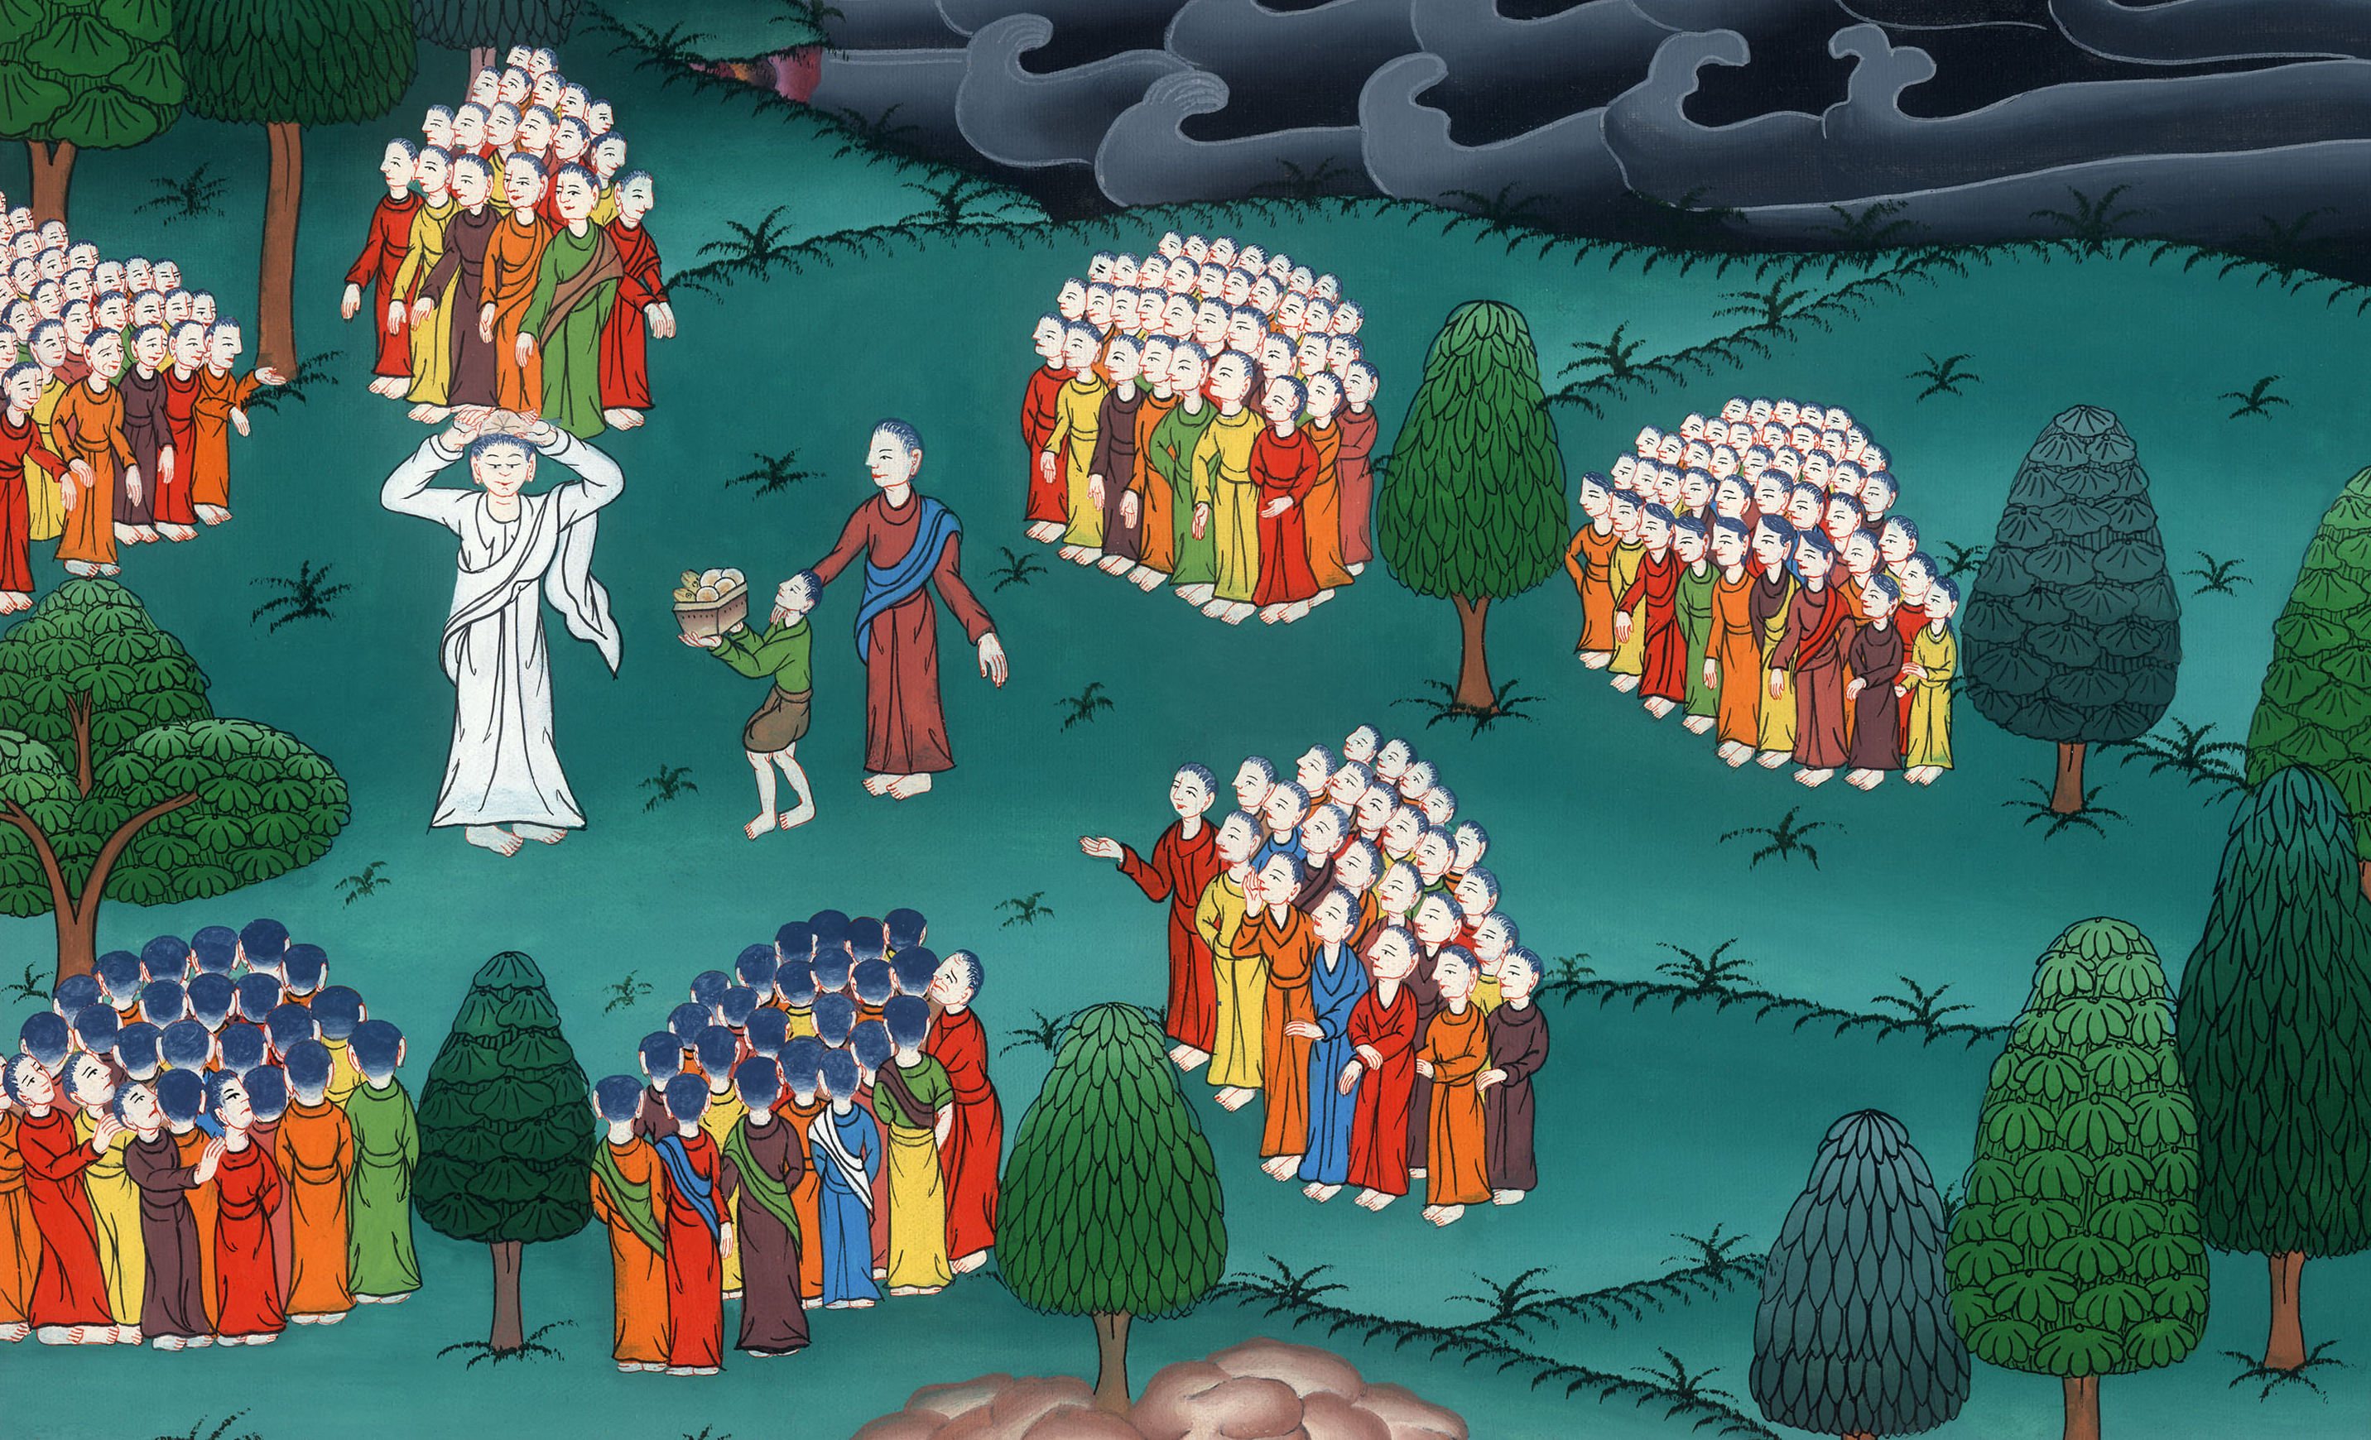
Mark 6:44

