Slide 1
36-5
This work is licensed under a Creative Commons Attribution-ShareAlike 4.0 International License.
Please add this statement to all the videos you create.
English Bible quotes are from the World English Bible US, which is in the public domain.
Notes:
Ch
36 Legion
1. Legion - Matt 8:28-34; Mark 5:1-20; Luke 8:26-39 (Left Center)
2. Woman touching Jesus’ cloak & Jairus’ daughter - Matthew 9:18-26; Mark 5:21-
43; Luke 8:40-56 (Top)
3. John Beheaded - Matt 14:1-12; Mark 6:14-29; Luke 9:7-9 (Right Bottom)
4. 1st Miracle with loaves - Matt 14:13-21; Mark 6:30-44;luke 9:10-17; John 6:1-15
(Left Bottom)
5. Jesus walks on Water - Matt 14:22-33; Mark 6:45-52; John 6:16-21 (Center)

Slide 2
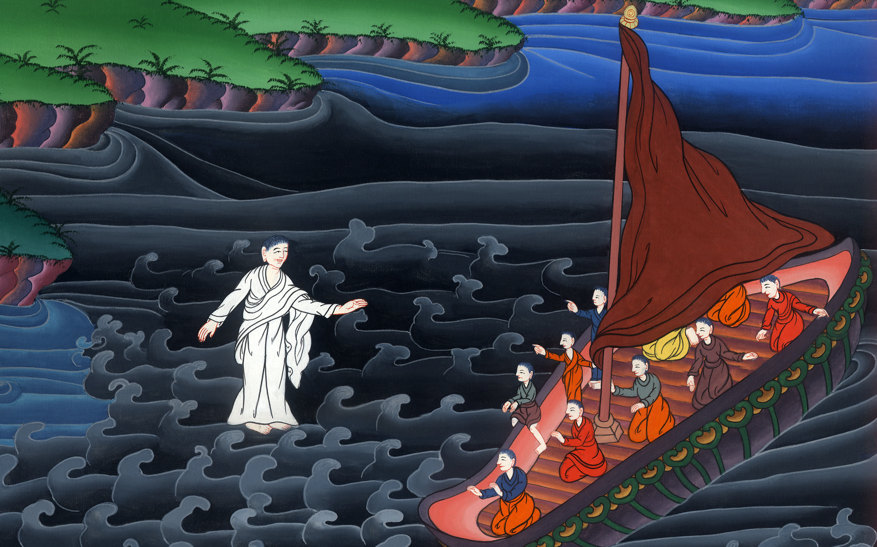
Jesus walks on Water –
Matthew 14:22-33

Slide 3
5. Jesus walks on Water - Matthew 14:22-33

Slide 4
Jesus walks on Water –
Matthew 14:22-33

Slide 5
22Immediately Jesus made the disciples get into the boat and go ahead of him to the other side, while he sent the multitudes away.

Slide 6
Matthew 14:22

Slide 7
23After he had sent the multitudes away, he went up into the mountain by himself to pray. When evening had come, he was there alone.

Slide 8
Matthew 14:23

Slide 9
24But the boat was now in the middle of the sea, distressed by the waves, for the wind was contrary.

Slide 10
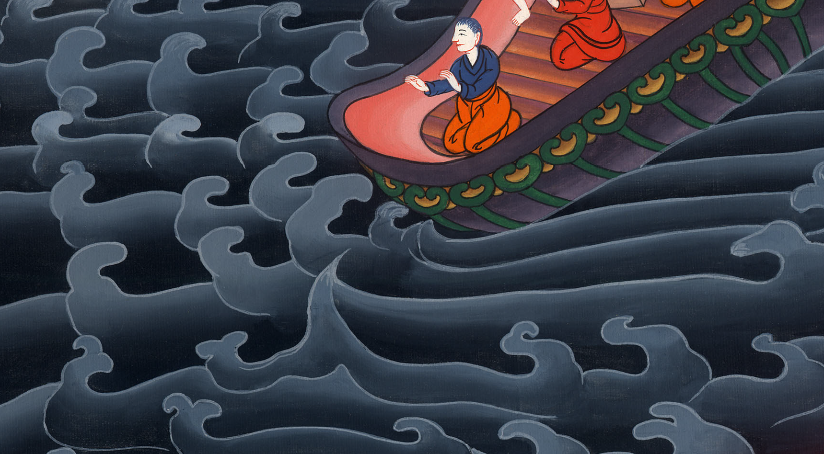
Matthew 14:24

Slide 11
25In the fourth watch of the night, Jesus came to them, walking on the sea.

Slide 12
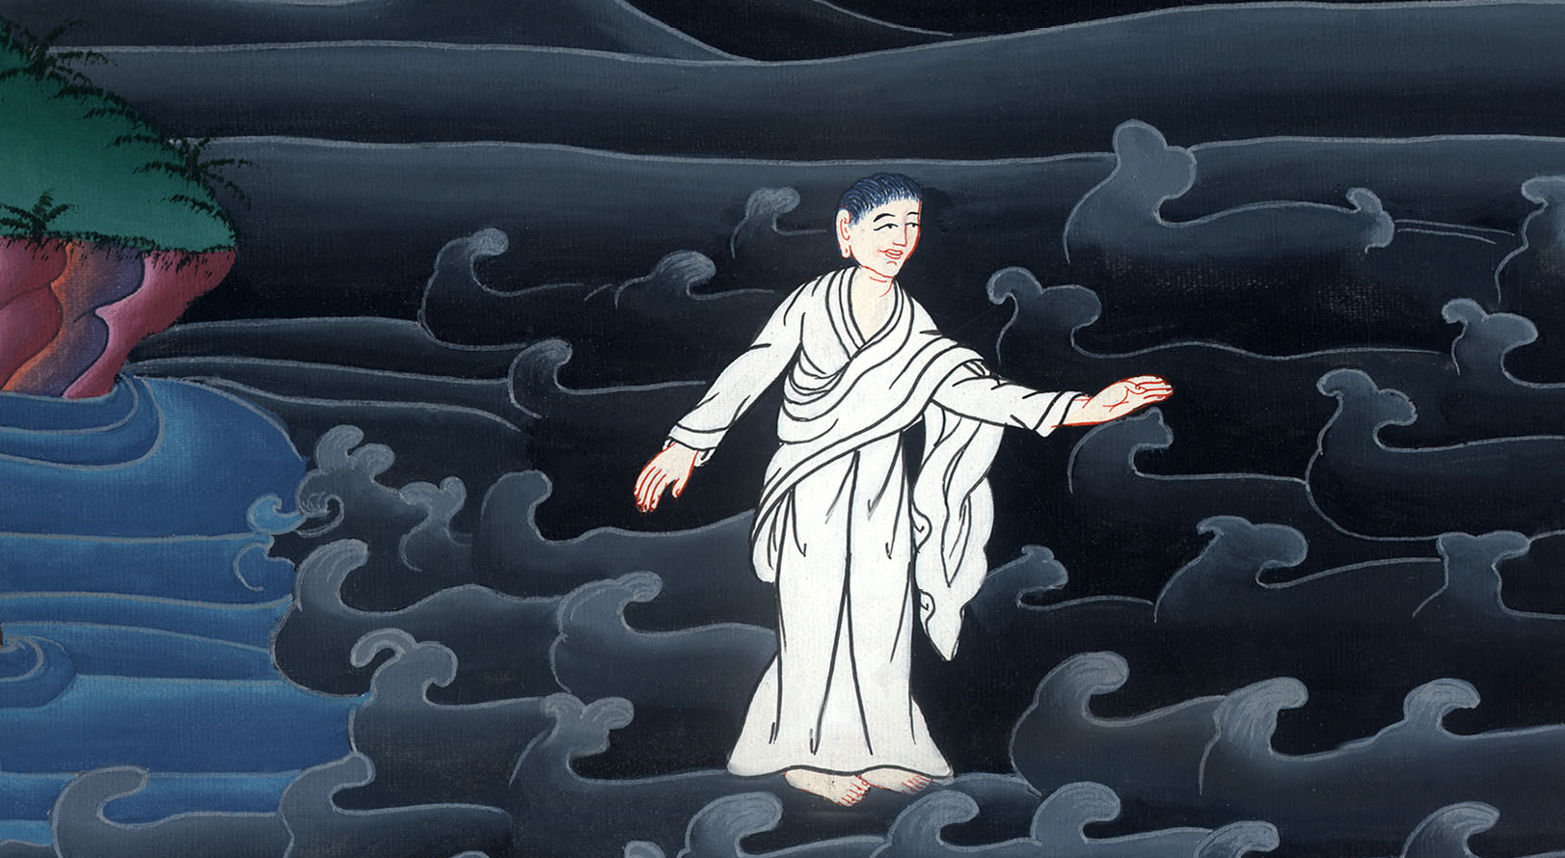
Matthew 14:25

Slide 13
26When the disciples saw him walking on the sea, they were troubled, saying, “It’s a ghost!” and they cried out for fear. 27But immediately Jesus spoke to them, saying, “Cheer up! It is I! Don’t be afraid.”

Slide 14
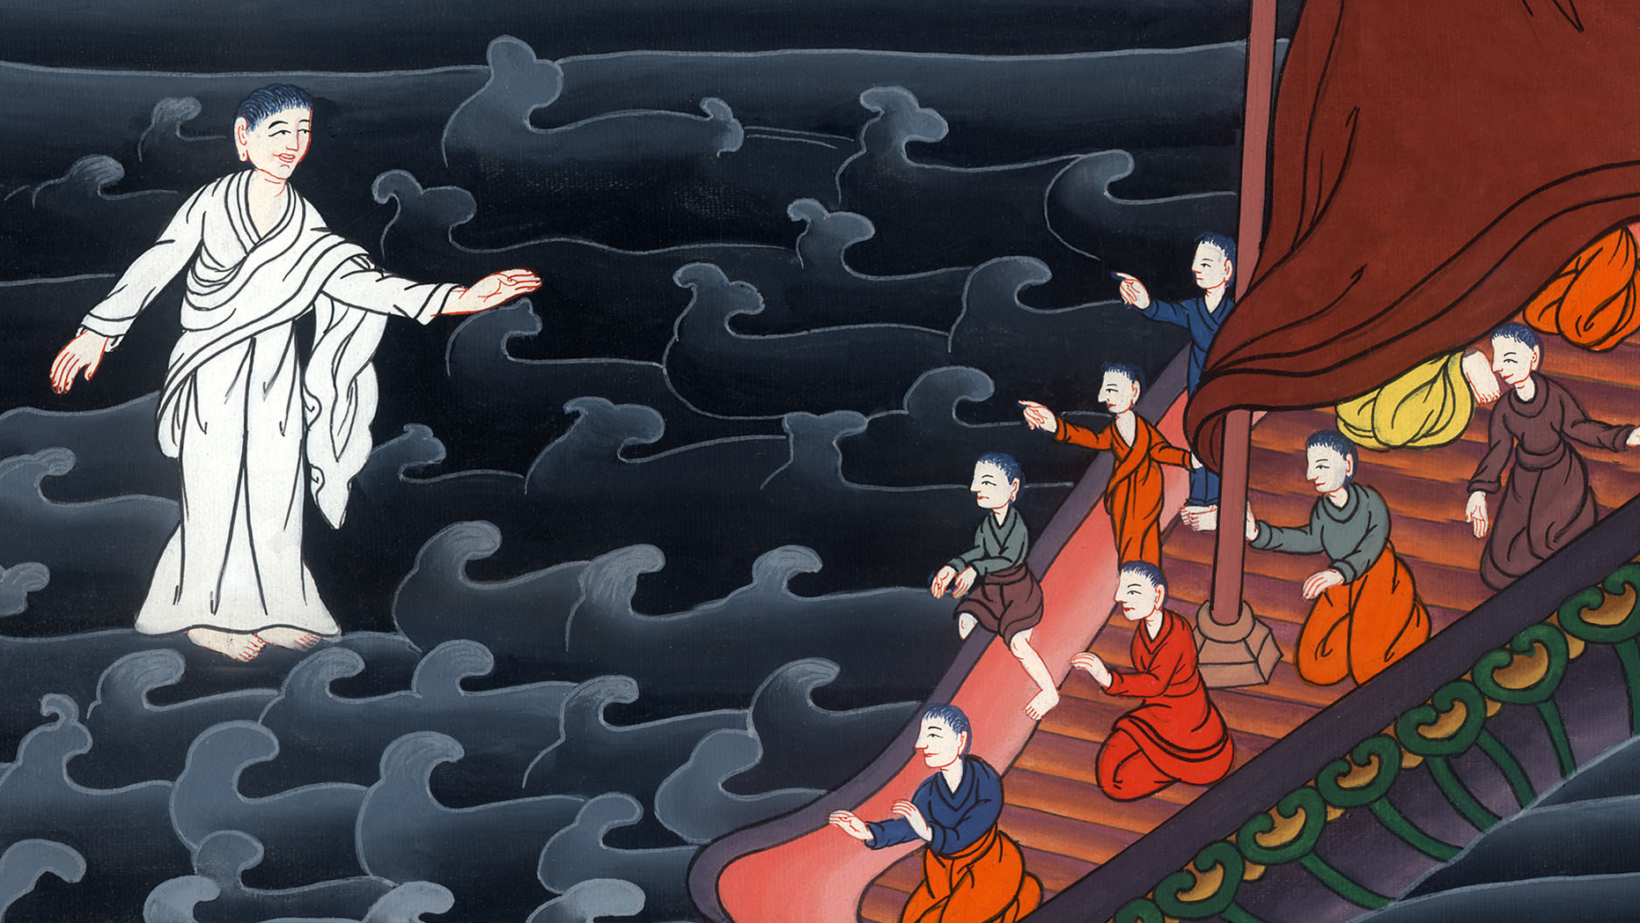
Matthew 14:26,27

Slide 15
29He said, “Come!”
Peter stepped down from the boat and walked on the waters to come to Jesus.

Slide 16
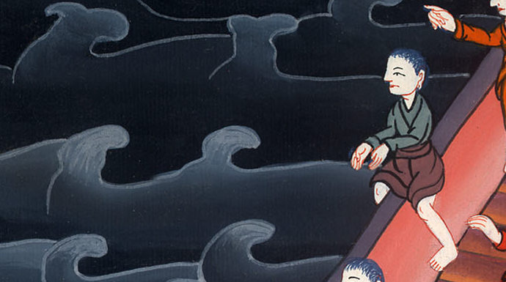
Matthew 14:29,29

Slide 17
30But when he saw that the wind was strong, he was afraid, and beginning to sink, he cried out, saying, “Lord, save me!”
31Immediately Jesus stretched out his hand, took hold of him, and said to him, “You of little faith, why did you doubt?”

Slide 18
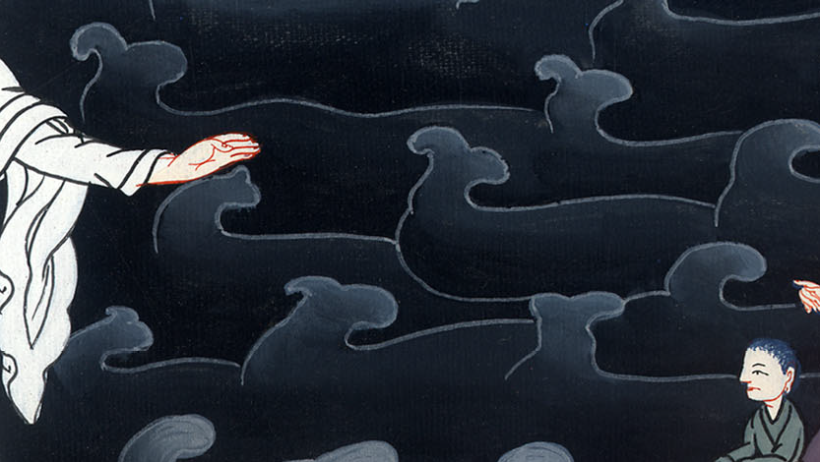
Matthew 14:30,31

Slide 19
32When they got up into the boat, the wind ceased. 33Those who were in the boat came and worshiped him, saying, “You are truly the Son of God!”

Slide 20
Matthew 14:32,33

