Slide 1
37-1
This work is licensed under a Creative Commons Attribution-ShareAlike 4.0 International License.
Please add this statement to all the videos you create.
English Bible quotes are from the World English Bible US, which is in the public domain.
Notes:
Ch
37 People reject Jesus
1. Jesus is the Bread of Life- John 6:22-71 (Left Top)
2. Officers sent to seize Jesus - John 7:1-53 (Right Top)
3. Woman accused of adultery - John 8:1-12 (Center)
4. Jesus talks to angry Pharisees - John 8:13-59 (Right near Bottom)
5. Blind man cured - John 9:1-41 (Right Bottom)
6. The Good Shepherd - John 10:1-21 (Left Bottom)
7. Jewish leaders try to stone Jesus - John 10:22-42 (Left Center)

Slide 2
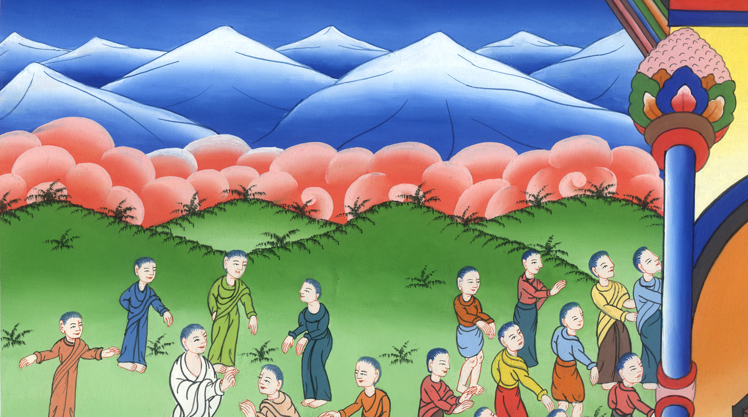
Jesus is the Bread of Life –
John 6:22-71

Slide 3
37 People reject Jesus
1. Jesus is the Bread of Life - John 6:22-71

Slide 4
Jesus is the Bread of Life –
John 6:22-71

Slide 5
24When the multitude therefore saw that Jesus wasn’t there, nor his disciples, they themselves got into the boats and came to Capernaum, seeking Jesus.

Slide 6
John 6:24

Slide 7
25When they found him on the other side of the sea, they asked him, “Rabbi, when did you come here?”
26Jesus answered them, “Most certainly I tell you, you seek me, not because you saw signs, but because you ate of the loaves and were filled.

Slide 8
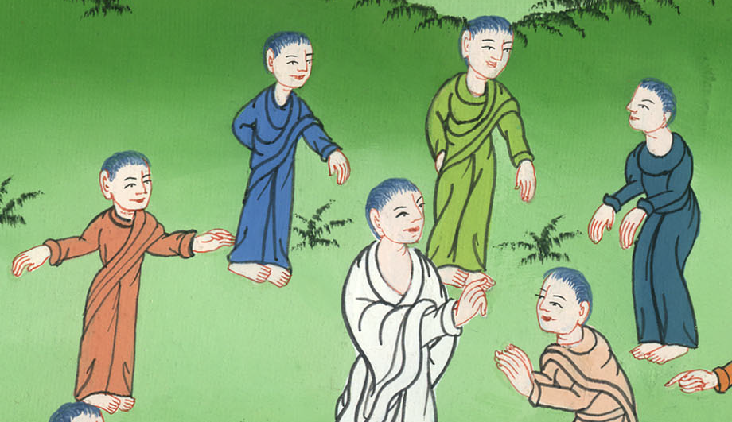
John 6:25,26

Slide 9
27Don’t work for the food which perishes, but for the food which remains to eternal life, which the Son of Man will give to you. For God the Father has sealed him.”

Slide 10
John 6:27

Slide 11
28They said therefore to him, “What must we do, that we may work the works of God?”
29Jesus answered them, “This is the work of God, that you believe in him whom he has sent.”

Slide 12
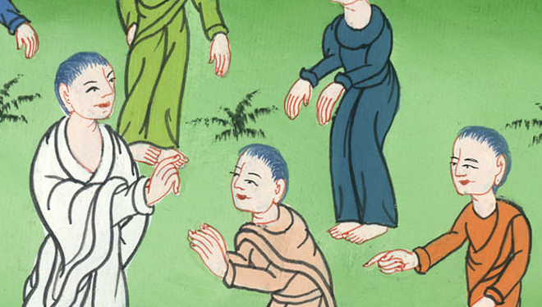
John 6:28,29

Slide 13
33For the bread of God is that which comes down out of heaven and gives life to the world.”

Slide 14
John 6:33

Slide 15
34They said therefore to him, “Lord, always give us this bread.”
35Jesus said to them, “I am the bread of life. Whoever comes to me will not be hungry, and whoever believes in me will never be thirsty.

Slide 16
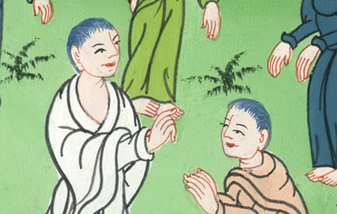
John 6:34,35

Slide 17
40This is the will of the one who sent me, that everyone who sees the Son and believes in him should have eternal life; and I will raise him up at the last day.”

Slide 18
John 6:40

Slide 19
41The Jews therefore murmured concerning him, because he said, “I am the bread which came down out of heaven.” 42They said, “Isn’t this Jesus, the son of Joseph, whose father and mother we know? How then does he say, ‘I have come down out of heaven?’”

Slide 20
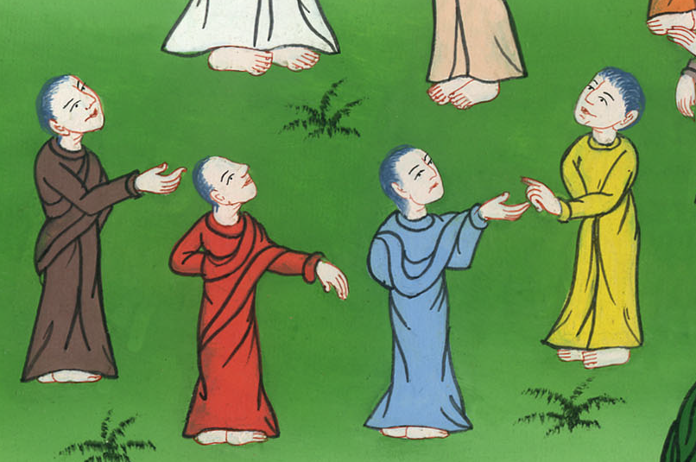
John 6:41,42

Slide 21
(Jesus continued) 47Most certainly, I tell you, he who believes in me has eternal life. 48I am the bread of life.

Slide 22
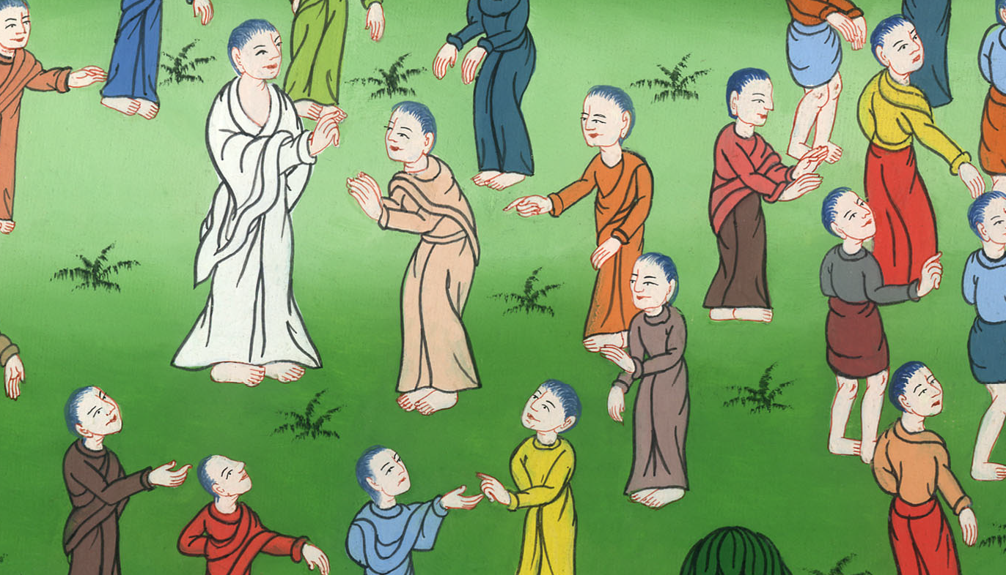
John 6:47,48

Slide 23
49Your fathers ate the manna in the wilderness and they died. 50This is the bread which comes down out of heaven, that anyone may eat of it and not die.

Slide 24
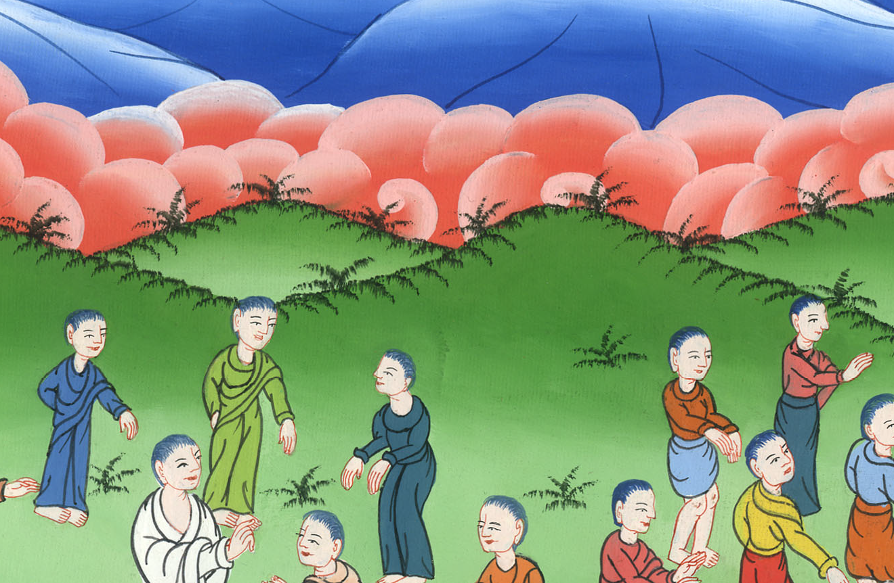
John 6:49,50

Slide 25
51I am the living bread which came down out of heaven. If anyone eats of this bread, he will live forever. Yes, the bread which I will give for the life of the world is my flesh.”

Slide 26
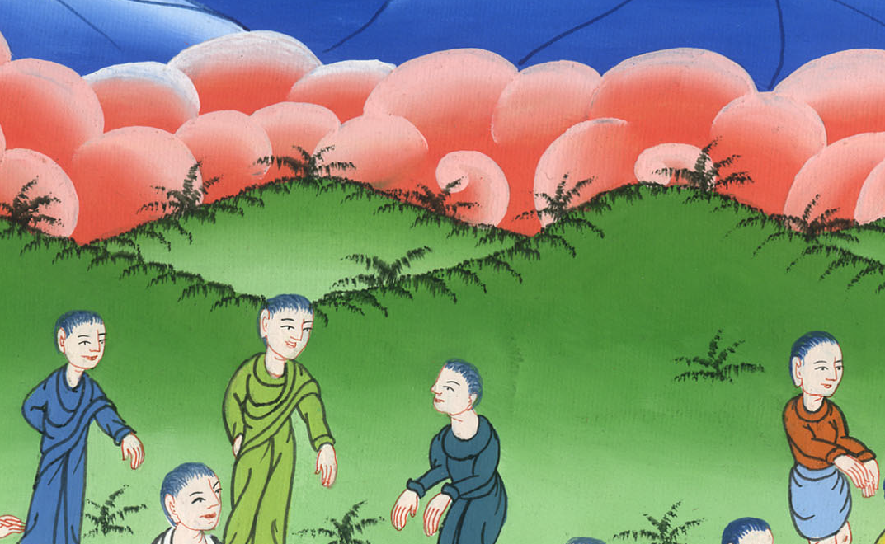
John 6:51

Slide 27
52The Jews therefore contended with one another, saying, “How can this man give us his flesh to eat?”

Slide 28
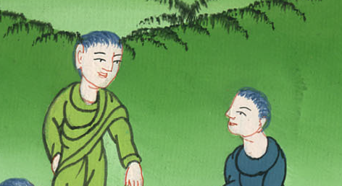
John 6:52

Slide 29
53Jesus therefore said to them, “Most certainly I tell you, unless you eat the flesh of the Son of Man and drink his blood, you don’t have life in yourselves.

Slide 30
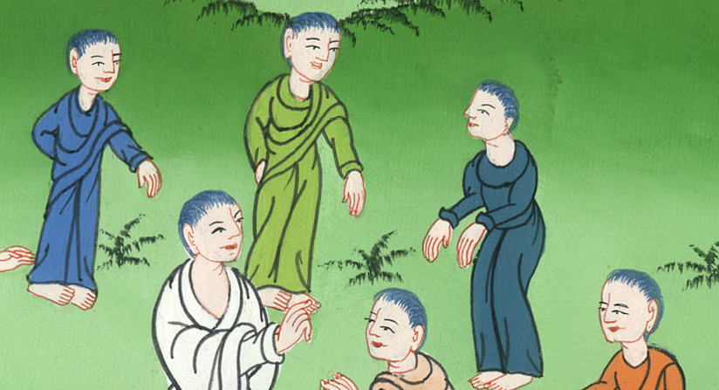
John 6:53

Slide 31
54He who eats my flesh and drinks my blood has eternal life, and I will raise him up at the last day. (They will live forever)

Slide 32
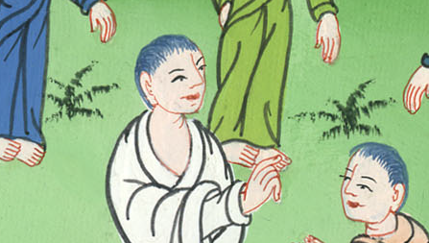
John 6:54

Slide 33
60Therefore many of his disciples, when they heard this, said, “This is a hard saying! Who can listen to it?”

Slide 34
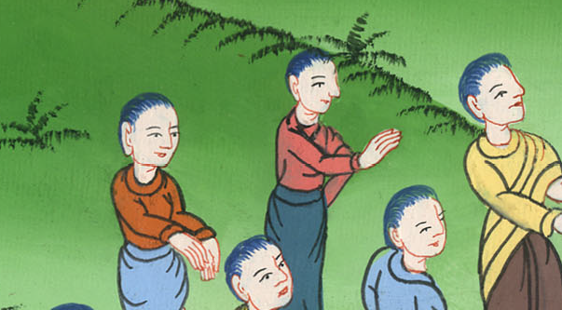
John 6:60

Slide 35
61But Jesus knowing in himself that his disciples murmured at this, said to them, “Does this cause you to stumble? 62Then what if you would see the Son of Man ascending to where he was before?

Slide 36
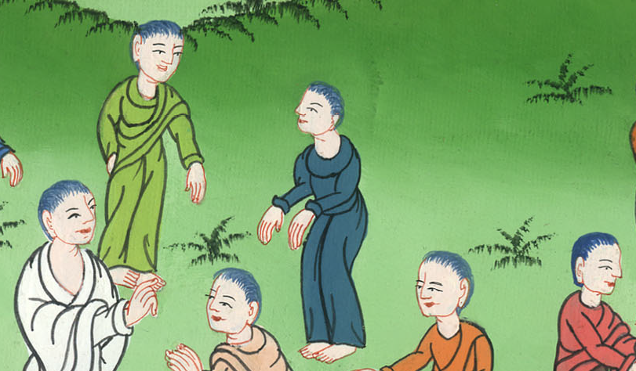
John 6:61,62

Slide 37
63It is the spirit who gives life. The flesh profits nothing. The words that I speak to you are spirit, and are life.

Slide 38
John 6:63

Slide 39
64But there are some of you who don’t believe.” For Jesus knew from the beginning who they were who didn’t believe, and who it was who would betray him.

Slide 40
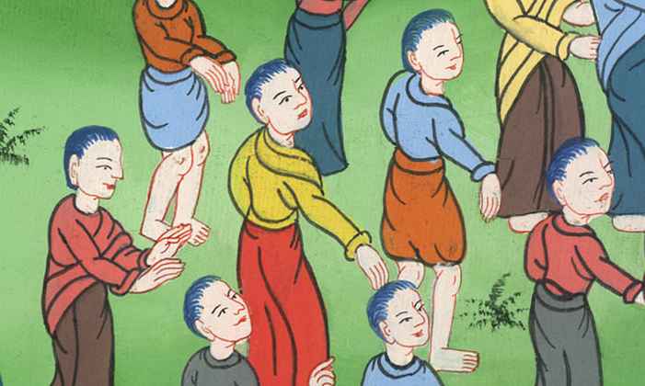
John 6:64

Slide 41
66At this, many of his disciples went back and walked no more with him. 67Jesus said therefore to the twelve, “You don’t also want to go away, do you?”

Slide 42
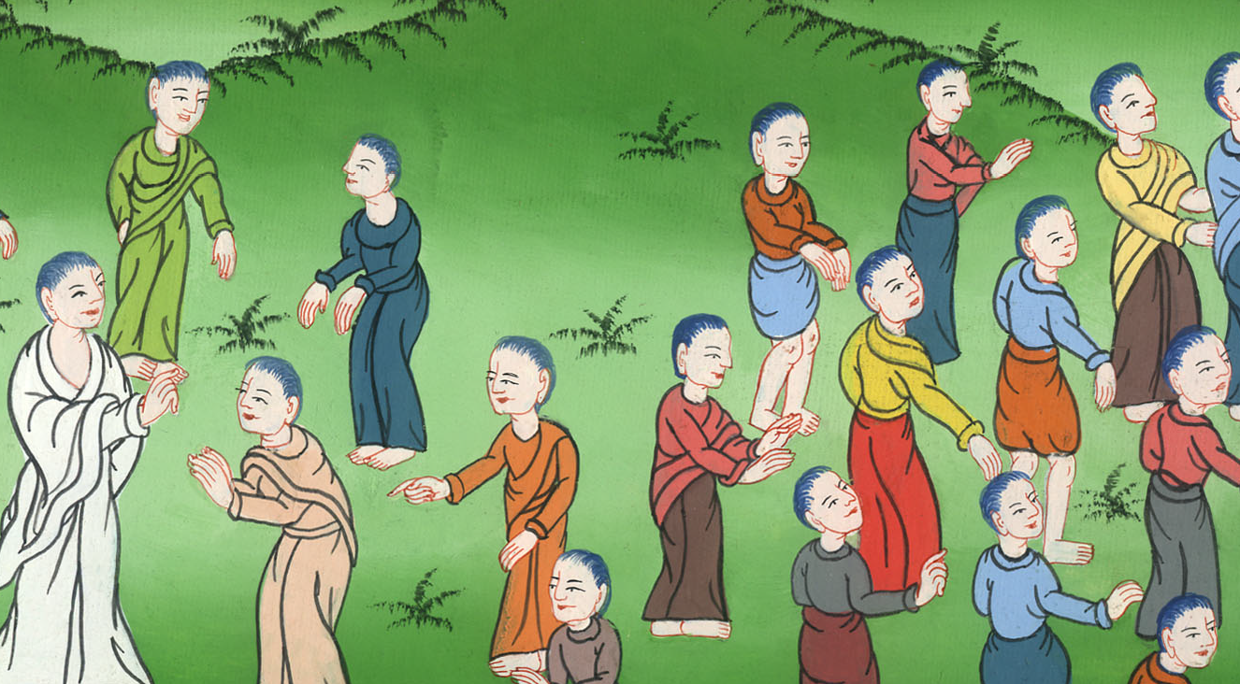
John 6:66,67

Slide 43
68Simon Peter answered him, “Lord, to whom would we go? You have the words of eternal life. 69We have come to believe and know that you are the Christ, the Son of the living God.”

Slide 44
John 6:68,69

