Slide 1
37-2
This work is licensed under a Creative Commons Attribution-ShareAlike 4.0 International License.
Please add this statement to all the videos you create.
English Bible quotes are from the World English Bible US, which is in the public domain.
Notes:
Ch
37 People reject Jesus
1. Jesus is the Bread of Life- John 6:22-71 (Left Top)
2. Officers sent to seize Jesus - John 7:1-53 (Right Top)
3. Woman accused of adultery - John 8:1-12 (Center)
4. Jesus talks to angry Pharisees - John 8:13-59 (Right near Bottom)
5. Blind man cured - John 9:1-41 (Right Bottom)
6. The Good Shepherd - John 10:1-21 (Left Bottom)
7. Jewish leaders try to stone Jesus - John 10:22-42 (Left Center)

Slide 2
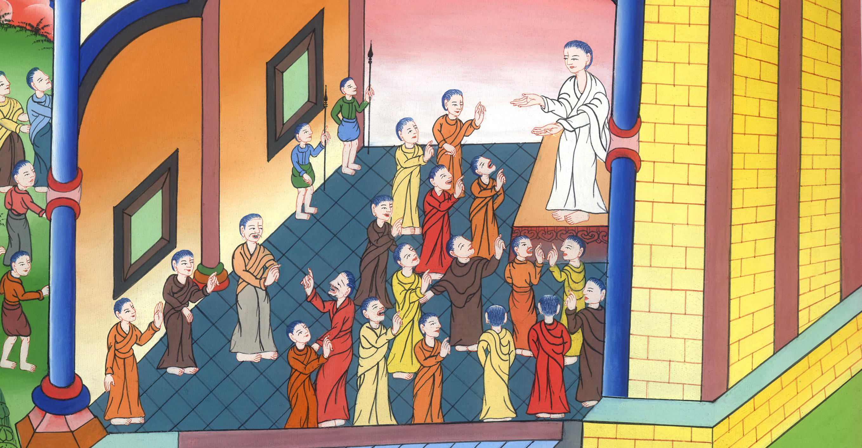
People Don’t Agree About Who Jesus Is - John 7:1-53

Slide 3
People Don’t Agree About Who Jesus Is - John 7:1-53

Slide 4
People Don’t Agree About Who Jesus Is - John 7:1-53

Slide 5
1After these things, Jesus was walking in Galilee, for he wouldn’t walk in Judea, because the Jews sought to kill him.

Slide 6
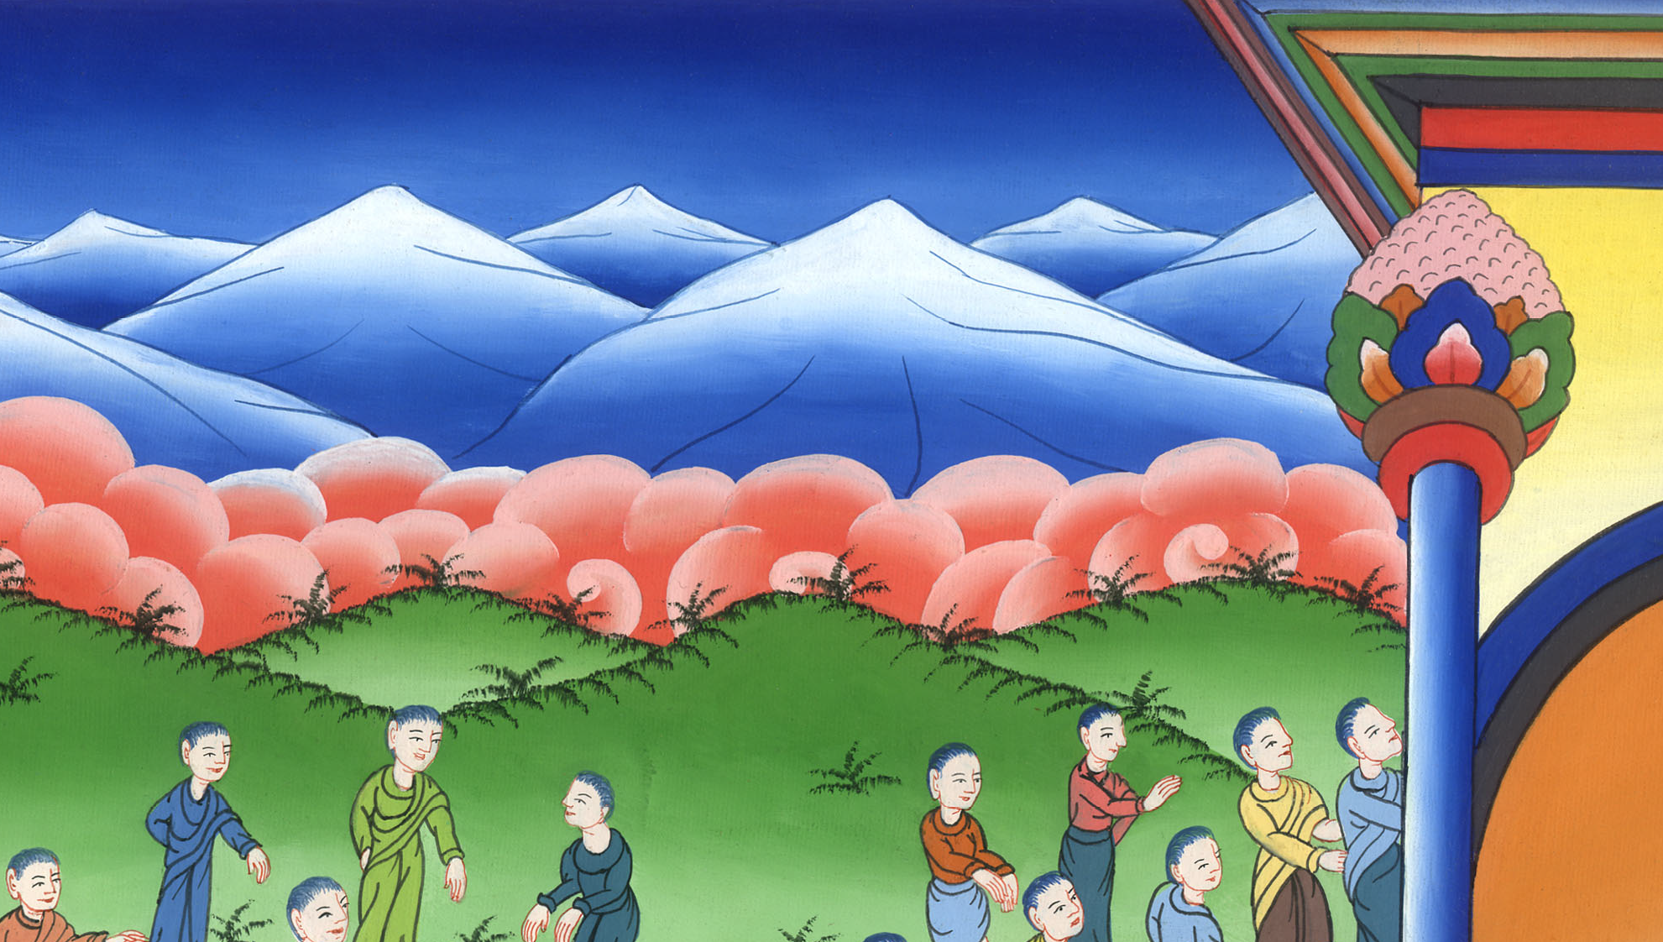
John 7:1

Slide 7
14But when it was now the middle of the feast, Jesus went up into the temple and taught. 15The Jews therefore marveled, saying, “How does this man know letters, having never been educated?”

Slide 8
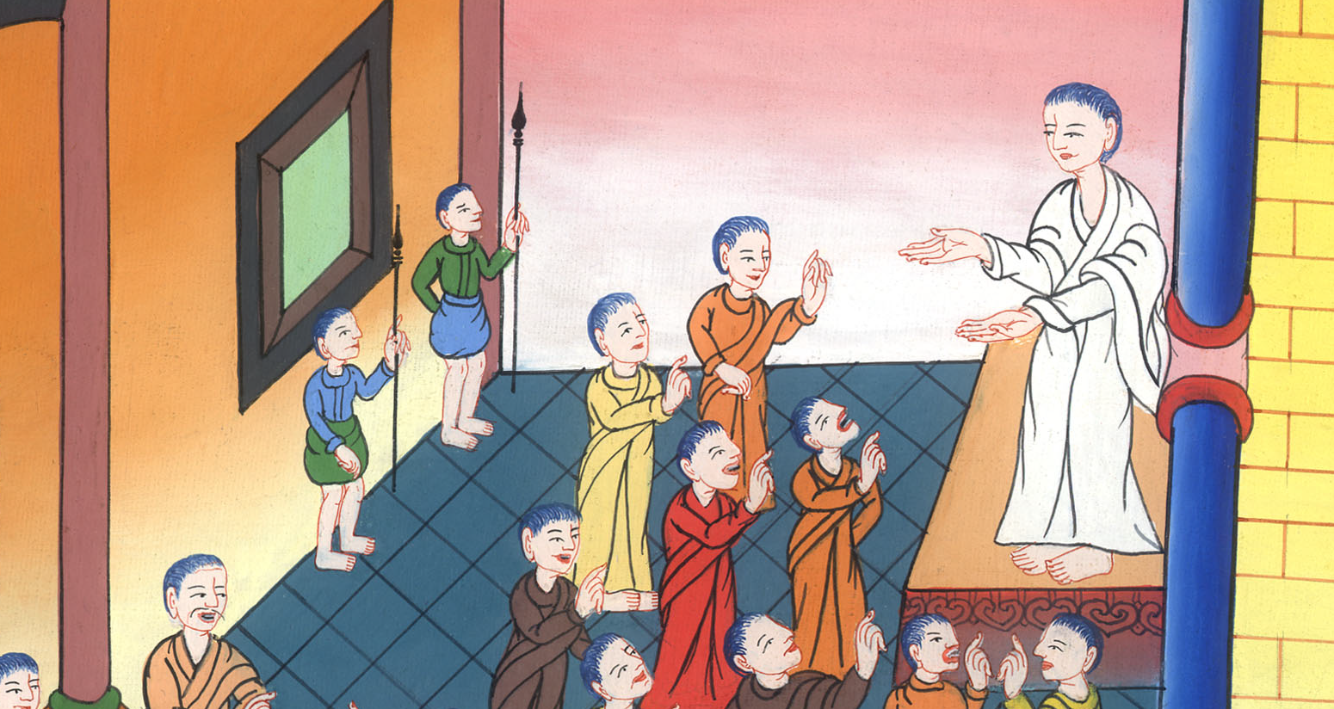
John 7:14,15

Slide 9
16Jesus therefore answered them, “My teaching is not mine, but his who sent me.

Slide 10
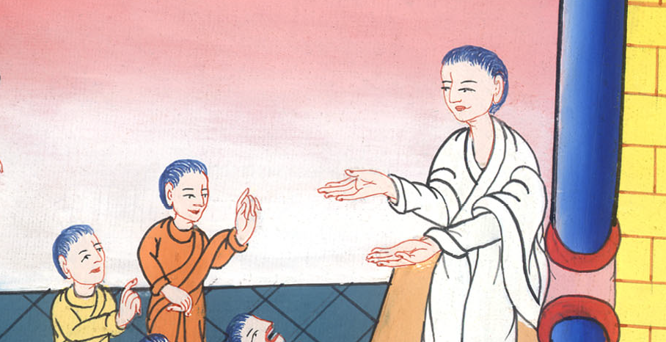
John 7:16

Slide 11
17If anyone desires to do his will, he will know about the teaching, whether it is from God or if I am speaking from myself.

Slide 12
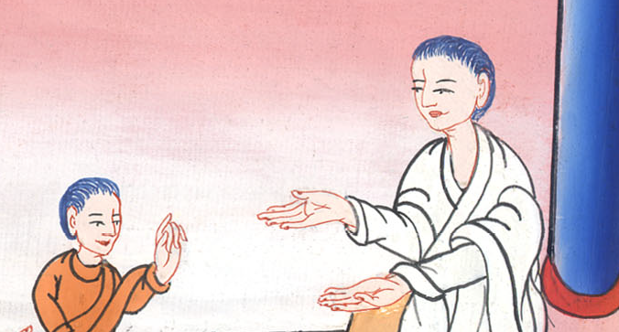
John 7:17

Slide 13
28Jesus therefore cried out in the temple, teaching and saying, “You both know me, and know where I am from. I have not come of myself, but he who sent me is true, whom you don’t know.

Slide 14
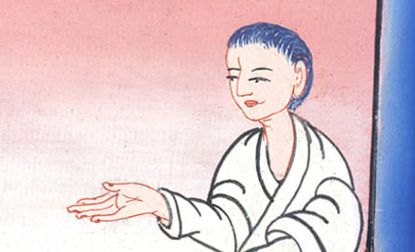
John 7:28

Slide 15
You do not know him. 29I know him, because I am from him, and he sent me.”

Slide 16
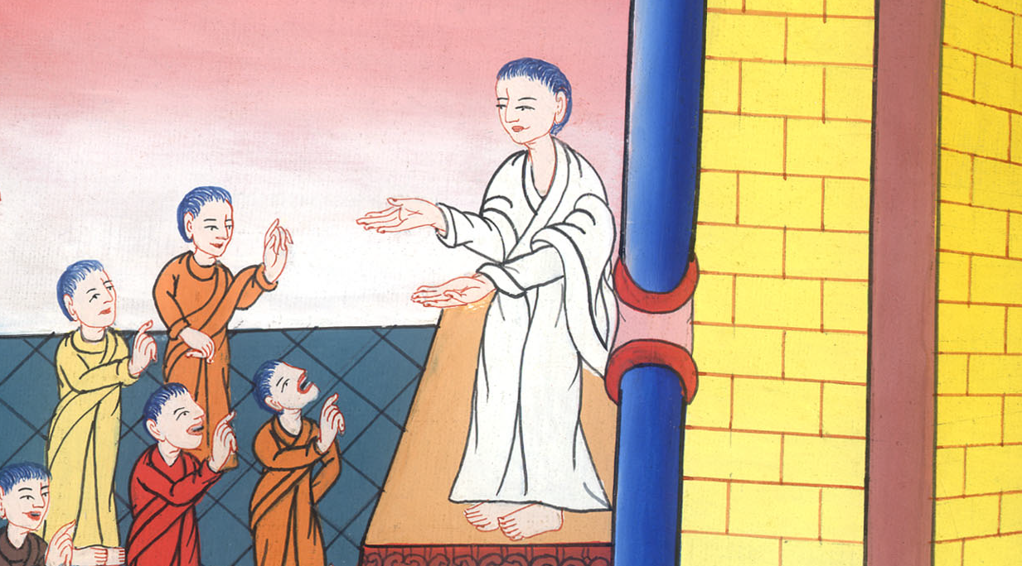
John 7:29

Slide 17
31But of the multitude, many believed in him. They said, “When the Christ comes, he won’t do more signs than those which this man has done, will he?”

Slide 18
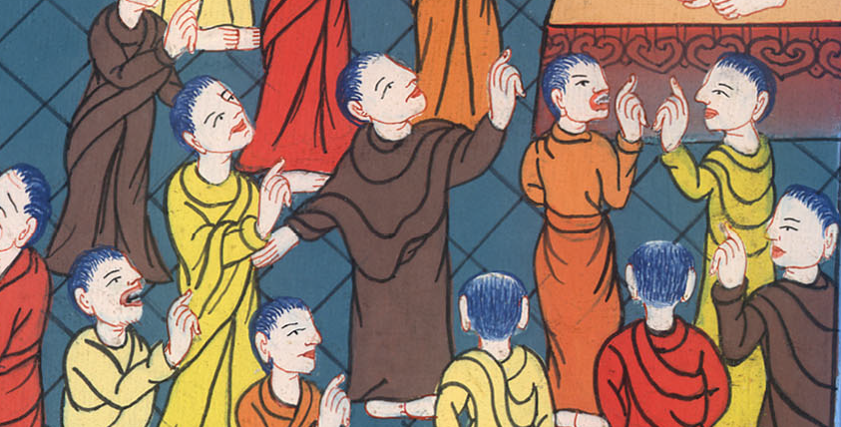
John 7:31

Slide 19
32The Pharisees heard the multitude murmuring these things concerning him, and the chief priests and the Pharisees sent officers to arrest him.

Slide 20
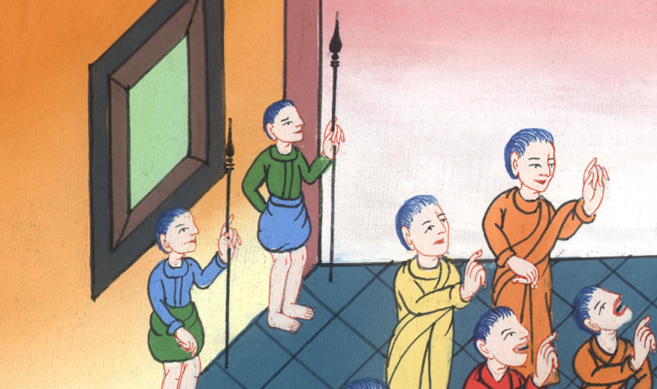
John 7:32

Slide 21
37Now on the last and greatest day of the feast, Jesus stood and cried out, “If anyone is thirsty, let him come to me and drink!

Slide 22
John 7:37

Slide 23
38He who believes in me, as the Scripture has said, from within him will flow rivers of living water.”

Slide 24
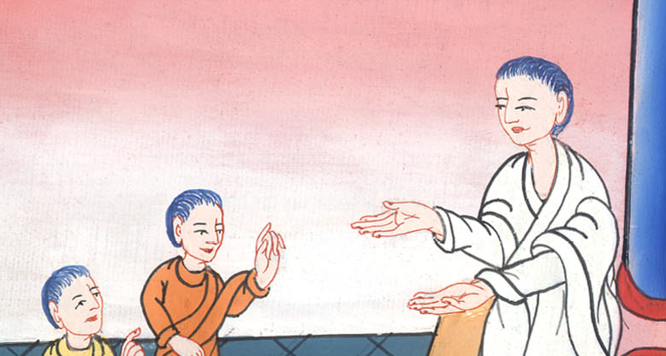
John 7:38

Slide 25
39But he said this about the Spirit, which those believing in him were to receive. For the Holy Spirit was not yet given, because Jesus wasn’t yet glorified.

Slide 26
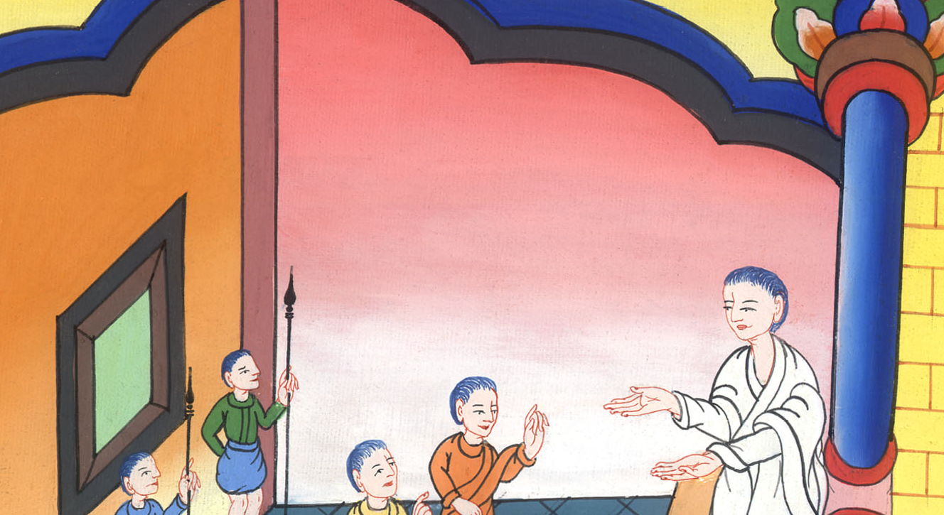
John 7:39

Slide 27
45The officers therefore came to the chief priests and Pharisees; and they said to them, “Why didn’t you bring him?”
46The officers answered, “No man ever spoke like this man!”

Slide 28
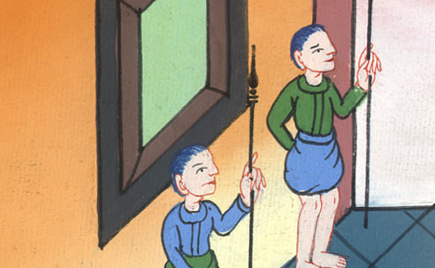
John 7:45,46

Slide 29
43So a division arose in the multitude because of him. 44Some of them would have arrested him, but no one laid hands on him.

Slide 30
John 7:43,44

