Slide 1
37-3
This work is licensed under a Creative Commons Attribution-ShareAlike 4.0 International License.
Please add this statement to all the videos you create.
English Bible quotes are from the World English Bible US, which is in the public domain.
Notes:
Ch
37 People reject Jesus
1. Jesus is the Bread of Life- John 6:22-71 (Left Top)
2. Officers sent to seize Jesus - John 7:1-53 (Right Top)
3. Woman accused of adultery - John 8:1-12 (Center)
4. Jesus talks to angry Pharisees - John 8:13-59 (Right near Bottom)
5. Blind man cured - John 9:1-41 (Right Bottom)
6. The Good Shepherd - John 10:1-21 (Left Bottom)
7. Jewish leaders try to stone Jesus - John 10:22-42 (Left Center)

Slide 2
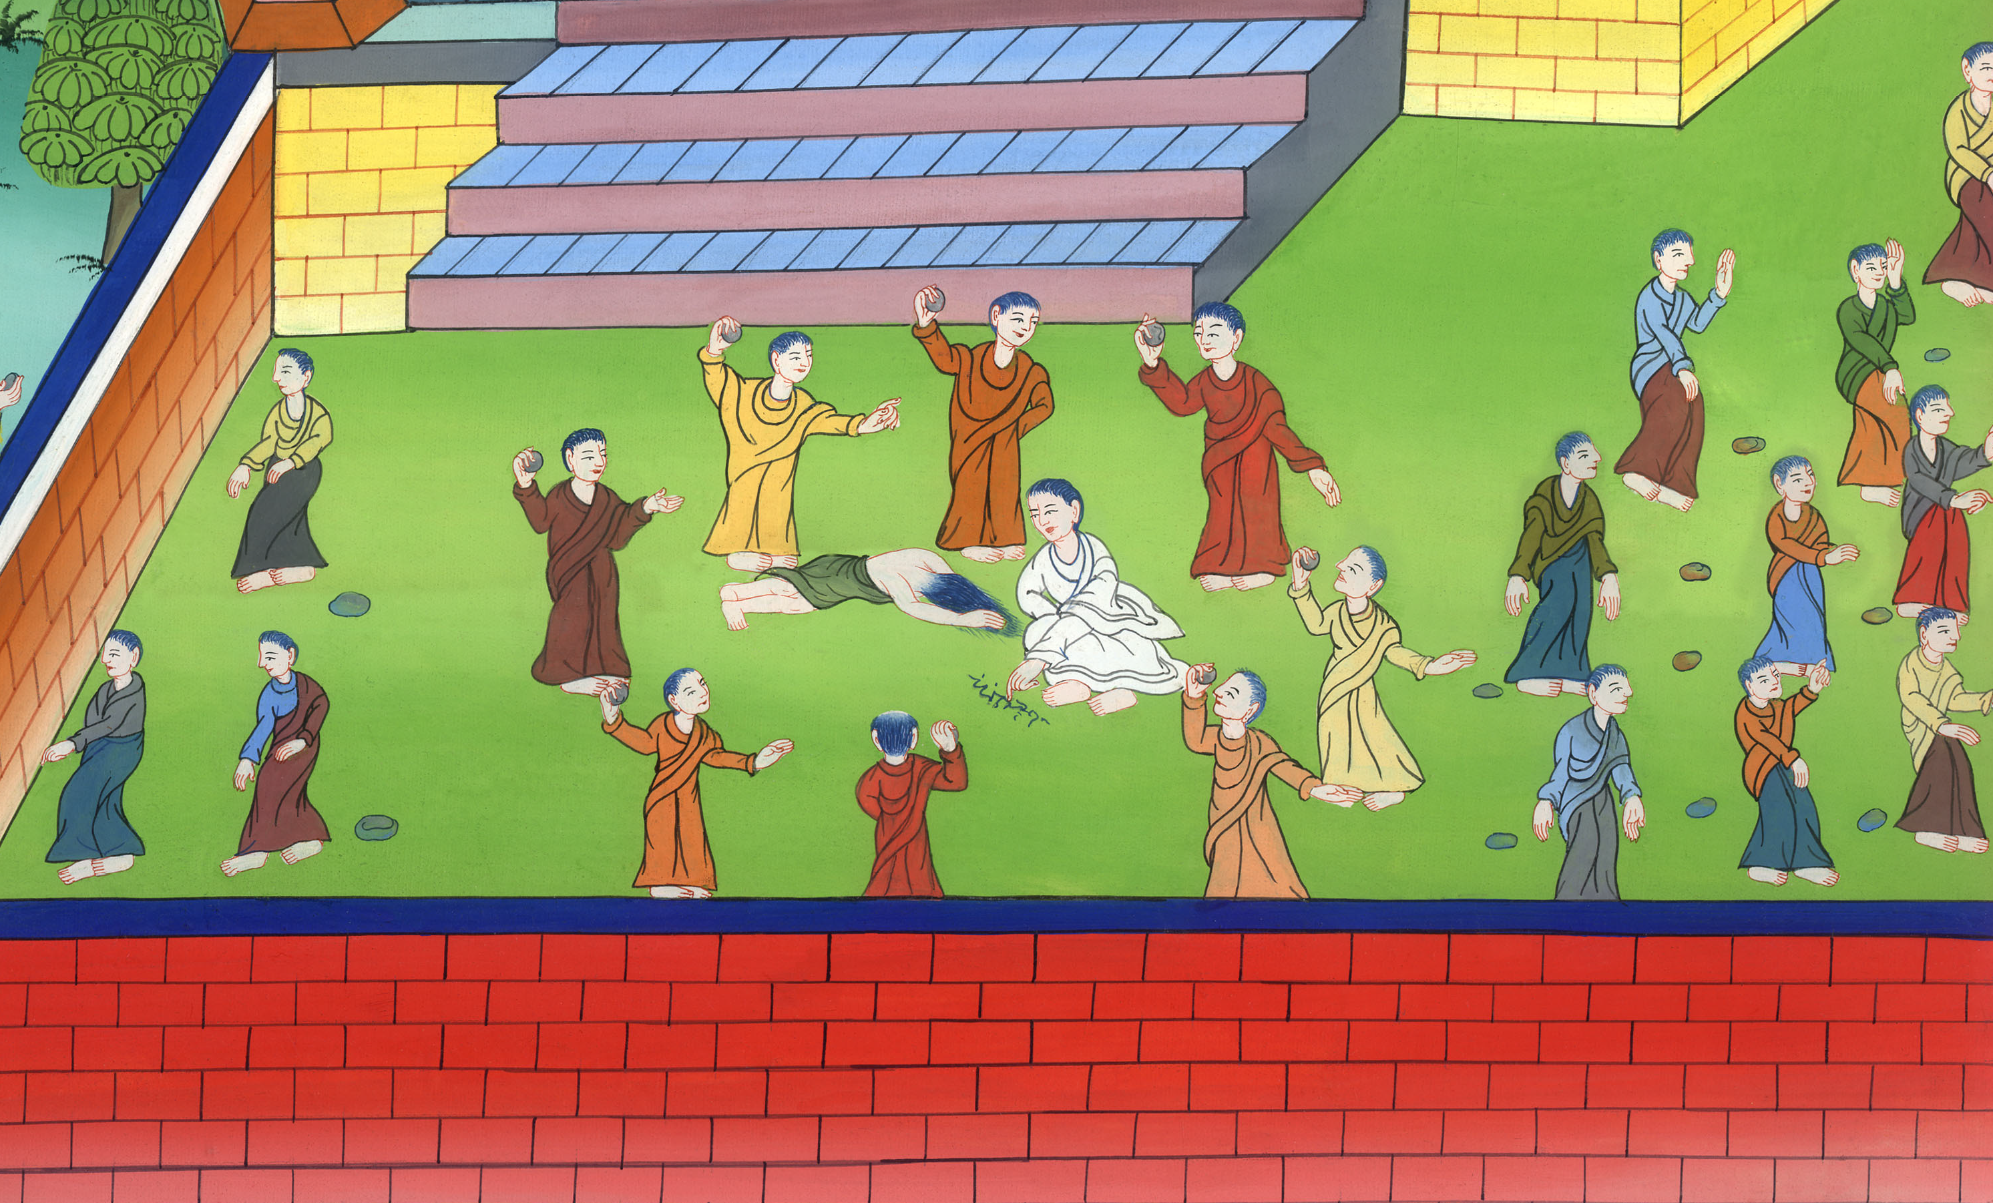
Woman accused of adultery –
John 8:1-12

Slide 3
Woman accused of adultery - John 8:1-12

Slide 4
Woman accused of adultery –
John 8:1-12

Slide 5
(After speaking to the people in the temple in Jerusalem, all the people went home)
1but Jesus went to the Mount of Olives.

Slide 6
John 8:1

Slide 7
2Now very early in the morning, he came again into the temple, and all the people came to him. He sat down and taught them.

Slide 8
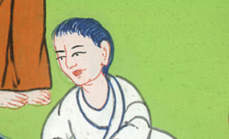
John 8:2

Slide 9
3The scribes and the Pharisees brought a woman taken in adultery. Having set her in the middle,

Slide 10
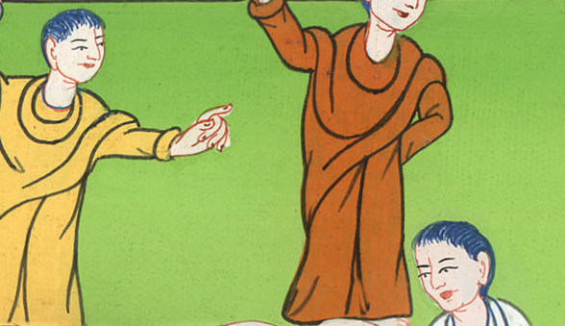
John 8:3

Slide 11
4they told him, “Teacher, we found this woman in adultery, in the very act.

Slide 12
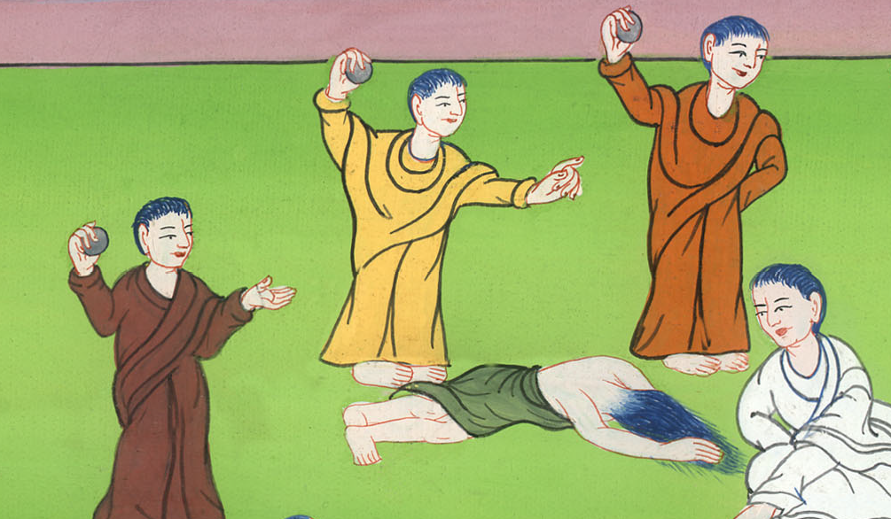
John 8:4

Slide 13
5Now in our law, Moses commanded us to stone such women. What then do you say about her?”

Slide 14
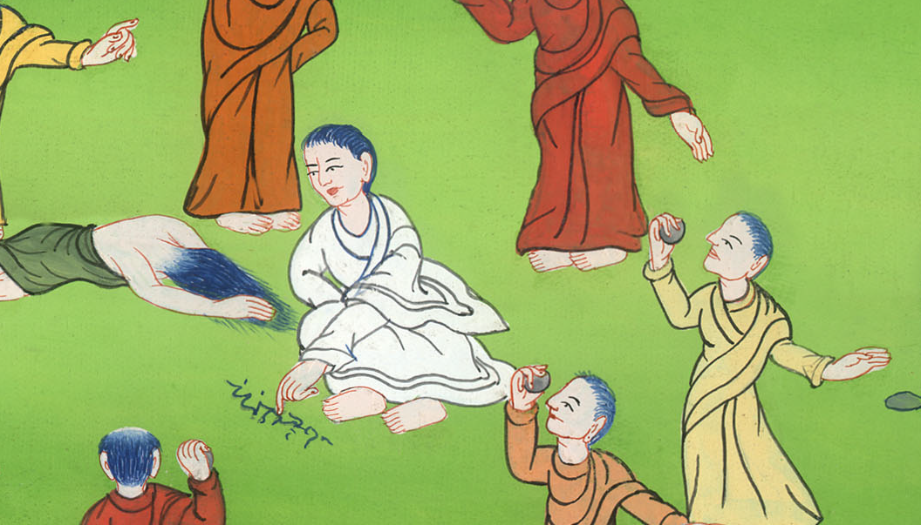
John 8:5

Slide 15
6They said this testing him, that they might have something to accuse him of.
But Jesus stooped down and wrote on the ground with his finger.

Slide 16
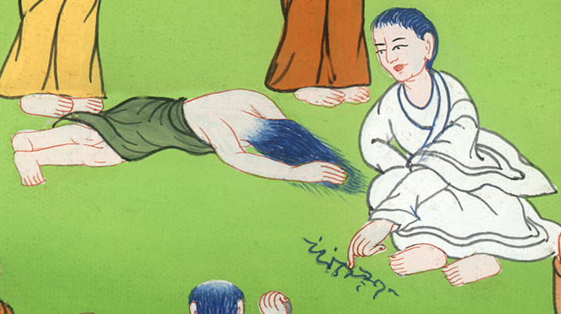
John 8:6

Slide 17
7But when they continued asking him, he looked up and said to them, “He who is without sin among you, let him throw the first stone at her.” 8Again he stooped down and wrote on the ground with his finger.

Slide 18
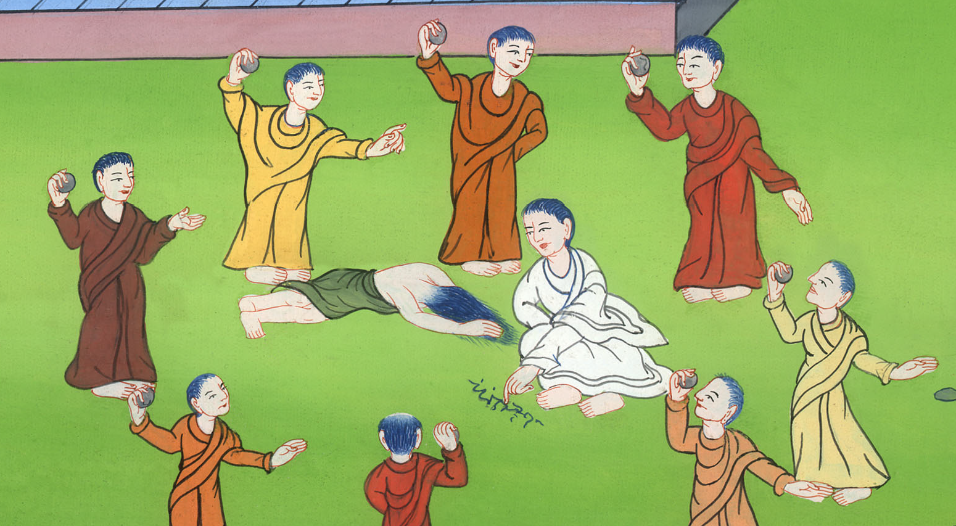
John 8:7,8

Slide 19
9They, when they heard it, being convicted by their conscience, went out one by one, beginning from the oldest, even to the last. Jesus was left alone with the woman where she was, in the middle.

Slide 20
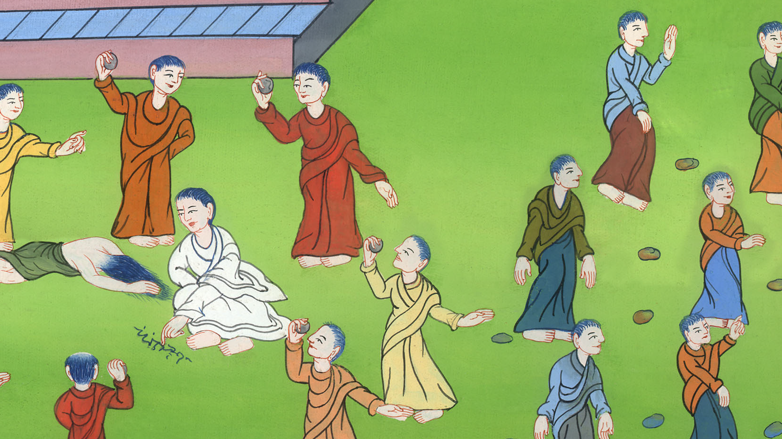
John 8:9

Slide 21
10Jesus, standing up, saw her and said, “Woman, where are your accusers? Did no one condemn you?”

Slide 22
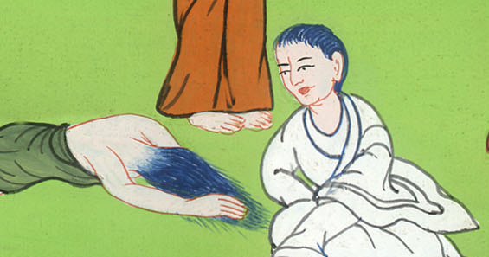
John 8:10

Slide 23
11She said, “No one, Lord.”
Jesus said, “Neither do I condemn you. Go your way. From now on, sin no more.”

Slide 24
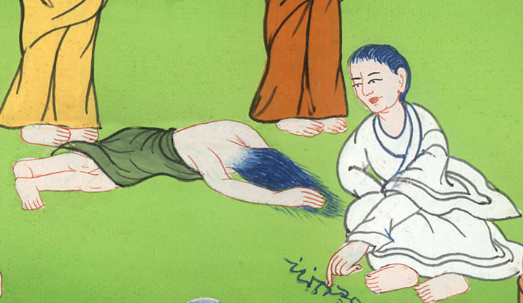
John 8:11

Slide 25
12Again, therefore, Jesus spoke to them, saying, “I am the light of the world. He who follows me will not walk in the darkness, but will have the light of life.”

Slide 26
John 8:12

